Slide 1
Shota Ohnishi
(Tokyo Inst. Tech. / RIKEN)
K⁻d scattering and structure of Λ(1405)
in collaboration with
Yoichi Ikeda (RIKEN)
Tetsuo Hyodo (YITP, Kyoto Univ. )
Emiko Hiyama (RIKEN)
Wolfram Weise (ECT*/TUM)

Slide 2
J^{π}=1/2⁻,
quasi bound state
Dalitz, Wong, Tajasekaran, PR 153(1967)1617
Phenomenological KN
Λ(1405) binding energy and scattering data
Chiral SU(3) KN interaction
Akaishi, Yamazaki, PRC65(2002) 044005.
Shevchenko, PRC85(2012) 034001.
Kaiser, Siegel, Weise, NPA594(1995) 325.
Oset, Ramos, NPA635(1998) 99.
Hyodo, Jido, PPNP67(2012)55.

Slide 3
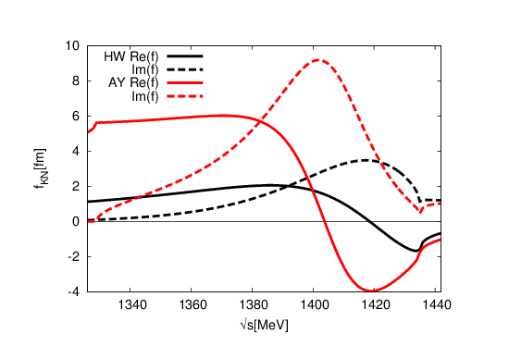
Pole position of Λ(1405) and energy dependence of the potential
Re(f)
Im(f)
HW potential
Re(f)
AY potential
Im(f)
Hyodo, Weise, PRC77(2008)035204
Phenomenological potential
Chiral SU(3) dynamics
Akaishi, Yamazaki, PRC65(2002).
Shevchenko, PRC85(2012).
Kaiser, Siegel, Weise, NPA594(1995).
Oset, Ramos, NPA635(1998).
Hyodo, Jido, PPNP67(2012).
Λ(1405), one pole
Energy independent
strong attraction
Λ(1420), two pole
Energy dependent
weak attraction

Slide 4
strange dibaryon
theoretical investigations:
interactions | Phenomenological | Chiral SU(3)
Variational | Akaishi, Yamazaki[1] Wycech, Green[5] | Doté, Hyodo, Weise[4] Barnea, Gal, Liverts[7]
Faddeev eqs. | Shevchenko, Gal , Mares[2] | Ikeda, Sato[3] Ikeda, Kamano, Sato[6]
Black；E-indep., Blue；E-dep.
[1] Akaishi, Yamazaki, PRC 65, 044005 (2002)
[2] Shevchenko, Gal, Mares, PRL. 98, 082301 (2007)
[3] Ikeda, Sato, PRC 76, 035203 (2007)
[4] Dote, Hyodo and Weise, NPA 804, 197 (2008)
[5] Wycech and A. M. Green, PRC 79, 014001 (2009)
[6] Ikeda, Kamano, Sato, PTP 124, 533 (2010)
[7] Barnea, Gal, Liverts, PLB 712, 132(2012)
The difference are enhanced in
“kaonic” nuclear systems

Slide 5
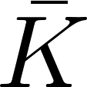
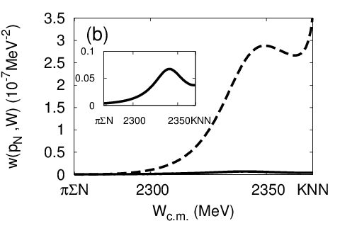
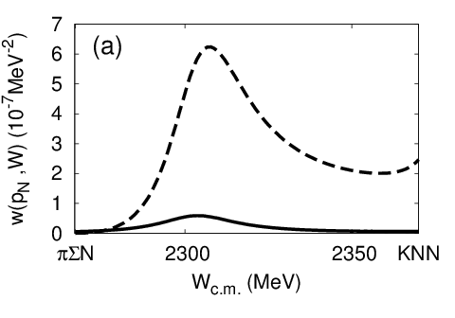
Signature of the K^{bar}NN-πYN resonance
Ohnishi, Ikeda, Kamano, Sato PRC88(2013)025204
E-dep.
E-indep.
E_{R}=2357MeV
E_{R}=2319MeV
Significant difference on production spectra
can be used to obtain K^{bar}N interaction information

Slide 6
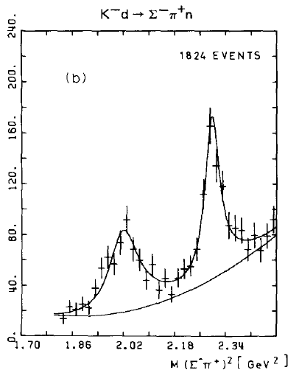
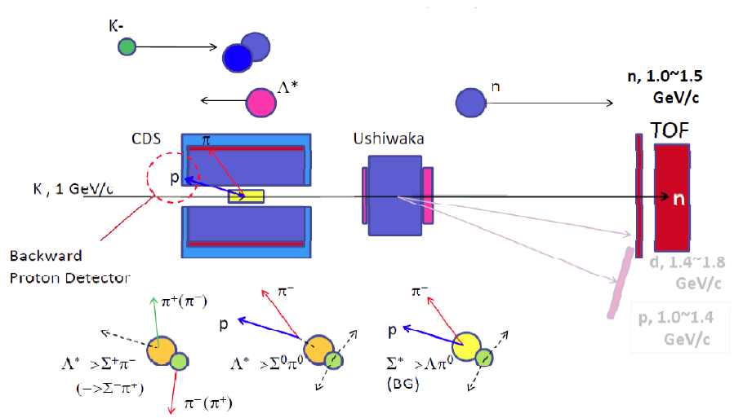
Kaon induced reaction
signal of Λ(1405) from reactions
O. Braun et al., NPB 129, 1(1977).
Peak shows up around M=1420MeV
J-PARC E31 experiment
http://j-parc.jp/researcher/Hadron/en/pac_0907/pdf/Noumi.pdf

Slide 7
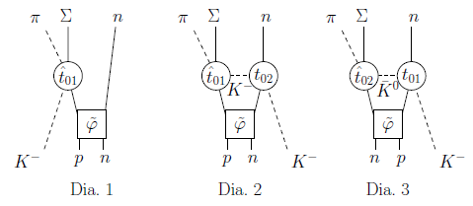
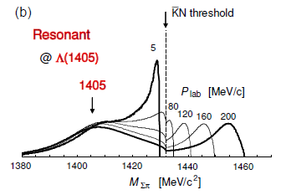
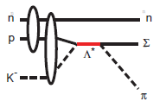
Kaon induced reaction
signal of Λ(1405) from reactions
Two-step process : Jido, Oset, Sekihara, EPJA42, 257(2009).
Miyagawa, Haidenbauer, PRC85,065201(2012).
Yamagata-Sekihara, Sekihara, Jido, PTEP043D02(2013).
Spectator model: Esmaili, Akaishi, Yamazaki, PRC83, 055207 (2011)
Purpose of this work : within Faddeev approach
study 3-body scattering amplitude and cross section
examine dynamics of in resonance production reaction
Chiral SU(3)
phenomenological

Slide 8
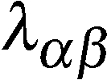
Meson-baryon interaction
meson-baryon interaction based on WT Lagrangian
“energy-independent” potentials (static approximation )
Ikeda, Sato, PRC 76, 035203 (2007)
“energy-dependent” potentials
(chiral unitary like)
E; two body scattering energy
Ikeda, Kamano, Sato, PTP 124, 533 (2010)
; baryon mass
; determined by flavor SU(3) structure
; meson mass

Slide 9
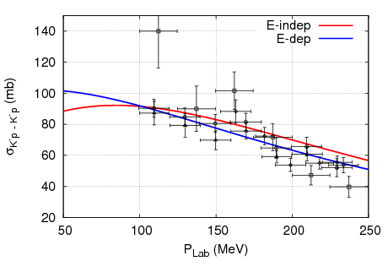
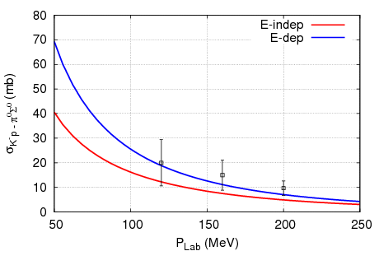
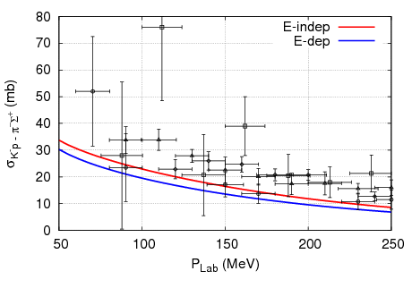
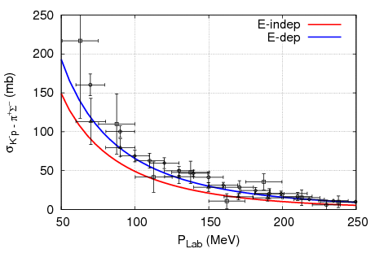
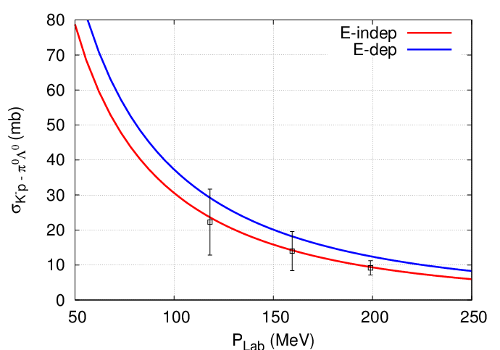
cutoff (model parameters)
cutoff which reproduce 2-body cross sections.

Slide 10
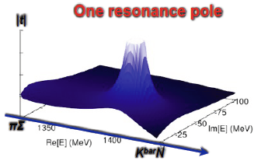
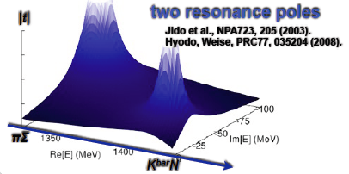
Pole positions of two-body amplitude
Ikeda, Sato, PRC76, 035203(2007);
Ikeda, Kamano, Sato, PTP124, 533(2010)
E-dep.
E-indep.
1338.8-i71.5(MeV)
1405.4-i18.2(MeV)
1418.7-i19.6(MeV)
Possibility to distinguish two models
from three-body reaction

Slide 11
K⁻d -> πΣn reaction
=
X
+
X
τ
g
τ
g
Alt-Grassberger-Sandhas(AGS) eq. : Xij；quasi two-body amplitude

Slide 12
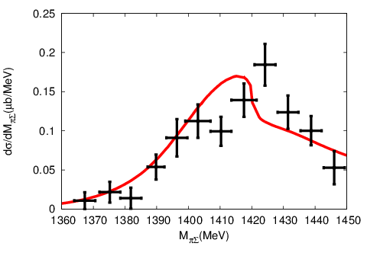
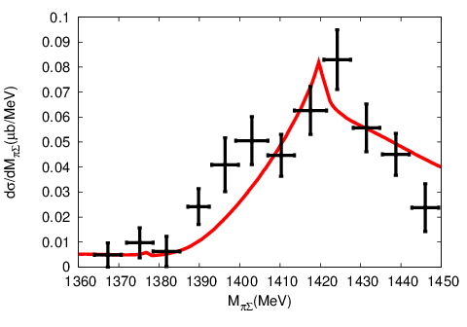
π⁺Σ⁻ invariant mass distribution
E-dep.
E-indep.
Accurate d(K⁻,n) reaction experiment is useful to distinguish dynamical model of Λ(1405)

Slide 13
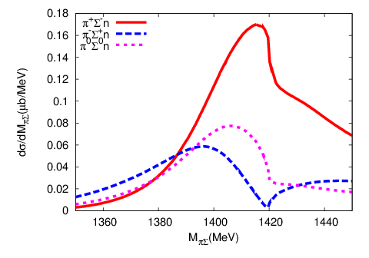
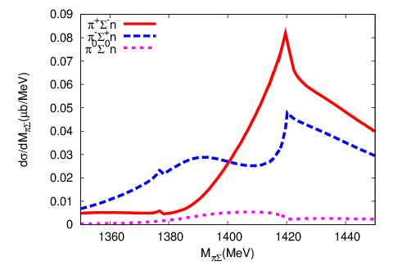
πΣ invariant mass distribution
E-dep.
E-indep.
Difference of the amplitudes is large for each channels

Slide 14
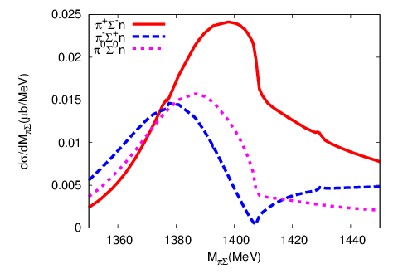
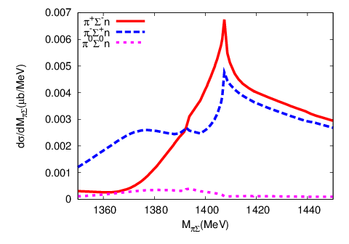
πΣ invariant mass distribution
E-dep.
E-indep.
Peak position and production cross section depend on the incident kaon momentum

Slide 15
Conclusion
Signal of Λ(1405) resonance shows up in the πΣ invariant mass distributions.
How the signatures appear depends on the two-body interaction model.
d(K⁻,n) reaction can be used to distinguish dynamical model of Λ(1405).
Future plan
Contribution from Σn and πn final state interaction
Improve the two-body interaction model.
Charge base calculation.

Slide 16
Thank you very much!

Slide 17
K⁻d -> πΣn reaction
=
+
X
X
τ
g
τ
g
+
X
+
τ
X
g
τ
g
Alt-Grassberger-Sandhas(AGS) eq. : Xij；quasi two-body amplitude

Slide 18
KN threshold
X
τ
g
KN threshold:

Slide 19
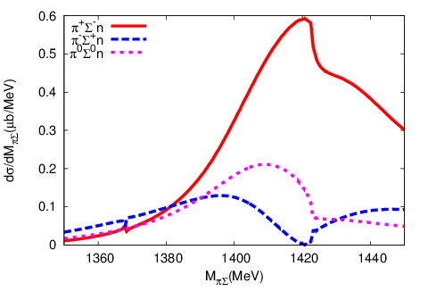
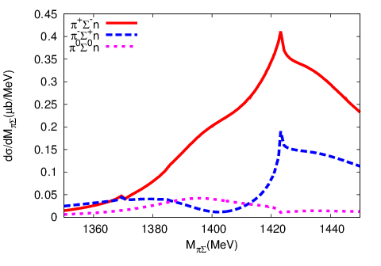
πΣ invariant mass distribution
E-dep.
E-indep.

Slide 20
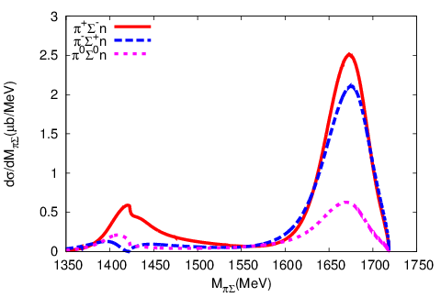
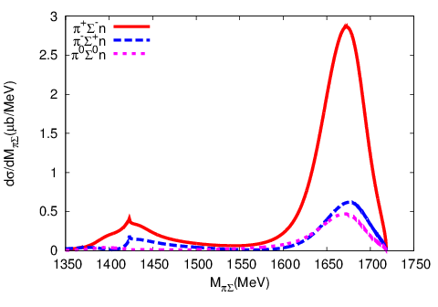
πΣ invariant mass distribution
E-dep.
E-indep.
Quasi free peak also depends on
the two-body KN-πΣ interaction

Slide 21
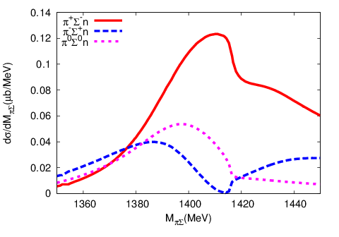
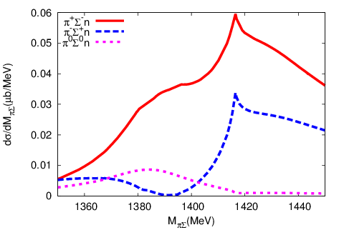
πΣ invariant mass distribution
E-dep.
E-indep.
d(K⁻,n) reaction may be useful to distinguish dynamical model of Λ(1405)

Slide 22
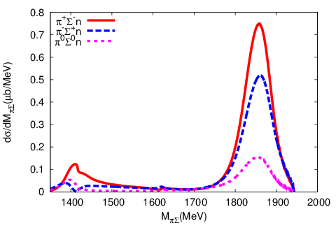
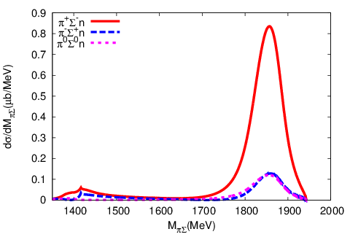
πΣ invariant mass distribution
E-dep.
E-indep.
Quasi free peak also depends on
the two-body KN-πΣ interaction

Slide 23
Coupled channel equation for
Faddeev eq.
separable 2-body Interaction；
Alt-Grassberger-Sandhas(AGS) eq. : Xij；quasi two-body amplitude
i
i
i
τn
Xij
=
Zij
+
Zin
Xnj
j
j
n
j

Slide 24
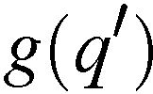
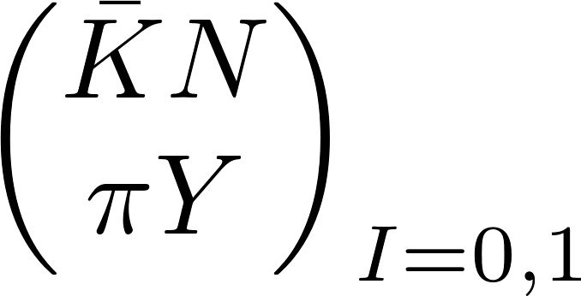
Model of system
2-body meson-baryon interaction;
2-body baryon-baryon interaction;
Yamaguchi-type separable interaction

Slide 25
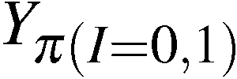
Model of system
3-body particle exchange (Z) interaction
baryon exchange
meson exchange
Y exchange
N exchange
K exchange
π exchange

Slide 26
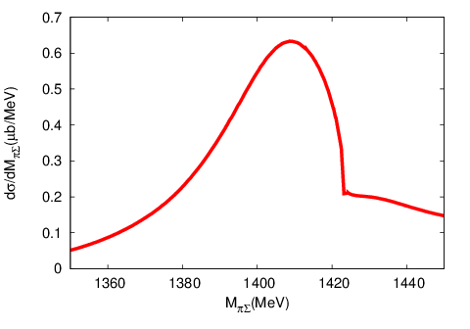
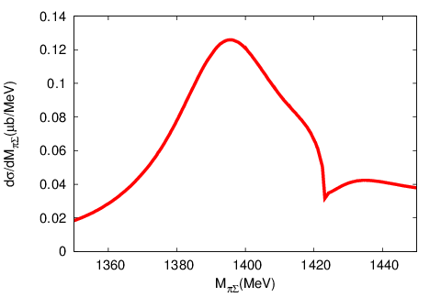
πΣ (I=0) invariant mass distribution
E-dep.
1419
E-indep.
1405
Signature of the Λ(1405) shows up on the invariant mass distribution

Slide 27
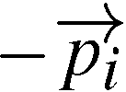
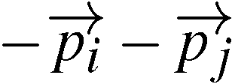
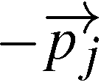
Singularity of particle exchange interaction
Z-diagram
moon shape singularity
methods to handle moon shape singularity numerically
spline interpolation, point method

Slide 28
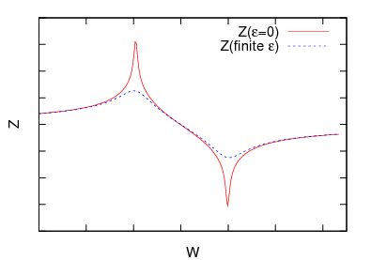
Point method
L. Schlessinger, PR 167, 1411(1968)
Kamada, Koike, Glökle, PTP 109, 869(2003)
evaluate X at finite εi
X at ε=0
continued
fraction

Slide 29
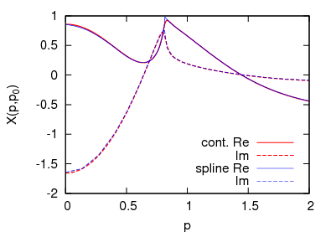
test of point method
three identical bosons model of Amado
scattering of a boson b from a two-boson bound state d
Matsuyama, Sato, Lee,
PR439, 193(2003)
m; boson mass, E; total energy,
B; two-body binding energy, β; cut-off
We can use this method for AGS eq.

Slide 30
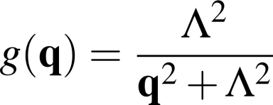
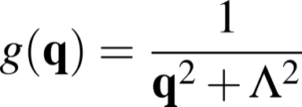
Model of baryon-baryon interaction
NN potential (Yamaguchi potential)
YN potential
Torres, Dalitz, Deloff, PLB 174, 213 (1986)

Slide 31
K⁻p scattering length
SIDDHARTA
E-dep. E-indep.

Slide 32
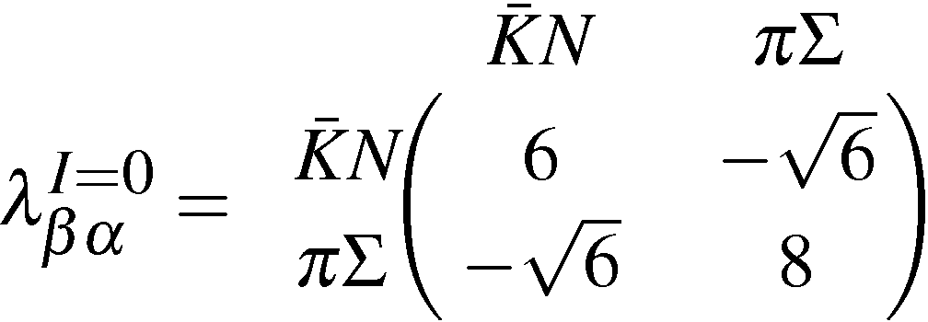
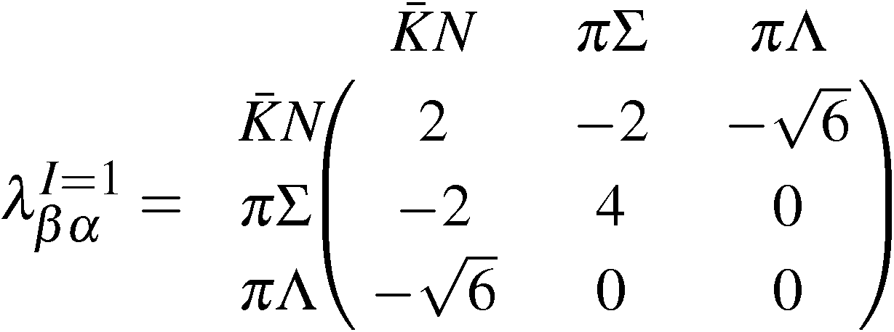
Coupling constant

Slide 33
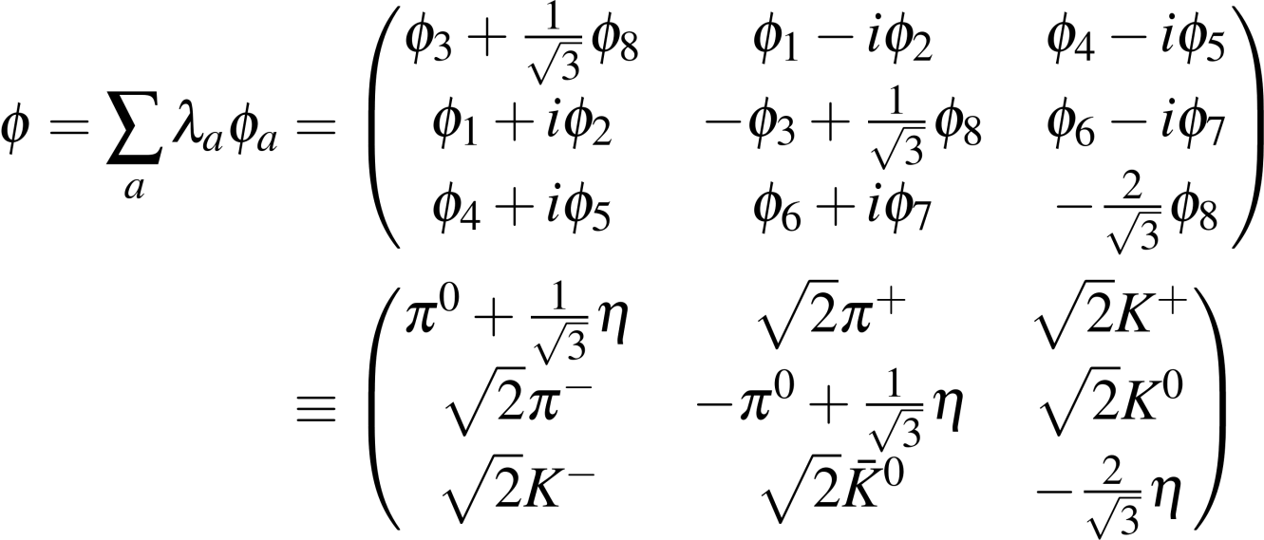
Meson Octet

Slide 34
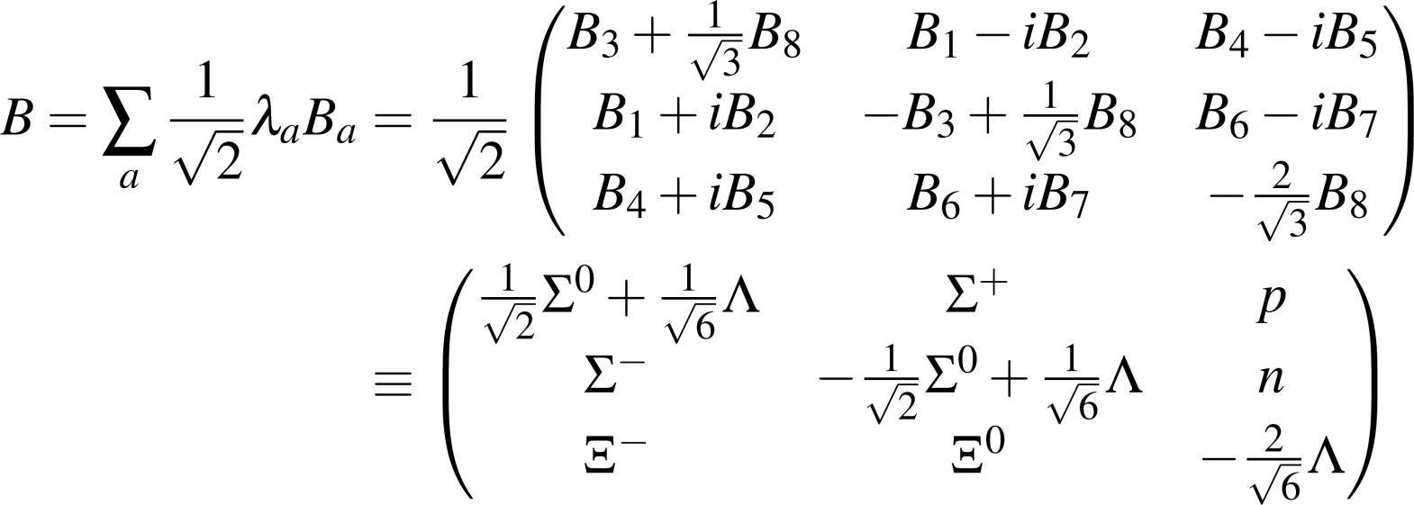
Baryon Octet

Slide 35
Signature of strange dibaryon resonance

Slide 36
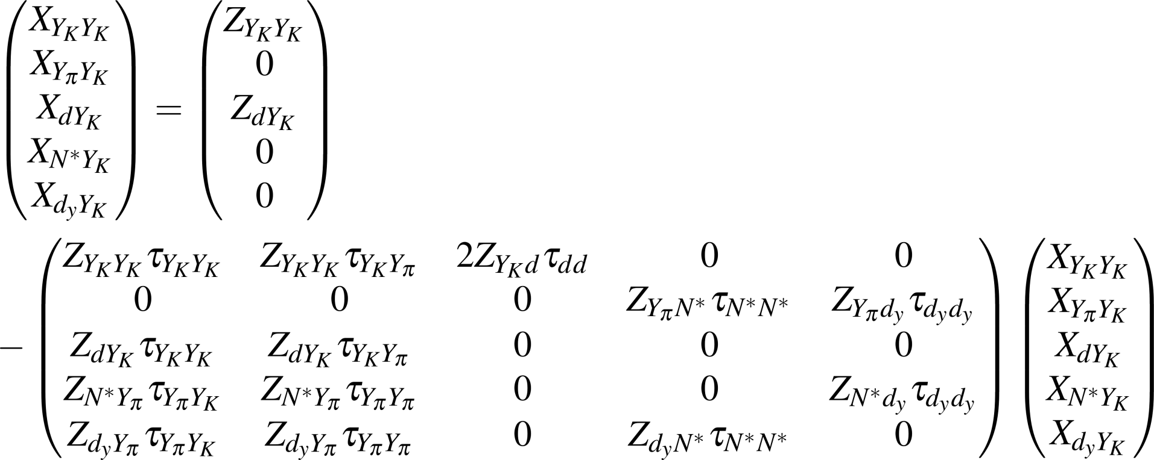
AGS equations

Slide 37
Break-up cross section
τ
g
+
τ
g
X
X
=
τ
g
τ
g
+
X
+
X

Slide 38
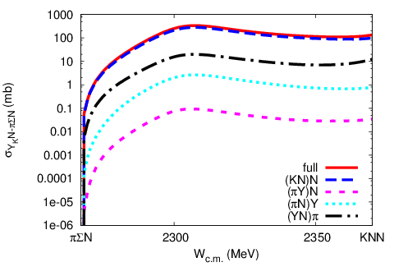
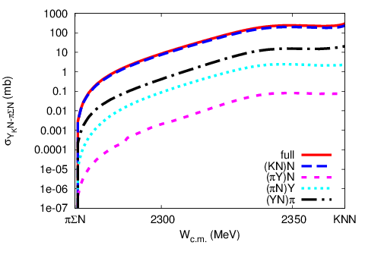
Each channel contribution to cross section
E-indep.
E-dep.

Slide 39
Normalization
There is arbitrariness how to factorize V.
There are no arbitrariness.

Slide 40
cutoff (model parameters)
Ikeda, Kamano, Sato, PTP124, 533 (2010)
E-indep.
E-dep.

Slide 41
Signature of strange dibaryon resonance
E-indep.
E-dep.

