Slide 1

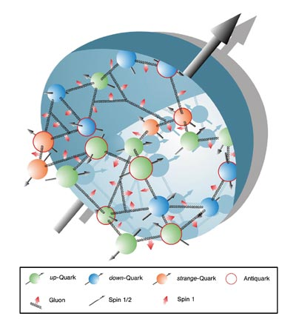
Spin at JLab 12 GeV and EIC
Zein-Eddine Meziani
Temple University
OUTLINE:
Nucleon spin structure and Imaging in the Valence quark region
  Inclusive measurements at large x; quark models tests and Lattice QCD tests
  Exclusive measurements in the valence region (imaging): DVCS + DVMP + Lattice to create an image.
  Semi-inclusive measurements (dynamical imaging)
Nucleon spin structure at an EIC
  Inclusive measurements at lower x (evolution of g_{1,} first moment, and g₂ )
  Exclusive measurement (Imaging of the glue and the sea )
  Semi-inclusive measurements (dynamical imaging with a focus on the sea and glue)

Slide 2
Some of the
NSAC LRP Overarching QCD questions
(December 2007)
What is the internal spin and flavor landscape of hadrons?
What is the role of gluons and gluons self interactions in nucleon and nuclei?
What governs the transition of quarks and gluons into pions and nucleons?

Slide 3
The Tools
Generalized Parton Distributions
Inclusive
Sum rules and polarizabilities
Transverse Momentum Distributions
Since 1998
Since 2002
Exclusive reactions
Elastic form factors
Deep Virtual Compton Scattering
Deep Virtual Meson Production
Semi-Inclusive DIS
Distributions and
Fragmentation functions
QCD
Electroweak
Physics/probe
Beyond the standard
Model/or a probe to hadronic systems
GPDs and TMDs in Nuclei
Exclusive
Semi-inclusive
Initial and final medium effects

Slide 4
Resolution of the probe and scale of theory tools
Models
0
1
10
∞
Q²
pQCD
Lattice QCD

Slide 5
12 GeV Upgrade Project
Upgrade is designed to build on existing facility: vast majority of accelerator and experimental equipment have continued use
New Hall
Add 5 cryomodules
Upgrade arc magnets
and supplies
CHL upgrade
Maintain capability to deliver lower pass beam energies:
2.2, 4.4, 6.6….
20 cryomodules
Add arc
20 cryomodules
Add 5 cryomodules
Scope of the project includes:
Doubling the accelerator beam energy
New experimental Hall and beamline
Upgrades to existing Experimental Halls
Enhanced capabilities
in existing Halls

Slide 6
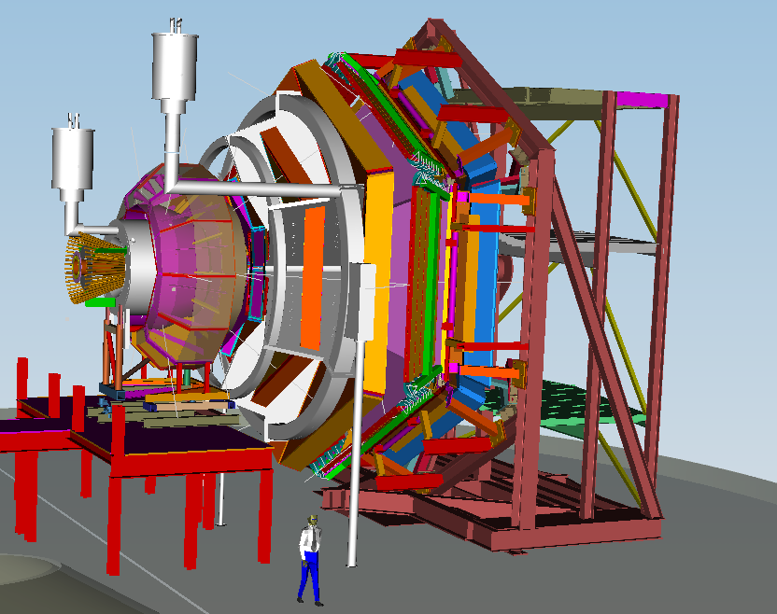
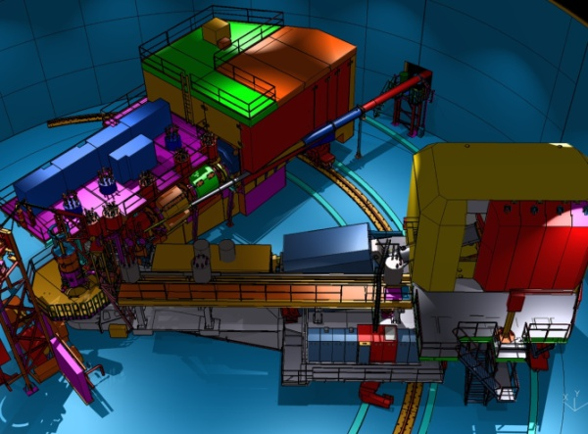
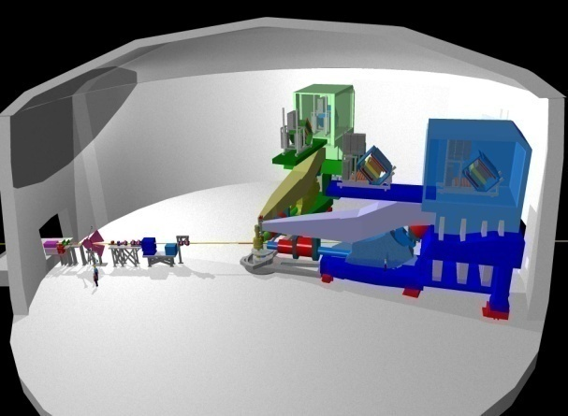
12 GeV Spin Physics Capabilities
Hall B – understanding nucleon structure via generalized parton distributions
Hall C – precision determination of valence quark properties in nucleons and nuclei
Hall A – future new experiments (e.g. PVDIS with SOLID and Moller)
Notes:
6
Note BSM not included in project

Slide 7
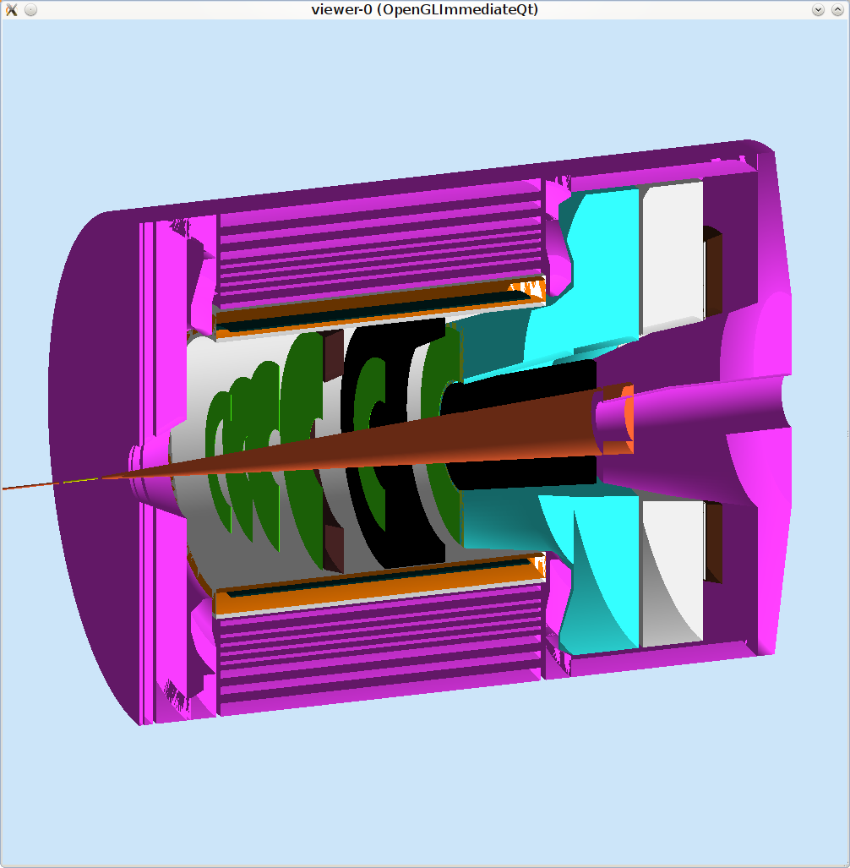
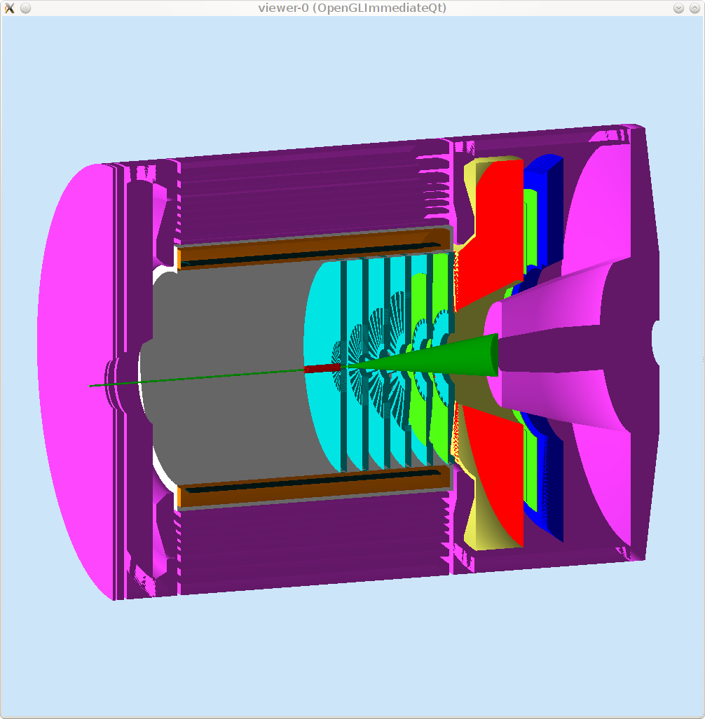
Hall A (Additional Equipment Required)
SOLID for SIDIS:
High luminosity on polarized ³He
Better than 1% errors for small bins
Large Q² coverage
x-range 0.08-0.6
W²> 4 GeV²
SOLID for PVDIS:
High Luminosity on LD2 and LH2
Better than 1% errors for small bins
Large Q² coverage
x-range 0.25-0.75
W²> 4 GeV²

Slide 8
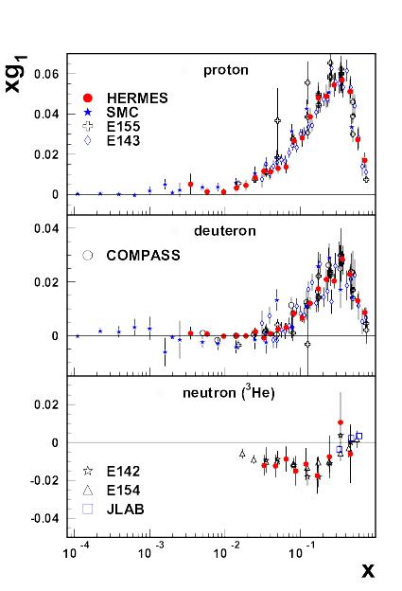
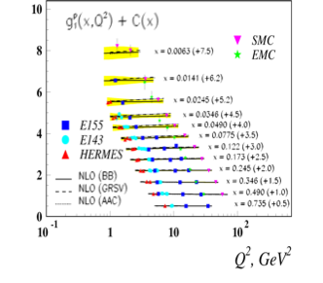
Polarized Structure functions

Slide 9
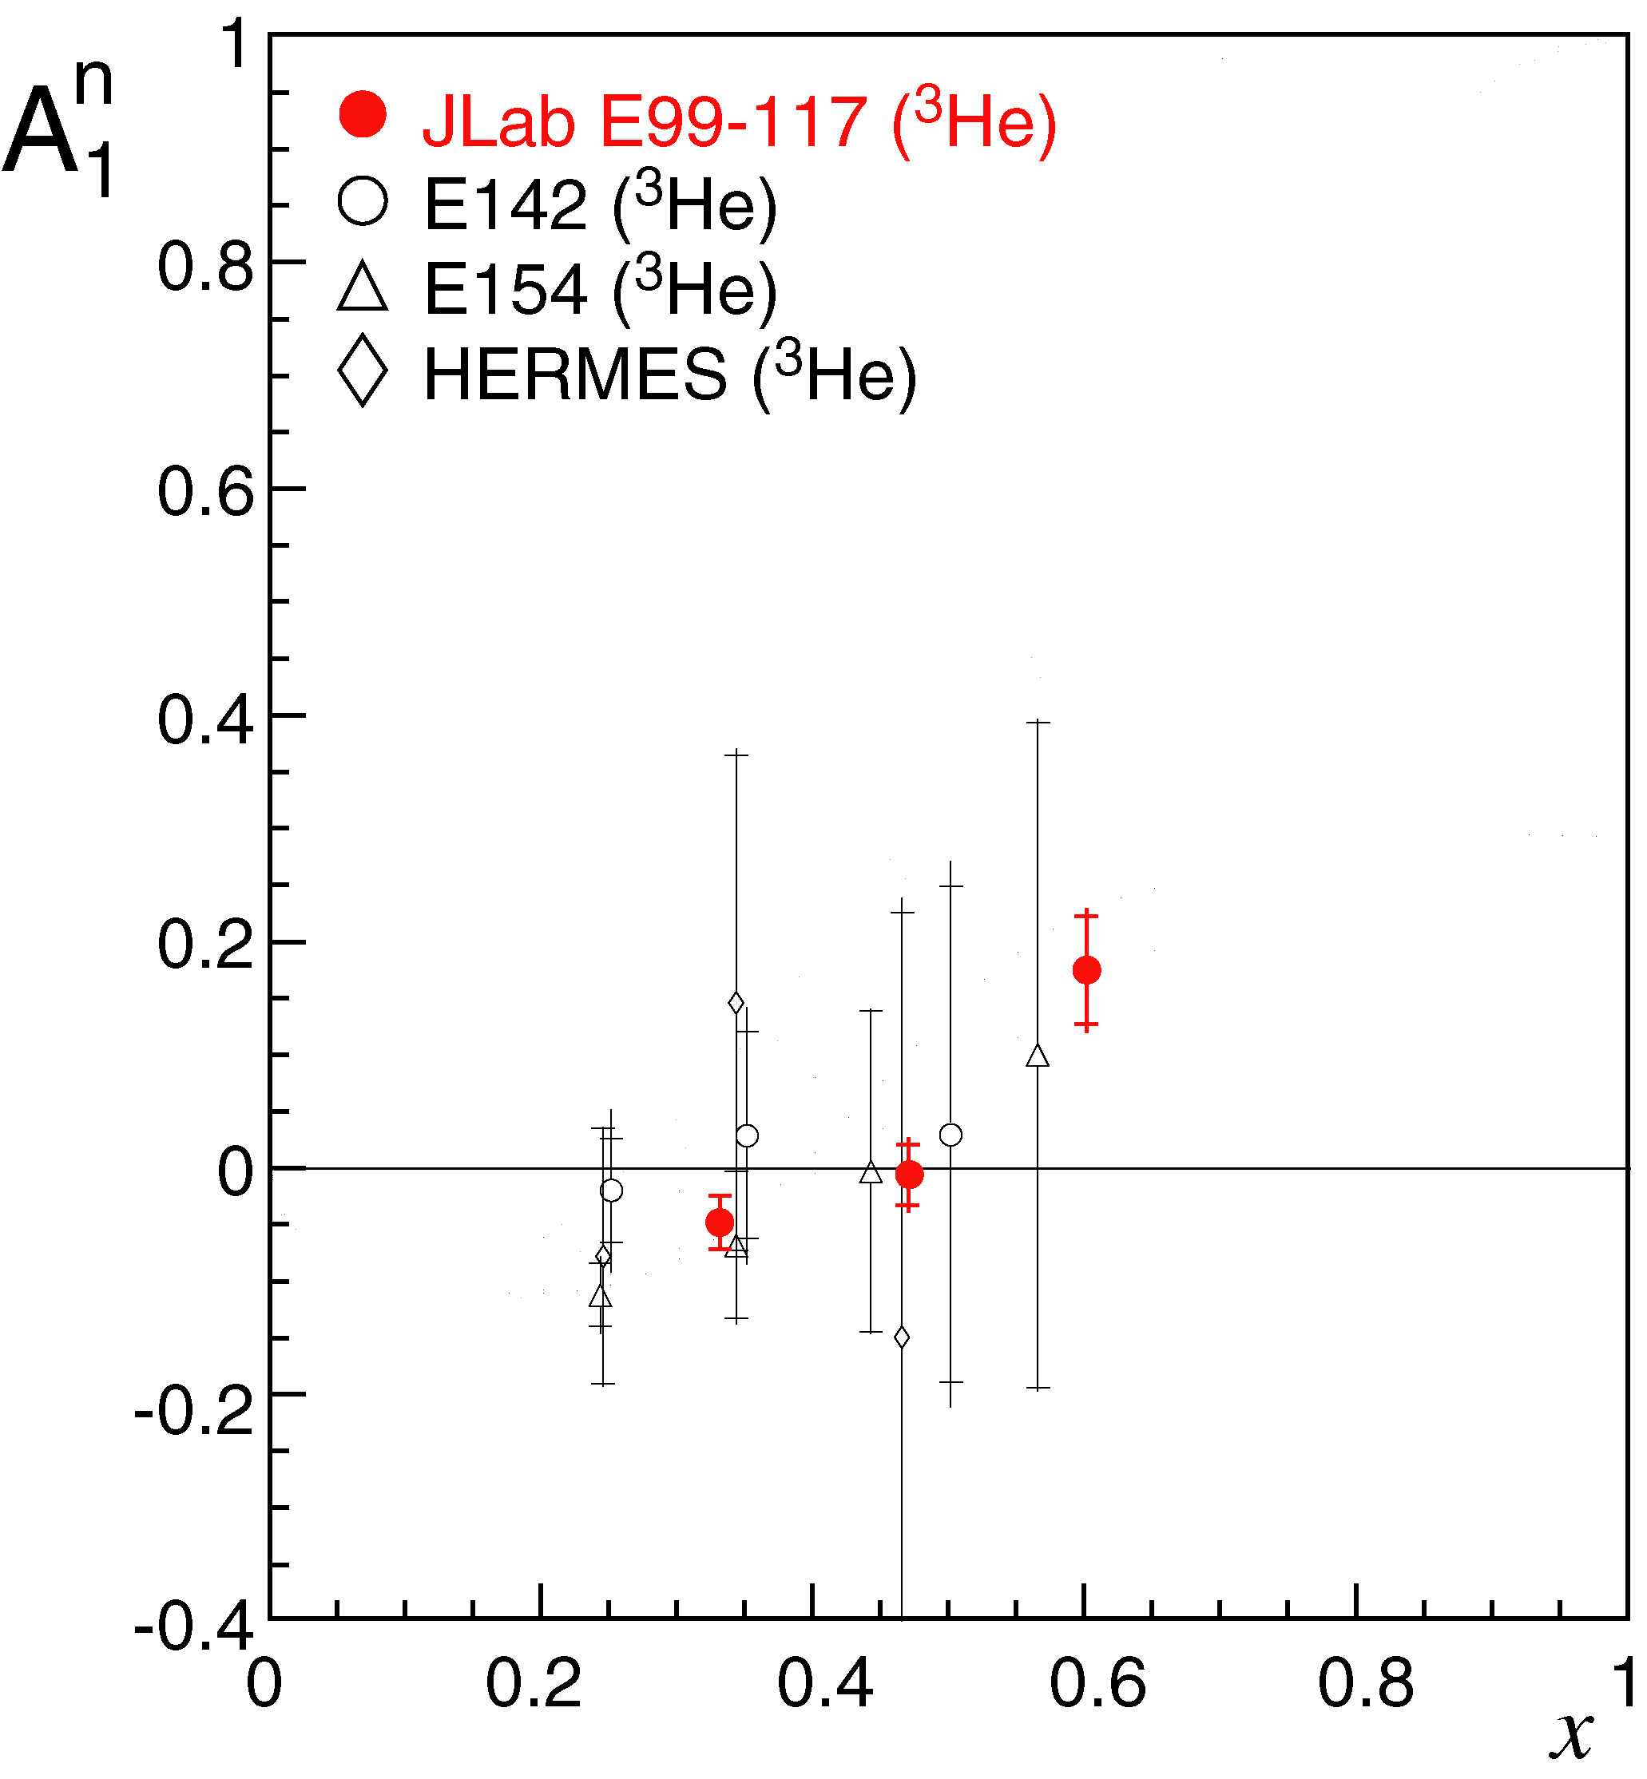
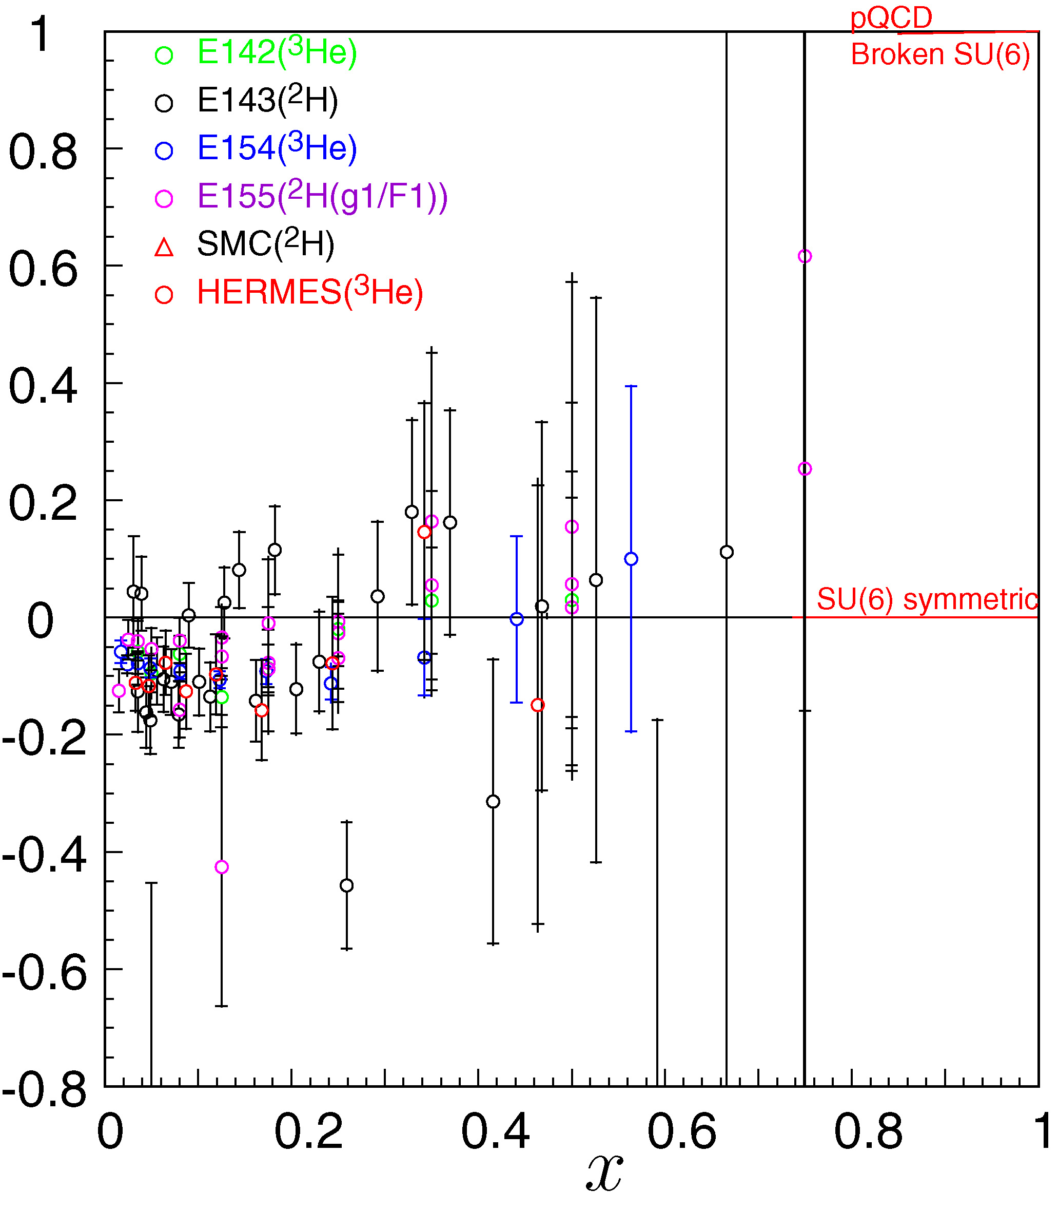
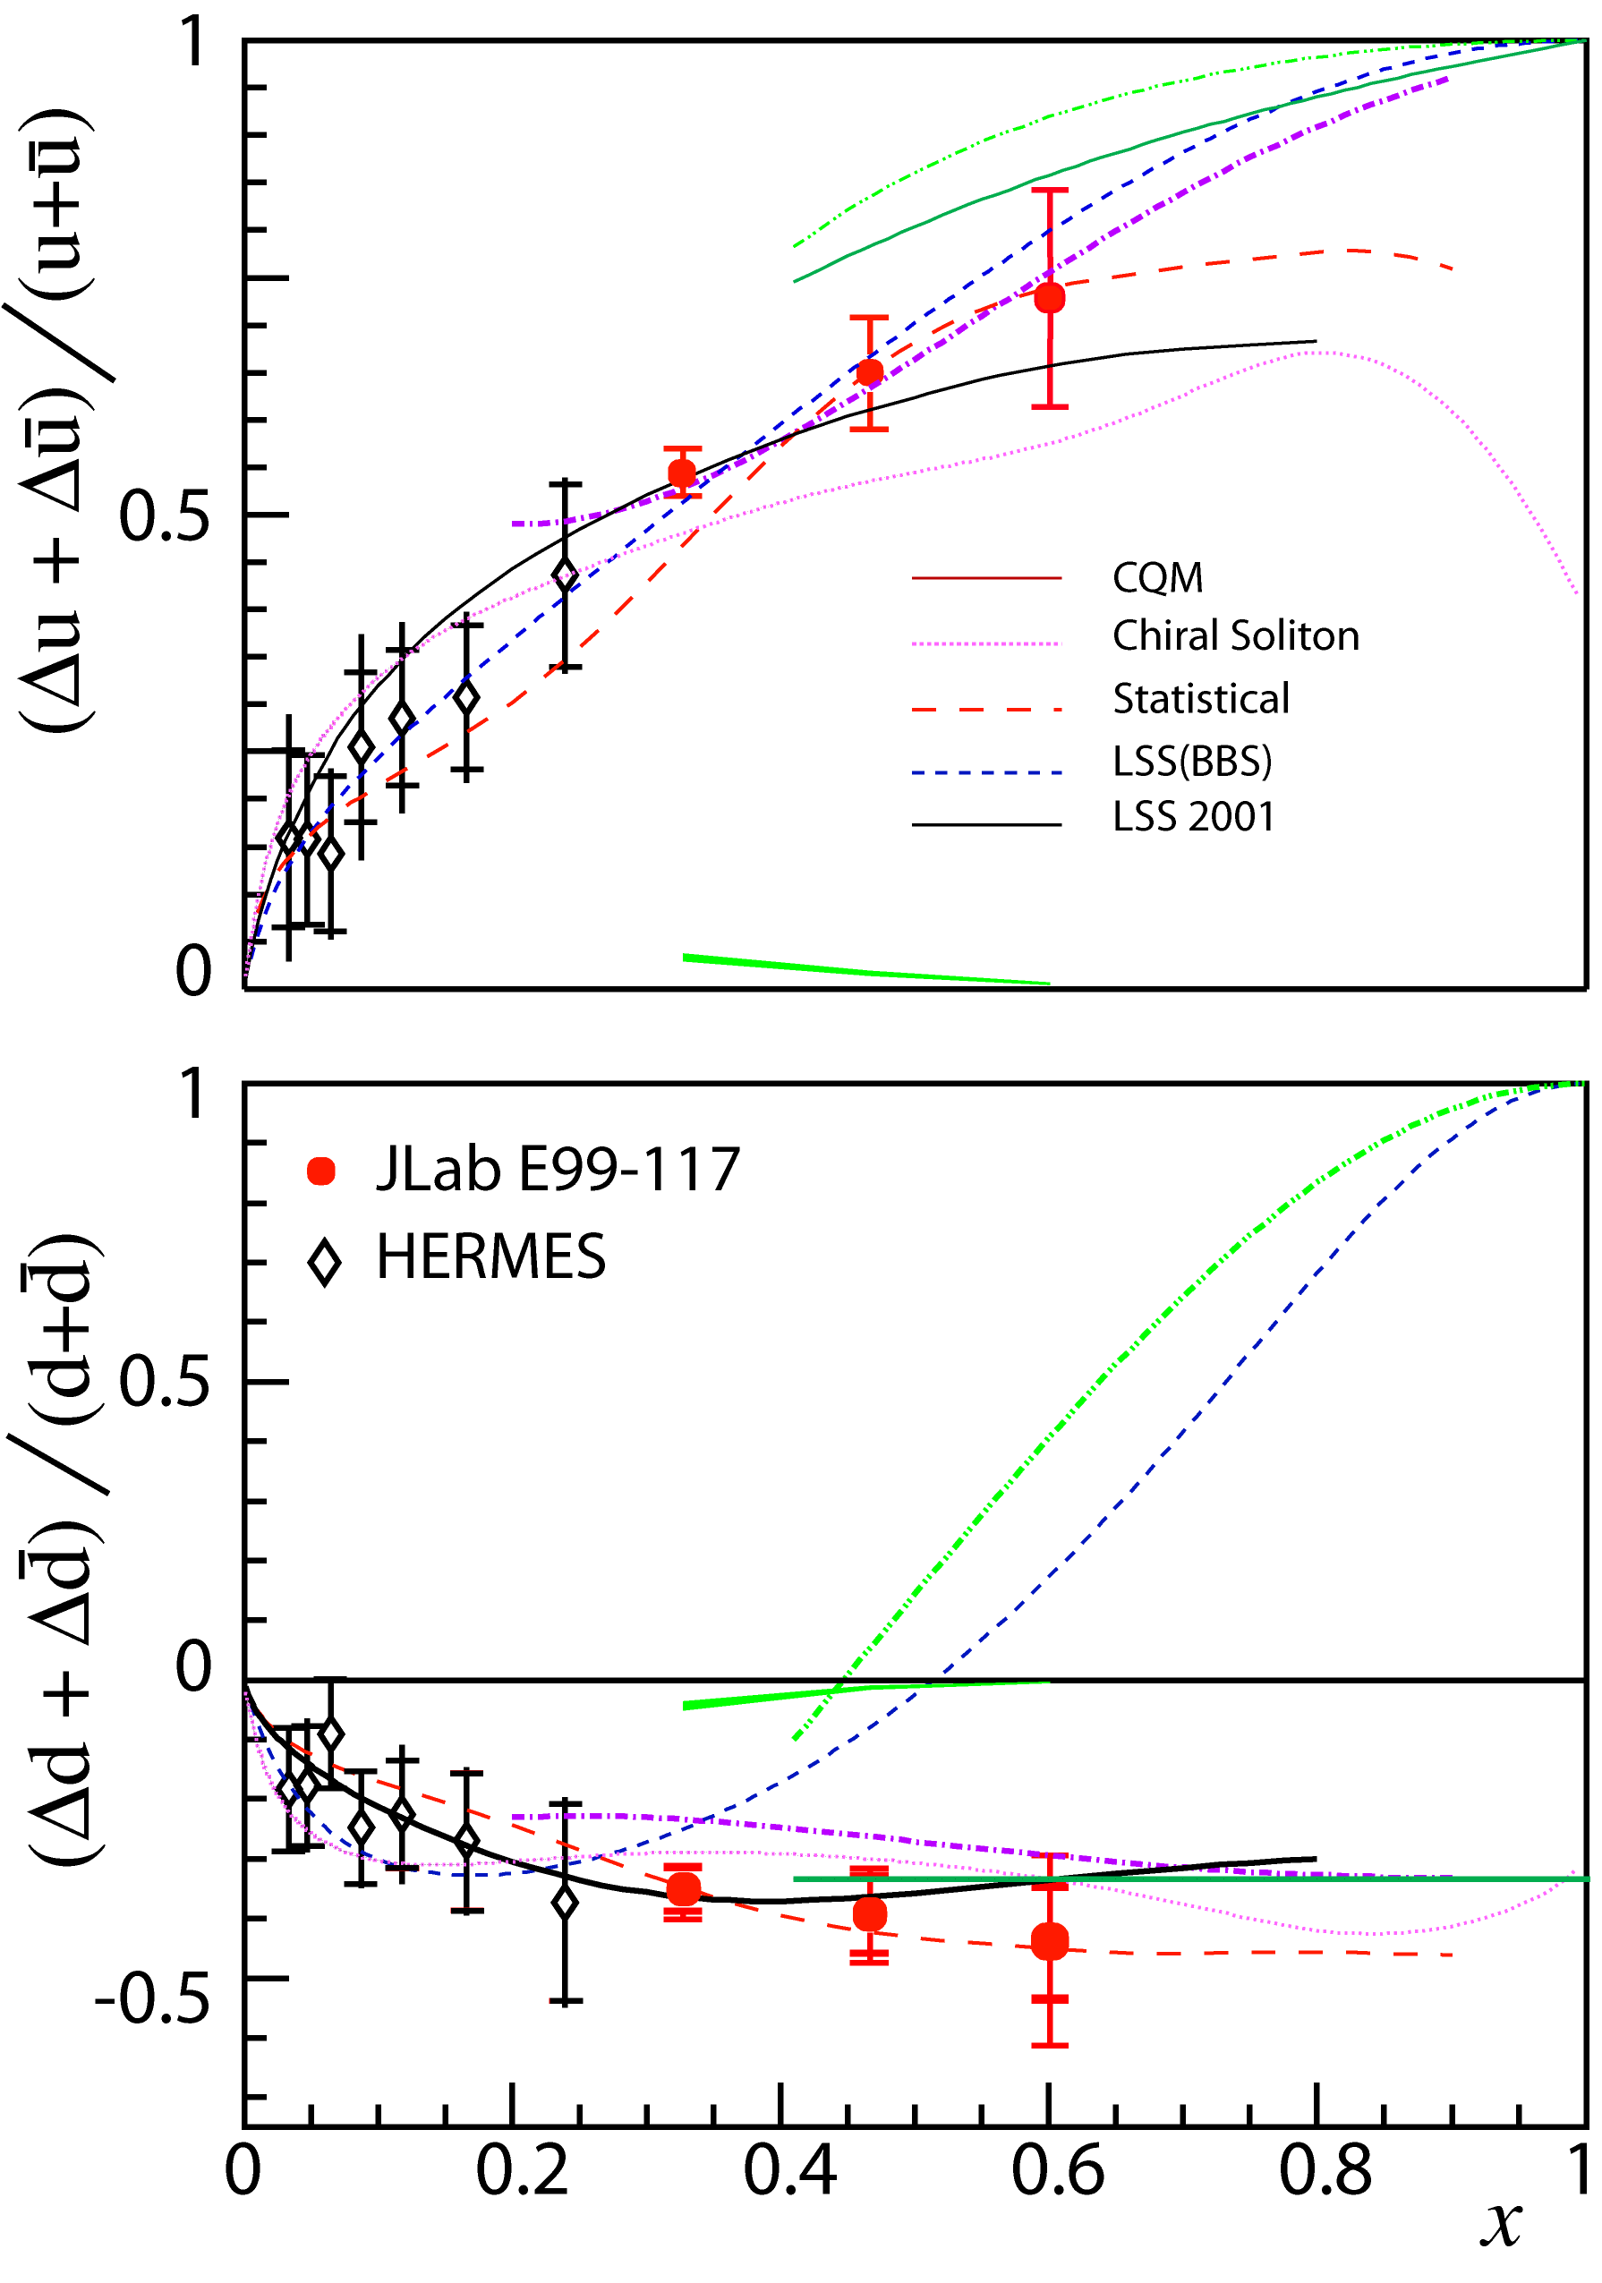
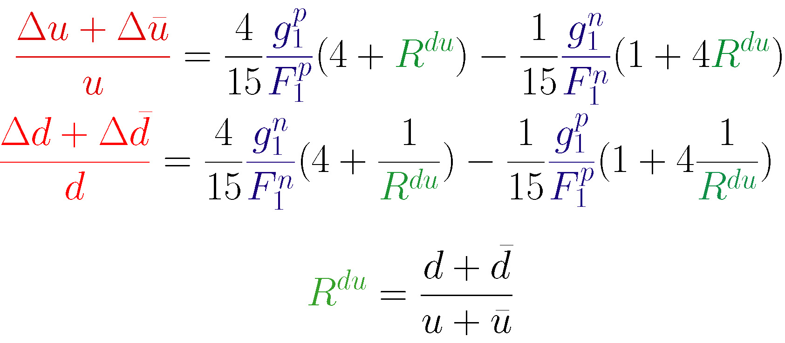
A₁^{n} and Helicity-Flavor Decomposition
JLab E99-117

Slide 10
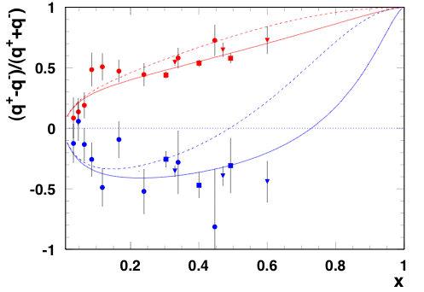




Effect of considering transverse momentum of quarks in the nucleon
Inclusive Hall A and B and Semi-Inclusive Hermes
Avakian, Brodsky, Deur and Yuan
Phys.Rev.Lett.99:082001,2007.
BBS
BBS+OAM

Slide 11
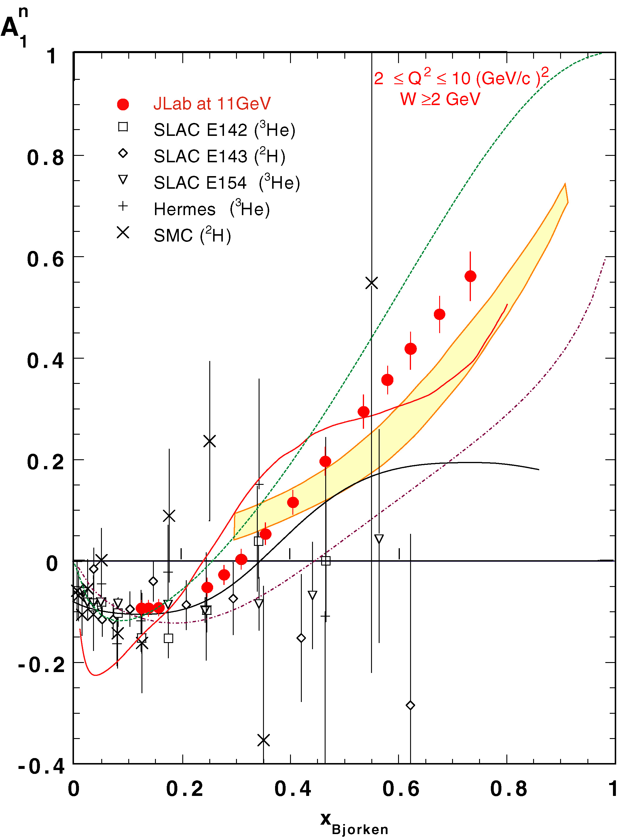
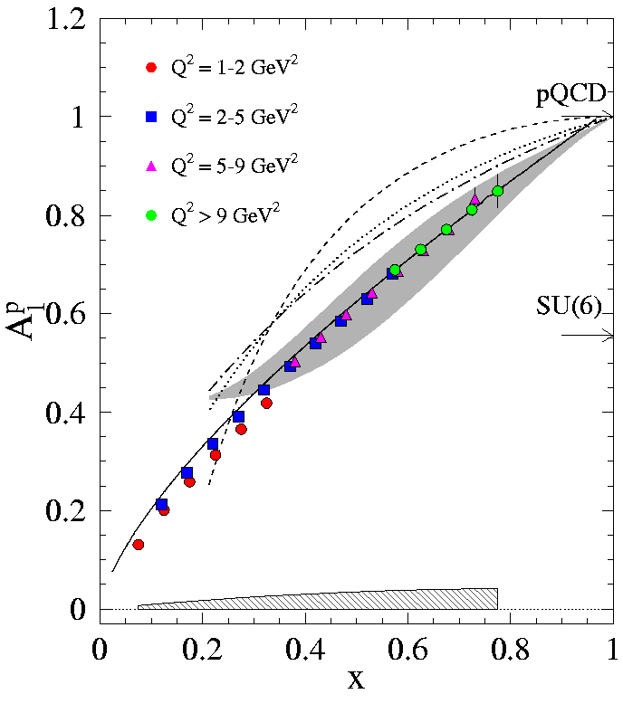

Inclusive double spin asymmetries using 12 GeV
A₁^{n} at 11 GeV Hall C
CLAS12
Proton
W>1.2

Slide 12
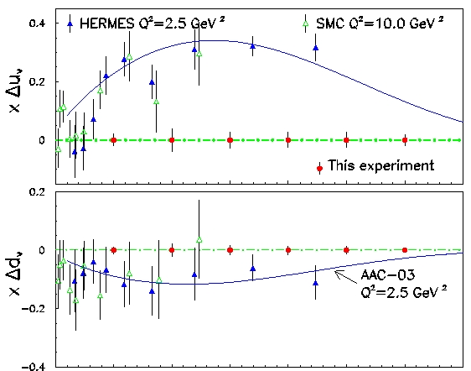
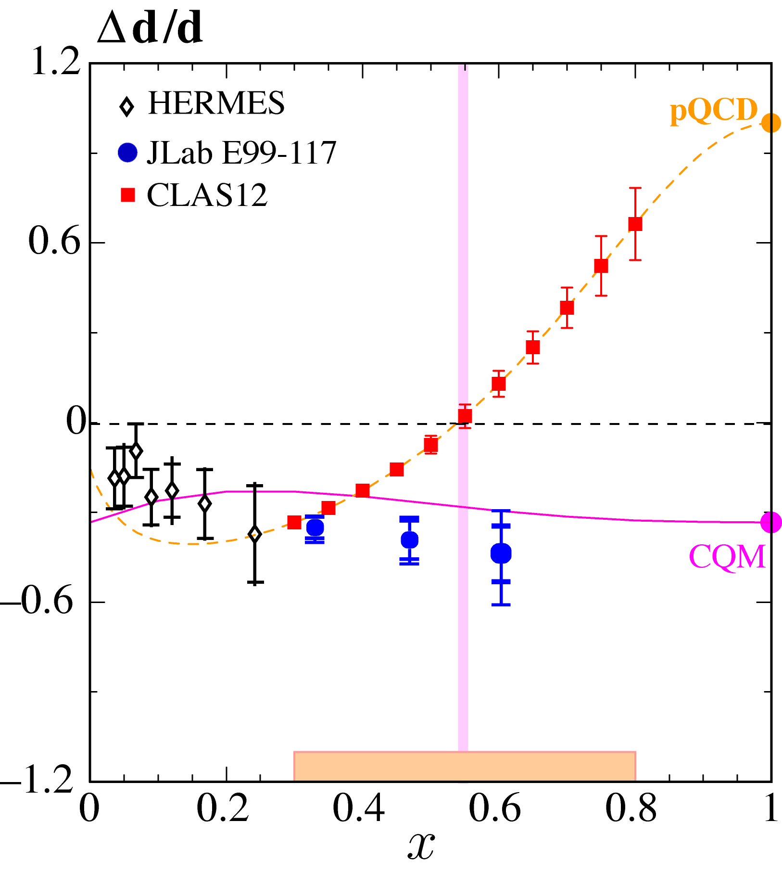
Longitudinal Double Spin Asymmetry in SIDIS
At JLab 12 GeV with SIDIS
E_{e} =11 GeV NH₃ and ³He
Asymmetry measurements with different hadrons (π+,π−) and targets (p,n) allows for flavor separation

Slide 13
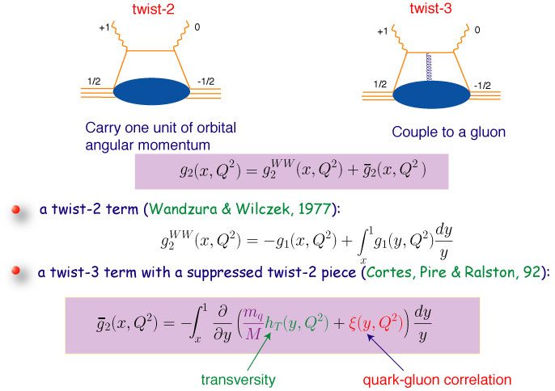
Quark Gluon Correlations

Slide 14
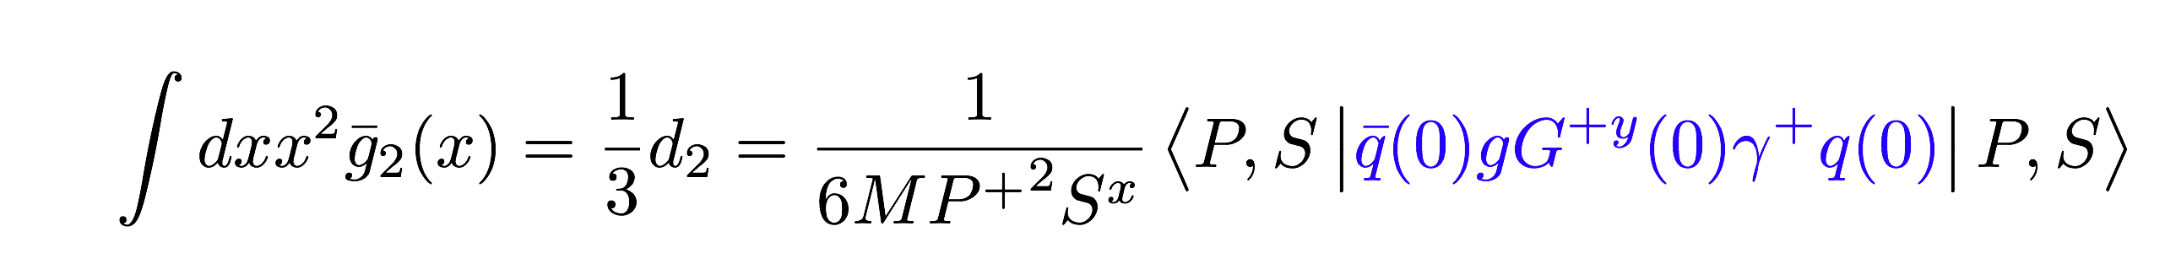
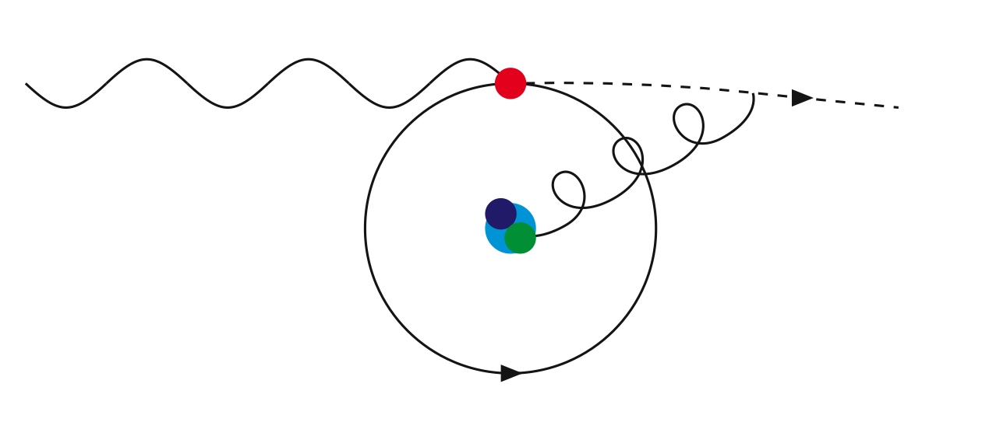
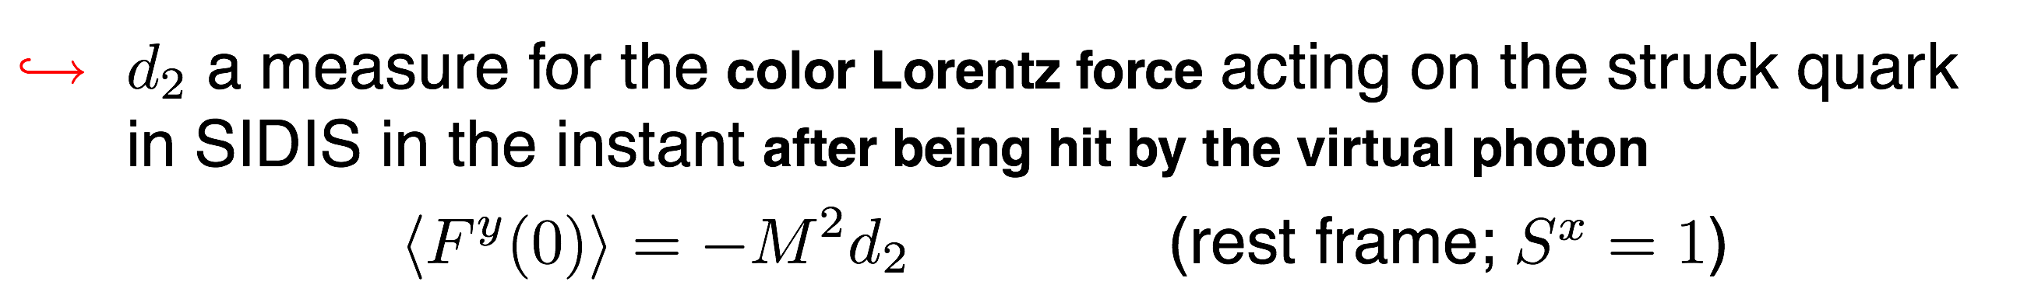
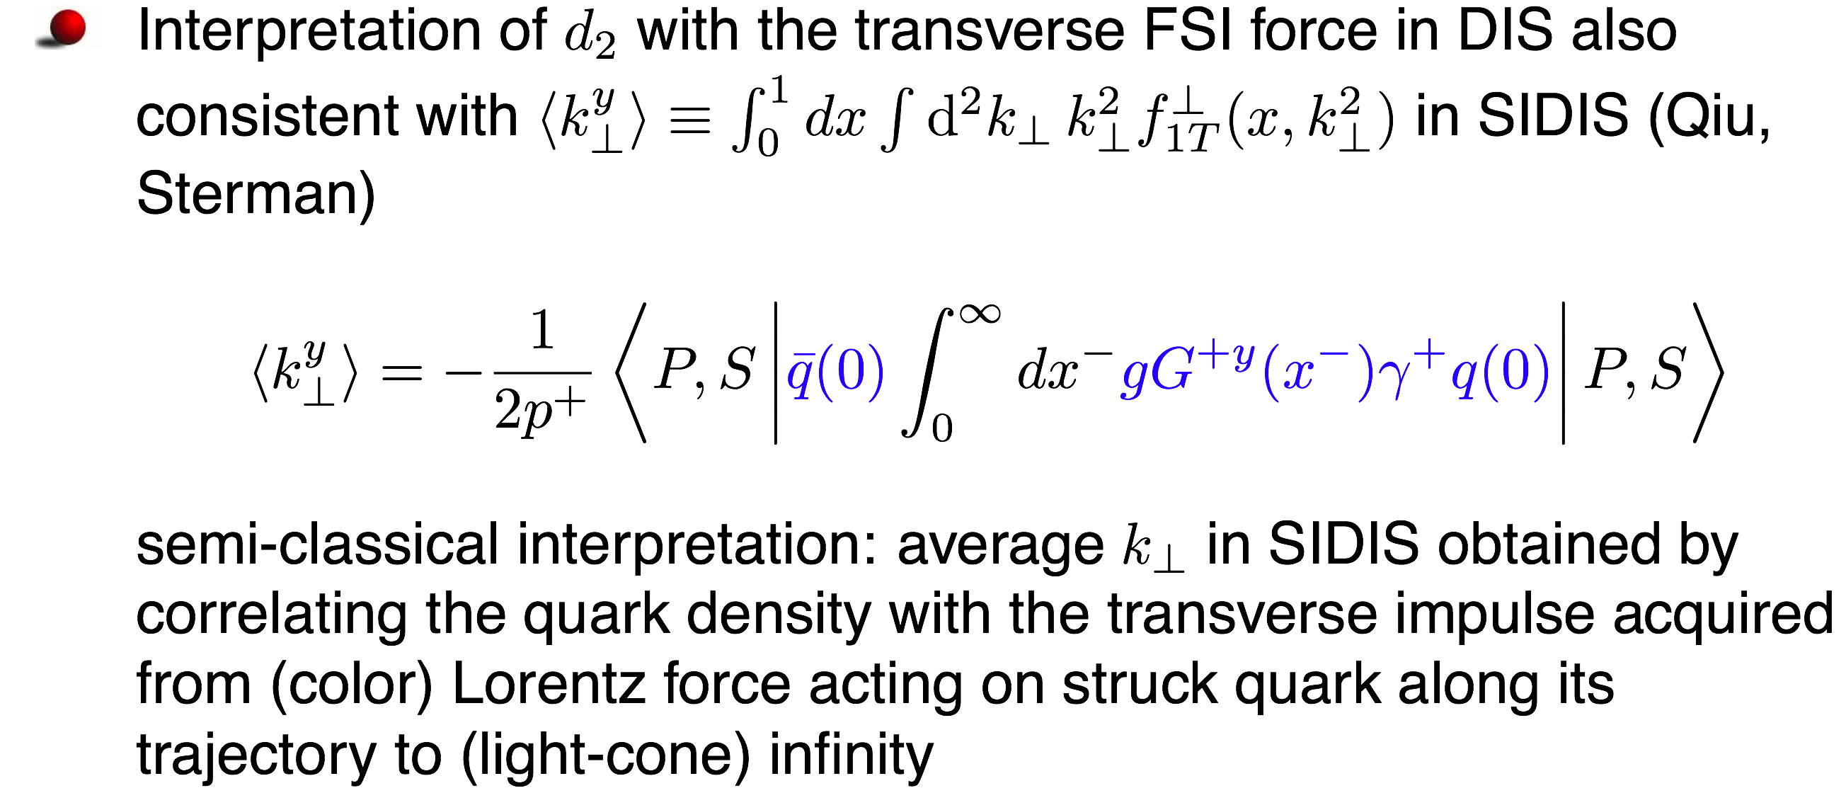
Average Color Lorentz Force (M. Burkardt)

Slide 15
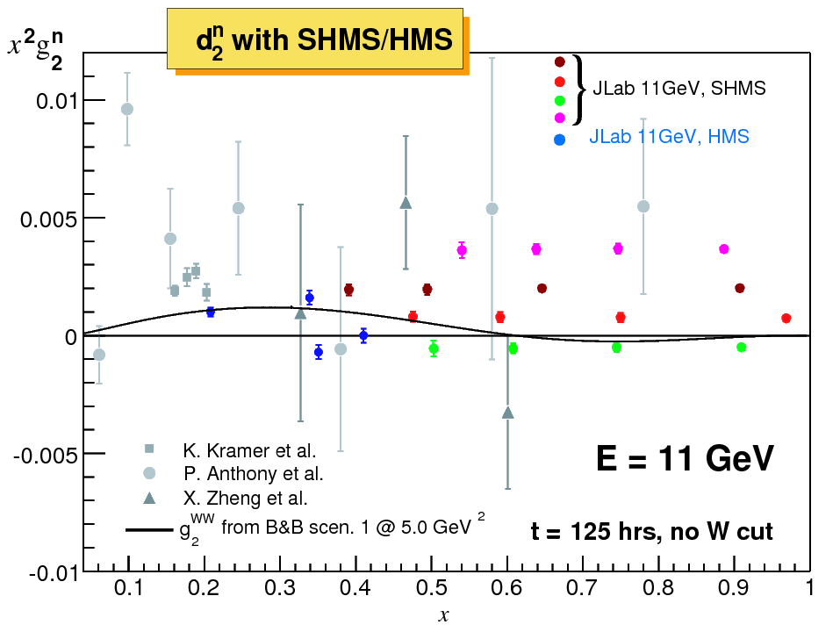
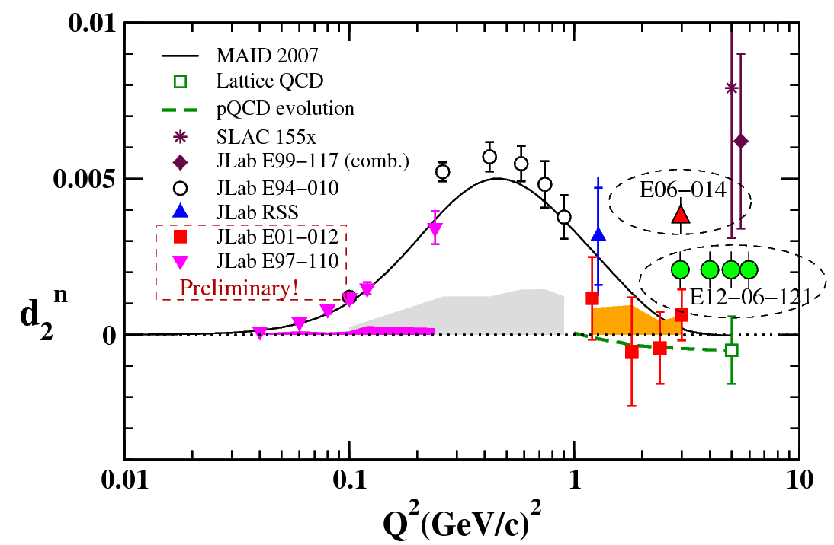
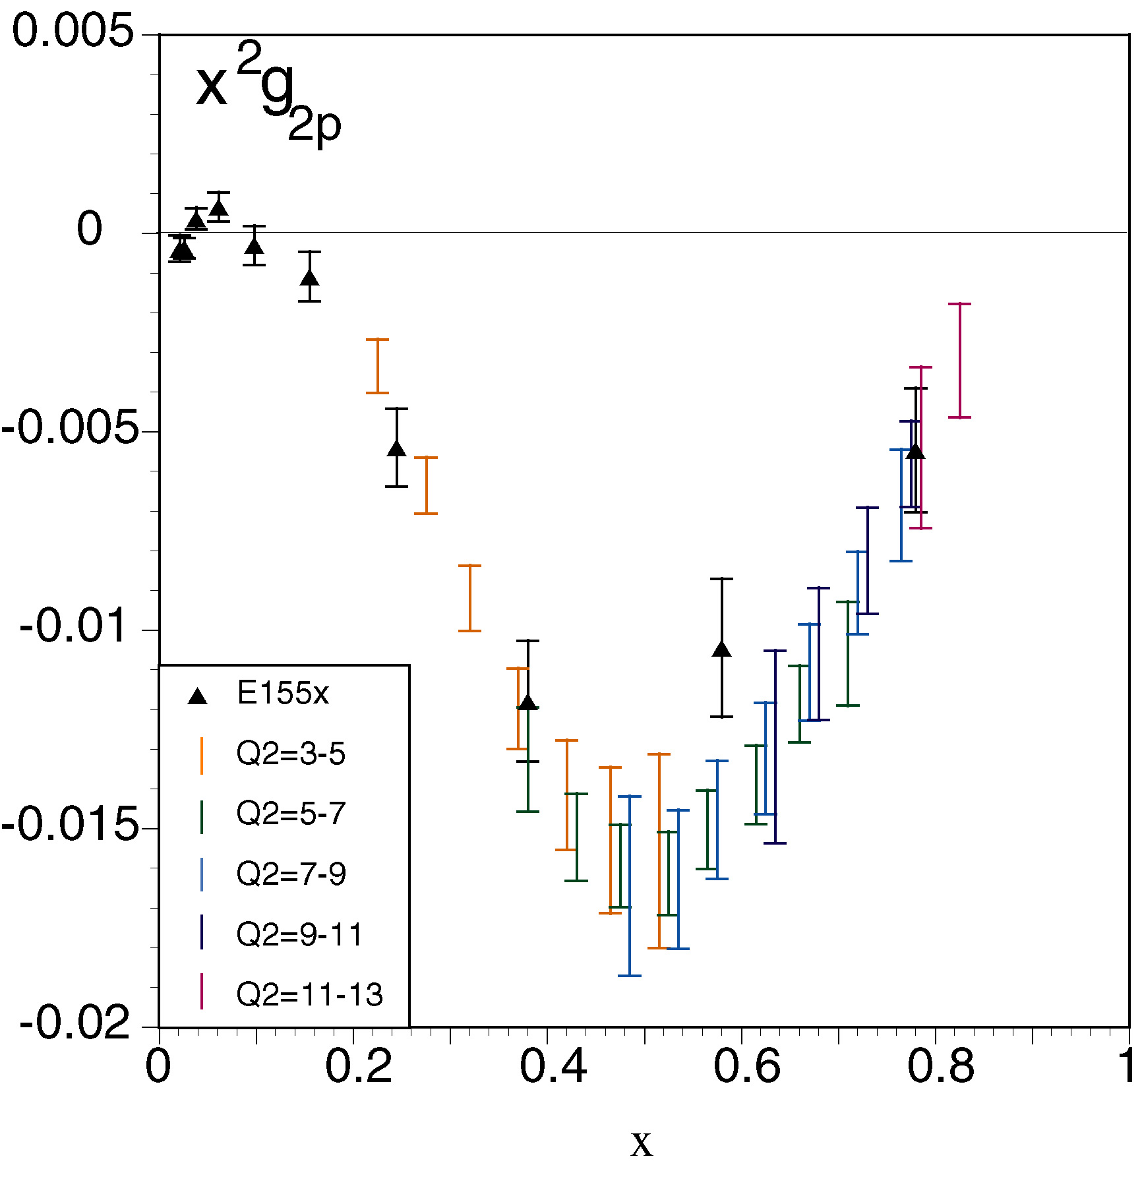
Projected results for g2n and d2n
Projected g₂^{n} points are vertically offset from zero along lines that reflect different (roughly) constant Q² values from 2.5—7 GeV².
g₂ for ³He is extracted directly from L and T spin-dependent cross sections measured within the same experiment.
Strength of SHMS/HMS:
nearly constant Q² (but less coverage for x < 0.3)
Notes:
g₂ for ³He is extracted directly from L and T spin-dependent cross sections measured within the same experiment.
Strength of SHMS/HMS:
nearly constant Q² (but less coverage for x < 0.3)

Slide 16
3D imaging of the nucleon
Tool: Generalised Parton Distributions
Form factors:
GPDs:
Parton Distrribution Functions:
Fourier transform of e.g. a radial charge distribution
Number density of quarks with longitudinal momentum fraction x
Generalized description in 2+ 1 dimensions

Slide 17



Theoretical Framework in QCD
Generalized Parton Distributions
  Matrix elements of non-local operators with quarks and gluon field
  Depend on two longitudinal momentum fractions
  For unpolarized quarks we have two distributions:
  H^{q} conserves proton helicity
  E^{q} flips proton helicity

Slide 18
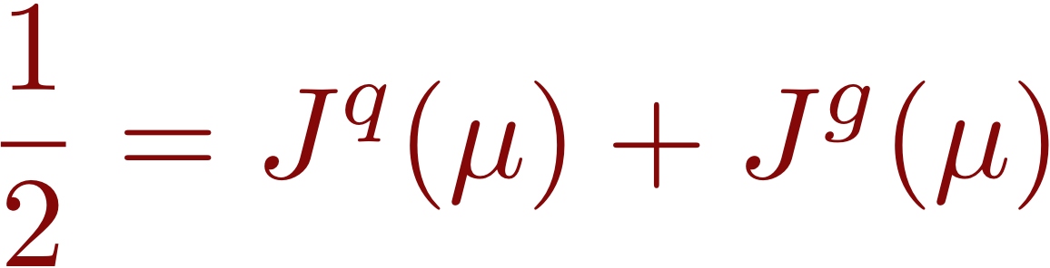
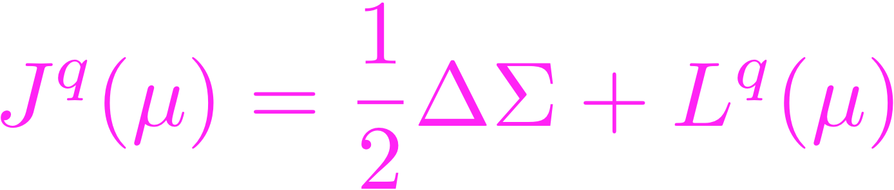
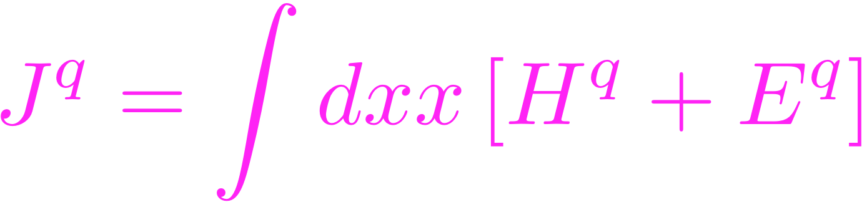
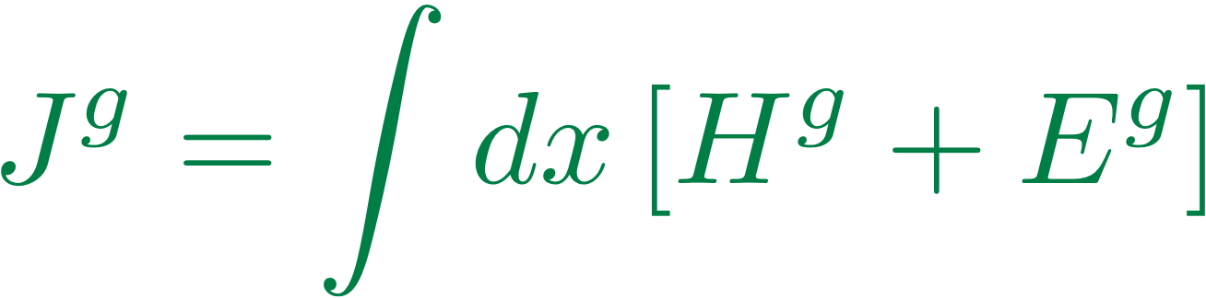

Nucleon Angular Momentum Sum Rule
Ji Sum rule (1997)
Spin of quarks
contribution
Orbital angular momentum
of quarks
Total angular momentum of gluons

Slide 19
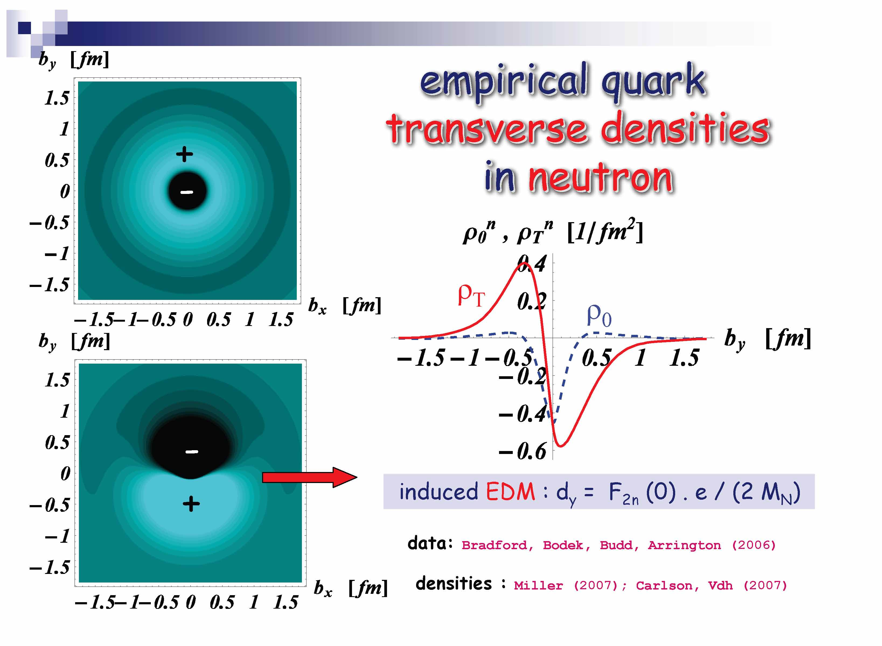

Slide 20
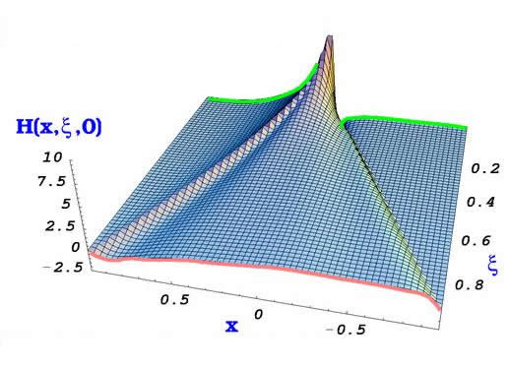
Generalized Parton Distributions, Deeply Virtual Compton Scattering
x+ξ
x-ξ
t
Model by
Goeke, Polyakov,
Vanderhaeghen
Deeply Virtual Compton Scattering
is the simplest hard exclusive
process involving GPDs
k’
k
q’
p
p’
The handbag dominance:
Factorization
Theorem
k
k’
q’
p
p’
amplitude
GPDs

Slide 21
GPDs : 3D quark/gluon imaging of nucleon
Fourier transform of GPDs :
simultaneous distributions of quarks w.r.t. longitudinal momentum x P and transverse position b
( M. Burkardt )
theoretical parametrization needed :
double distributions, dual param. (Guzey), conformal param. (Müller)

Slide 22
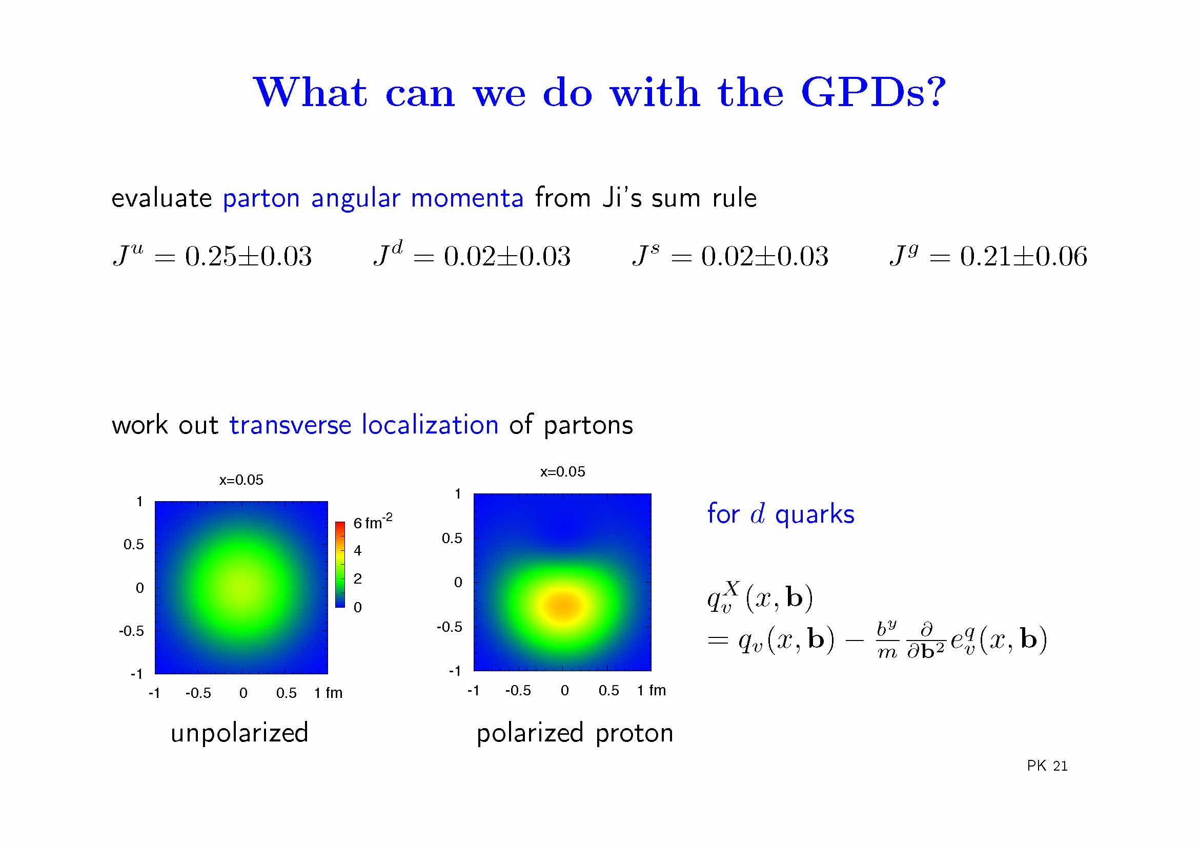
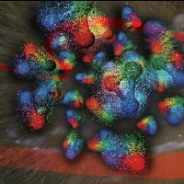


Peter Kroll

Slide 23
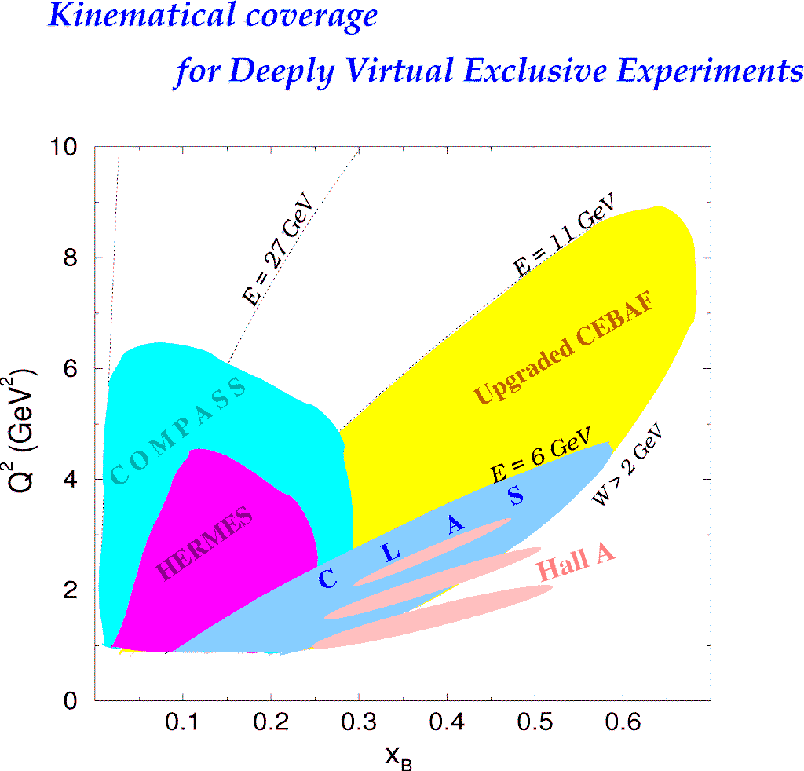
Large phase space (ξ,t,Q²)
and High luminosity required
EIC
Sea/gluon
region
Valence
region
JLab12
High x_{B} only reachable
with high luminosity
H1, ZEUS
JLab Upgrade
Upgraded JLab has
complementary
& unique capabilities

Slide 24
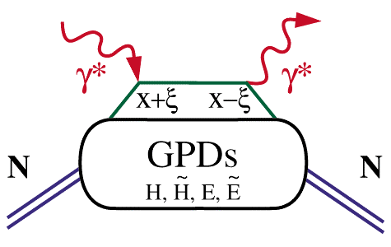
Extraction of GPD’s
global analysis : cross sections, asymmetries, (p,n), (γ,M)
ep epγ
hard vertices
Cleanest process: Deeply Virtual Compton Scattering
σ⁺ − σ⁻
σ⁺ +σ⁻
Δσ
2σ
A =
=
ξ=x_{B}/(2-x_{B})
k = -t/4M²
t
Polarized beam, unpolarized target:
~
H(ξ,t)
Δσ_{LU}~ sinφ{F₁H+ ξ(F₁+F₂)H+kF₂E}dφ
Unpolarized beam, longitudinal target:
~
~
H(ξ,t)
Δσ_{UL}~ sinφ{F₁H+ξ(F₁+F₂)(H+ξ/(1+ξ)E)}dφ
Unpolarized beam, transverse target:
E(ξ,t)
Δσ_{UT}~ sinφ{k(F₂H – F₁E)}dφ

Slide 25
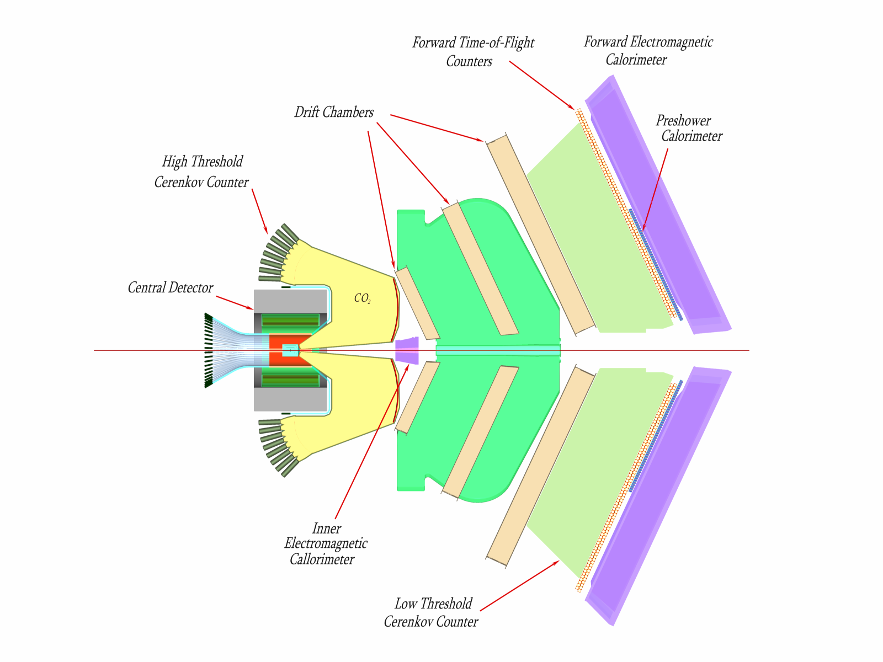
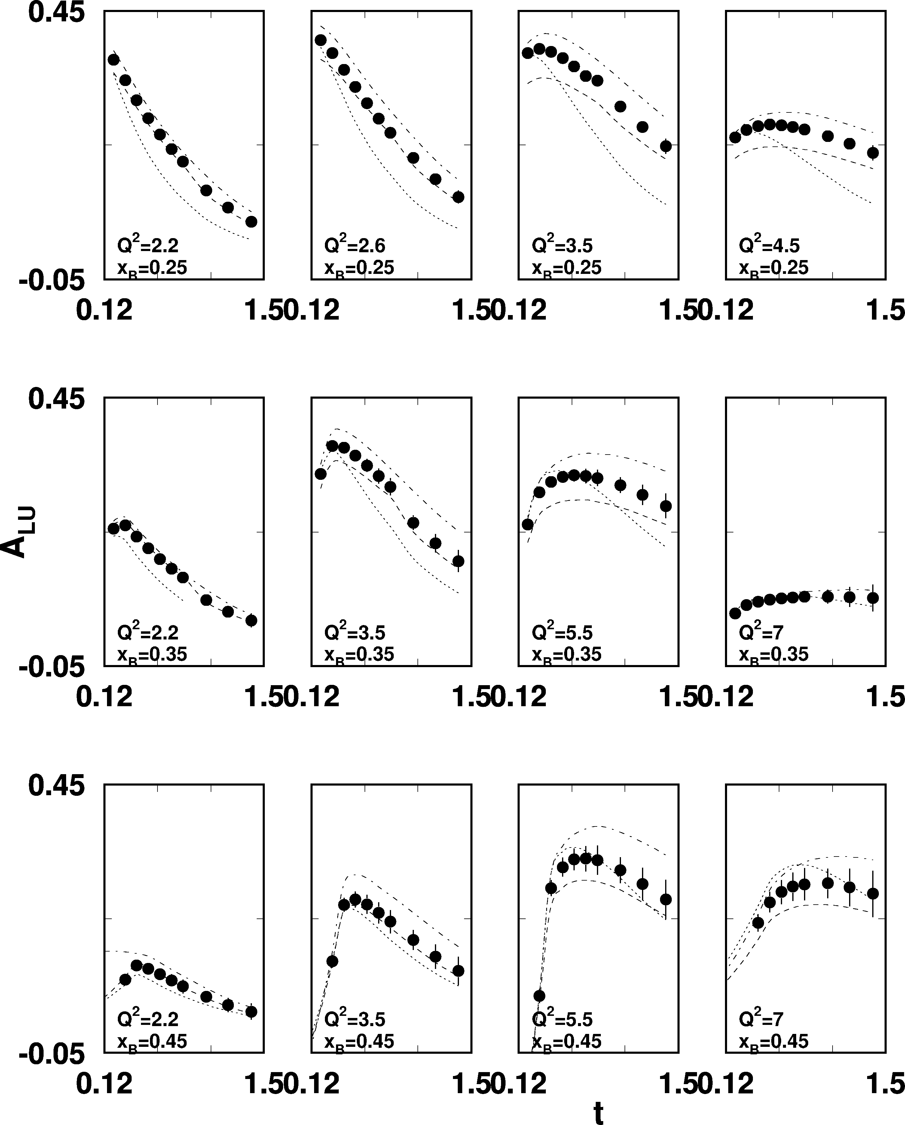
exclusive DVCS : BSA @ JLab 12 GeV
CLAS12
e p epγ
Projected results
E = 11 GeV
Δσ_{LU}~sinφIm{F₁H+..}dφ
Selected Kinematics
L = 1x10³⁵
T = 2000 hrs
ΔQ² = 1 GeV²
Δx = 0.05
Avakian

Slide 26
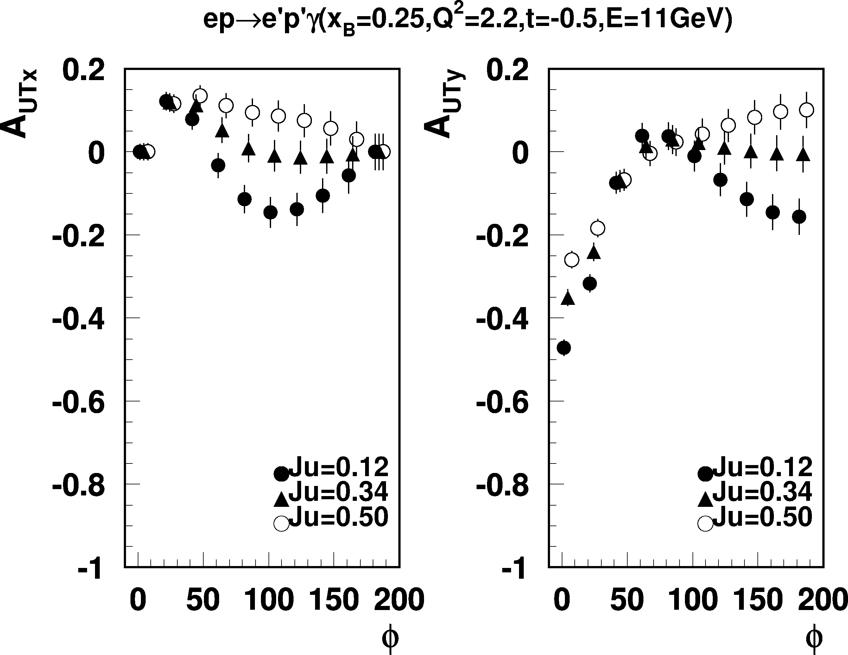
Exclusive DVCS on transverse target
@ JLab 12 GeV
Projected results
e p epγ
E = 11 GeV
Q²=2.2 GeV², x_{B} = 0.25, -t = 0.5GeV²
Transverse polarized target
Δσ ~ sinϕIm{k₁(F₂H – F₁E) +…}dϕ
A_{UTx} Target polarization in scattering plane
A_{UTy} Target polarization perpedicular to
scattering plane
Asymmetry highly sensitive to the u-quark contributions to proton spin.

Slide 27
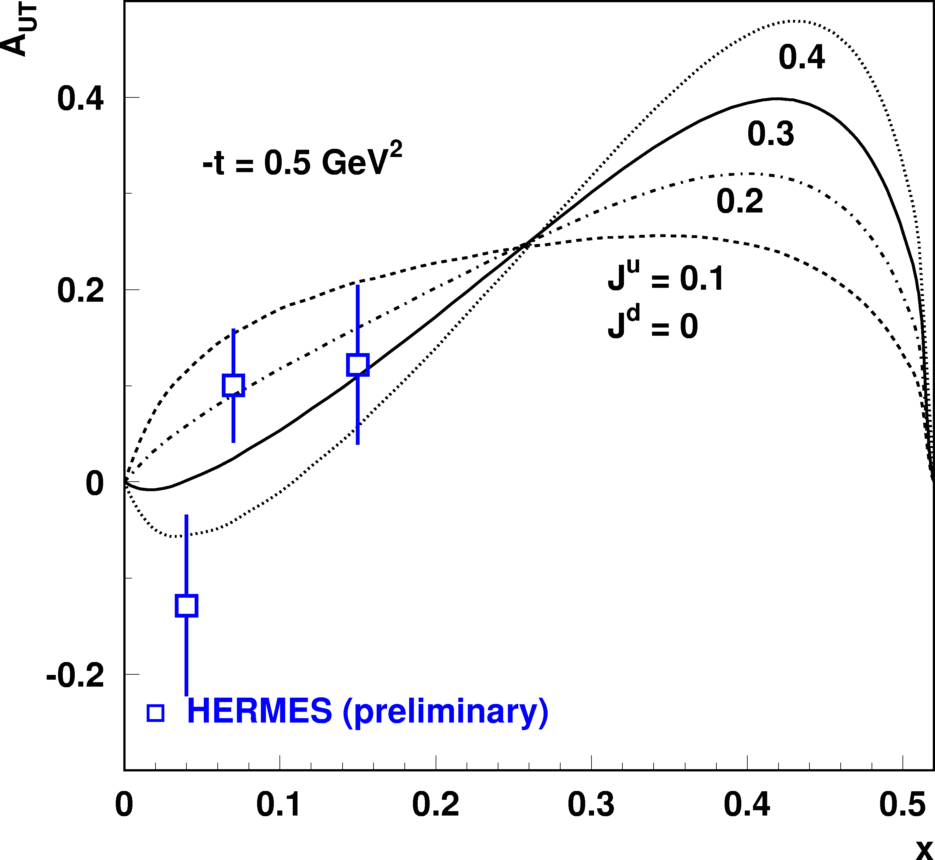
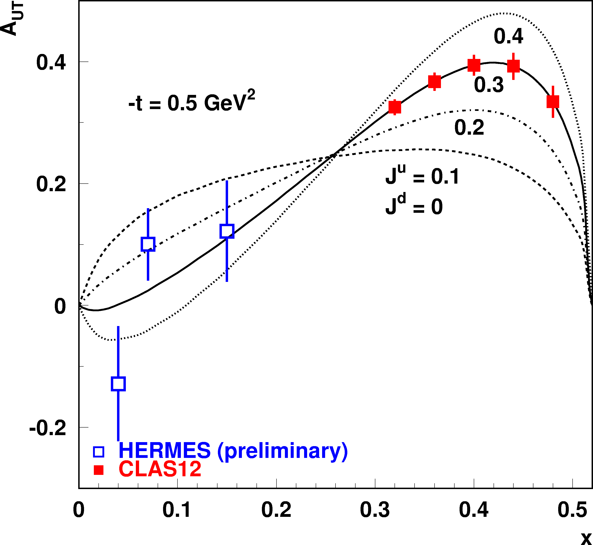
exclusive ρ⁰ production on transverse target
2Δ (Im(AB*))/π
Α_{UT} = −
T
|Α|²(1−ξ²) − |Β|²(ξ²+t/4m²) - Re(ΑΒ∗)2ξ²
A ~ 2H^{u} + H^{d}
ρ⁰
Projected results
B ~ 2E^{u} + E^{d}
Q²=5 GeV²
A ~ H^{u} - H^{d}
B ~ E^{u} - E^{d}
ρ⁺
ρ⁰
E^{u}, E^{d} needed for
angular momentum
sum rule.
data
Goeke, Polyakov, Vdh (2001)

Slide 28
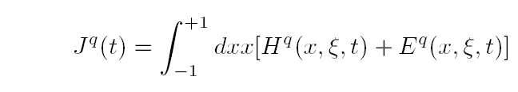
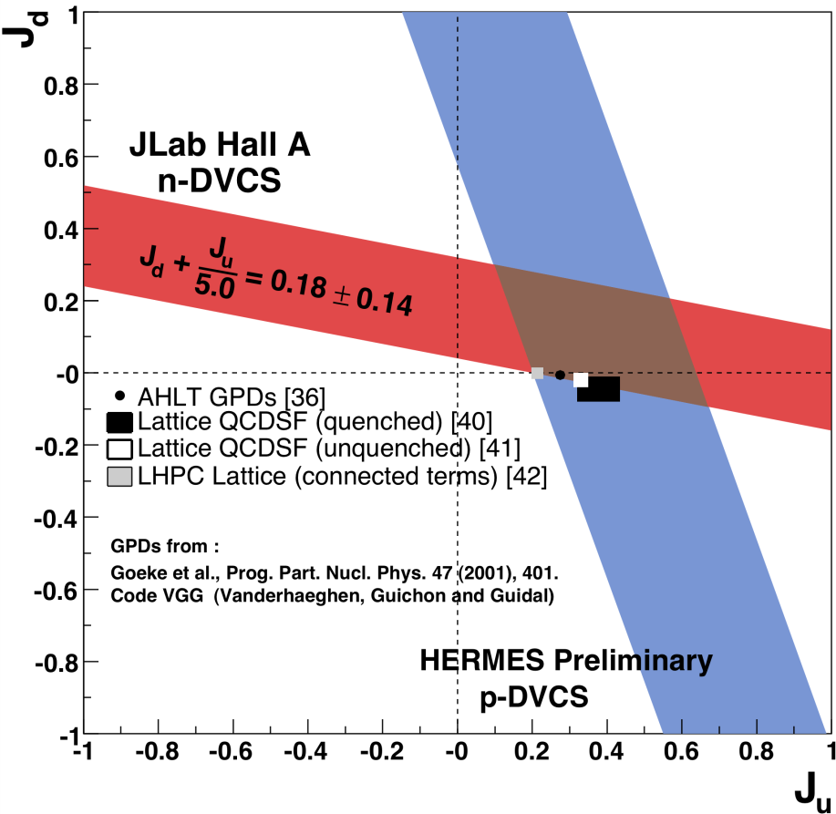
Quark Angular Momentum
→ Access to quark
orbital angular
momentum
Total angular momentum of gluons

Slide 29
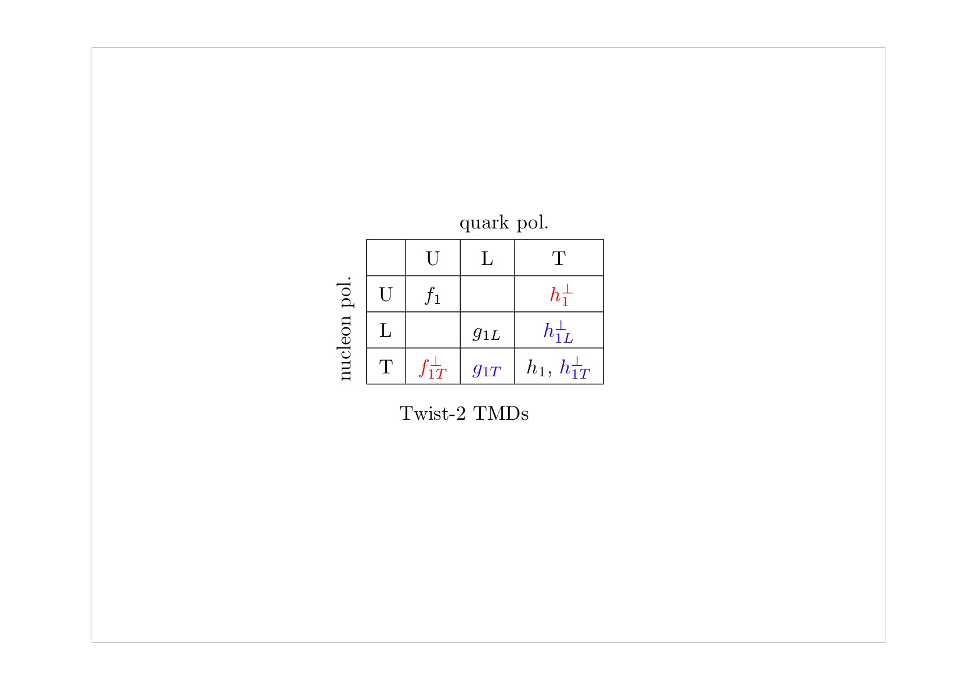
TMDs program @ 12 GeV in Hall B and Dynamical Imaging
PAC approved experiments & LoI
q
N
E12-06-112: Pion SIDIS
E12-09-008: Kaon SIDIS
U
E12-07-107: Pion SIDIS
E12-09-009: Kaon SIDIS
L
LOI12-06-108: Pion SIDIS
LOI12-09-004: Kaon SIDIS
T
Complete program of TMDs studies for pions and kaons
Kaon measurements crucial for a better understanding of the TMDs “kaon puzzle”
Kaon SIDIS program requires an upgrade of the CLAS12 detector PID RICH detector to replace LTCC
Project under development

Slide 30
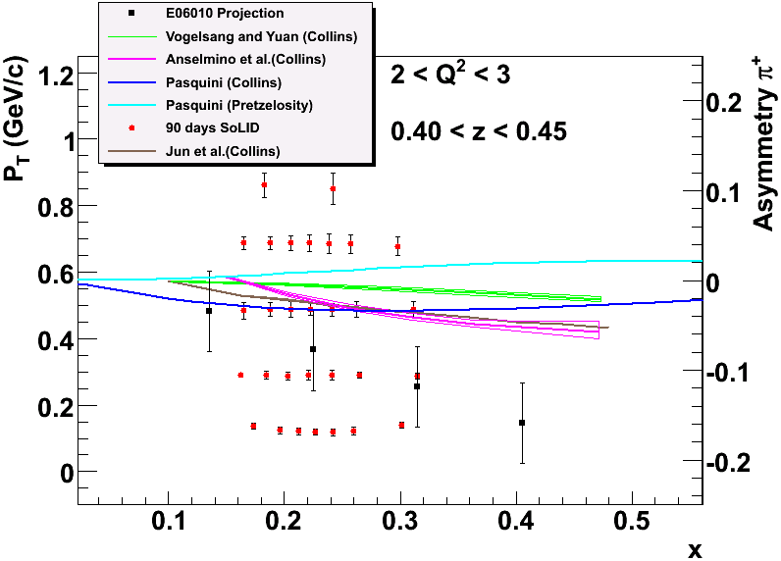
Hall A Transversity Projected Data Using SOLID
Total 1400 bins in x, Q², P_{T} and z for 11/8.8 GeV beam.
z ranges from 0.3 ~ 0.7, only one z and Q² bin of 11/8.8 GeV is shown here. π⁺ projections are shown, similar to the π⁻ .

Slide 31
3-D quark imaging of the nucleon; What‘s missing
Tool: Generalised Parton Distributions
Valence quark imaging of the nucleon is one goal of JLab at 12 GeV.
Gluon imaging is still missing
Sea Quarks imaging is also missing
Total Spin of the nucleon in terms of all of its constituents.
Generalized description in 2+ 1 dimensions

Slide 32
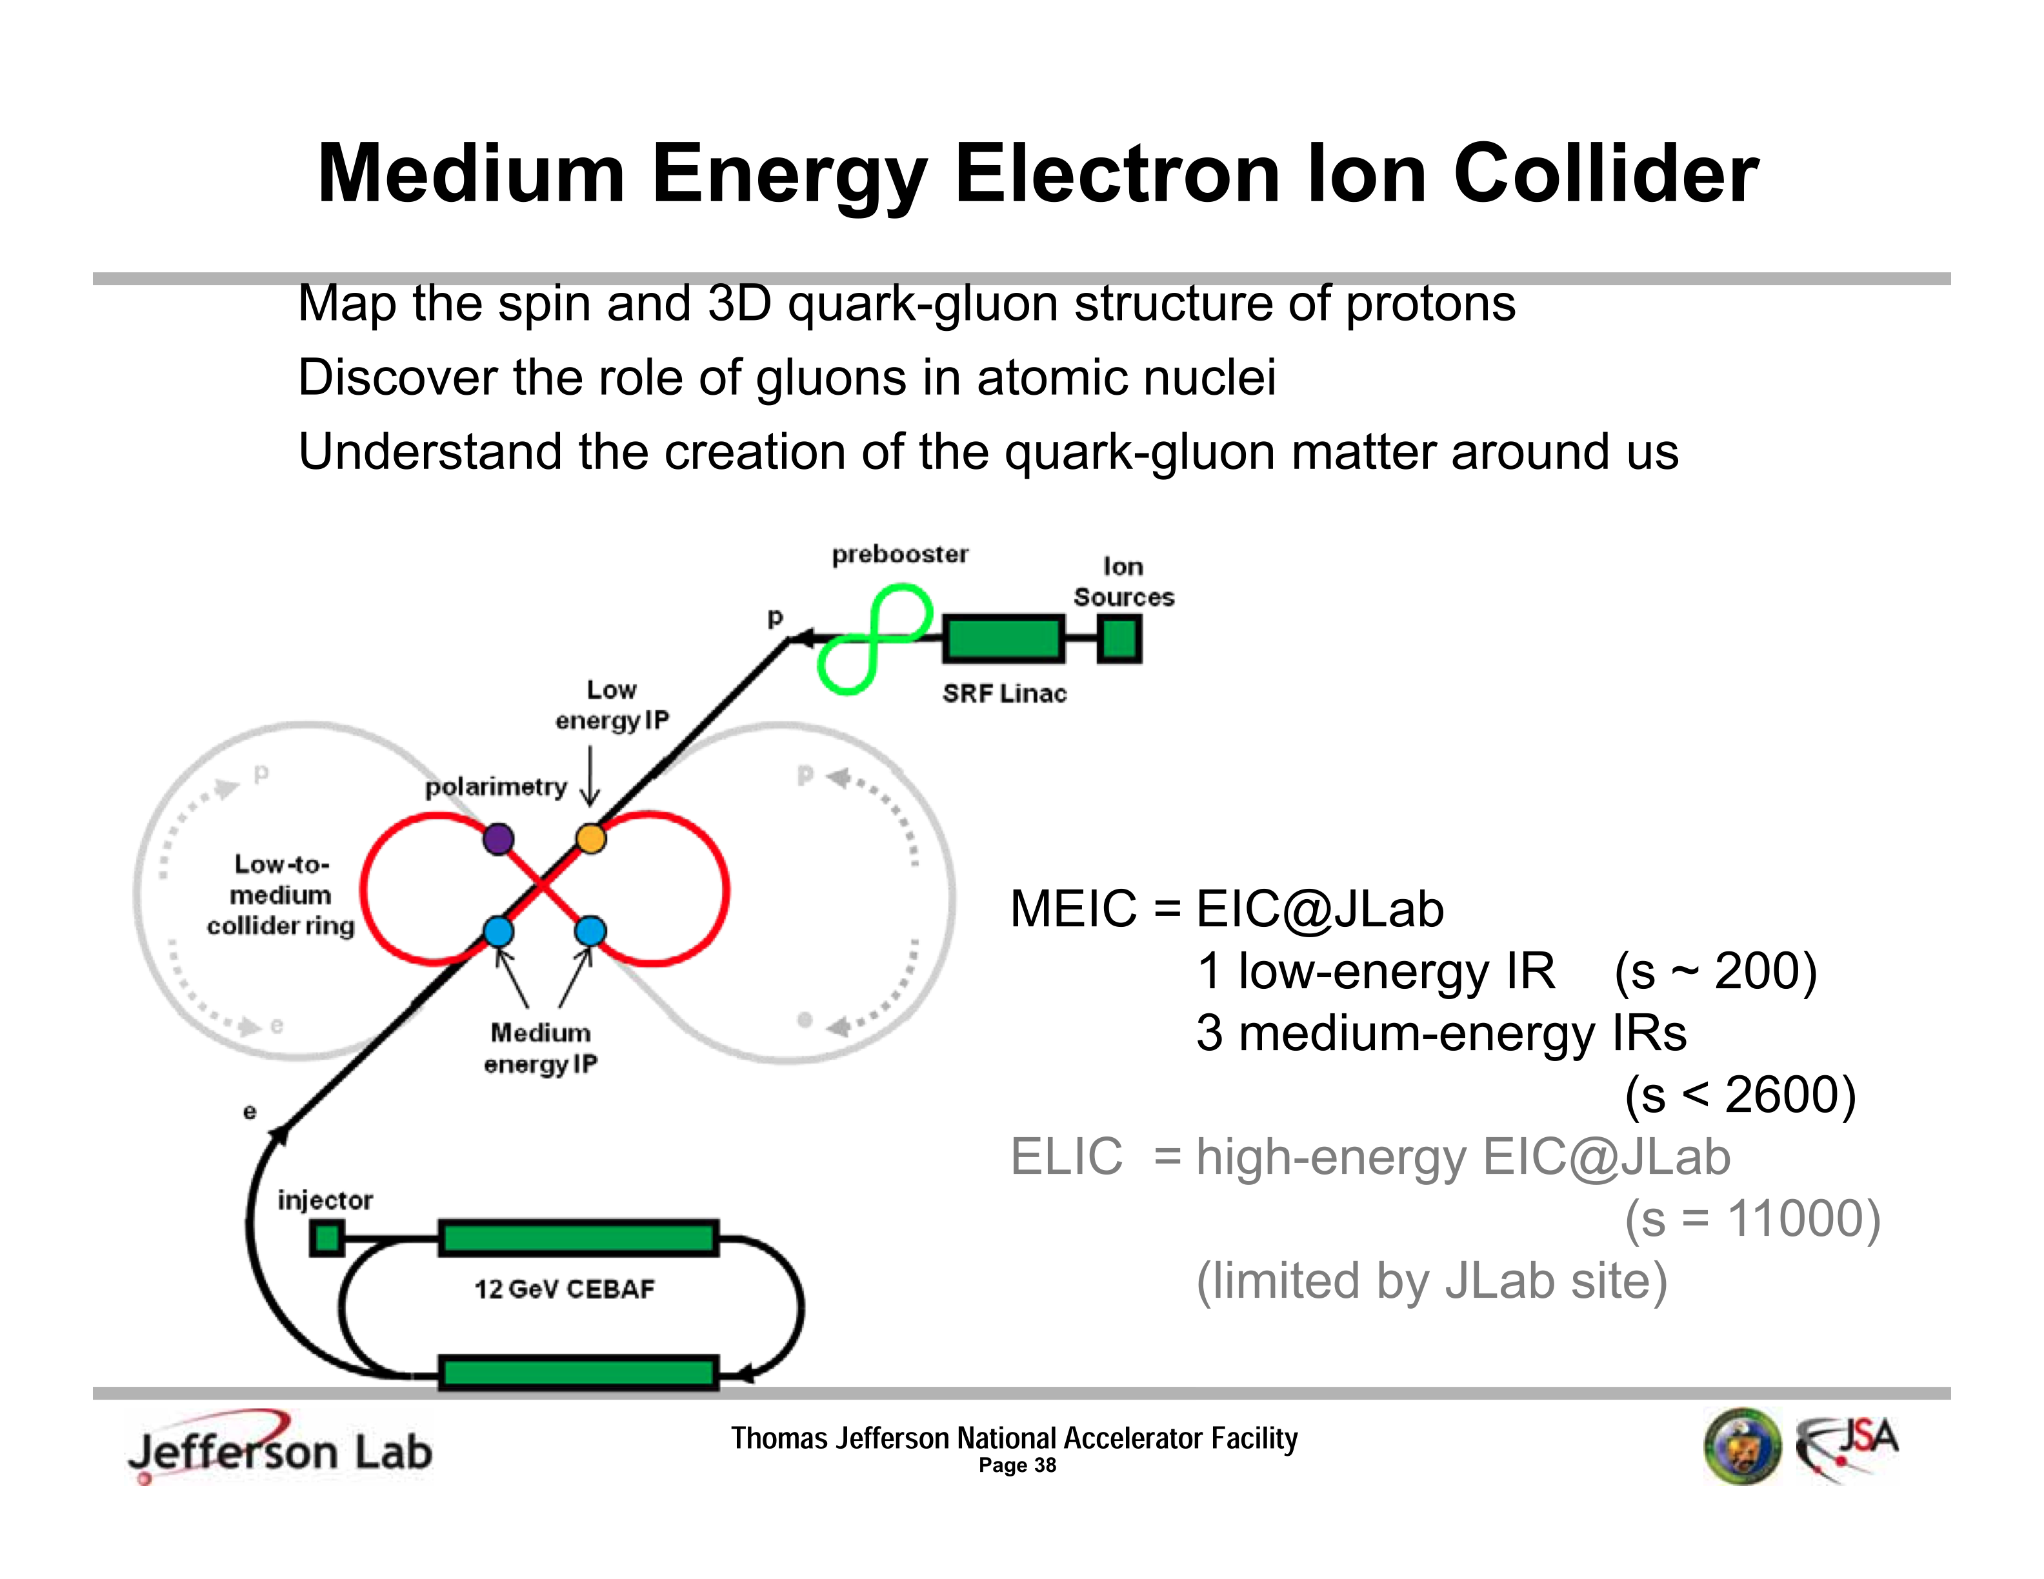
Luminosity~ few 10³⁴ cm⁻¹s⁻¹

Slide 33
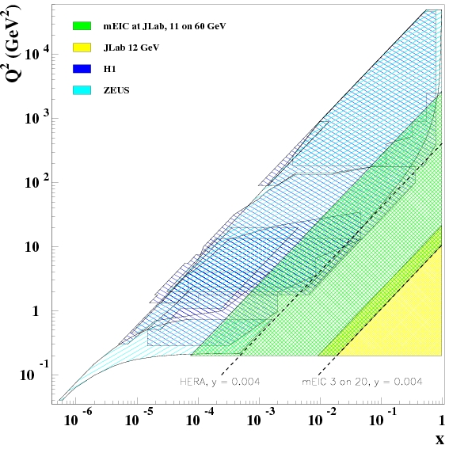
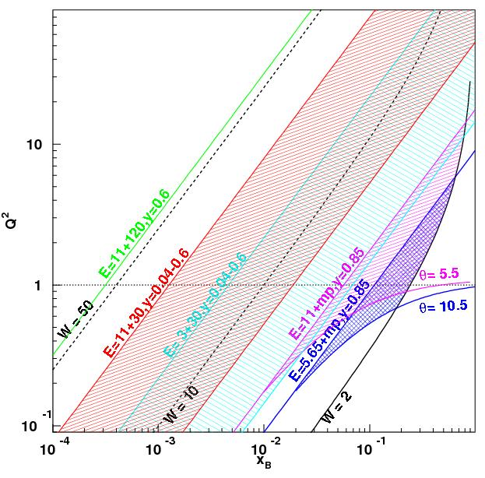
EIC Kinematic Coverage
ep mEIC: 11+60
eA mEIC: 3+30/11+30 (0.04<y<0.6)
eA eLIC: 11+120 (y=0.6)
EIC connects JLab and HERA kinematic region

Slide 34
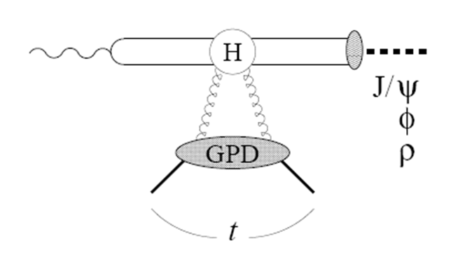
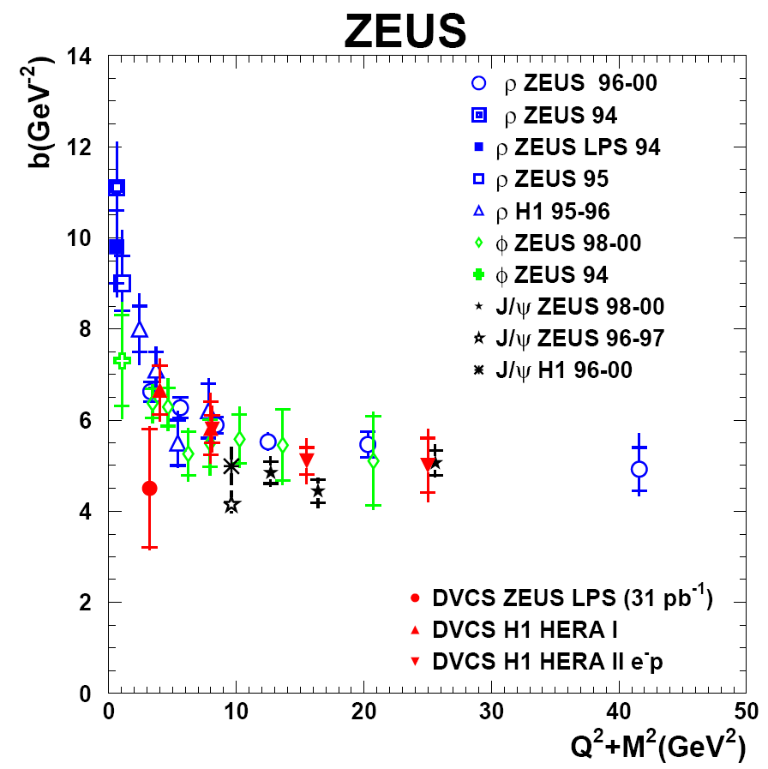
Gluon Imaging with exclusive processes
Goal: Transverse gluon imaging of nucleon over wide range of x: 0.001 < x < 0.1
Two-gluon exchange dominant for J/ψ,φ, ρ production at large energies → sensitive to gluon distribution squared!
LO factorization ~ color dipole picture → access to gluon spatial distribution in nuclei
Fit with dσ/dt = e^{-Bt}
A.Levy(hep:0907.2178)
Measurements at DESY of diffractive channels (J/ψ, φ, ρ, γ) confirmed the applicability of QCD factorization:
t-slopes universal at high Q²
flavor relations φ:ρ
Hard exclusive processes provide access to transverse gluon imaging at EIC!

Slide 35
Nucleon Spin Sum Rule
Ji Sum rule (1997)
Total angular momentum of gluons
Through the momentum sum rule and HERA DVMP with J/Psi data we have a glimpse on GPD H^{g}
Nothing is known about GPD E^{g}
Spin of quarks
Contribution:
Measured in DIS
Orbital angular momentum of quarks:
Input from Lattice
and measurements at JLab 12 GeV

Slide 36
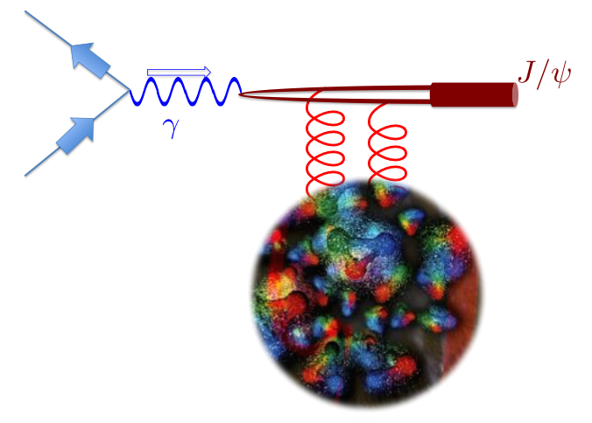

“My“ Golden Experimental Program
Glue imaging using unpolarized targets and accessing gluon GPD H through exclusive meson production in the valence region
Transversely polarized nucleon to access gluon GPD E and the Spin Sum Rule.

Slide 37


Transversity and the Tensor Charge
Quark transverse polarization in a transversely polarized nucleon:
  Can be probed in Semi-Inclusive DIS, Drell-Yan processes.
  Does not mix with gluons, has valence like behavior.
  Nucleon tensor charge can be extracted from the lowest moment of h₁ and compared to LQCDcalculations
h_{1T} =
Nucleon Spin
Quark Spin
Tensor Charge

Slide 38

Projections with ³He (neutron)
11 + 60 GeV
72 days
3 + 20 GeV
36 days
11 + 100 GeV
72 days
12 GeV SoLid
³He: 87% effective polarization
Equal stat. for proton and neutron (combine ³He and D)
 | 11 + 60 GeV | 11 + 100 GeV | 3+20 GeV
P | 36 d (3x10³⁴/cm²/s) | 36 d (1x10³⁴/cm²/s) | 36 d (1x10³⁴/cm²/s)
D | 72 d | 72 d | 72 d
³He | 72 d | 72 d | 72 d

Slide 39

3-D momentum structure the nucleon: Dipole pattern due to Sivers effect
( Plot from Prokudin; red: positive effect, blue: negative effect)
Notes:
Model dependent, plot generated from data.

Slide 40
Proton π⁺ (z = 0.3-0.7)

Slide 41
Summary
JLab 12 GeV will enhance significantly our knowledge of nucleon spin structure in valence region.
A high polarized luminosity EIC with variable energy will be a natural extension for achieving full imaging of the nucleon including the glue and the sea.
More than one interaction region in the EIC is important for complementarity of explored physics (exclusive vs semi-inclusive) and confirmation of discoveries.
A range of s from 200 to 4000 GeV² would be desirable
But a luminosity above 10³⁴cm⁻²s⁻¹ is a must

