Slide 1
8th Circum-Pan-Pacific Symposium on High Energy Spin Physics
Higher Twist Contributions
to the Azimuthal Asymmetries in Semi-Inclusive DIS
梁作堂 (Liang Zuo-tang)
山东大学物理学院
(School of Physics, Shandong University)
Cairns, Austrlia, 2011年6月22日

Slide 2
Contents
Introduction: Why higher twist?
How should we take higher twist contributions into account systematically?
Azimuthal asymmetries in the un-polarized semi-inclusive DIS process up to twist-4
Summary & Conclusions

Slide 3
Contents
Introduction: Why higher twist?
How should we take higher twist contributions into account systematically?
Azimuthal asymmetries in the un-polarized semi-inclusive DIS process up to twist-4
Summary & Conclusions

Slide 4
Azimuthal asymmetry in unpolarized SIDIS
Definition
lepton plane
in c.m. frame, z: proton’s momentum direction
xz-plane = lepton plane, x-component of lepton momentum is positive.

Slide 5
Azimuthal asymmetry in unpolarized SIDIS
Georgi & Politzer, PRL(1977): “Clean test to pQCD”.
Cahn, PLB(1978): Intrinsic momentum effects. (Cahn’s effect)
Generalized parton model to include an intrinsic
(twist 3)
(twist 4)
In current experiments,
Q ~ several GeV;
the same order of the exp. results.

Slide 6
Azimuthal asymmetry in polarized SIDIS
Triggered by the striking single-spin asymmetry observed in p(↑)+p→π+X
1978, Kane, Pumplin, Repko: pQCD a_{N}[q(↑)+q→q+q]=0.
1991, Sivers: asymmetric quark distribution (Sivers effect)
1993, Boros, Liang, Meng: quark orbital angular momentum &
“surface effect”
Collins: Proof of non-existence of Sivers effect,
asymmetric fragmentation function (Collins effect).
2002, Brodsky, Hwang, Schmidt: quark orbital angular momentum &
“final state interaction”.
Ji, Yuan: “final state interaction” = “gauge link”
Collins: 1993’s proof is wrong because forgot gauge link.
Since 2001, experimental results from HERMES and COMPASS.

Slide 7
Azimuthal asymmetry in polarized SIDIS
Conclusions:
both Sivers and Collins effects can exist when
gauge link is taken into account.
intrinsic transverse momentum induced higher twist effects and gauge link are important in studying azimuthal asymmetries in SIDIS.
Questions:
Where does the gauge come from?
How should we take intrinsic transverse momentum induced higher twist effects into account consistently?

Slide 8
Contents
Introduction: Why higher twist?
How should we take higher twist contributions into account systematically?
Azimuthal asymmetries in the un-polarized semi-inclusive DIS process up to twist-4
Summary & Conclusions
Look at the inclusive DIS first.

Slide 9
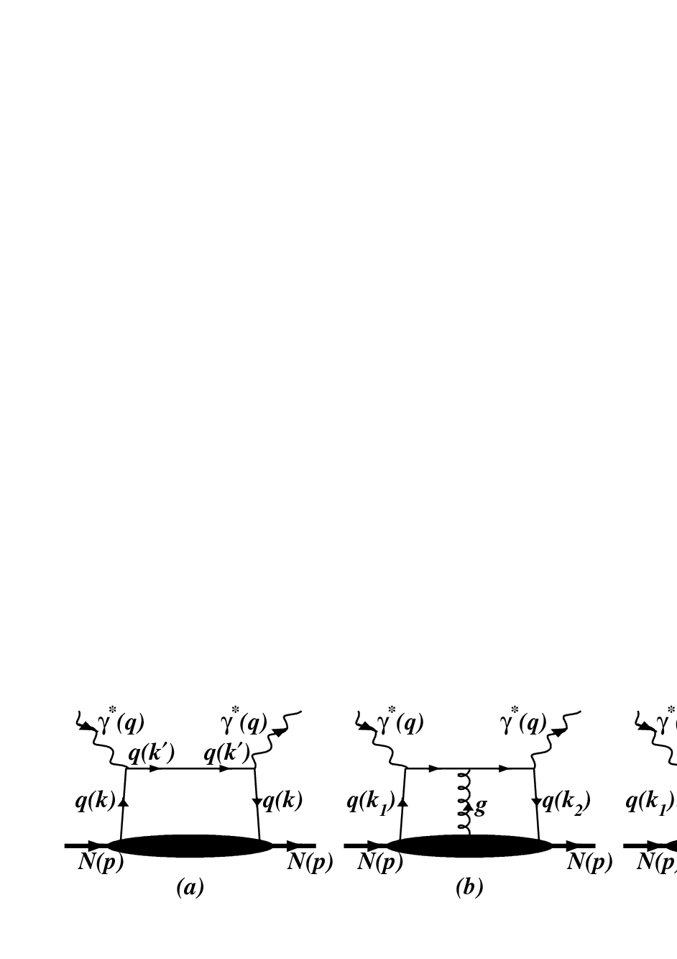
Inclusive DIS: where does the gauge link come from?
DIS without QCD interaction
The hard part:
contracted with the leptonic tensor
The matrix element:
parton distributions
No QCD interactions.
Not (color) gauge invariant.

Slide 10
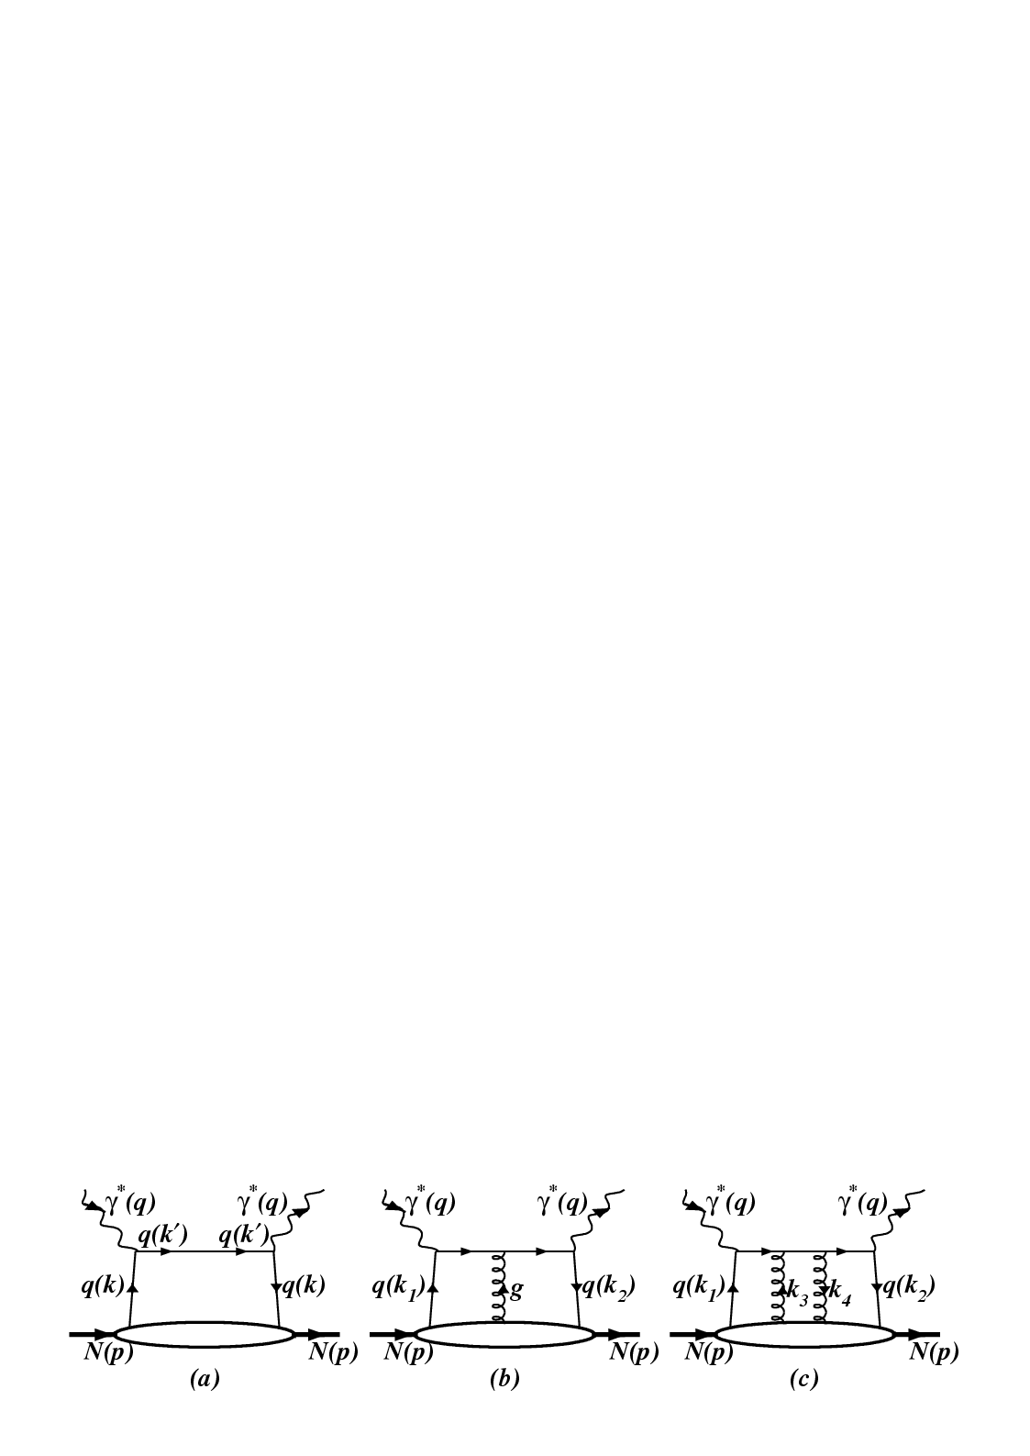
Inclusive DIS with QCD interaction
…
multiple gluon scattering
Parton distribution/correlation:
Not gauge invariant!

Slide 11
Inclusive DIS with QCD interaction
Collinear approximation:
• Approximate the hard parts by those at k =xp:
• Keep only the longitudinal component of the gluon field:
• Using the Ward identities such as,
only leading twist contribution can be obtained

Slide 12
Inclusive DIS with QCD interaction
Ellis, Furmanski, Petronzio, (82) Qiu, Sterman (90,91)
Collinear expansion:
• Expanding the hard parts around k =xp:
• Decomposition of the gluon field:
• Using the Ward identities such as,
to replace the derivatives etc.

Slide 13
Inclusive DIS with QCD interaction
twist-2 and higher
twist-3 and higher
Contain QCD interactions.
(Color) gauge invariant !

Slide 14
Inclusive DIS with QCD interaction
Conclusion:
Gauge link comes from the multiple gluon scattering and collinear expansion is the necessary procedure to obtain the correct form of gauge invariant parton distributions.
Question: How about semi-inclusive DIS?
For simplicity and clarity, consider first
e +p →e + q + X, i.e., NO fragmentation.
ZTL & X.N. Wang, PRD (2007).

Slide 15
Semi-Inclusive DIS with QCD interaction
SIDIS e +p →e + q (jet) + X:
…
C.f.:

Slide 16
Semi-Inclusive DIS with QCD interaction
Using the mathematical identity:
We obtain:

Slide 17
Semi-Inclusive DIS with QCD interaction
Under collinear approximation, i.e.,
we obtain

Slide 18
Semi-Inclusive DIS with QCD interaction
The same collinear expansion leads to
Gauge invariant parton distributions/correlations (with gauge link)

Slide 19
Contents
Introduction: Why higher twist?
How should we take higher twist contributions into account systematically?
Azimuthal asymmetries in the un-polarized semi-inclusive DIS process up to twist-4
Summary & Conclusions
ZTL & X.N. Wang, PRD (2007); J. Gao, ZTL, & X.N. Wang, PRC (2009); Y.K. Song, J.H. Gao, ZTL & X.N. Wang, PRD (2010).

Slide 20
Semi-Inclusive DIS with QCD interaction
For
twist-2 and higher
twist-4 and higher
twist-3 and higher

Slide 21
SIDIS with : Direct consequence I
Consider the contribution from
Cross section for ep→eqX
=
Parton distributions
Cross section for eq→eq without
⊗
(neglect the intrinsic transverse momentum )
TMD Parton distributions
⊗
(take intrinsic transverse momentum into account)

Slide 22
SIDIS with : Direct consequence II
A simplification of
left cut
independent of x₂!
right cut
independent of x₁!

Slide 23
SIDIS with : Direct consequence II
This leads to
Only
contributes in semi-inclusive deep-inelastic lepton-nucleon scattering.
Similar for

Slide 24
SIDIS with : differential cross-section to 1/Q²
A complete twist-4 result for
TMD quark distribution:
Quark correlation functions such as :

Slide 25
SIDIS with : Azimuthal asymmetries
Up to twist-4
If g=0, i.e., no multiple gluon scattering (results by Cahn):
proportional to
proportional to
A good place to study such correlation functions and effects of multiple gluon scattering.

Slide 26
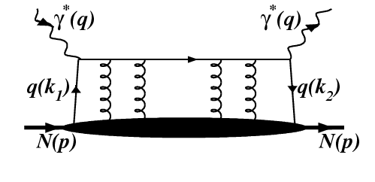
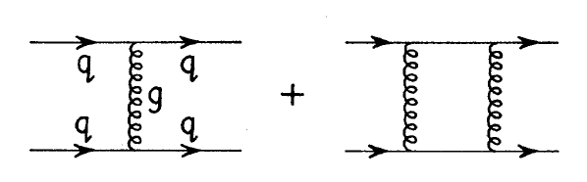
Transverse momentum broadening in nucleus
Gauge link comes from:
+
+…+
…
+…
Replace N by A, the gluons can connect to different nucleons in A.
Nuclear enhancement
Transverse momentum broadening
Transverse momentum broadening should be contained in the gauge link
With “maximal two gluon approximation”, i.e. taking only the case that two gluons are connected to one nucleon into account,
ZTL, X.N. Wang &
J. Zhou, PRD (2008).

Slide 27
Nuclear dependence of the azimuthal asymmetries
An example: take a Gaussian for the transverse momentum dependence
for the case that
suppressed!
Integrated over :

Slide 28
Contents
Introduction: Why higher twist?
How should we take higher twist contributions into account systematically?
Azimuthal asymmetries in the un-polarized semi-inclusive DIS process up to twist-4
Summary & Conclusions

Slide 29
Summary
Comparison of the results already obtained
g=0, i.e., no multiple gluon scattering
g=0, i.e., with multiple gluon scattering
gauge link
gauge link
 Sivers function
 Sivers function


Cahn’s results


 no A-dependence
 transverse momentum broadening in nuclei
■ other effects ...........
■ other effects ...........
and their A-dependence in
Measurements of
and compare the obtained results with those obtained in 1978 by Cahn
effect of multiple gluon scattering and structure of nucleon.

Slide 30
Summary
Gauge link is result of multiple gluon scattering and collinear expansion is a necessary procedure to obtain the correct form.
Collinear expansion can be extended to SIDIS e+p→e+q+X.
Naïve extension of TMD parton distributions convoluting with eq → eq cross section to include intrinsic transverse momentum is incorrect.
Many other consequences.
Thank you for your attention!

