Slide 1
Twist-3 predictions for single spin asymmetry for light-hadron productions at RHIC
Koichi Kanazawa (Niigata Univ)
Based on
・ KK and Y. Koike , PRD 83, 114024 (2011)
・ KK and Y. Koike , PRD 82, 034009 (2010)

Slide 2
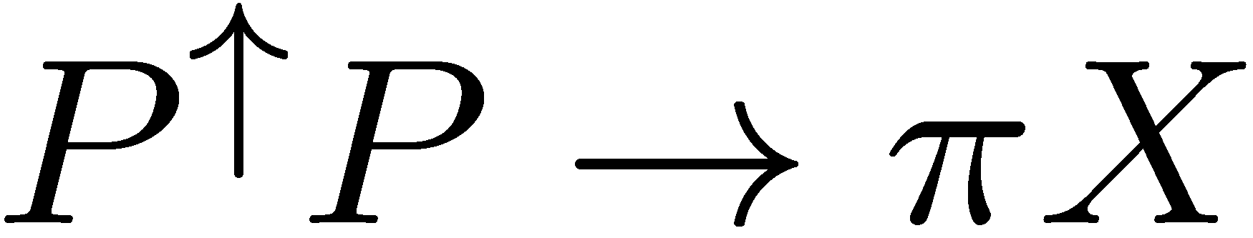
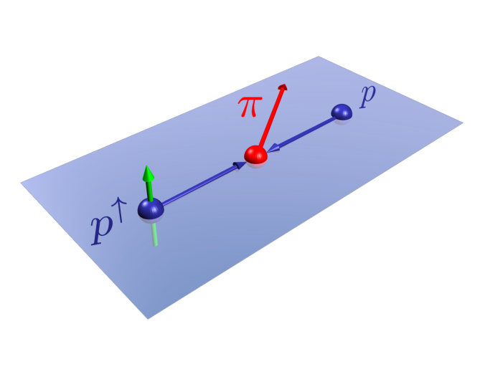


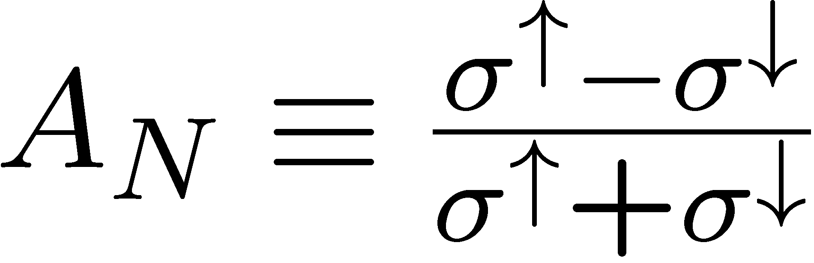


Single transverse-Spin Asymmetry (SSA)
★
★ FNAL E704
P.L. B264 (’91) 462
P.L. B261 (’91) 201
★ SIDIS :
- HERMES, COMPASS, etc
★ etc.
・ Cannot be understood by the collinear parton model.
⇒ Need extension of the framework for QCD hard process.

Slide 3
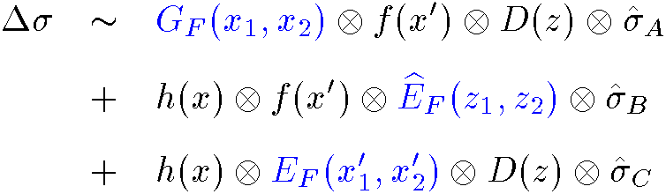


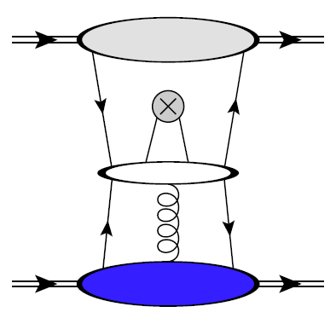
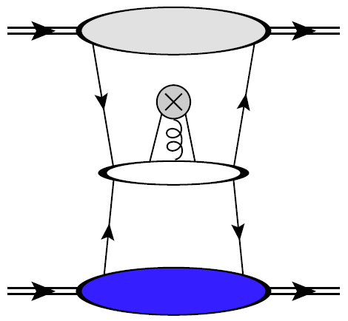




★ Twist-3 contribution to the spin-dependent cross-section :
Qiu, Sterman (‘99)
Kang, Yuan, Zhou (‘10)
Kanazawa, Koike (‘00)
- ⇒ The 3rd term can be ignored.
- Graphical representation of the 1st and 2nd terms :
“ twist-3 distribution ”
“ twist-3 fragmentation ”
：This talk

Slide 4

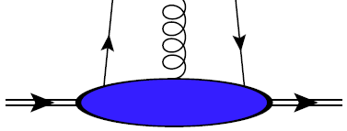






Twist-3 quark-gluon correlation functions
- Two independent quark-gluon correlation functions :
- Symmetry property by PT-invariance of QCD:
2-types of contribution :
- Pole contribution to the spin-asymmetry :
⇒ “SGP and SFP”
Soft-Gluon-Pole :
Soft-Fermion-Pole :

Slide 5
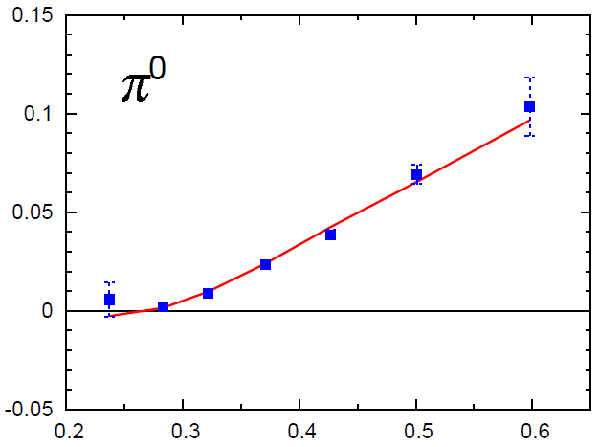
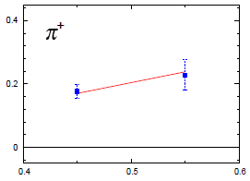
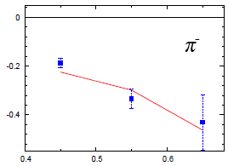

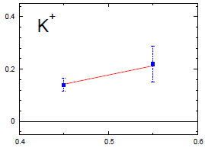
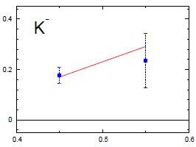


Description of RHIC data
- Complete cross-section from the quark-gluon correlation functions :
Kouvaris-Qiu-Vogelsang-Yuan (2006)
Koike-Tomita (2009)
- Reasonable description of SSA for pions and kaons with this formula:
KK-Koike (2010)

Slide 6
Contents of this talk
・ Details of the analysis :
Flavor structure of the asymmetry
- PT-dependence
・ Predictions for ongoing or future RHIC experiments :
- SSA for pions and kaons at √S=500 GeV
- SSA for eta-meson production (Ongoing at STAR and PHENIX)
: by using the SGP and SFP functions obtained from RHIC data.

Slide 7
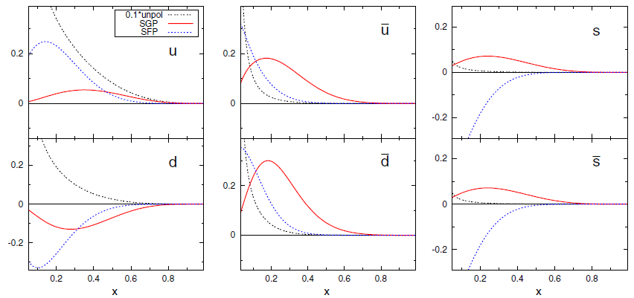
SGP and SFP functions obtained from RHIC data
unp.PDF (1/10)
SGP
SFP
The SGP functions spread more in the larger-x region
compared with the SFP functions.
⇒ the SGP effect gives larger contribution to AN at large xF (next slide)

Slide 8
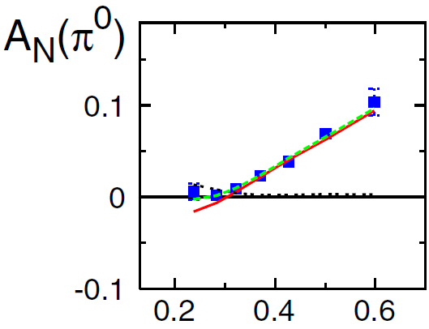
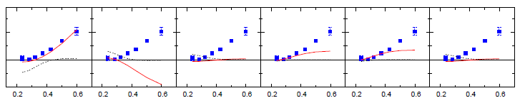








Flavor structure of the asymmetry
SGP+ SFP (only in Total graph)
SGP
SFP
・ Total
・ Decomposition of SGP and SFP into each flavor components.
Valence SGP components
give the largest contributions.
and are also
relevant for .

Slide 9
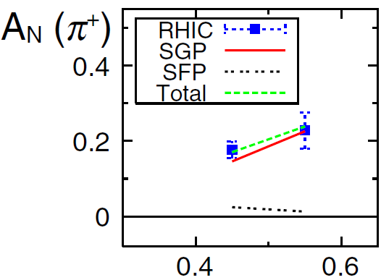
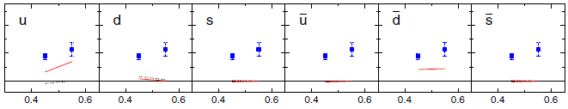

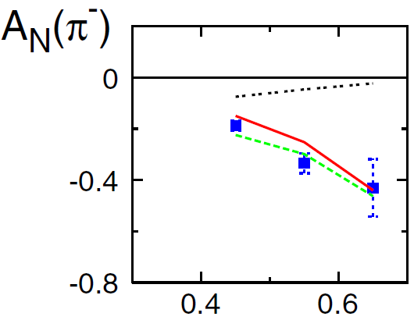
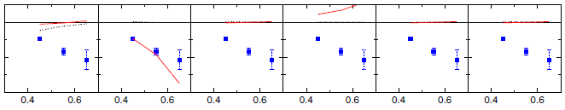
Flavor decomposition of SSA for charged pions
・ Total
・ Decomposition
SGP+SFP
SGP
SFP
Favored SGP components are dominant for pions.
⇒ reflect the flavor structure of the FF rather than that of the SGP function.

Slide 10
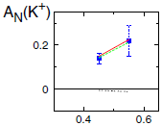
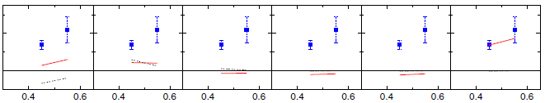
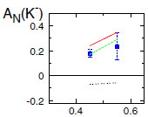
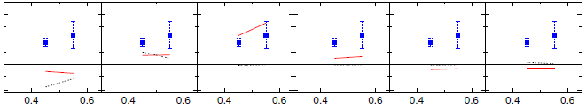
Flavor decomposition of SSA for charged kaons
・ Total
・ Decomposition
SGP+SFP
SGP
SFP
Strange SGP components give largest contribution to the asymmetry.
⇒ Sea quarks are relevant at RHIC energy.
- SFP contributions is more important for K-.

Slide 11
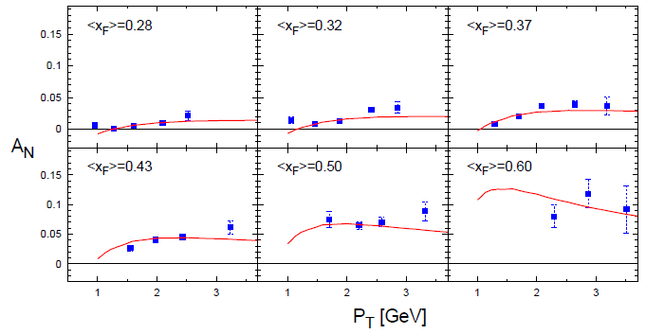

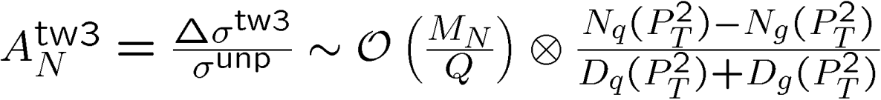



Comparison of PT-dependence with STAR result
★ STAR (2008)
PT dependence is well reproduced :
⇒

Slide 12
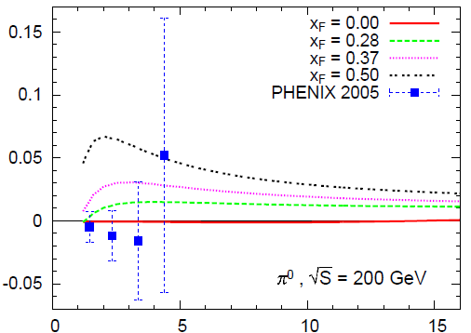
Prediction of PT-dependence at various Feynman X
・ At xF=0, prediction is consistent with the PHENIX data.
・ SSA in the large PT region does not decrease as fast as 1/PT.

Slide 13
Contents of this talk
・ Details of the analysis :
Flavor structure of the asymmetry
- PT-dependence
・ Predictions for ongoing or future RHIC experiments :
- SSA for pions and kaons at √S=500 GeV
- SSA for eta-meson production (Ongoing at STAR and PHENIX)

Slide 14

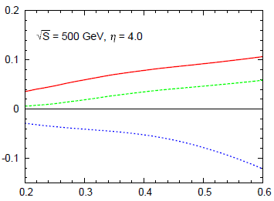
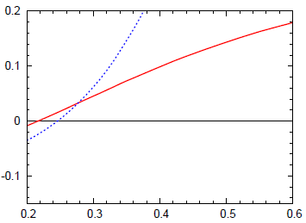



Predictions for SSA for pions and kaons at √S = 500 GeV
- General trend of AN for pions are the same as those at lower energies.
- Its magnitude becomes smaller at each xF.
: AN is order of 10%
- For kaons, large asymmetries are obtained.
- Strange twist-3 distributions are not well constrained at this point.
⇒ More variety data for kaons are required.

Slide 15
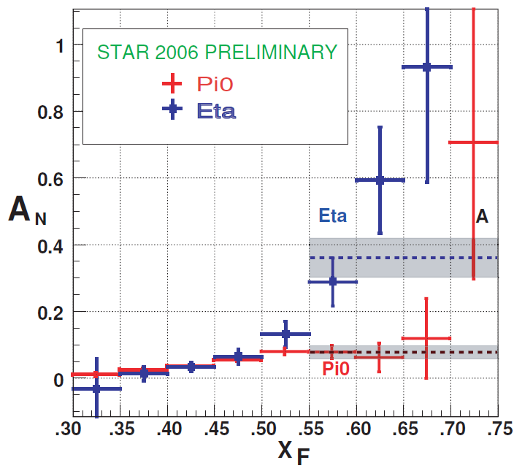
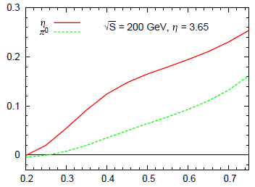

Prediction for SSA for eta-meson production
★ STAR (2009)
- Calculated asymmetry is consistent with the tendency of the STAR data.
- Its magnitude seems to be insufficient to explain the experimental result.

Slide 16
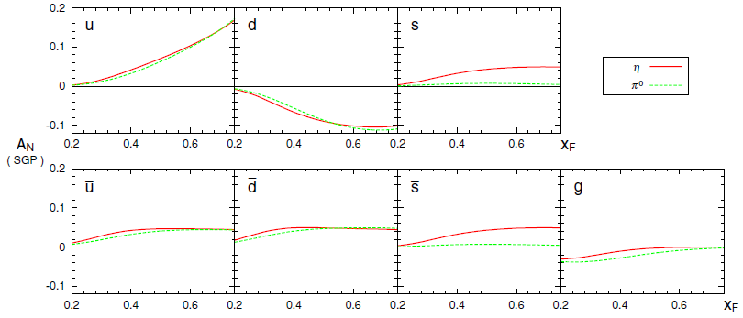
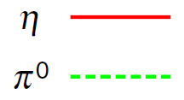
Difference between two mesons
★ Decomposition of the asymmetries into each fragmentation channel
- The difference comes from the strange components.
Contribution of the twist-3 fragmentation could be
another possible origin of the difference. Kang-Yuan-Zhou (2010)
⇒ should be clarified with future global analysis of SSA

Slide 17
Summary and Outlook
・ Pions and Kaons :
- All RHIC data are well described with the “SGP + SFP” contributions.
- Its validity should be tested at wider kinematics.
・ Eta-meson , D-meson , J/ψ :
- Sensitive to twist-3 fragmentation or 3-gluon correlation.
・ Other processes :
Drell-Yan, direct photon, etc at RHIC
Semi-inclusive DIS at EIC
will also give valuable information.
Need a global analysis of a greater variety of data for the complete clarification of SSA.

Slide 18
BACKUP

Slide 19
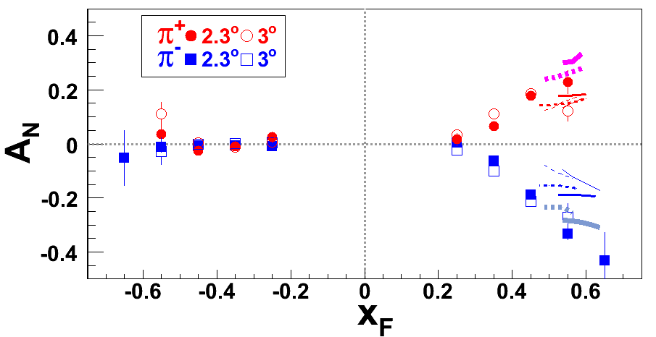
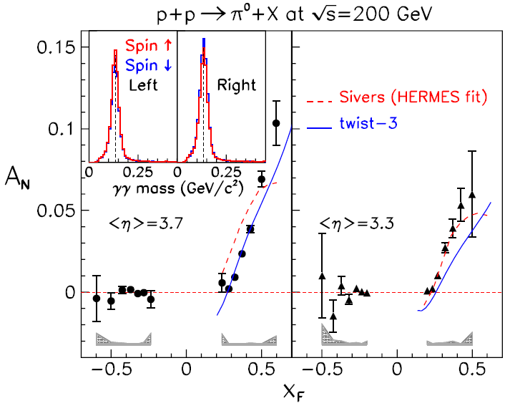
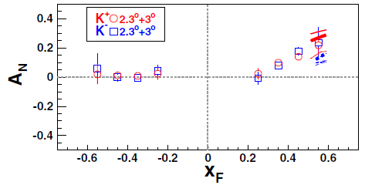
Recent results on SSA at RHIC
★ BRAHMS (‘08)
★ STAR (‘08)

Slide 20
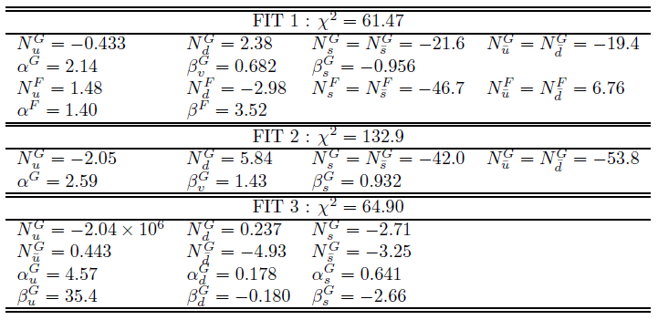
Parameters obtained by the fitting

Slide 21
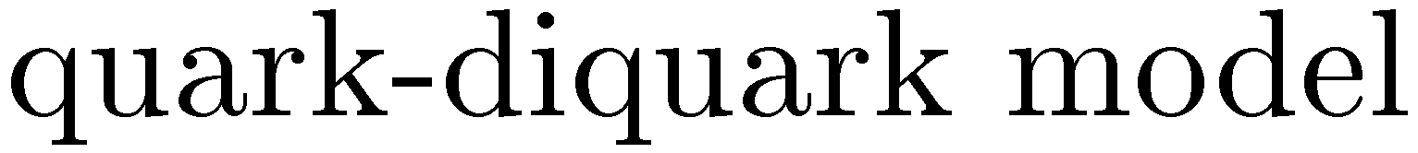

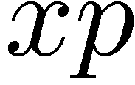
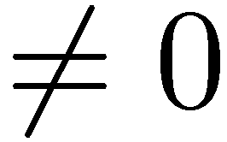
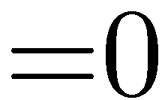






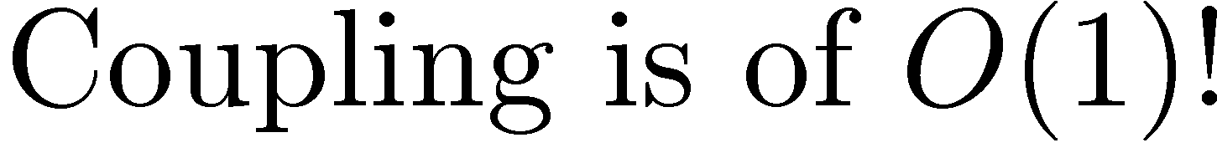
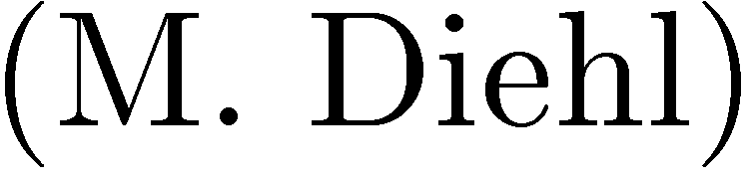

Slide 22








Data included in the fitting
61 data points in total.
・ RHIC-STAR
- We include all data.
・ RHIC-BRAHMS
useful to disentangle flavor structure of the asymmetry.
- AN data for and K with have been included.
・ E704
- NLO-QCD cannot reproduce the unpolarized cross-section.
PT values at each xF are unknown.
⇒ We did not include.

Slide 23




Strategy of analysis
・ Parametrization of the SGP and SFP functions
- SGP :
- SFP :
- Scale dependence assumed to be same as unp.PDF.
・ three types of fitting
- FIT.1 : SGP + SFP with 13 free parameters :
- FIT.2 : Only SGP contribution with 7 free parameters :
⇒ omission of the SFP in FIT.1
- FIT.3 : Only SGP contribution with 12 free parameters :
⇒ Maximal d.o.f to SGP

Slide 24
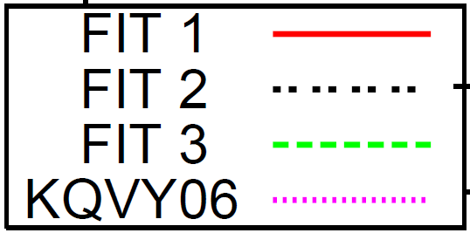
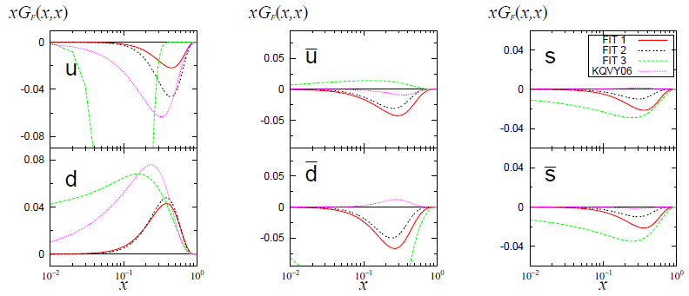


SGP functions in three fits and by KQVY06
- and in FIT.3 are extreme and physically unnatural.
⇒ Difficult to explain the asymmetry by only the SGP contribution.
⇒ We will focus on the result in FIT. 1 (SGP+SFP).

Slide 25
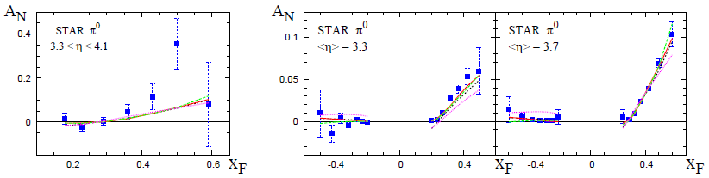
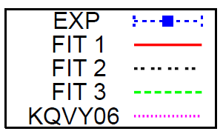

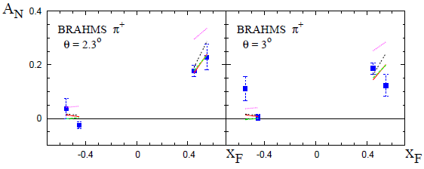
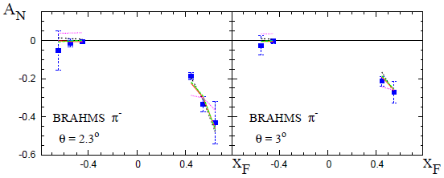
Results for pion
- Three fits well reproduce the SSA for pions.

Slide 26
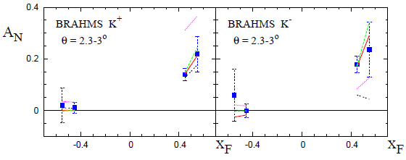
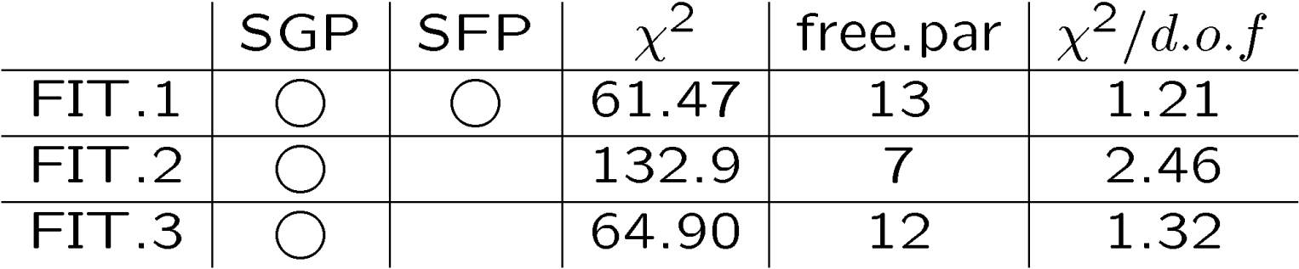
Results for kaon
- FIT.2 (Omission of SFP) fail to reproduce the AN(K⁻)
← not good.

Slide 27

Comment on fragmentation function
・ DSS fragmentation function (PRD75)
- Can describe greater variety of data compared with the older ones.
Large gluon fragmentation functions
⇒ Sensitive to the SFP contributions
・ Kretzer fragmentation function
- We could not get good fit by Kretzer’s fragmentation functions.

Slide 28


Decomposition into SGP and SFP in FIT 1
SGP
SFP
- For neutral pion
- SGP effect gives major contribution at forward region.
SFP effect appear in the small xF region.
⇒ cancel the positive SGP component.

Slide 29







Decomposition into SGP and SFP in FIT 1
- For charged pions
SGP
SFP
- For charged kaons
・ negatively charged mesons
- SFP effect is sensitive.
via large (negative)
gluon frag channels.
・ positively charged mesons
- SFP effect is small
Cancelation with positive contributions from quark-frag channels.

Slide 30


Validity of the NLO-QCD at RHIC
★ RHIC-STAR (‘04)
★ RHIC-BRAHMS (‘07)
⇒ Justify to use the RHIC data.
⇔ in contrast to the case at E704.

