Slide 1
Experimental Evidence for Partonic Orbital Angular Momentum at RHIC
Douglas Fields
University of New Mexico

Slide 2
“Experimental Evidence”
Direct vs. Indirect Measurement
  Width of room
    Tape measure
  Spin ½ of proton
    Stern-Gerlach experiment
  ΔΣ
    DIS
  ΔG
    DIS Q² dependence, RHIC
    But, definition is unclear
  L_{g}, L_{q}, L_{g+q}
    Can one simply say L = ½ - ΔΣ - ΔG? No!
    Other methods…
  Temperature of room
    Tape measure?

Slide 3
Template for Indirect Measurements
“Directly” measured quantity
Theory basis for implying indirect measurement
Limits on indirect measurement from experimental and theoretical uncertainties

Slide 4
RHIC Spin
Absolute Polarimeter
(H jet)
RHIC pC Polarimeters
BRAHMS & PP2PP (p)
PHENIX (p)
STAR (p)
Siberian Snakes
Spin Rotators
2 × 10¹¹ Pol. Protons / Bunch
ε = 20 π mm mrad
Partial Siberian Snake
LINAC
BOOSTER
Pol. Proton Source
500 μA, 300 μs
AGS
200 MeV Polarimeter
AGS Internal Polarimeter
Rf Dipoles

Slide 5
Anomalous Magnetic Moment
Spin transport in Snake Magnets
Burkardt & Schnell Phys. Rev. D 74, 013002 (2006)
  Toy model for u-quarks in the valence region yields:
I.e., very weak (but nonzero) constraint on contributions of nonzero orbital angular momentum states to each quark flavor.
But the sum over flavors is not necessarily nonzero!

Slide 6
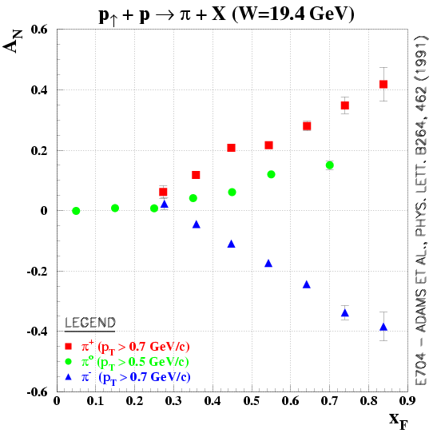
Single Spin Asymmetries (SSAs)
Fixed target pion SSAs (E704)
left
right
QCD prediction -> zero

Slide 7
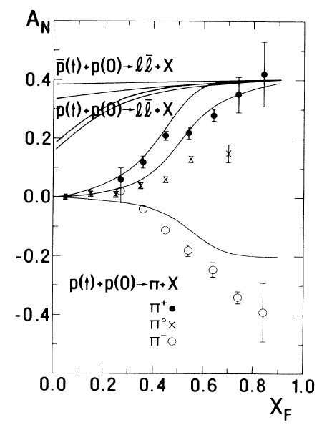
Early theoretical connection to OAM
There is a long history of trying to explain SSA’s with orbital motion.
  C.Boros, et al., PRL 70 p1751 (1993).
  Interaction with orbiting valence quarks.

Slide 8

More Modern Approach
Sivers Function (angular momentum)
Transversity (structure)
Collins Function
(Fragmentation)
Collins Effect
Sivers Effect

Slide 9
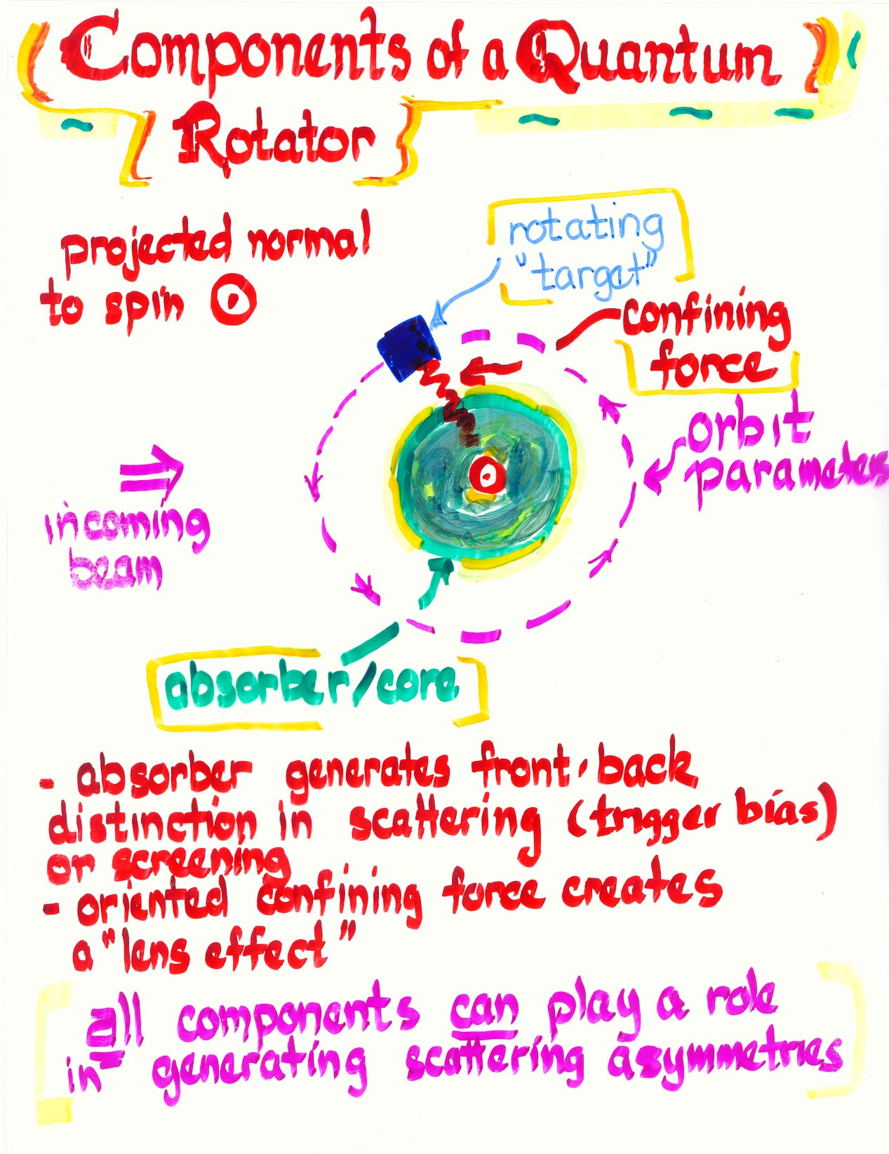
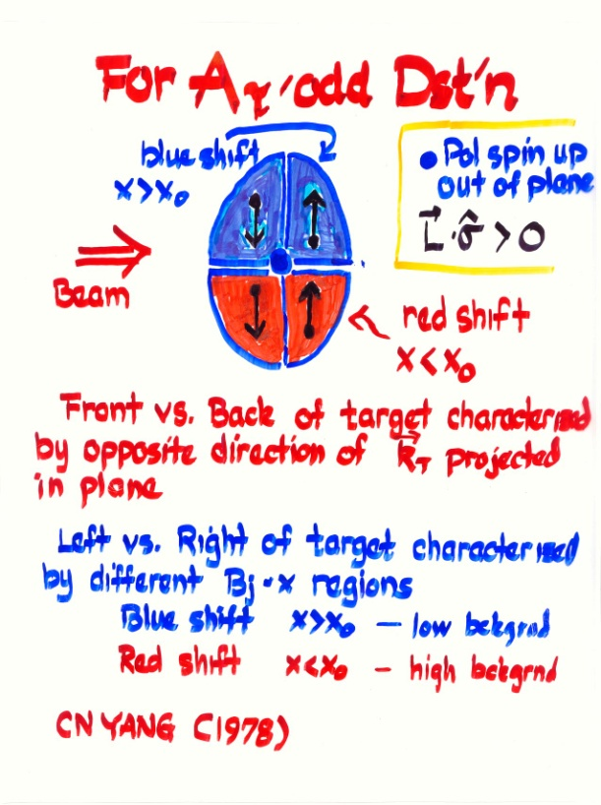
How can you get a net k_{T}?
Nice conceptual picture from D. Sivers (talk given at UNM/RBRC Workshop on Parton Orbital Angular Momentum).
Summary:
  Sivers effect requires orbital motion.
  Is process dependent.

Slide 10
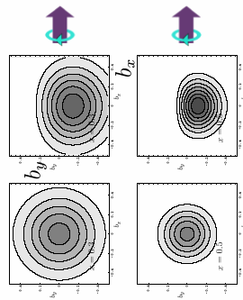
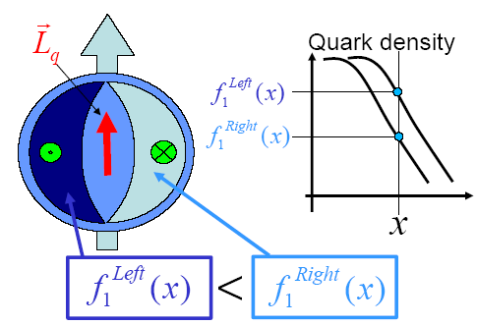
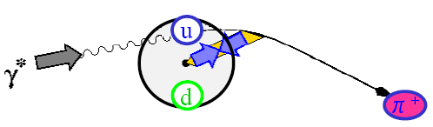
Relation to GPDs
Leads to Asymmetric parton densities.
Which leads to preferential left-right interaction depending upon direction of OAM relative to spin direction.
Which leads to left-right scattering depending upon the initial/final state interactions.

Slide 11
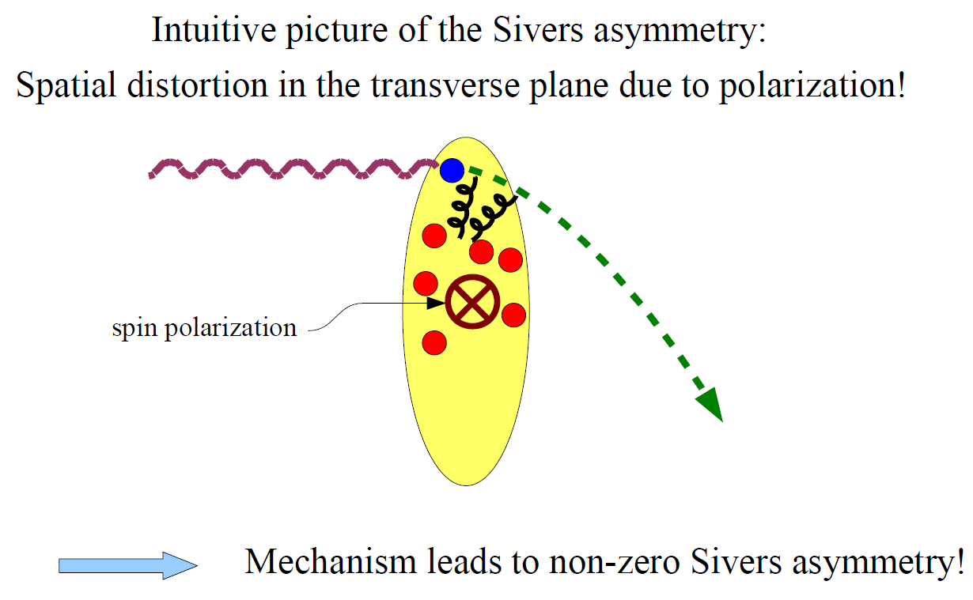
Effect requires OAM
So what do we see at RHIC?

Slide 12
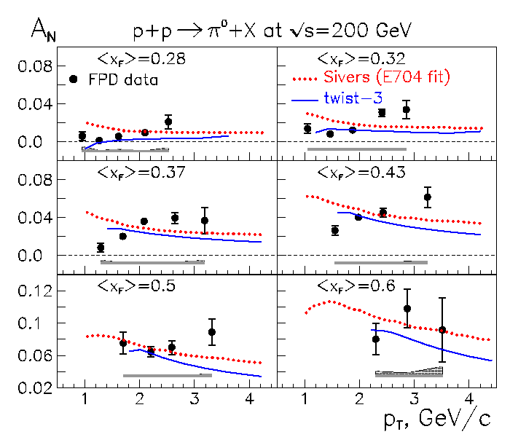
Neutral meson SSAs (STAR forward)

Slide 13
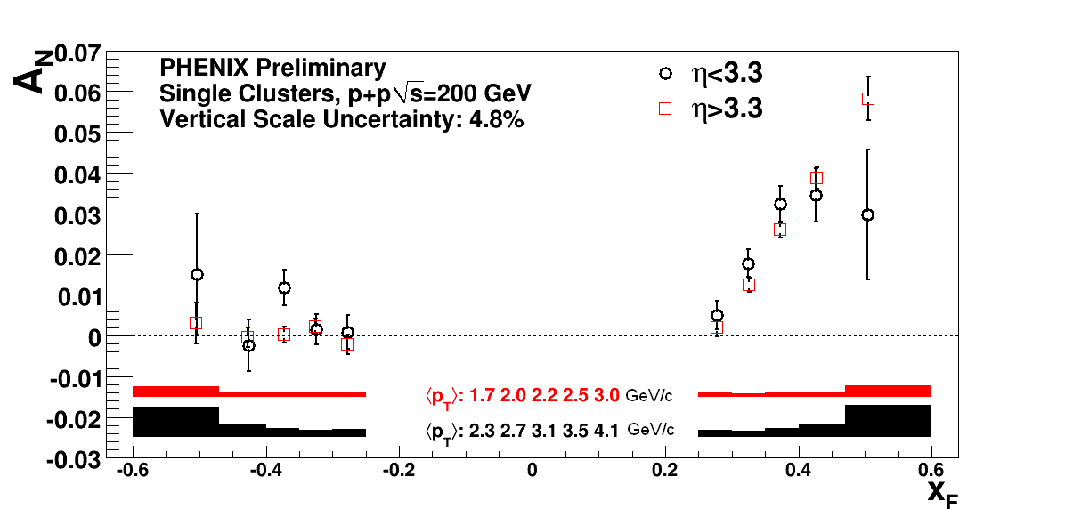
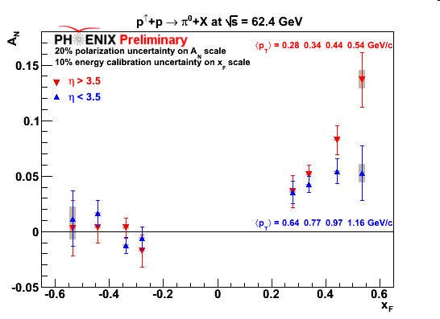
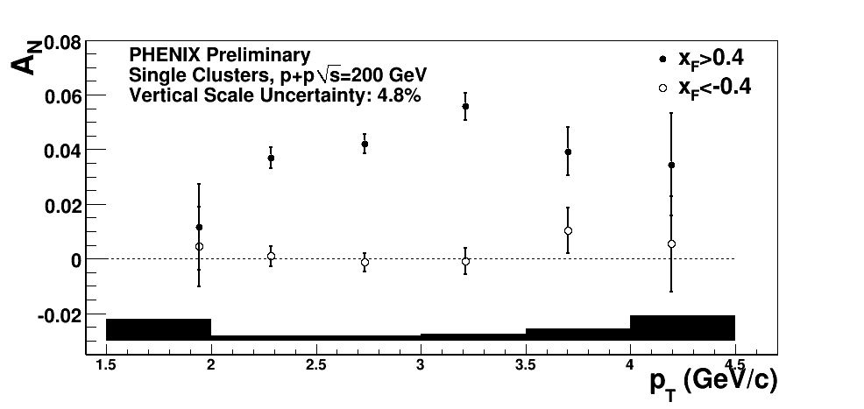
Neutral meson SSAs (PHENIX forward)

Slide 14
Combined π⁰ forward
x_{F} scaling
Larger asymmetries at larger x_{F}
  Valence quark effects?

Slide 15
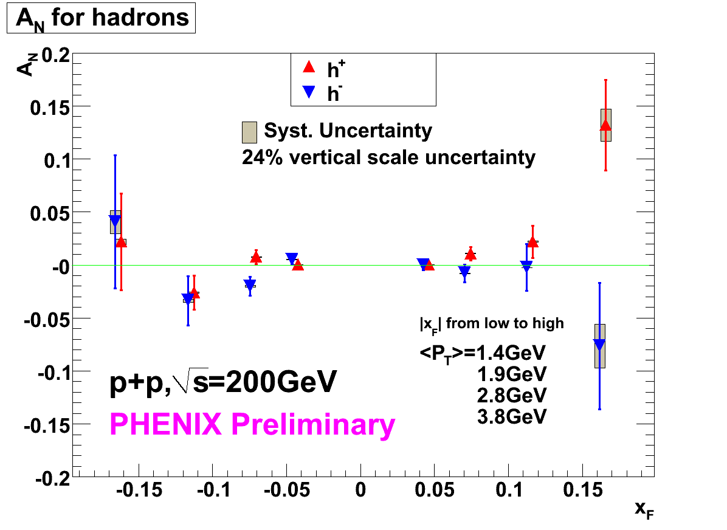
Charged meson SSAs (PHENIX forward)
Charged mesons in muon arms.

Slide 16
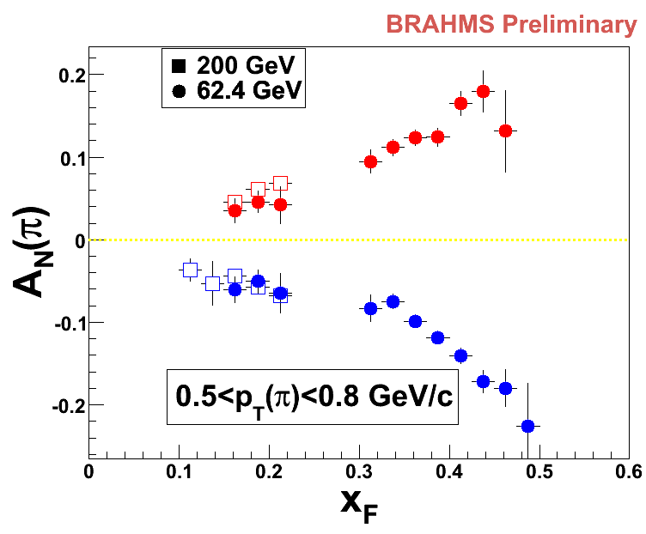
Charged meson SSAs (BRAHMS forward)

Slide 17
Combined charged meson SSAs (forward)

Slide 18
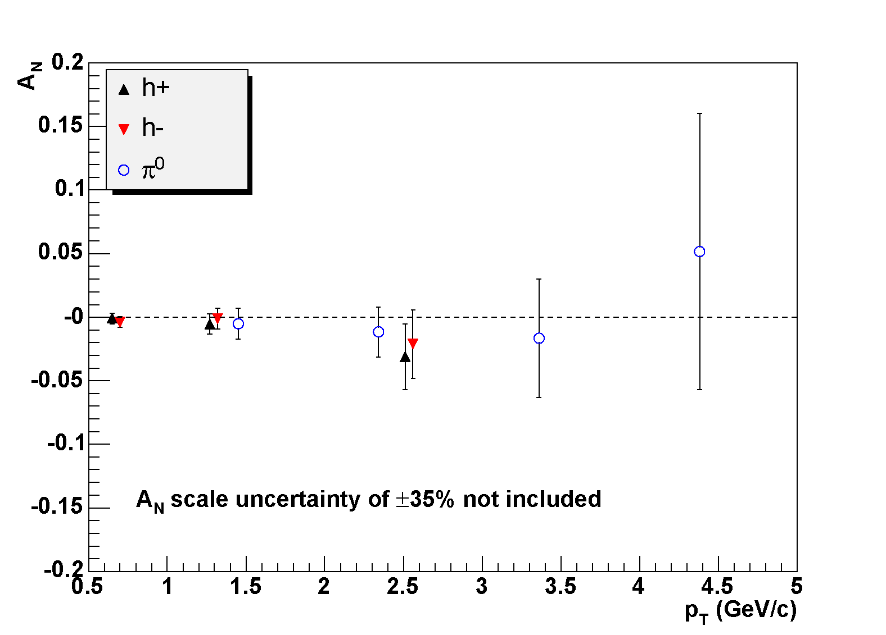
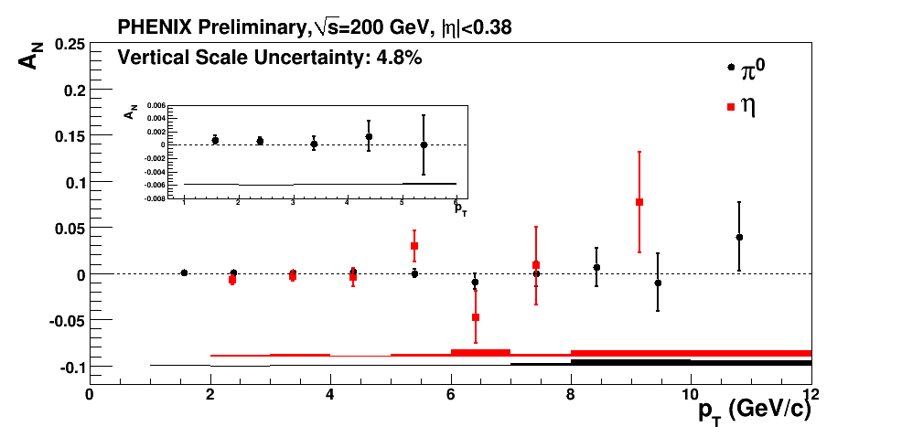
Charged/neutral meson SSAs (PHENIX central)
Seen as a limit on Gluon Sivers

Slide 19
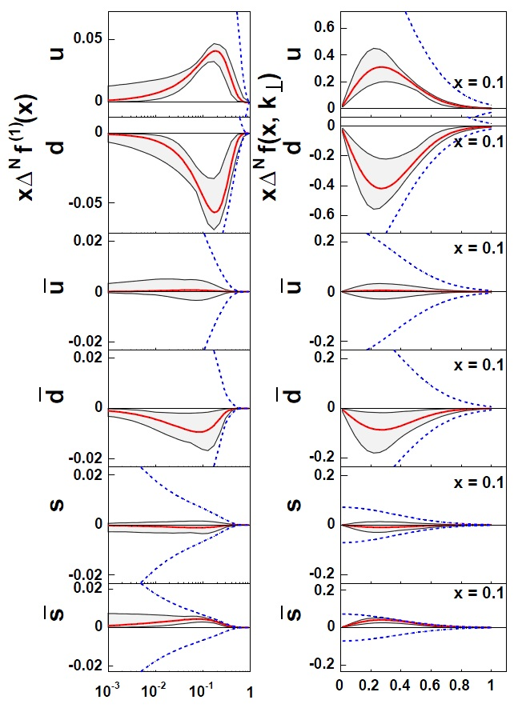
Sivers functions
Have extracted Siver’s functions for DIS.
Can extend to include RHIC data?
What does it mean for OAM?

Slide 20
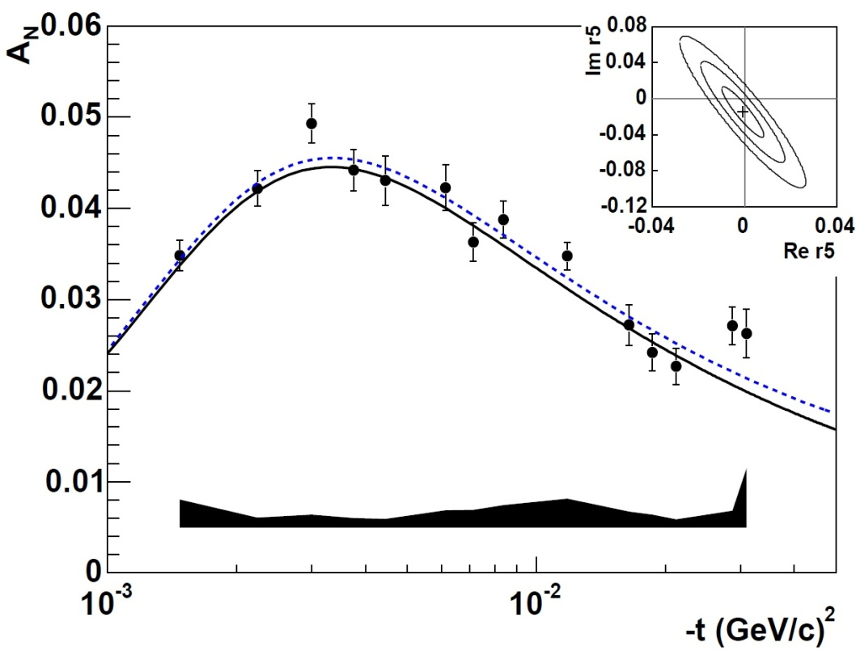
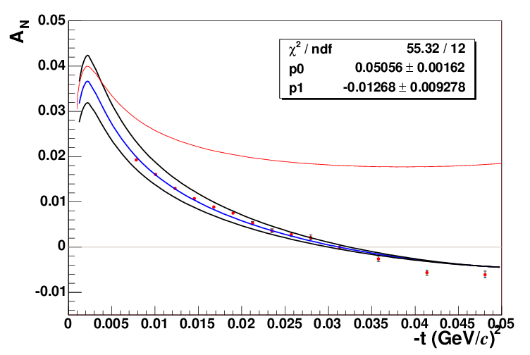
p+p and p+C CNI Asymmetry
p+p CNI (jet)
Rer5=0, Imr5=0
no hadron spin-flip
p+C CNI
Preliminary

Slide 21
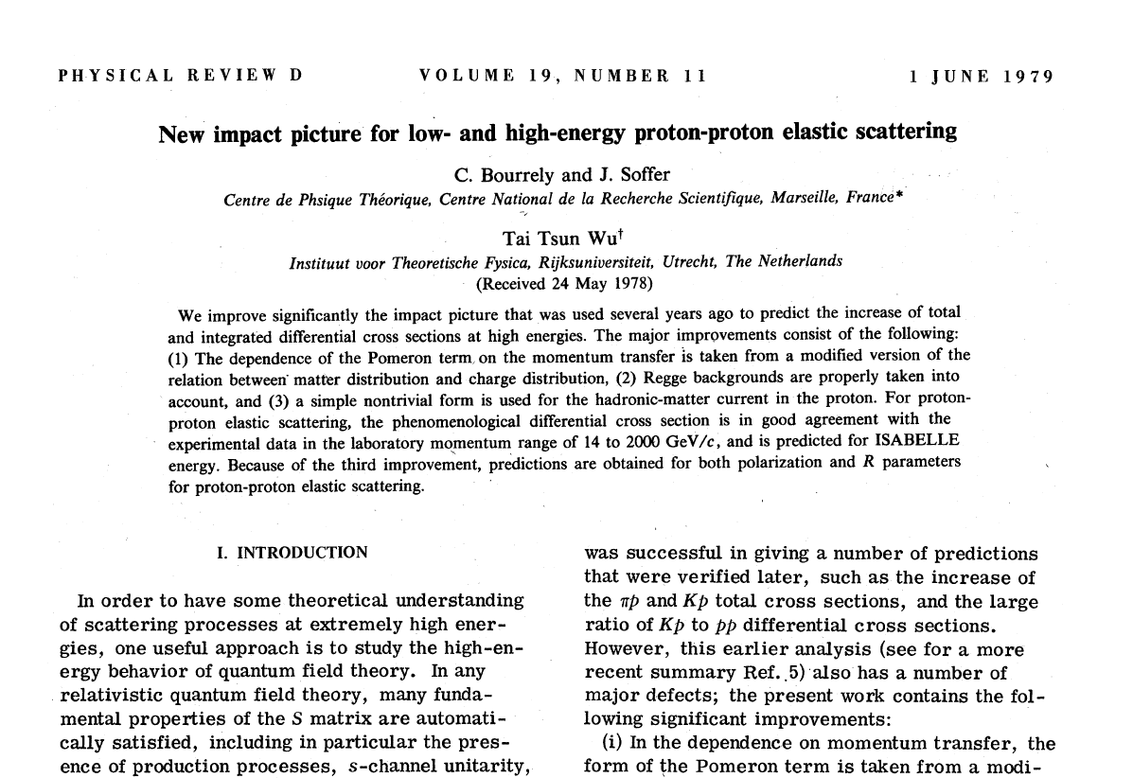
Some (rather old) theoretical connection…

Slide 22
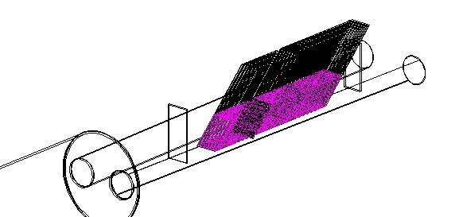
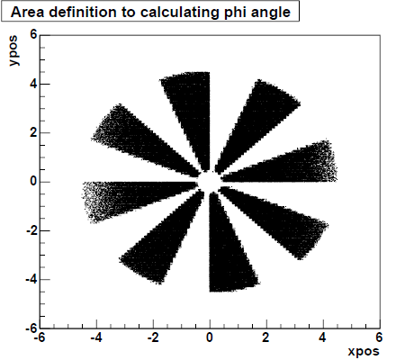
Forward Neutron SSA
～1800cm
10cm
blue beam
yellow beam
D_{x} magnet
±3 mrad

Slide 23
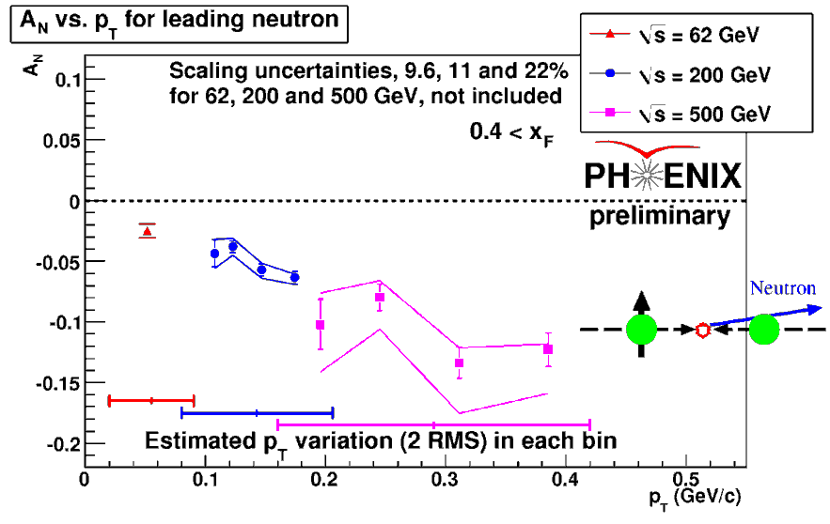
Forward Neutron SSA
Inclusive neutron

Slide 24
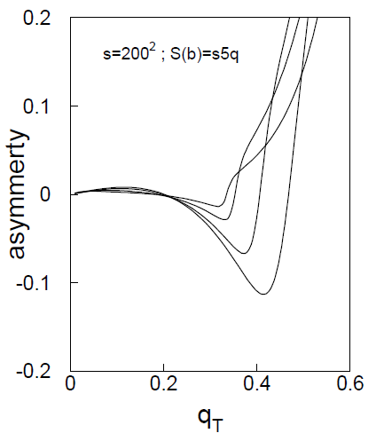
Model prediction
OPE fails to predict both the cross section and the asymmetry.
Also possible relation to OAM?
B.Z. Kopeliovich et al.
arXiv: 0807:1449

Slide 25
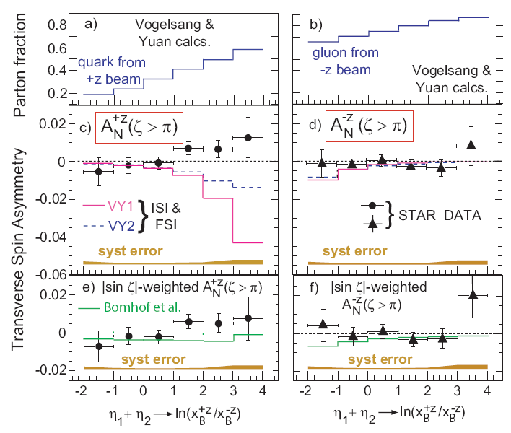
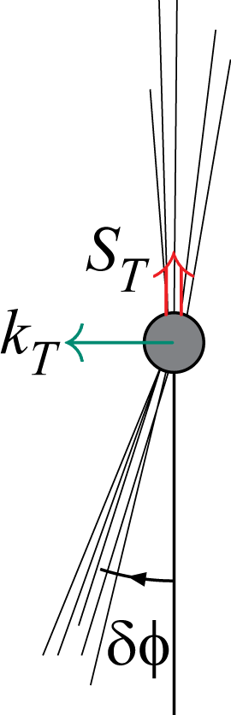
Jet SSAs (STAR)
A_{N} ∝ p_{beam} • (k_{T} × S_{T})
jet
Boer & Vogelsang, PRD 69 (2004) 094025
p_{beam}
into page
jet
Idea: directly measure k_{T} by observing momentum imbalance of a pair of jets produced in p+p collision and attempt to measure if k_{T} is correlated with incoming proton spin

Slide 26
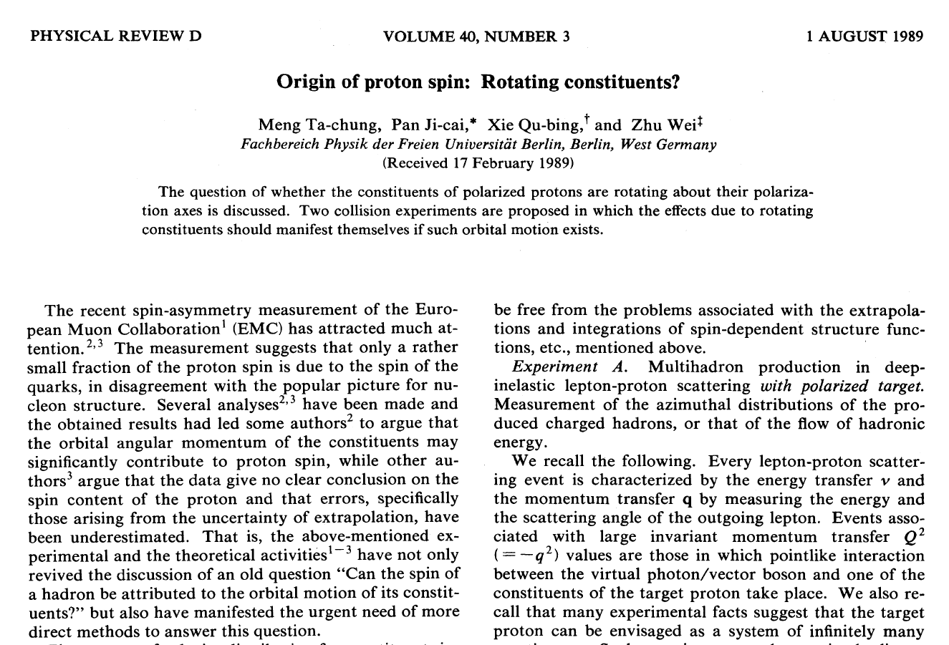

Slide 27
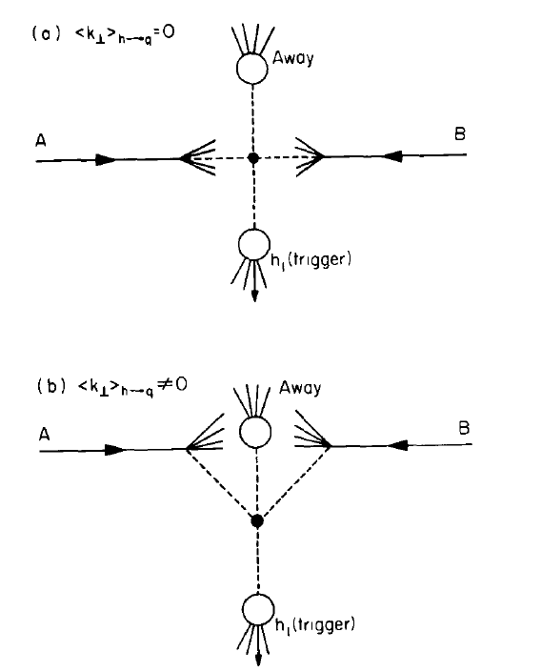
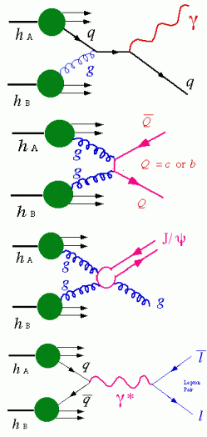
What is the origin of jet k_{T}?
Intrinsic (Confinement) k_{T} ≈ 200 MeV/c
Soft QCD radiation.
An example - J/ψ production.
Extra gluon kick
⟨p_{T}⟩_{J/ψ} =1.8±0.23±0.16 GeV/c
Phys. Rev. Lett. 92, 051802, (2004).
Breaks collinear factorization

Slide 28
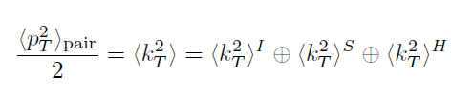
Origin of Jet k_{T}
Net transverse momentum of a di-hadron pair in a factorization ansatz
k_{T}
Di-hadron p_{T}
I = initial – fermi motion of the confined partons, initial-state gluon radiation…
S = soft – one or several soft gluons emitted
H = hard – final-state radiation (three-jet)…
Another Possibility:
Spin-correlated transverse momentum – partonic orbital angular momentum
Can examine the helicity dependence of each term:

Slide 29
k_{T} Asymmetry
•×: Beam momenta
Like helicities
Jet 2 w/<k_{T}>=0
Partonic orbital angular momentum leads to rotation of partons correlated with the proton spin vector
This leads to different p_{T} imbalances (p_{T}-kicks) of jet pairs in semiclassical models
Can be measured by measuring helicity dependence of <k_{T}²>
Peripheral Collisions
Larger
Jet 1
Jet 2
Net p_{T} kick
Integrate over b, left
with some residual k_{T}
Jet 2 w/<k_{T}>=0
Central Collisions
Smaller
Jet 2
Jet 1
For details on jets see: Phys. Rev. D 74, 072002 (2006)

Slide 30
k_{T} Asymmetry
•×: Beam momenta
Unlike helicities
Jet 2 w/<k_{T}>=0
Partonic orbital angular momentum leads to rotation of partons correlated with the proton spin vector
This leads to different p_{T} imbalances (p_{T}-kicks) of jet pairs in semiclassical models
Can be measured by measuring helicity dependence of <k_{T}²>
Jet 2
Peripheral Collisions
Smaller
Jet 1
Net p_{T} kick
Integrate over b, left
with different residual k_{T}
Jet 2 w/<k_{T}>=0
Central Collisions
Larger
Jet 2
Jet 1
For details see: Phys. Rev. D 74, 072002 (2006)

Slide 31
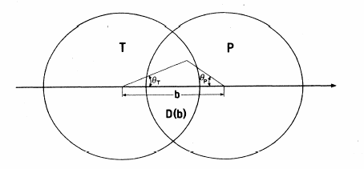
Integrating over Impact Parameter
Drell-Yan pair production in polarized p+p collisions.
(Meng Ta-Chung et al. Phys. Rev. D 1989)
Like Helicity
Averaging over D(b):
k_{PR}
k_{TR}
Integrating over impact parameter b:
k_{PR}
k_{TR}
Un-like Helicity

Slide 32
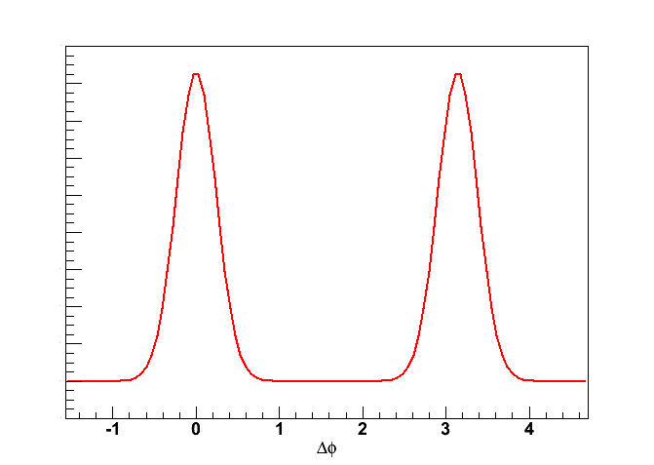
Measuring jet k_{T} – di-hadron correlation
Intra-jet pairs angular width : σ_{near} → ⟨j_{T}⟩
Inter-jet pairs angular width : σ_{far} → ⟨j_{T}⟩
p_{Ta}
^
p_{Tt}
p_{Ta}
^
Zero k_{T}
p_{Tt}
j_{Ty}

Slide 33
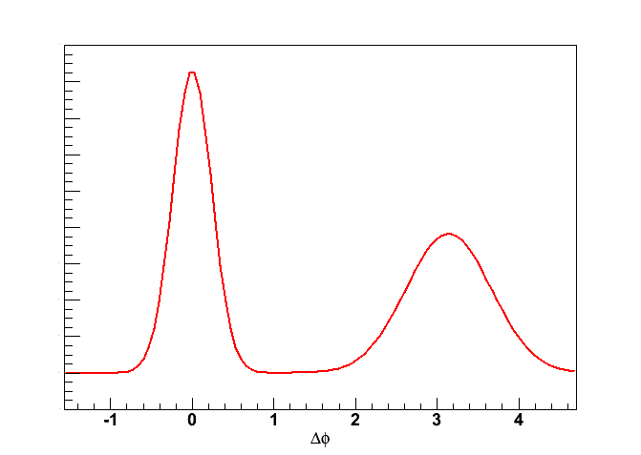
Measuring jet k_{T} – di-hadron correlation
Intra-jet pairs angular width : σ_{near} → ⟨j_{T}⟩
Inter-jet pairs angular width : σ_{far} → ⟨j_{T}⟩
⊕ ⟨k_{T}⟩
p_{Ta}
Non-Zero k_{T}
^
p_{Tt}
p_{Ta}
^
p_{Tt}
k_{Ty}
j_{Ty}

Slide 34
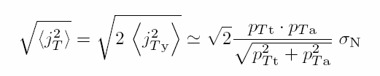

Jet Kinematics
p_{Ta}
^
p_{Tt}
p_{Ta}
^
p_{out}
p_{Tt}
k_{Ty}
j_{Ty}
p_{Tt}
For details, see PRD 74, 072002 (2006)

Slide 35
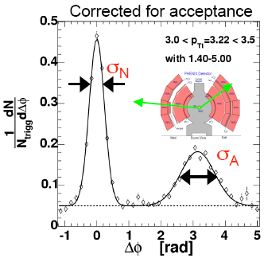
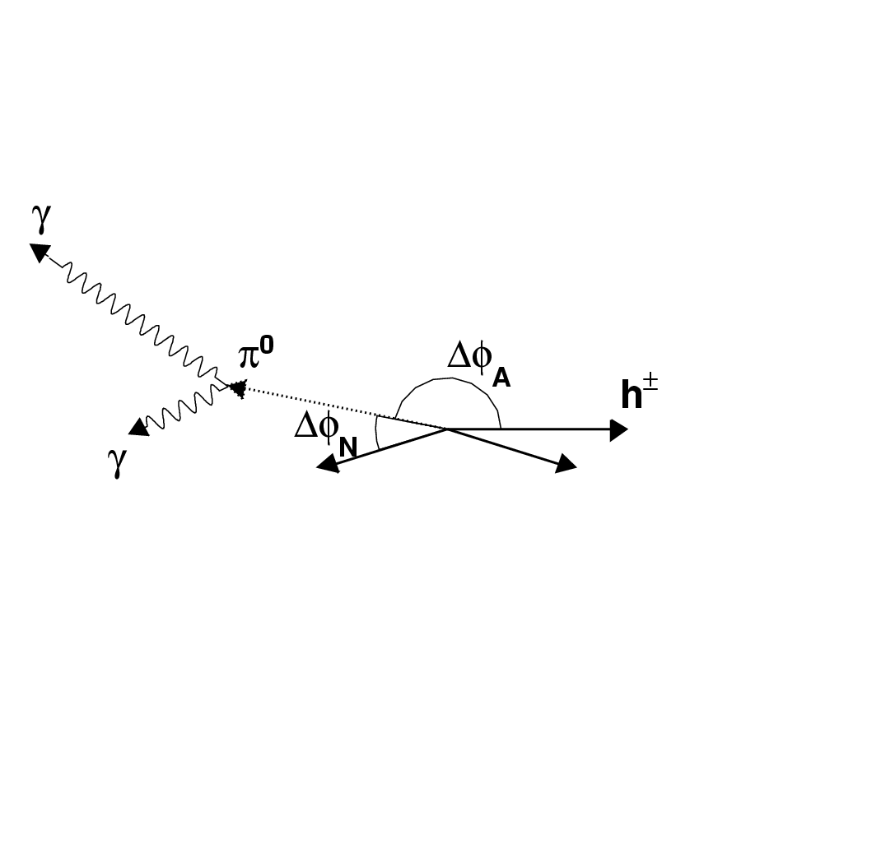
Measuring jet k_{T} – di-hadron correlation
πº- h± azimuthal correlation
Trigger on a particle, e.g. πº, with transverse momentum p_{Tt}. Measure azimuthal angular distribution w.r.t. the azimuth of associated (charged) particle with transverse momentum p_{Ta}. The strong same and away side peaks in p-p collisions indicate di-jet origin from hard scattering partons.

Slide 36
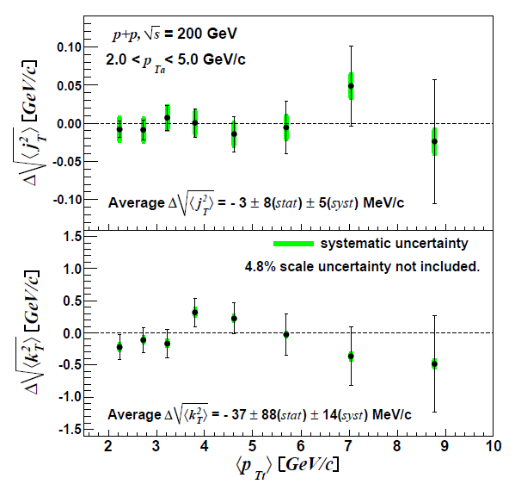
PHENIX Results
Both Δj_{T} and Δk_{T} consistent with zero.
We now have higher statistics data which we will soon analyze.

Slide 37

Interpretation
The first term can be related in the “Meng conjecture” to partonic transverse momentum:
where c^{ij} give the initial state weights and W^{ij} give the impact parameter weighting.

Slide 38
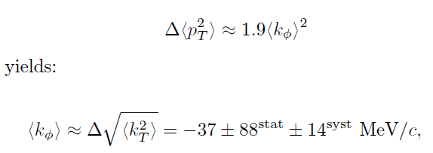
Relating to Meng…

Slide 39
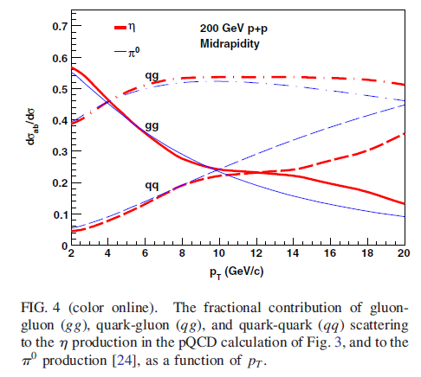
Interpretation
Since PYTHIA studies show that the final state studied here is dominated by gg scattering (~50%),
We can interpret this as a (rather weak) constraint on the gluon orbital angular momentum.
Consistent with previous (Sivers) measurements, and complimentary, since one naïvely needs no initial or final state interactions (although Sivers measures orbital in transversely polarized proton).

Slide 40
k_{T} Asymmetry Summary
We have an analysis tool – di-hadron azimuthal correlations - that allows us to measure k_{T}.
We are studying this in helicity-sorted collisions to see if there is a spin-dependent, coherent component of k_{T}.
In our kinematic range, we find Δj_{T} ^{RMS} = -3 ± 8(stat) ± 5(syst) MeV, and Δk_{T} ^{RMS} = -37 ± 88 ± 14(syst) MeV.
While this is consistent with other measurements related to gluon OAM, the connection to parton OAM needs theoretical guidance!

Slide 41
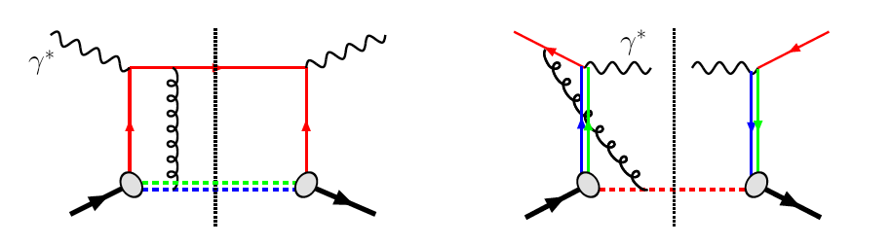
Future
Drell Yan:
Plans to look at intermediate mass range.
  Is that sufficient?
Drell Yan
ϒ-states
J/Ψ
charm
bottom
Ψ’

Slide 42
Drell Yan
HERMES Sivers Results
For the non-zero DIS result, Q²=1GeV.
Sivers Amplitude
Markus Diefenthaler
DIS Workshop
Műnchen, April 2007
0
0.1 0.2 0.3 x

Slide 43
Summary
There are many direct measurements that have been/will be made at RHIC that have a connection to Partonic Orbital Angular Momentum.
Theoretical work is needed to relate these measurements to OAM on a more quantitative footing.

Slide 44
Backups

Slide 45
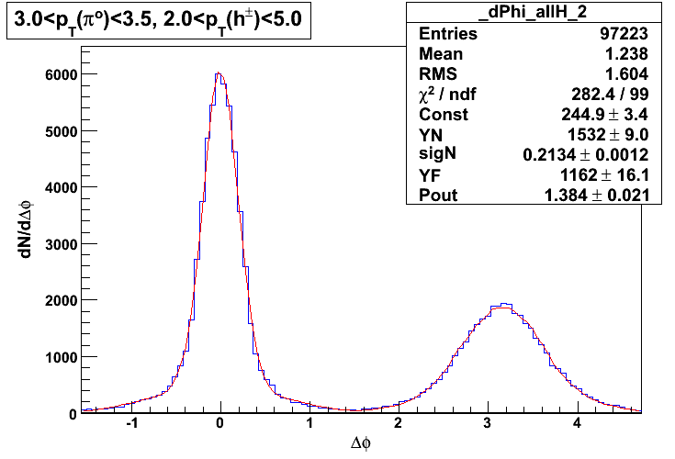
Fit Function
Blue – real (raw Δφ)
Red – Fit from above equation

Slide 46
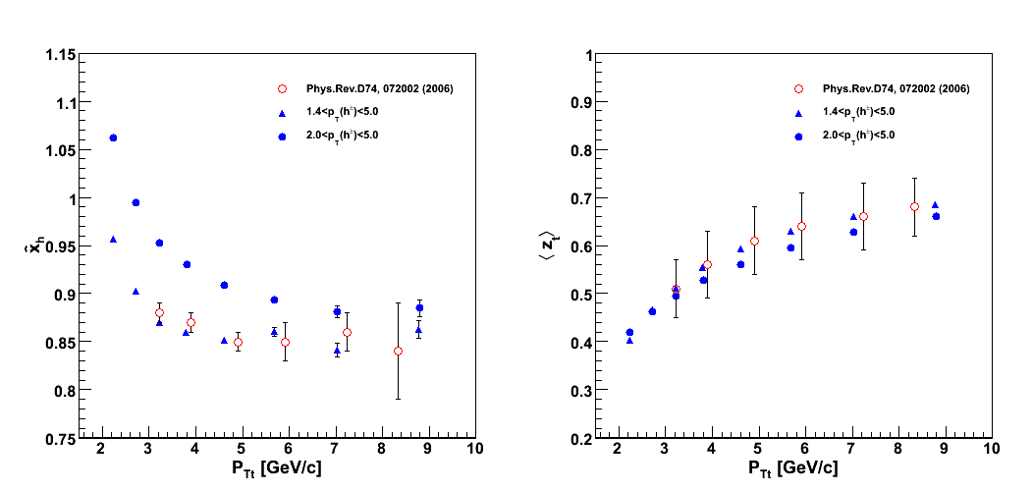
Need <z_{t}> and x_{h}
<k²_{T}> asymmetry results are not sensitive to this x_{h} and <z_{t}> values – only needed to set the scale.
^
^
x_{h} and <z_{t}> are determined through a combined analysis of the π° inclusive cross section and using jet fragmentation function measured in e⁺e⁻ collisions. Ref. PRD 74, 072002 (2006)

Slide 47
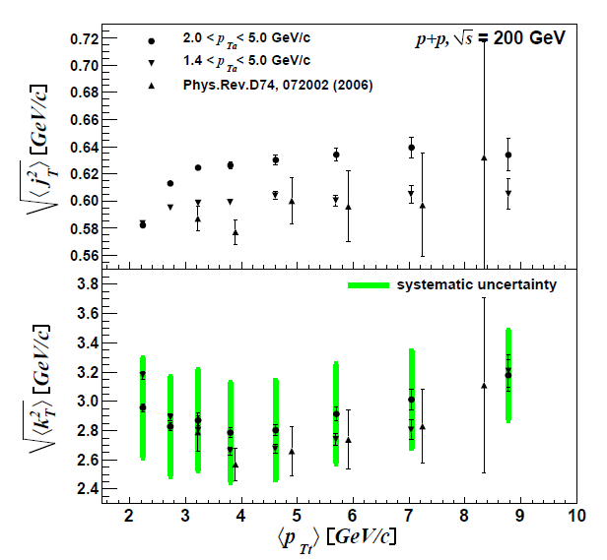
k_{T} results for unpolarized case

