Slide 1
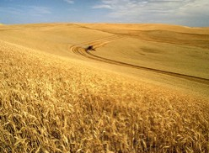
The ultimate complex system: networks in molecular biology
A. W. Schreiber
Australian Centre for Plant Functional Genomics
Waite Campus, University of Adelaide
Achievements and new directions
in Subatomic Physics:
Workshop in Honour of Tony
Thomas’s 60th birthday
February 2010

Slide 2

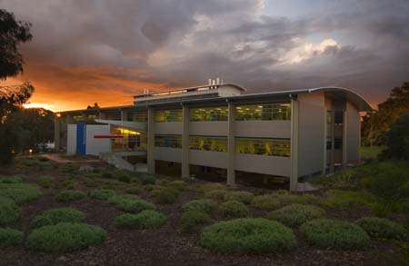
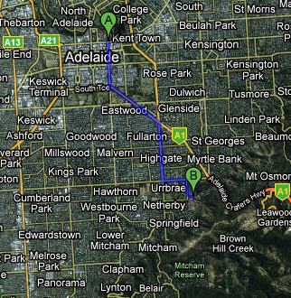
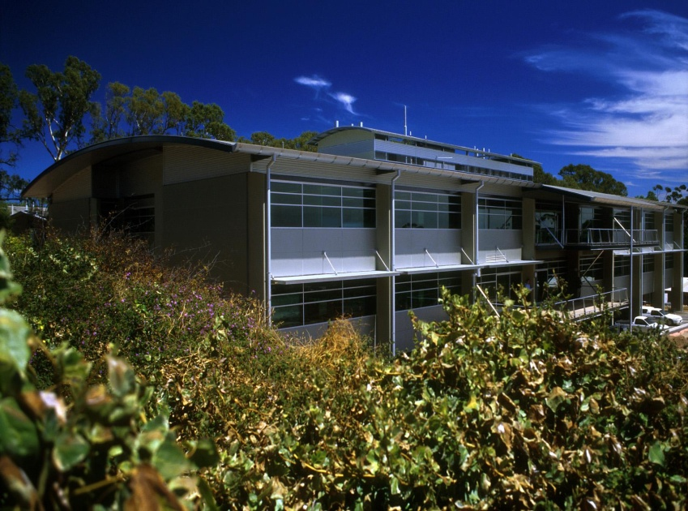
First operational: 2003
Mission: to improve abiotic stress
tolerance in cereal crops (salinity,
drought, nutrient deficiency etc.)
> 100 scientists
O(M$10)/annum

Slide 3
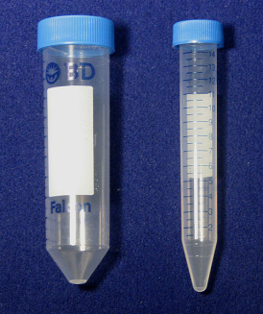
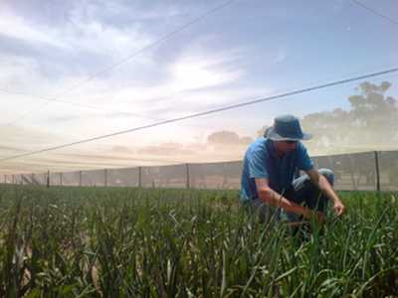
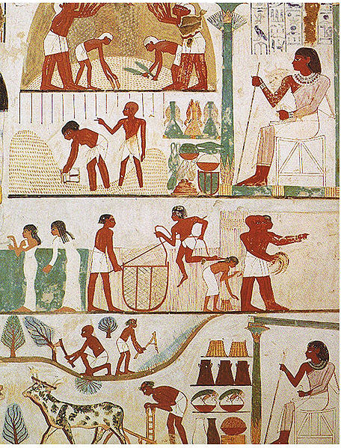


Like physics, improving stress tolerance of crops is one of humanity’s most ancient pursuits!
Plant breeding, 5500 BC
Plant breeding, 20th century
Genetics
Molecular
Biology
Source: Wikimedia commons
Plant breeding, 21st century
Agricultural scenes, tomb of Nakht,
18th dynasty, Thebes
High throughput technologies
The Plant Accelerator

Slide 4
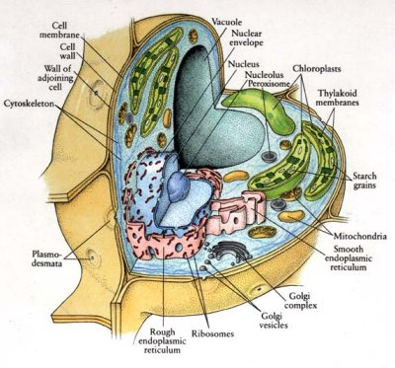
At the heart of it all: the molecular cell
Internet encyclopedia of science

Slide 5
Signalling hormones, ligands,extracellular metabolites
extra-cellular
space
Metabolic reactions
cell
Complex formation, protein-protein interactions
Metabolites
Genes
Post-transcriptional regulation
ncRNA
Post-translational regulation
DNA
Gene expression
RNA
Proteins
Transcriptional regulation
nucleus
Transcription
factors
Protein degradation
Notes:
Discuss experimental status at this stage

Slide 6
Signalling hormones, ligands,extracellular metabolites
extra-cellular
space
Metabolic reactions
cell
Complex formation, protein-protein interactions
Metabolites
Post-transcriptional regulation
Genes
Post-transcriptional regulation
ncRNA
Post-translational regulation
Gene expression
Gene expression
RNA
Proteins
Proteins
Transcriptional regulation
Transcriptional regulation
nucleus
Transcription
factors
Protein degradation

Slide 7
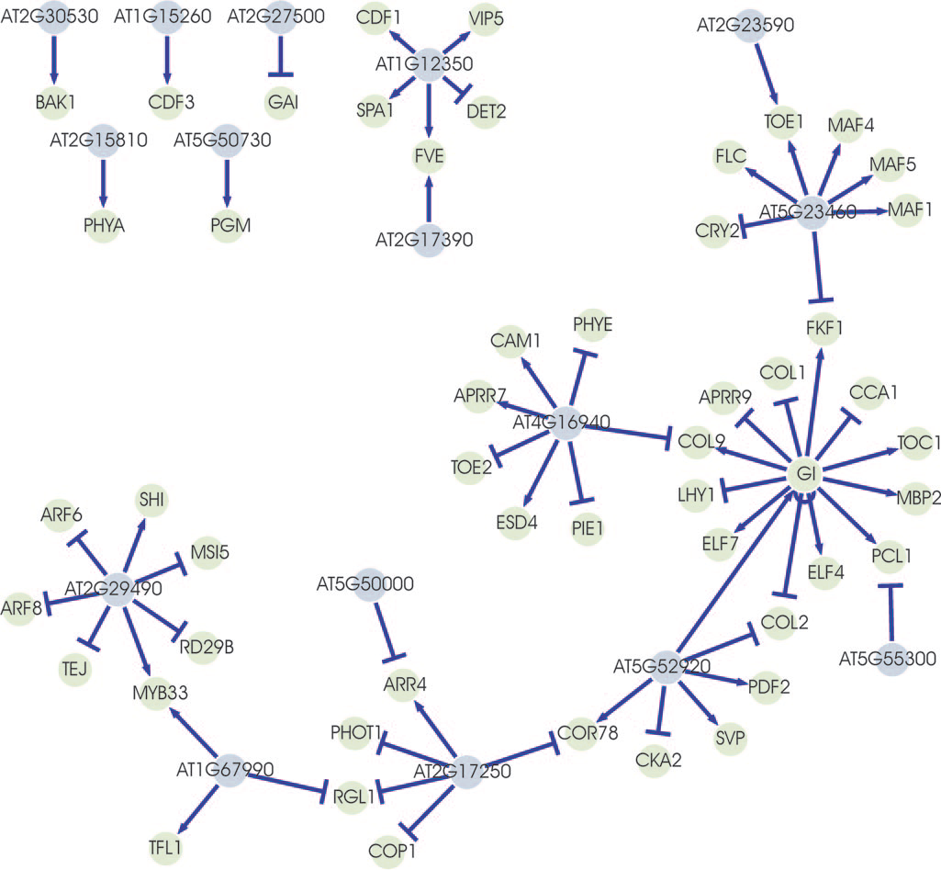
Gene regulatory networks
(directed graph)
Regulatory network of genes involved
in the transition to flowering
Positive regulation
inhibition
Regulator
Gene
J.J.B.Keurentjes et al, Regulatory network construction in Arabidopsis by using genome-wide gene expression quantitative trait loc, PNAS 2007, 104, 1708

Slide 8
Signalling hormones, ligands,extracellular metabolites
extra-cellular
space
Metabolic reactions
Complex formation, protein-protein interactions
cell
Complex formation, protein-protein interactions
Metabolites
Genes
Post-transcriptional regulation
ncRNA
Post-translational regulation
Gene expression
RNA
Proteins
Transcriptional regulation
nucleus
Transcription
factors
Protein degradation

Slide 9
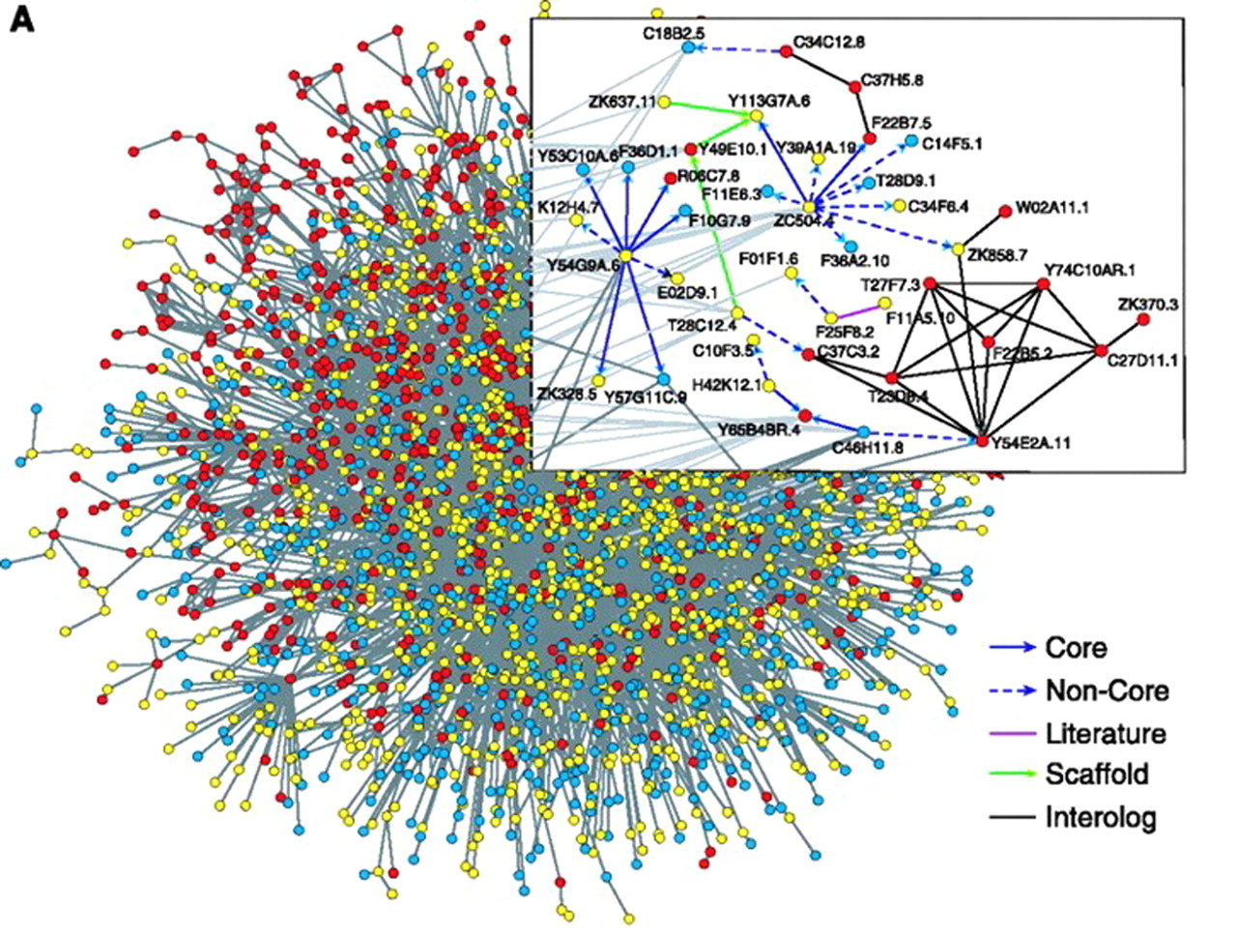
Protein-protein interaction
network
(undirected graph)
interaction, e.g. binding
Protein
C. elegans protein interaction network
Albert, R. J Cell Sci 2005;118:4947-4957

Slide 10
Signalling hormones, ligands,extracellular metabolites
extra-cellular
space
Metabolic reactions
Metabolic reactions
cell
Complex formation, protein-protein interactions
Metabolites
Genes
Post-transcriptional regulation
ncRNA
Post-translational regulation
Gene expression
RNA
Proteins
Transcriptional regulation
nucleus
Transcription
factors
Protein degradation

Slide 11
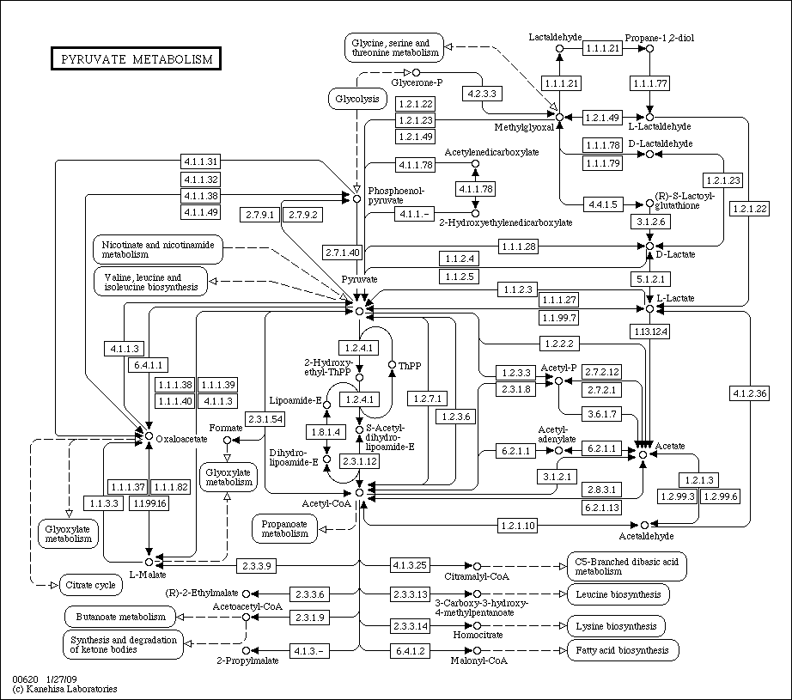
Metabolic networks: represent metabolism as directed graphs
Edges: Enzymes
e.g.
Nodes:
Compounds
Links to other pathway maps
taken from KEGG Pathway database

Slide 12
Signalling hormones, ligands,extracellular metabolites
extra-cellular
space
Metabolic reactions
cell
Complex formation, protein-protein interactions
Metabolites
Genes
Post-transcriptional regulation
ncRNA
Post-translational regulation
Gene expression
Gene expression
RNA
Proteins
Transcriptional regulation
nucleus
Transcription
factors
Protein degradation

Slide 13
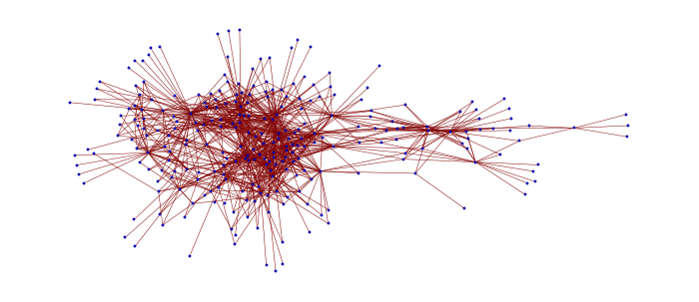
Gene co-expression network
(undirected graph)
High correlation of expression patterns
Gene
Modularity discovery of function
Transcriptional response to drought stress

Slide 14
Signalling hormones, ligands,extracellular metabolites
extra-cellular
space
Metabolic reactions
cell
Complex formation, protein-protein interactions
Metabolites
Genes
Post-transcriptional regulation
ncRNA
Post-translational regulation
Gene expression
RNA
Proteins
Transcriptional regulation
nucleus
Transcription
factors
Protein degradation

Slide 15
Why are networks so important in biology?
Molecular biology, like high energy physics, is all about about parts (genes, proteins, metabolites,...) and how they interact:
Classification of network structures, definition of
functional modules, etc. are part of the effort to move away from the one gene-one function paradigm
High-throughput data is becoming prevalent. How does
one interpret this data? How does one generate hypotheses? There is a need to formalize analysis techniques
4) Scale-free networks
 |  | Tools
“Genomic era” | Genes, Proteins: sequences of letters (e.g. A,T,C,G) | String comparison, computational linguistics, informatics
“Post-genomic era” | Interactions: links, networks | Graph & network theory
The search for more suitable d.o.f.s

Slide 16
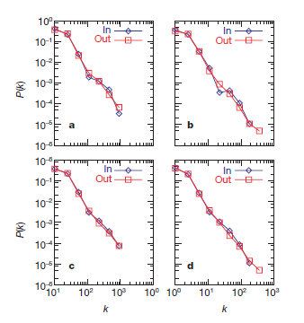
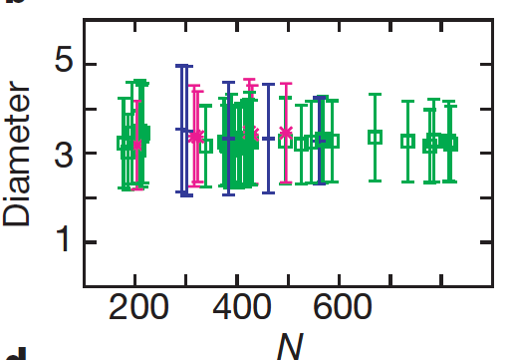
Barabasi et al, Nature 2000
Metabolomic networks are scale-free
(as well as the WWW, transportation system, food-webs, social and sexual networks, citation networks, protein-protein interaction networks, transcriptional regulatory networks, co-expression networks)
6 archaea, 32 bacteria,
5 eukaryotes
Universality:
Degree distribution
Number of metabolites

Slide 17
The proposed significance of ‘scale-free-ness’:
Nature’s normal abhorrence of power laws is suspended when
the system is forced to undergo a phase transition. Then power
laws emerge—nature’s unmistakable sign that chaos is departing in
favor of order. The theory of phase transitions told us loud and clear
that the road from disorder to order is maintained by the powerful
forces of self-organization and is paved by power laws. It told us that
power laws are the patent signatures of self-organization in complex
systems.
Barabasi 2002
The new science of networks
This interpretation is a little controversial, but universality of power-law (or at least
power-law-like) behaviour is less so:
“The first law of genomics” Slonimski 1998

Slide 18
How do these networks arise in molecular biology?
The fundamental process is evolution: inheritable changes coupled with a selection
process (‘survival of the fittest’)
Inheritable changes are:
point mutations: under selective pressure, slow
(e.g. cystic fibrosis, sickle-cell anaemia)
gene duplications and deletions: under more limited selective pressure
“The most important factor in evolution” (Ohno, 1967)
(e.g. α- and β- globin arose from globin)
To understand biological network structure, one should
study gene duplications
7
7
6
6
1’
5
1
5
1
1
4
2
Gene
duplication
2
4
3
3

Slide 19
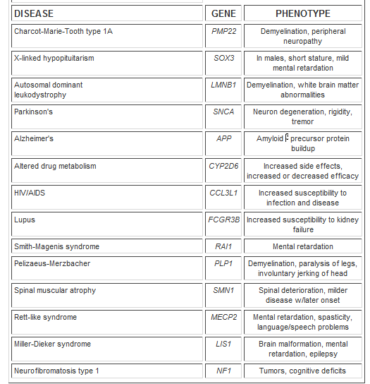
Gene duplications (con’t):
give rise to (gene) copy number variations among individuals –
a hot topic at present!
CNV and human disease
(compilation taken from
Cohen, Science ‘07)

Slide 20
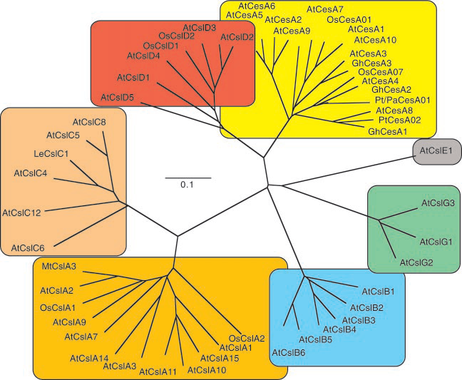
Gene duplications (con’t):
give rise to gene families:
The CesA superfamily
Somerville, Plant Phys. 2000

Slide 21
Cluster (≈ gene family) size distribution

Slide 22
In the absence of selective pressure (i.e. ‘neutral model of evolution’), the evolution of gene family sizes is amenable to modelling:
gene duplications
gene loss
gene ‘innovation’
branching of existent families
These models predict functional form of family size distributions
e.g. f(i) ∼ with
θ = duplication rate/(loss rate + branching rate)
θ^{i}
/i
Wojtowicz and Tiuryn,
J. Comp. Biology (2007)
Departures from model predictions can indicate presence of
selective pressure

Slide 23
Summary
Networks are the natural language to use for understanding molecular
biology on a system-wide scale. They are
complex
ubiquitous
interdependent
evolving
Concepts from network theory provide both
conceptual insights (e.g. spontaneous emergence of order in
living systems, higher-level degrees of freedom)
practical tools (e.g. discovery of gene function through modules
in co-expression networks)
We are only at the very beginning of understanding biological networks
we only have a very incomplete parts list
network integration is needed
both spatial and temporal aspects are largely neglected
Where is the rich phenomenology so familiar from statistical physics?
(e.g. collective degrees of freedom, phase transitions)

