Slide 1
A Tony Thomas-inspired guide to INSPIRE
The evolution from SPIRES to INSPIRE and what it means for you

Slide 2
Personal note
1990: sat in this lecture theatre for Tony Thomas’ second-year Quantum Mechanics lectures.
System has undergone following transformation
  t → t + 20
  AWT <-> me

Slide 3
What is SPIRES all about?
Physics asks the Big Questions
  How did we get here?
  How did it all begin?
  What are the fundamental building blocks?
SPIRES wants to help with this

Slide 4
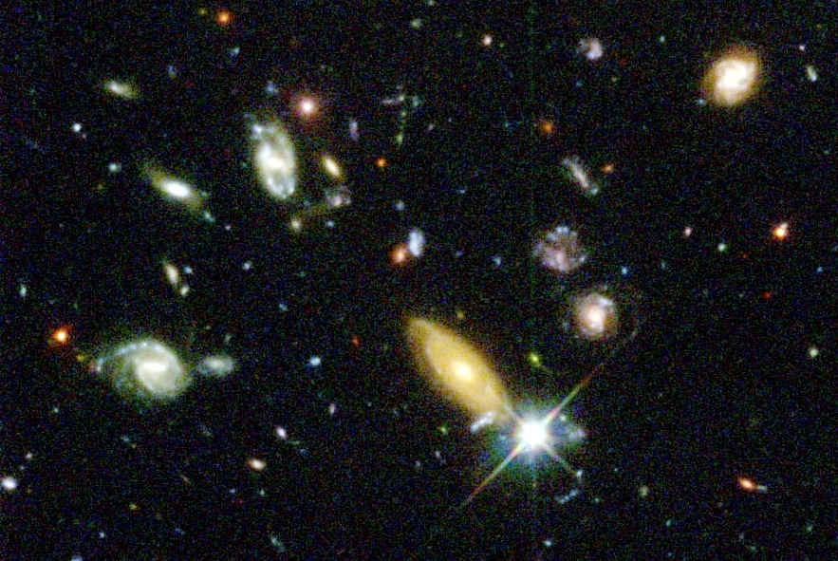
How did we get here??

Slide 5
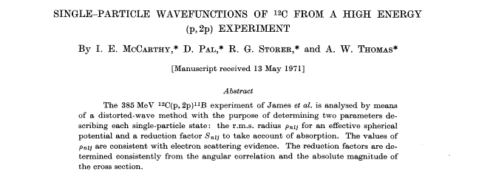
How did it all begin?

Slide 6
What are the fundamental building blocks??
* Title words from Tony Thomas’ 600+ papers.

Slide 7
A brief history of SPIRES
1968 – today.
How it started.
How it grew.
Parallel developments.
With context!

Slide 8
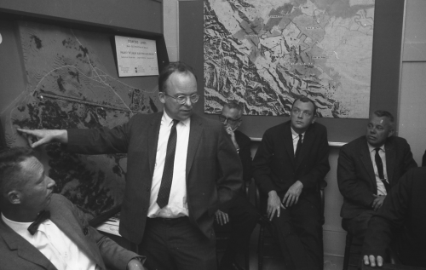
A brief history of SPIRES (Late 1960s)
SLAC receives preprints from around the world. Pief Panofksy instructs SLAC Library to catalogue them in SPIRES (Stanford Physics Information REtrieval System) database developed at Stanford.
SLAC sends hardcopy weekly mailing, generated by SPIRES, of new preprints to institutions around the world.
DESY maintains HEPI db of published papers.
Tony Thomas enters undergrad.

Slide 9
Brief history continued (Mid 1970s)
SLAC SPIRES and DESY HEPI merge.
Published papers get announced in the “anti-preprint” list (must be kept separate from “preprint” list).
Tony Thomas awarded Ph.D. and moves to Canada.

Slide 10
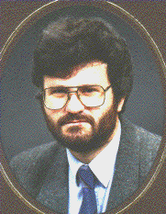
Brief history continued (Mid 1980s)
SLAC introduces “Remote SPIRES” interface to database through email and bitnet login. Now possible to query SPIRES as a database from anywhere in the world.
SLAC’s weekly mailing sent by email.
Tony Thomas returns to Adelaide.

Slide 11

Brief history continued (1991)
August: LANL string theorist, Paul Ginsparg, introduces eprint service, xxx.lanl.gov, with email interface (then + ftp).
  Starts with hep-th and expands gradually into other fields with the help of servers at other institutions.
SLAC helps xxx with daily mail-out through SPIRES preprint listserv.

Slide 12
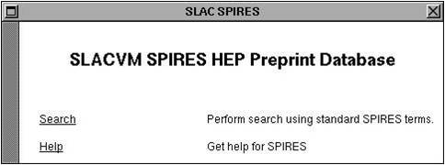

Brief history (1991 continued)
SLAC scientist, Paul Kunz, sees demonstration of World Wide Web at CERN.
Back at SLAC he tells SLAC Librarian, Louise Addis, that SPIRES is an ideal candidate.
December: SPIRES becomes first website outside Europe, and first database on web.
xxx on www in April 1993.

Slide 13
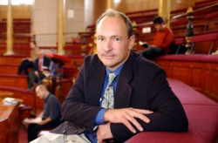
Brief History Continued (1991)
Tim Berners-Lee, the CERN IT engineer who invented the World-Wide Web, has called the SLAC web interface to SPIRES-HEP the "killer app" that showed the world what the web could do.

Slide 14
Brief history continued (22 Jan 1993)
First Tony Thomas paper appears in xxx
“Shadowing in deuterium”
  By W. Melnitchouk, A.W. Thomas (Adelaide U.), ADP-92-192-T120
  nucl-th/9301016

Slide 15



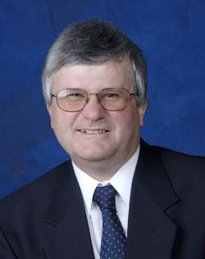
Brief history continued (2000s)
SPIRES a collaboration of
  keywords and conference proceedings
  HEPJobs, HEPNAMES
  everything else
The underlying technology is the 1985 “Remote SPIRES” for the web interface and the 1968 SPIRES for the database.
Slow for users, cumbersome for developers.
Tony Thomas at Jefferson Lab.

Slide 16

Brief history continued (late 2000s)
SPIRES collaboration begins talks with
CERN runs a database system called Invenio
  Modern
  Open Source (anyone can install it, build on it)
  Supported by an IT team at CERN
Agreement signed Invenio + SPIRES -> INSPIRE
Tony Thomas returns to Adelaide.

Slide 17
Current work on INSPIRE
Enormous effort principally between SLAC and CERN to reproduce the functionality of SPIRES.
Database must be built to:
  Store same information as SPIRES
    papers have, e.g. conference info, experiment number, authors, affiliations, references, citations, etc.
  Provide same search behaviour as SPIRES
    “Thomas, A” should find “Thomas, A.W.”, “Thomas, Anthony”
Despite age, SPIRES is remarkably sophisticated database system.

Slide 18
An INSPIRE test version is in release
http://inspire-hep.net
Extremely fast.
New features such as collaborators list and links to outside databases.
Closely resembles traditional SPIRES experience.
New Google-like search + most of SPIRES syntax.
Now updating data on a daily basis.

Slide 19
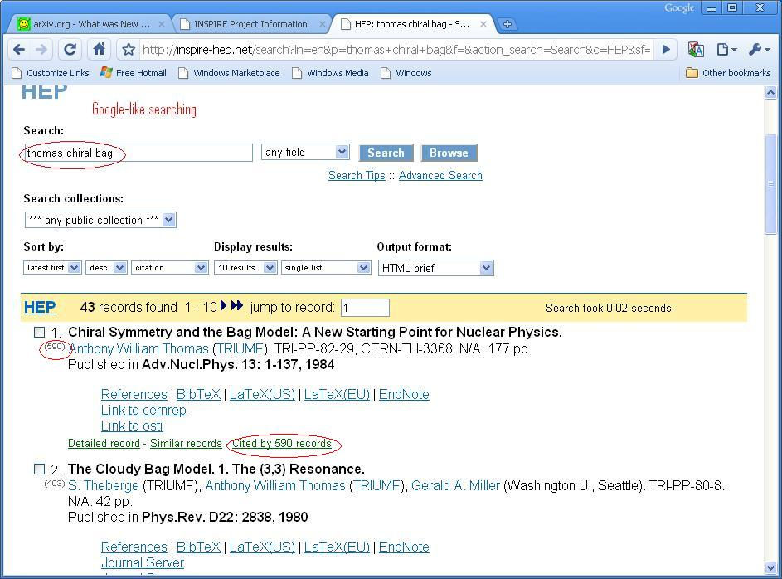

Slide 20
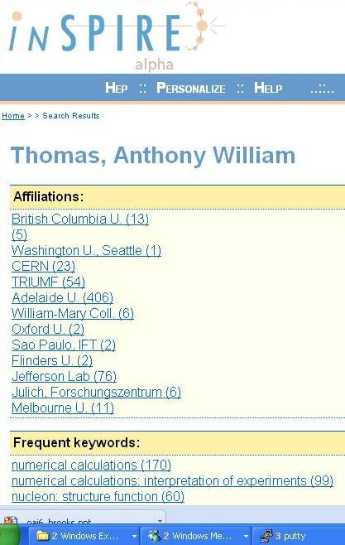
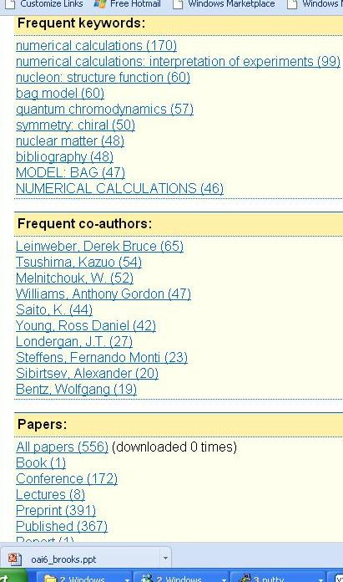

Slide 21
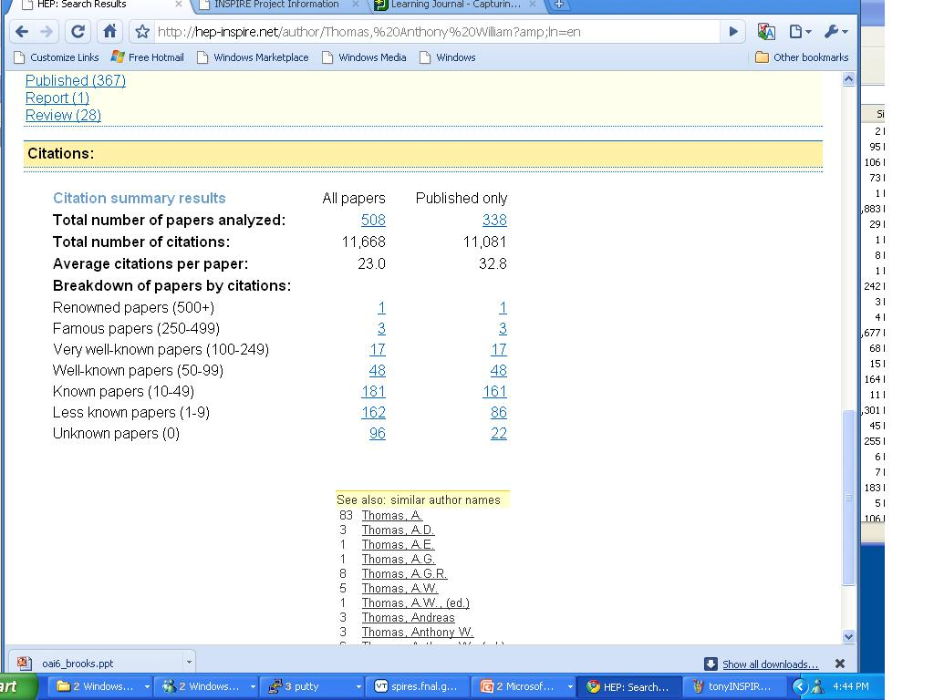

Slide 22
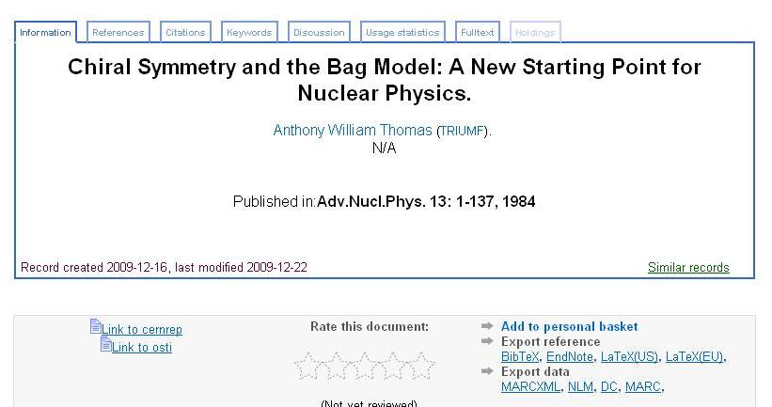
The “Detailed Record” in INSPIRE

Slide 23
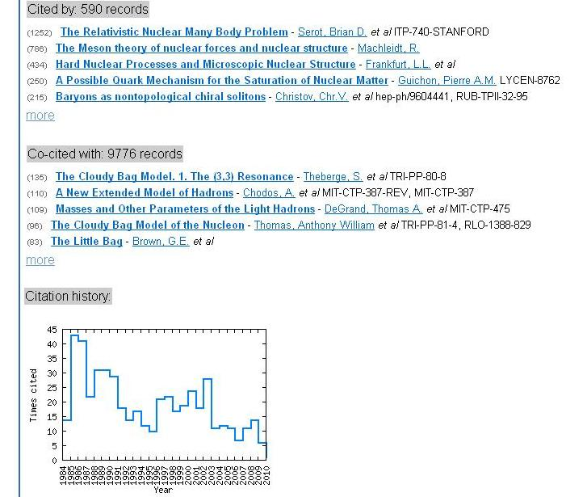

Slide 24
An INSPIRE Author ID number
Problem to uniquely identify all your papers.
  Leads to some long, unstable SPIRES searches.
Recently introduced an “INSPIRE number” in the HEPNAMES database: INSPIRE-\d{8}
  Number is meaningless, so no privacy concerns.
Working with ORCID group (publishers, Web of Science, etc) to ensure getting your papers right in INSPIRE means they’re right everywhere.

Slide 25
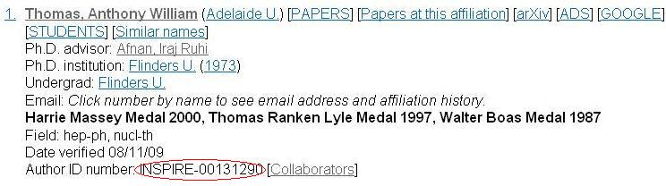

Slide 26
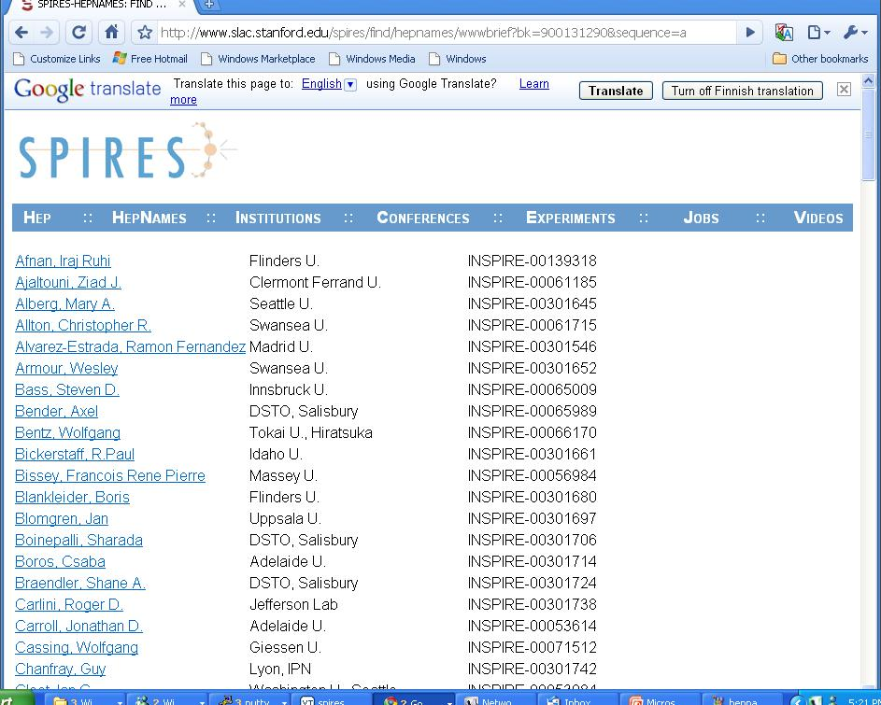

Slide 27
An author ID number (contd.)
Use the ID number to supply information on identity when submitting to arXiv,
  authors.xml
  necessary really only for large collaborations
    for other papers, can be automatically generated
INSPIRE and arXiv share INSPIRE ID numbers.
Provides efficient way to identify your papers.
Currently 20,000 INSPIRE numbers assigned.

Slide 28
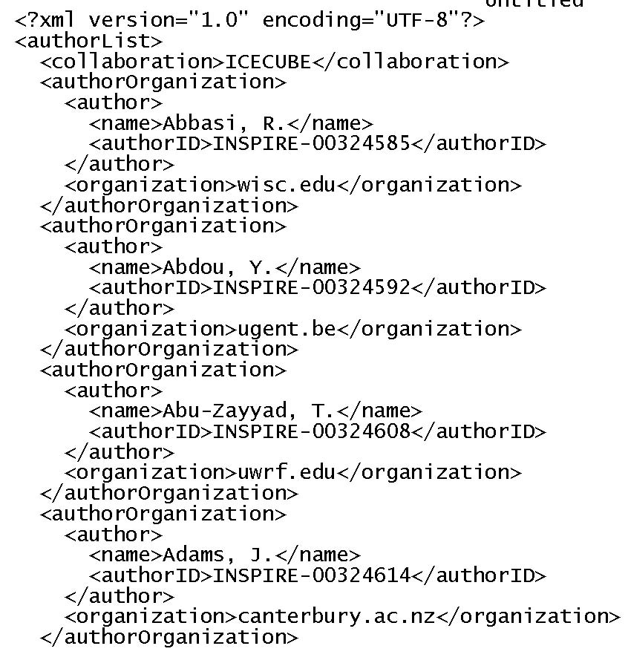

Slide 29
The current plan for INSPIRE
Going live in April 2010.
Will have all the SPIRES features.
Regular roll out of new features such as
  Personal accounts with ability to:
    Store favourite papers.
    Tag records with keywords and other information.
    Vastly improved correction process for mistakes.
    Email alerts on pre-determined searches.
    Upload full-text of older papers (not suitable for arXiv).

Slide 30
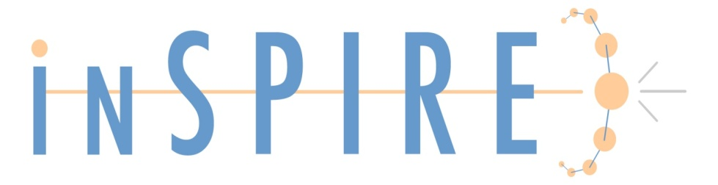
Conclusion
INSPIRE is going live in April 2010.
Greatly increased speed and new features.
Just what is needed by Tony Thomas (and others).
Happy birthday, Tony, please consider INSPIRE a late present!

