Slide 1
LIVING ON A RADIOACTIVE PLANET
THE PROS AND CONS
Sarah Lawley

Slide 2
OUTLINE OF TALK
Background Radiation
Dose-response
Epidemiology
Radiobiology
Conclusions

Slide 3
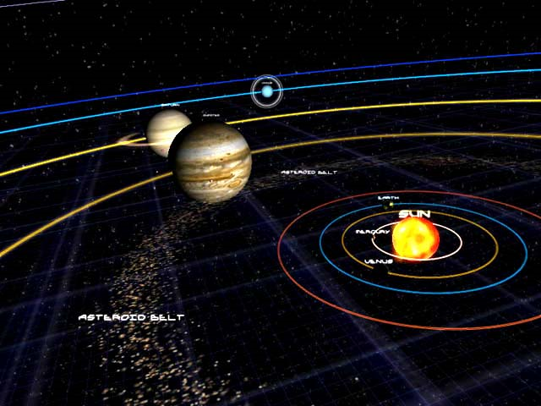
YYOU ARE HERE

Slide 4
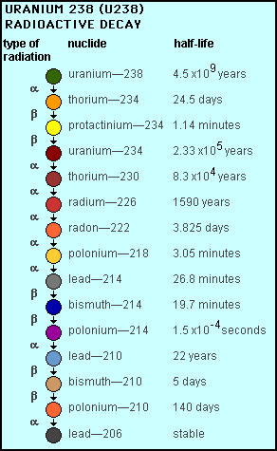
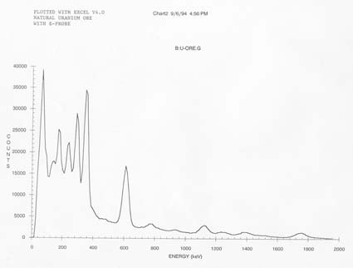
Gamma spectrum from Uranium ore
Bismuth 214
Energy 609 keV

Slide 5
Radiation Units
Radioactivity – 1 Becquerel (Bq)= 1 radioactive decay per second
Absorbed dose – 1 Gray (Gy) = the absorption of one joule energy (in the form of ionising radiation) by one kilogram of matter
Equivalent dose (biological effect) – Sievert (Sv) the unit of absorbed dose equivalent for the body, based on the damaging effect for the type of radiation (W_{R}) and the biosensitivity of the exposed tissue (W_{T}). (Note: 1 Sv = 100 rem)
Sv = Gray x W_{R} x W_{T}
International Commission on Radiological Protection (ICRP):
Annual Dose Limit (public) = 1 mSv
Annual Dose Limit (workers) = 20 mSv

Slide 6
Principles of Radiation Protection
Justification
Optimisation
Limitation

Slide 7
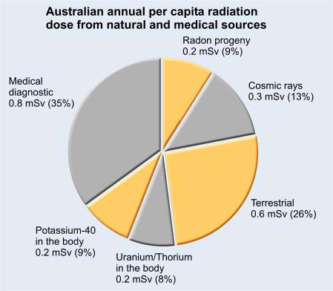
Source: http://www.arpansa.gov.au/radiationprotection

Slide 9
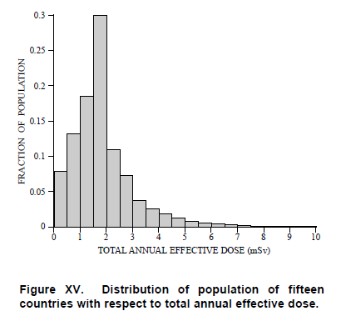
Natural Variation in Background
UNSCEAR Report 2000, Annex B

Slide 10
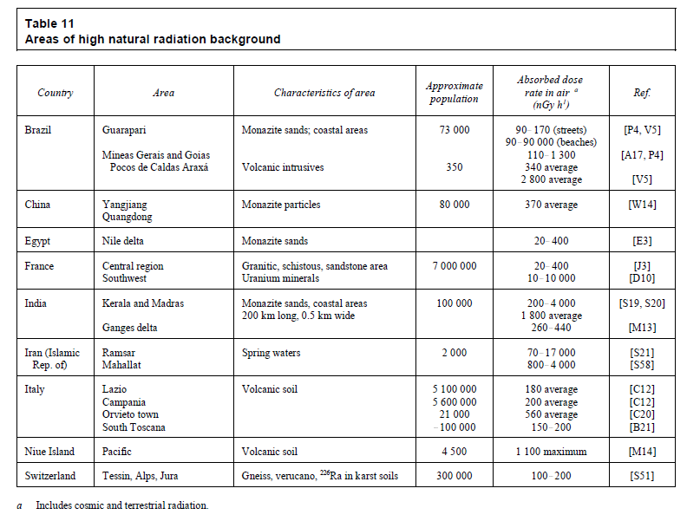
(260 mSv/yr)

Slide 11
How much is bad? / good?
1. Epidemiology (“large scale” population studies)
  Atomic bomb survivors, Hiroshima & Nagasaki
  Medical treatments and accidents (X-rays, thorium injections)
  Radium dial painters
  Underground miners (coal, iron, tin, uranium, etc, etc, etc)
  High background areas
  Nuclear shipyard workers, US
  Radioactive apartments in Taiwan
2. Biology (experiments)
  Cell repair
  Immune system stimulation
  Adaptive response
  Apoptosis
  Hormesis

Slide 12
How the question was answered
United Nations Scientific Committee on the Effects of Atomic Radiation (UNSCEAR) used data from 1945 atomic bomb survivors (1958)
Detailed Hiroshima Data | Total N | Total Cancers | Average Dose | % Cancer | % Difference
Background (beyond 3km) | 23493 | 3230 | 2 | 13.7 | 0
within 3km, < 5 mSv | 10159 | 1301 | 4 | 12.8 | -0.9
5 - 100 mSv | 30524 | 4119 | 50 | 13.5 | -0.3
100 - 200 mSv | 4775 | 739 | 150 | 15.5 | 1.7
200 - 500 mSv | 5862 | 982 | 350 | 16.8 | 3.0
500 - 1000 mSv | 3048 | 582 | 750 | 19.1 | 5.3
1 - 2 Sv | 1570 | 376 | 1500 | 23.9 | 10.2
> 2 Sv | 470 | 126 | 4000 | 26.8 | 13.1
Data Source: Pearce and Preston, 2000

Slide 13
AN ASSUMPTION WAS MADE
single particle
of radiation
single DNA
molecule
cancer
initiation
probability of
cancer initiation
∝
number
of hits
∝
number of
particles
∝
the
dose
Implying that cancer risk is linearly dependent on dose
“The Linear No Threshold Hypothesis (LNT)”
Meaning the cancer risk from 1 mSv
is 0.001 the risk from 1 Sv

Slide 14
Excess deaths from leukemia per 100 "expected" among Japanese A-bomb survivors (1950—90) vs. dose
Pierce D.A. et al, Studies of the mortality of atomic bomb survivors, Report 12, Part 1, Cancer 1950—90, Radiation Research, vol. 146, p1—27, 1996.

Slide 15
LNT applied at < 100 mSv/a
Accepted by:
UNSCEAR
ICRP → most regulators
2. LNT overestimates risk:
  France Academy of Sciences
  US National Academy of Medicine
Risks/benefits are too small to measure:
US National Council on Radiological Protection (NCRP)
Australasian Radiation Protection Society (ARPS) (Submission to ICRP)
Risk
Dose

Slide 16
Risk Assertions based on LNT model:
“Radon is the number one cause of lung cancer among non-smokers, according to US EPA estimates.”
Deaths attributed to Radon:
Approximately 21,000 US EPA 2003*
*http://www.epa.gov/radon/risk_assessment.html
“It is estimated that radon causes 1,000 – 2,000 lung cancer deaths per year [in the UK].”
UK Health Protection Agency

Slide 17
“(If) everyone on earth adds a 1-inch lift to their shoes for just 1 year the resultant very small increase in cosmic ray dose would yield a collective dose large enough to kill 1500 people with cancer over the next 50 years”
Marvin Goldman: Cancer Risk of Low-Level Exposure Science 1996 272 1821-1822

Slide 18
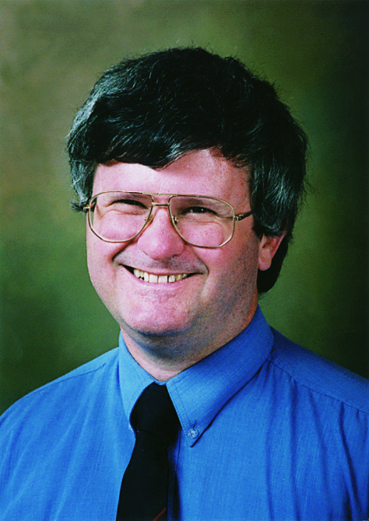
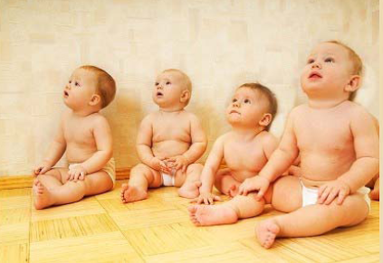
“Sometimes averages are not helpful”
- Ches Mason, ARPS 2009
60
Average Age = (60 + 2x4)/5 = 13
It doesn’t really describe any of them, does it?

Slide 19
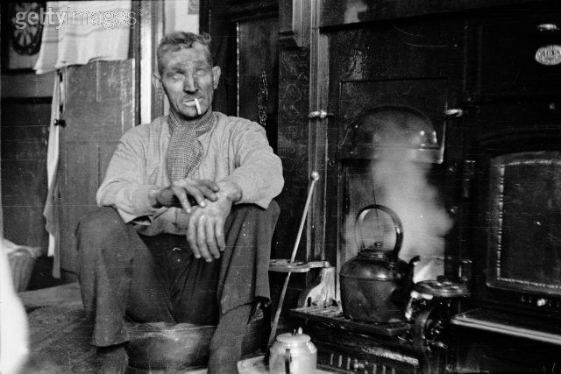
Population risk doesn’t represent the risk for either smokers or non-smokers!
Smokers (20%) of population have 25x higher risk of lung cancer*
Non-smokers (80%)
Average Population risk = (25 x r_ns + 4 x r_ns)/5 = 5.8 x r_ns
*European Collaborative Study on Radon Risk and Lung Cancer (2006)

Slide 20
Tobacco Use in the US, 1900-2002
Per capita cigarette consumption
Male lung cancer death rate
Female lung cancer death rate
*Age-adjusted to 2000 US standard population. Source: Death rates: US Mortality Public Use Tapes, 1960-2002, US Mortality Volumes, 1930-1959, National Center for Health Statistics, Centers for Disease Control and Prevention, 2005. Cigarette consumption: US Department of Agriculture, 1900-2002.
Notes:
The last set of slides describes at the prevalence of cancer risk factors, such as tobacco use and physical inactivity, and the prevalence of cancer screening, such as use of mammography.
Tobacco use is a major preventable cause of death, particularly from lung cancer. The year 2004 marks the anniversary of the release of the first Surgeon General’s report on Tobacco and Health, which initiated a decline of per capita cigarette smoking in the United States. As a result of the cigarette smoking epidemic, lung cancer death rates showed a steady increase through 1990, then began to decline among men. The lung cancer death rate among US women, who began regular cigarette smoking later than men, continues to increase slightly.

Slide 21
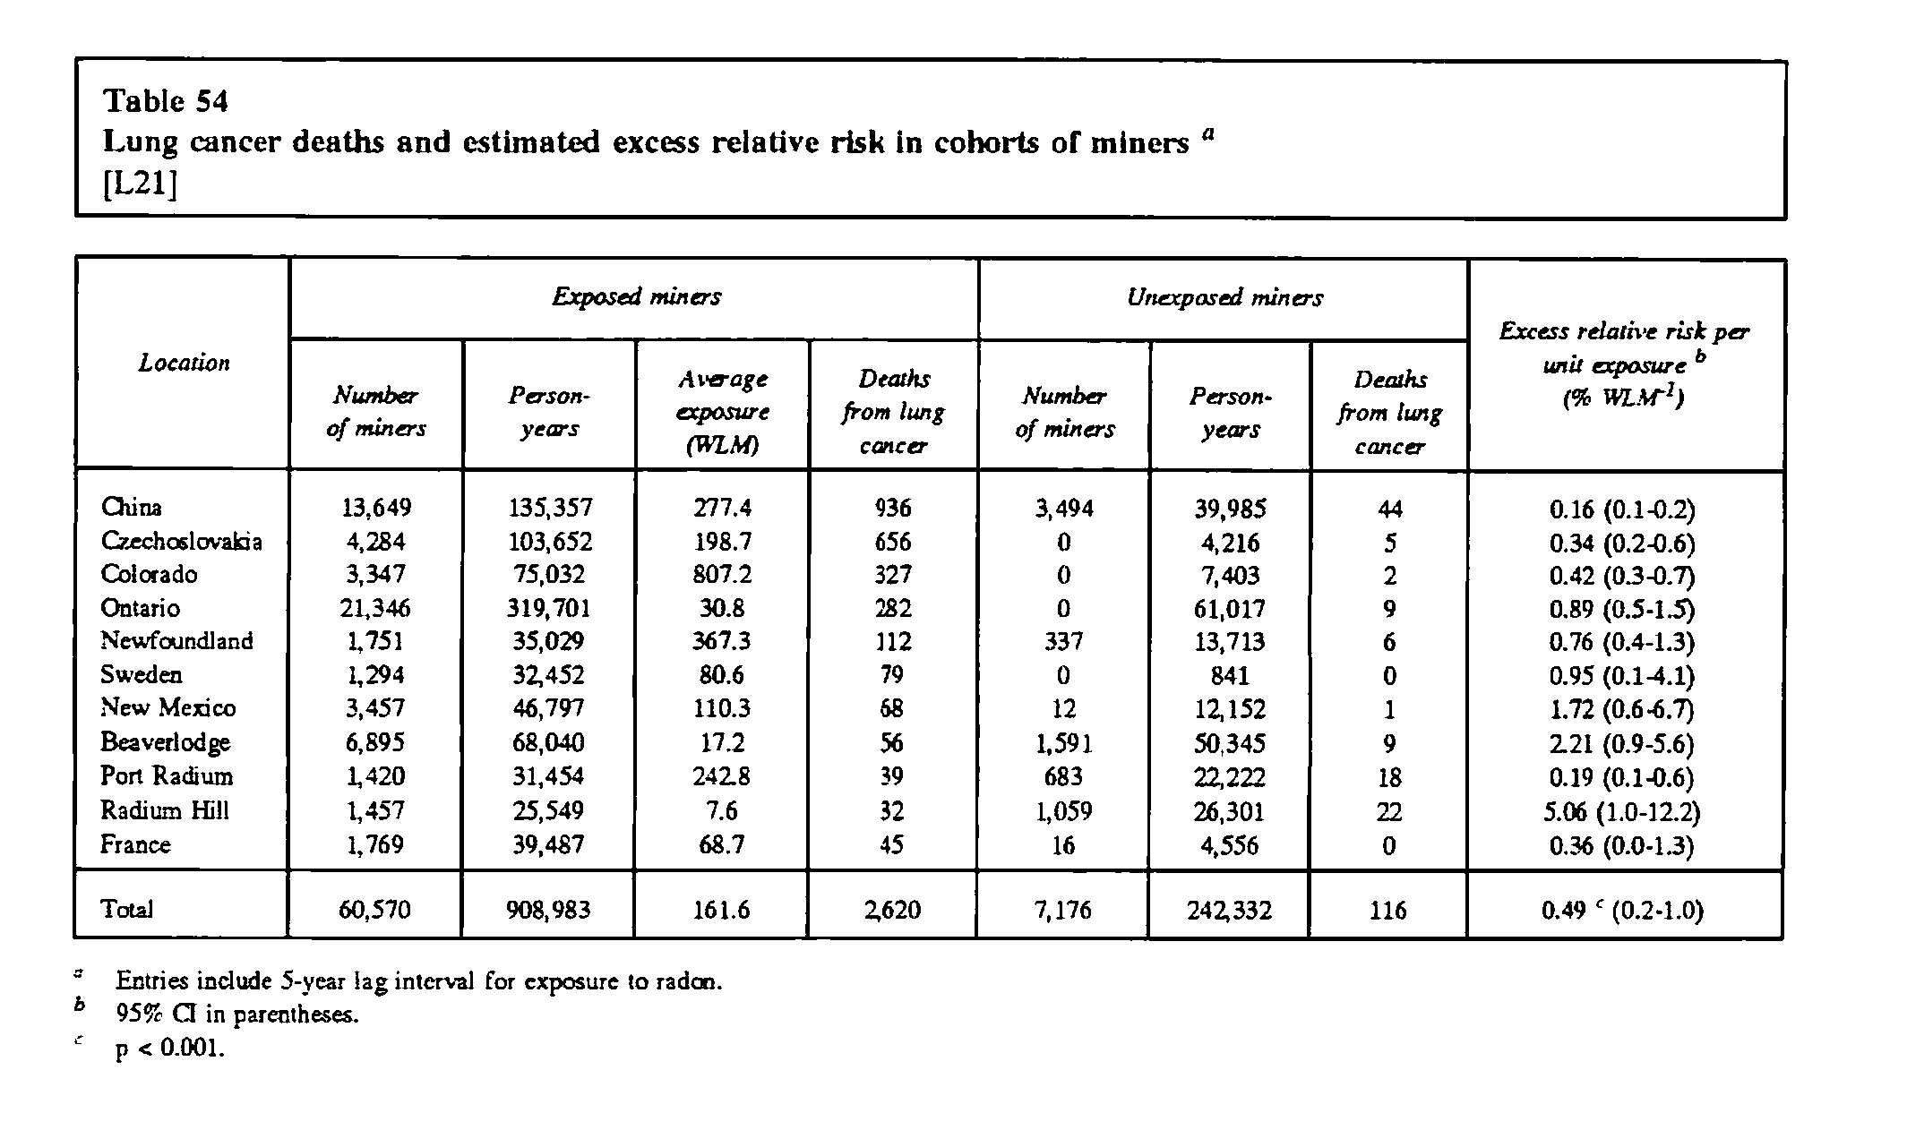
Radon Epidemiology for Miners
Note: 70% smokers
UNSCEAR report 1994, Annex A.
1 WLM = 800 Bq/m³ ➔ average for miners was ~130,000 Bq/m³

Slide 22
ICRP Dose Conversion Factor for Radon at Home
Based on populations of mine workers exposed to high radon levels (1920 – 1968). Using a linear model, ignoring the effects of smoking, ICRP conversion:
1.7 mSv yr⁻¹ per 100 Bq/m³
Estimated prevalence of smoking in miners: 67%*
0.33 x r_{ns} + 0.67 x 25 x r_{ns} = 1.7 mSv yr⁻¹ per 100 Bq m⁻³
      0.1 mSv yr⁻¹ per 100 Bq m⁻³ for non-smokers
      2.5 mSv yr⁻¹ per 100 Bq m⁻³ for smokers
      * 50–70 % male population (general public) were smokers
      (1925–1950), US Surgeon Generals Report (1980).

Slide 23
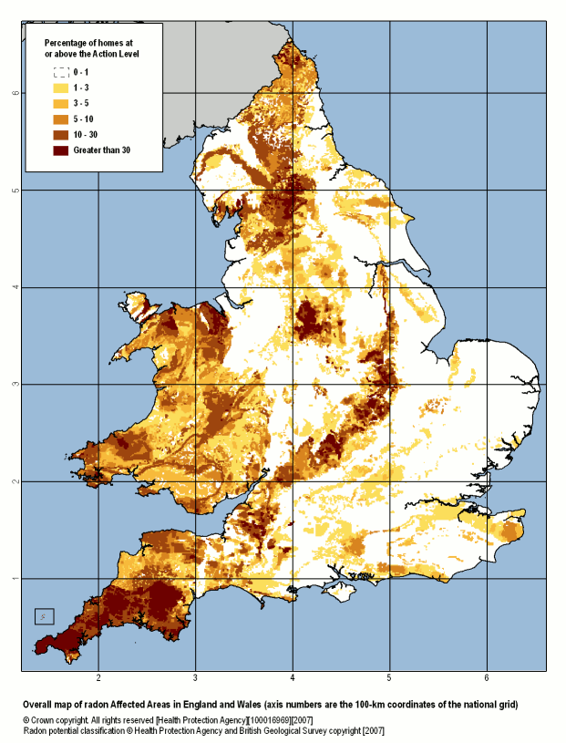
“Action Level”
= 200 Bq/m³

Slide 24
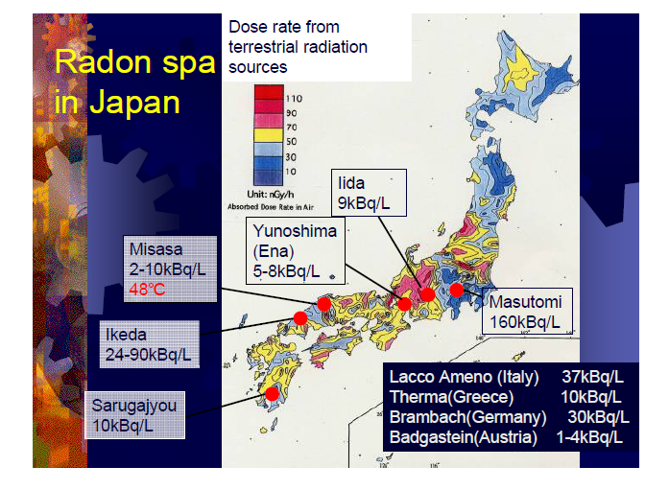
Hidenori Yonehara, ARPS 2009

Slide 25
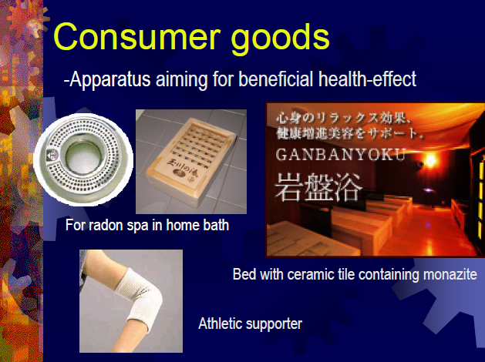

Slide 26
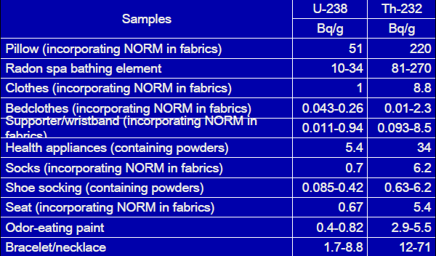
Activity Concentrations in Consumer Goods (Japan)
Hidenori Yonehara, ARPS 2009

Slide 27
WHAT ABOUT BIOLOGY?
“A single mutation is not enough to cause cancer. In a lifetime, every single gene is likely to have undergone mutation on about 10¹⁰ separate occasions in any individual human being. The problem of cancer seems to be not why it occurs, but why it occurs so infrequently...
...If a single mutation in some particular gene were enough to convert a typical healthy cell into a cancer cell, we would not be viable organisms.”
- J. Michael Bishop, Nobel Laureate, discoverer of the oncogene.

Slide 28
Hmmm... It’s only a 30 min talk...
Don’t have time to explain this slide ☺

Slide 29
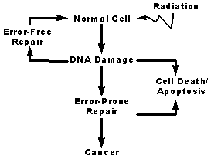
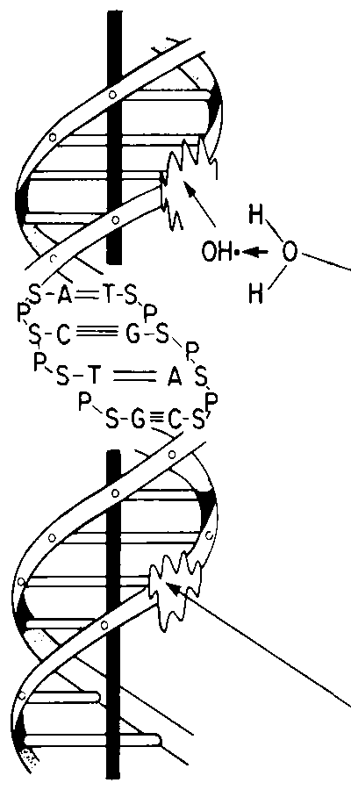
Causes of Damage to
Chromosomes
Indirect damage
  Water molecule is ionized, breaks apart, and forms OH free radical.
  OH free radical contains an unpaired electron in the outer shell and is highly reactive: Reacts with DNA.
  75 percent of radiation-caused DNA damage is due to OH free radical.
  NOTE: 2-3% of all metabolized oxygen is converted to free radicals (The main cause of DNA damage is oxygen from breathing).
Direct damage
  DNA molecule is struck by radiation, ionized, resulting in damage.

Slide 30
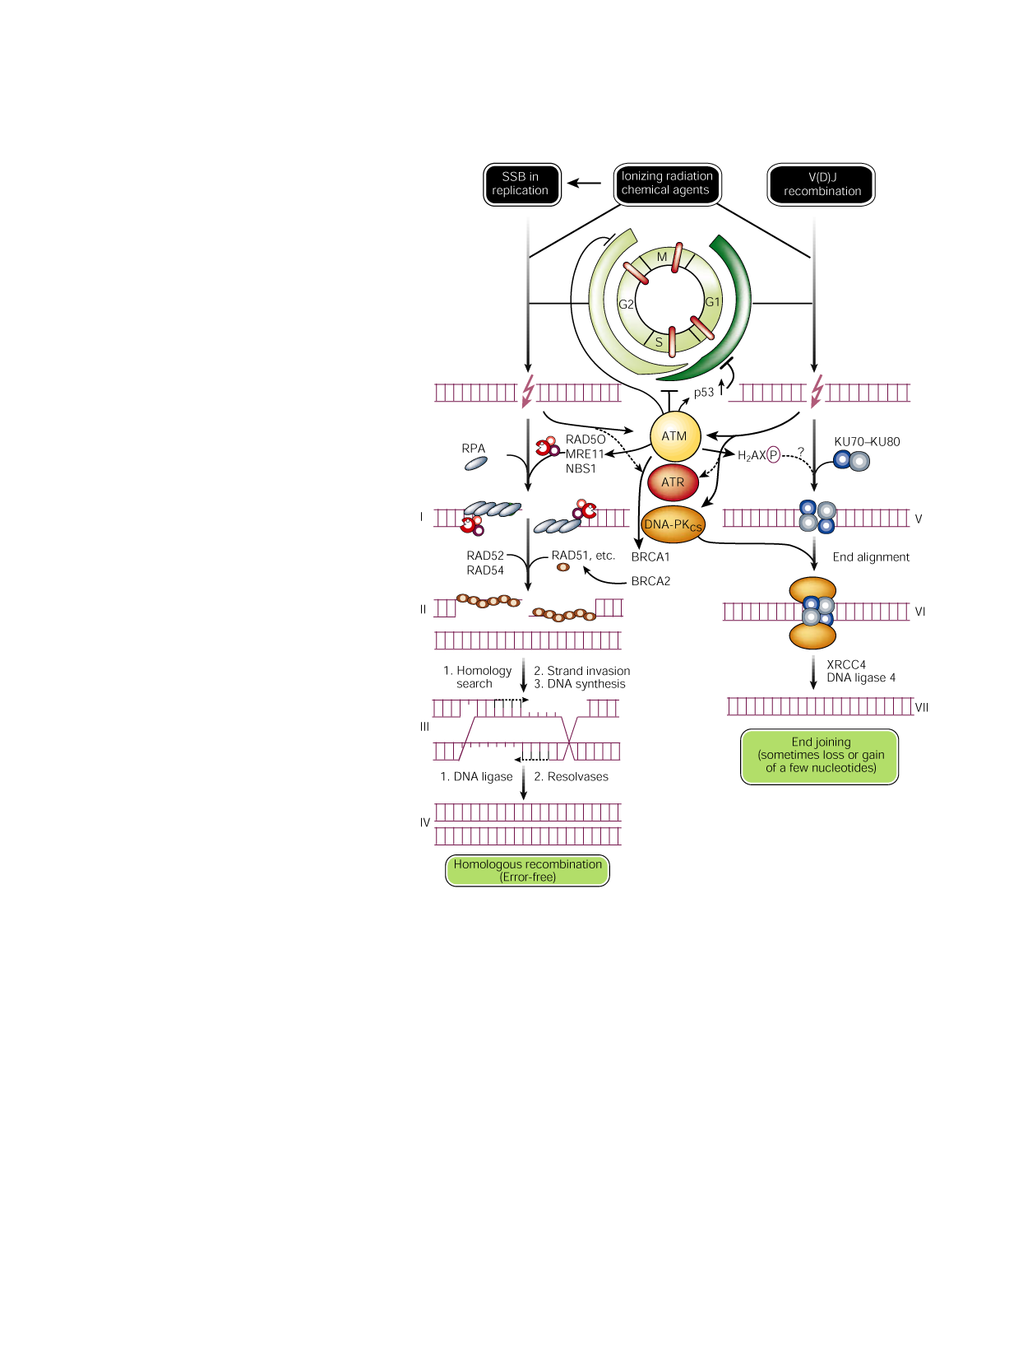
DNA double strand
break repair
Nature, 411:366-374, 2001

Slide 31
Adaptive Response
When a small dose of radiation is given before a larger one, it would be expected there would be more chromosome aberrations than when just the large dose was given. But that is not what happens. With a small “tickle” dose before the larger dose, there were only about half as many aberrations than with just a large dose!
90
80
70
60
Aberrations
50
Observed
40
Expected
30
20
10
0
0
0.5
150
0.5 + 150
Dose cGy
Shadley and Wolff 1987
Notes:
The next important area of study is to determine the influence of low doses of radiation on the response of cells and tissues to subsequent larger radiation doses. The slide demonstrates that a small dose of radiation results in an adaptive response that makes it more resistant to the subsequent large radiation exposure. It is essential to determine the genes that are involved in production of this adaptive response and ultimately to determine if and how this adaptive response can alter the risk from low doses of radiation. It has been suggested that the low doses of radiation produce a protective response that would reduce the risk from radiation relative to that predicted from the linear-no-threshold model.

Slide 32
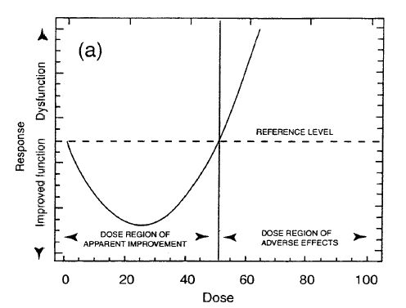
Theoretical Curve for hormesis

Slide 33
Evidence that low dose radiation is good for you
10
spleen
prostate
*
*
*
*
Inversion frequency +/- SE
*
(Ratio of treatment/endogenous)
1
*
*
0.1
0.001
0.01
0.1
1
10
100
1000
*
,
p
< 0.05
X-Radiation (mGy)
Hooker et al, (2004). Radiat. Res. 162: 447-452

Slide 34
Dose-response curves of apoptosis in mouse organs

Slide 35
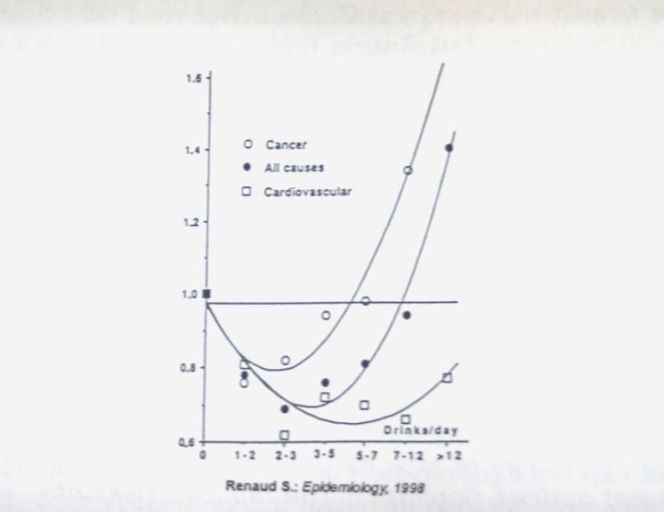
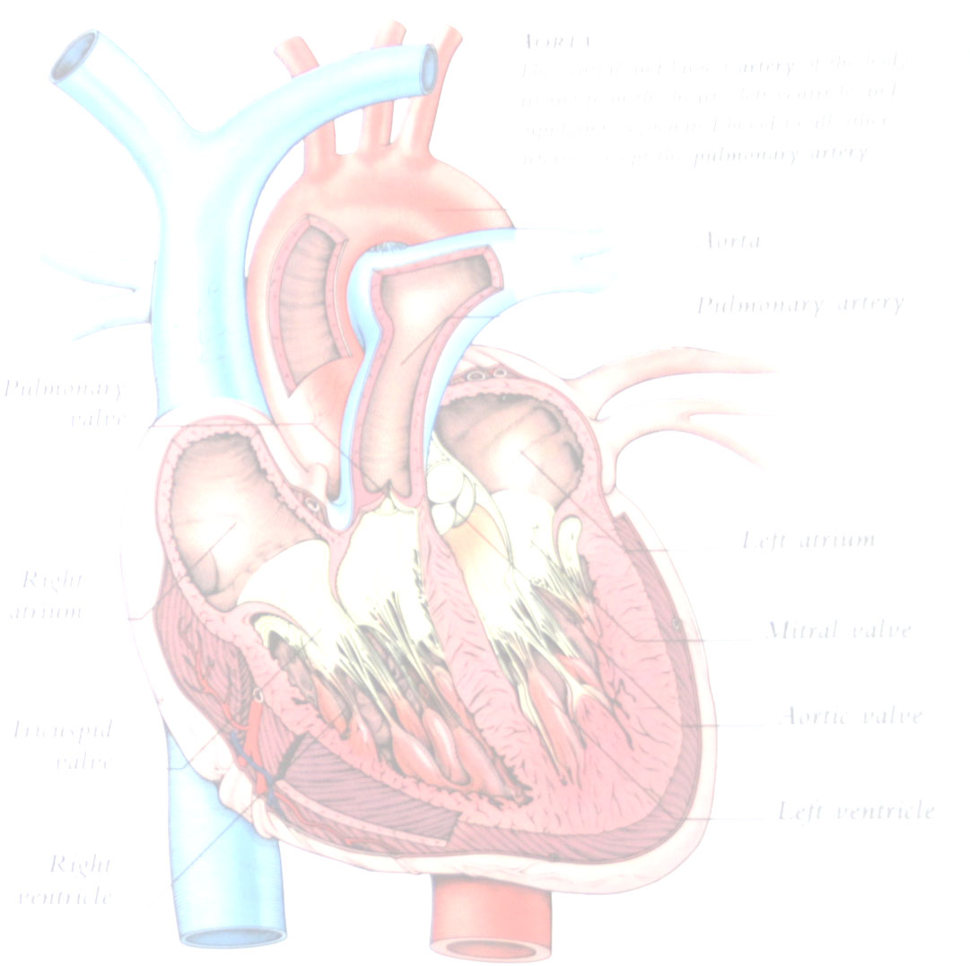
Alcohol Dose-Response Curves
Notes:
Slide shows that with increasing # of drinks/day, there is decrease in deaths from all causes through 7-12/day. Then there is increase in all except HD

Slide 36
Is using the Linear No Threshold (LNT) model a good thing?
POSITIVES
  Conservative dose limits (< 20 mSv/a)
  High standards for decontamination
NEGATIVES
  Poor risk assessment, poor risk communication
  Unnecessary anguish to recipients of low doses
  Reluctance of patients to undergo treatment
  Unwarranted fear of low dose radiation

Slide 37
TAKE HOME MESSAGES
Don’t believe everything you read! Sometimes health warnings are model dependent (LNT)
LNT for dose-response is under debate
Quit smoking, it’s bad for you
Try some Aussie wine, it’s good for you!
Thank you

Slide 39
Cell
Nucleus contains DNA
DNA is packaged on chromosomes
DNA double stranded helix

Slide 40
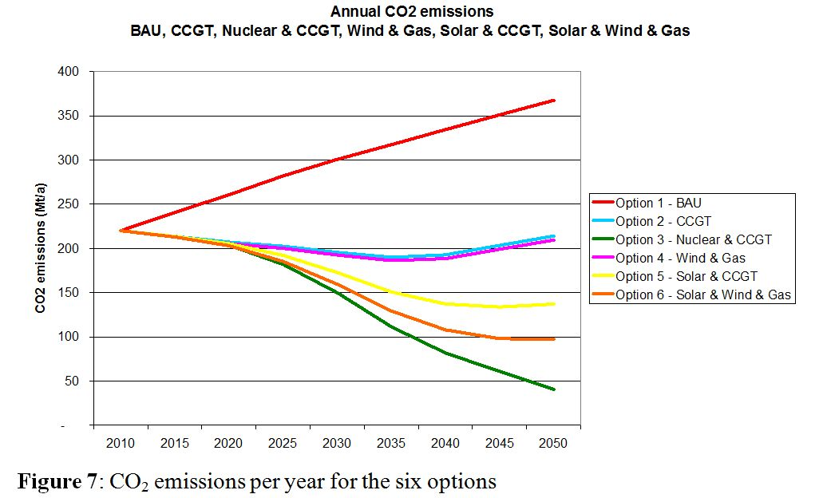
P. Lang, Brave New Climate, 2010

Slide 41
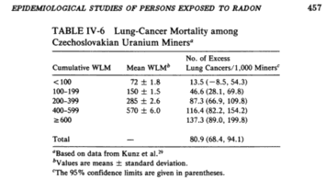
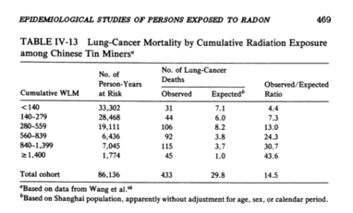
Radon Epidemiology for Miners
Note: 1 WLM == 800 Bq/m³ (ICRP Publication 65)
World average indoor concentration = 40 Bq/m³ (UNSCEAR)
BEIR IV (1988).

