Slide 1
Exact Lattice Supersymmetry at the Quantum Level for N=2 Wess-Zumino Models in Lower Dimensions
Noboru Kawamoto
(Hokkaido University)
In collaboration with
K.Asaka, A.D’Adda and Y.Kondo
D’Adda, Feo, Kanamori, N.K., Saito
JHEP 1203 (2012) 043, JHEP 1009 (2010) 059

Slide 2
Major difficulties for lattice SUSY
Let’s consider the simplest lattice SUSY algebra:
(1) Difference operator does not satisfy Leibniz rule.
(2) Species doublers of lattice chiral fermion copies appear:
unbalance of d.o.f. between bosons and fermions

Slide 3
Proposal of solution for the difficulties
Difficulties in lattice
Solutions
Leibniz rule
in momentum space
latt. mom. conservation
(１) No Leibniz rule
in coordinate space
(２) Species doublers on lattice
unbalance of fermion
and boson
Doublers as super partners
of extended SUSY
No chiral fermion problem !

Slide 4
Solution to (1):
Momentum:
Coordinate:
Good:
product is non-local
Short comings:
loss of translational invariance

Slide 5
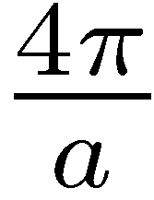
Interpretation of (2):
translation generator of
half translation generator
Brilliuon zone

Slide 6
Essense of Lattice SUSY transformation: D=N=1
species doublers

Slide 7
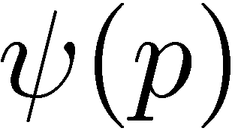
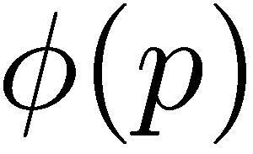
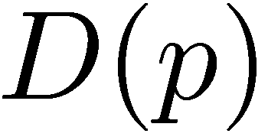
Two different modes (N=2)
fermion
species doubers
boson
auxiliary field

Slide 8
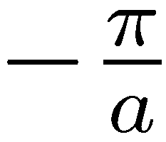
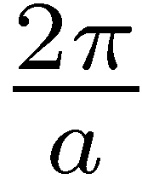
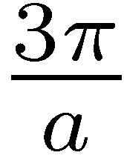
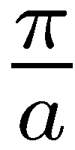
Truncation of d.o.f. (chiral condition: D=N=2)
identification

Slide 9
N=2 Wess-Zumino model in two dimensions
N=D=2 algebra:
Light cone coordinate
direct product

Slide 10
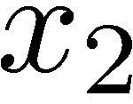
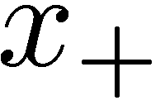
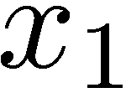
D=N=2 super symmetry on the lattice
has 4 species doublers
truncation needed
chiral conditions

Slide 11
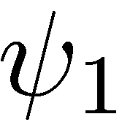
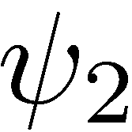
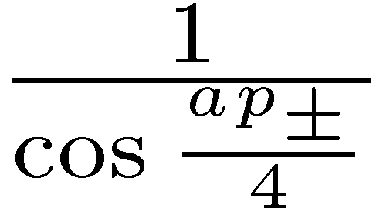
the meaning of

Slide 12
Wess-Zumino action in two dimensions
Super charge exact form exact lattice SUSY inv.
Kinetic term
Interaction term

Slide 13
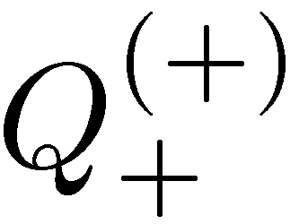
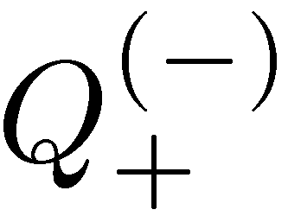
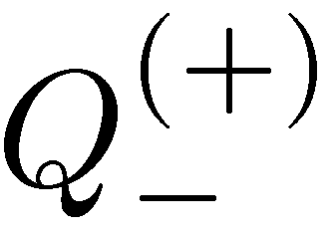
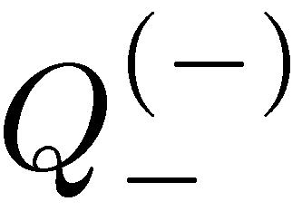
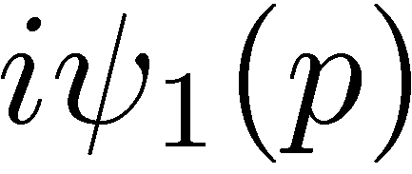
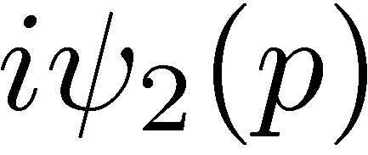
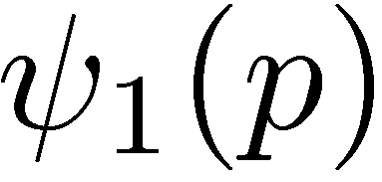
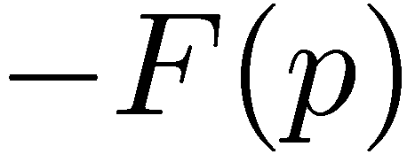
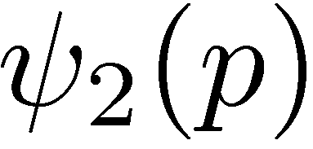
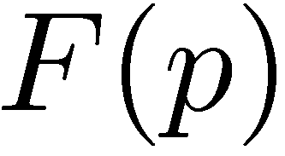
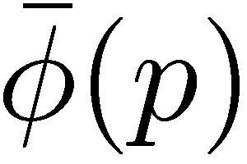
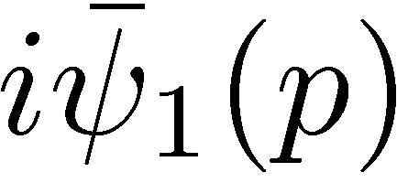
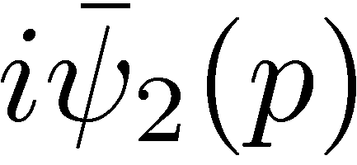
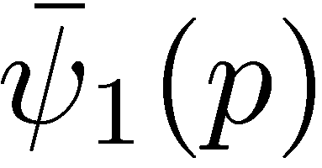
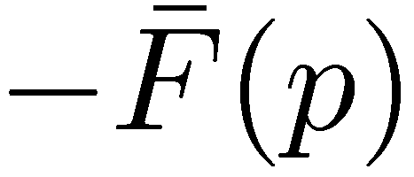
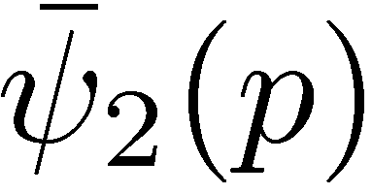
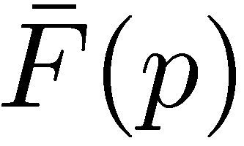
D=N=2 lattice SUSY transformation
Chiral
Anti-chiral

Slide 14
N=2 Wess-Zumino actions in coordinate
product actions in two dimensions
Kinetic term
Interaction term
SUSY algebra with Leibniz rule is satisfied on product !

Slide 15
Ward Identity: SUSY exact in quantum level ?
When lattice SUSY is exact:
Suppose we choose:

Slide 16
Tree level Ward Identity
Tree level W.I. is satisfied.

Slide 17
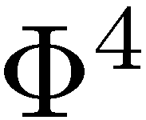
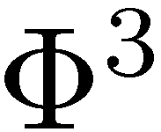
One loop Ward Identity:
one loop W.I. tree W.I.

Slide 18
Two loop Ward Identity:
two loop W.I. tree W.I.

Slide 19
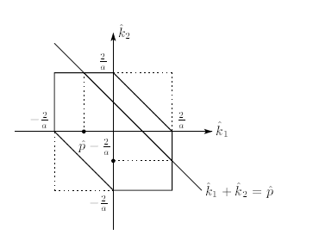
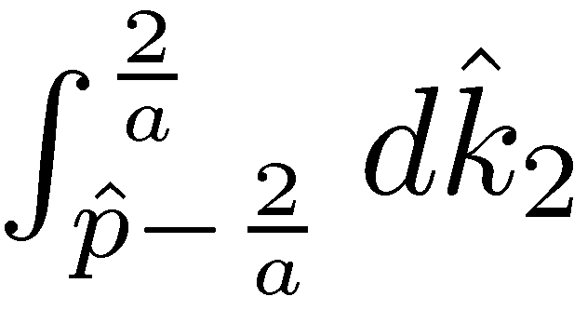
Subtleties of integration domain
equal ?

Slide 20
Summary of the formulation
(non-gauge theory: D=N=2)
Good:
Exact lattice SUSY with correct Leibniz rule
on the product, quantum level exactness
No chiral fermion problems (species doublers
are truncated by chiral conditions)
Short comings:
non-local field theory
Loss of translational invariance
(recover at )
super Yang-Mills ?

Slide 21
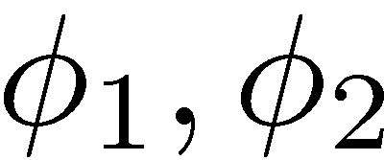
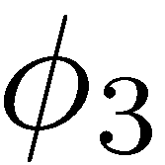
Breakdown of associativity
Integration region
(A)
(B)
Since and are different fields,
associativity is broken

Slide 22
Even though the associativity is broken the following
product is well defined.
non-gauge lattice SUSY has exact symmetry
In the formulation of lattice super Yang-Mills
the breakdown of the associativity is problem.
SUSY transformation is linear in fields
while gauge transformation is non-linear.

Slide 24
Conclusions
Exactly SUSY invariant formulation in mom.
and coordinate space is found.
A new star product is defined where exact
lattice SUSY algebra is fulfilled.
Another solution to chiral fermion problem
Species doublers are physical

Slide 25
N=1
Momentum representation
N=2
＝
species doubler

Slide 26
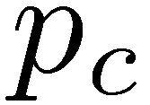
SUSY transformation in momentum space
(N=2 in 1-dim.)
N=2 lattice SUSY algebra
continuum momentum:
species doubler

Slide 27
Lattice super covariant derivative
Chiral lattice SUSY algebra (D=1,N=2)
No influence to the cont. limit

Slide 28
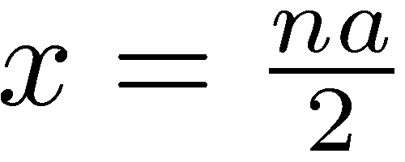
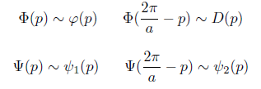
bi-local nature of
SUSY transformation
species doubler
as supermultiplets
N=2

Slide 29
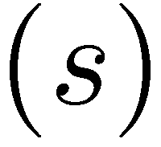
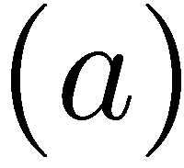
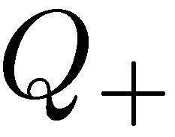
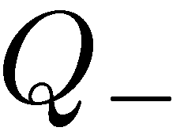
Chiral conditions
truncation of
species doub. d.o.f.
1-dim.
rescaled field !
meaning ?
chiral
anti-chiral

Slide 30
Exact Lattice SUSY action for N=2 D=1
Super charge exact form exact lattice SUSY invariant
lattice momentum conservation

Slide 31
New＊product and Leibniz rule (coordinate rep.)
New star ＊ product
Leibniz rule in lattice momentum space
Leibniz rule on＊product (coordinate rep.)
Action on ＊ product

Slide 32
D=N=2 Lattice SUSY transformation
Chiral algebra

Slide 33
has 4 species doublers
truncation needed
chiral conditions

Slide 34
D=N=2 super covariant derivative

Slide 35
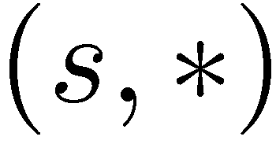
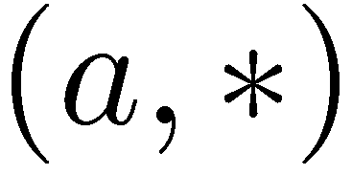
Chiral conditions for D=N=2
chiral fields

Slide 36
D=N=2 lattice SUSY transformation
Chiral
suffix (s,s)
is omitted
Anti-chiral
suffix (a,a)
is omitted

Slide 37
Wess-Zumino action in two dimensions
Super charge exact form exact lattice SUSY inv.
Kinetic term
Interaction term

Slide 38
N=2 Wess-Zumino actions in coordinate
product actions in two dimensions
Kinetic term
Interaction term
SUSY algebra with Leibniz rule is satisfied on product !

Slide 39
Conclusions
Exactly SUSY invariant formulation in mom.
and coordinate space is found.
the first example
A new star product is defined where exact
lattice SUSY algebra is fulfilled.
Another solution to chiral fermion problem
Species doublers are physical
Higer dimensions, gauge extension, quantum…

Slide 40
Symmetric difference operator
No Leibniz rule
Possible solutions:
(1) Link approach:
Hopf algebraic symmetry
(2)
New star product:
Leibniz rule ?

Slide 41
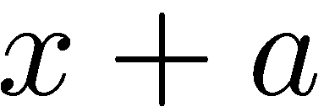
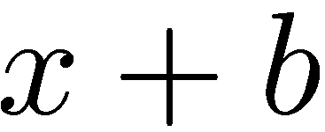
Two Problems
Bruckmann
Kok
When
“inconsistency”
but if we introduce the following “mild non-commutativity”:
then
In general

Slide 42
Conjecture
-product formulation and link approach
are equivalent.
non-locality non-commutativity

Slide 43
Chiral condition
Anti-chiral condition

Slide 45
Lattice super covariant derivative

Slide 46
Species doublers as super multiplets
in lattice supersymmetry :
Exact supersymmetry with interactions for D=1 N=2
JHEP 016P 0710 (hep-lat:1006.2046)
Extension to higher dimensions: D=N=2
Noboru KAWAMOTO
Hokkaido University
In collaboration with
A. D’Adda, A. Feo, I. Kanamori and J. Saito

Slide 47
Ｌａｔｔｉｃｅ ＳＵＳＹ ｔｒａｎｓｆｏｒｍａｔｉoｎ
=
half lattice shift translation (1dim.)
+
species doublers
as supermultiplets
alternating sign
Exact SUSY in momentum space with
New (commutative) star product in coordinate space
Lebniz rule
difference operator
Link approach

Slide 48
role of supercoordinate
Lattice superfield:
SUSY transformation:
hermiticity
alternating sign
key of the lattice SUSY

Slide 49
D=1 N=2 Lattice SUSY
Fourier transform

Slide 50
Kinetic term
Mass term
Interaction term
Lattice mom. conservation
exact lattice SUSY invariance under and
Momentum representation

Slide 51
Since difference operator does not satisfy Leibniz rule
“ How can algebra be consistent ?”

Slide 52
Symmetric difference operator
No Leibniz rule
Possible solutions:
(1) Link approach:
Hopf algebraic symmetry
(2)
New star product:
Leibniz rule ?

Slide 53
Lattice momentum:
Leibniz rule in mom.
New star product in coordinate space:
commutative

Slide 54
star product
Leibniz rule

Slide 55
Exact SUSY invariance in coordinate space
on star product actions

