Slide 1
Analytical derivation of gauge fields from link variables in SU(3) lattice QCD and its application in Maximally Abelian gauge
S.Gongyo(Kyoto Univ.)
T.Iritani, H.Suganuma (Kyoto.U)
Lattice 2012 at Cairns
25 Jun. 2012

Slide 2
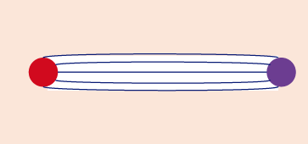
Dual-superconductor picture (DSC) for quark confinement
Nambu（１９７４）
’tHooft（１９７5）
Mandelstam（１９７６）
Higgs mechanism
(Type II) Superconductor
Dual-superconductor
Meissner effect
⇒magnetic flux is repelled
Dual Meissner
⇒Electric flux is repelled
Dual transf.
E↔B
Magnetic flux
quark
anti-quark
Electric flux
QCD vacuum
Electric charge（Cooper pairs）condensation
Magnetic flux is squeezed
Magnetic monopole condensation
Color electric flux is squeezed
Notes:
Eigenvalue is mass dimension

Slide 3
Dual-superconductor picture for QCD
and Maximally Abelian Gauge（ＭＡG）
There are two issues for DSC in QCD
・Based on Abelian gauge theory
・the existence of Monopole and their condensation
Notes:
Eigenvalue is mass dimension

Slide 4
Dual-superconductor picture for QCD
and Maximally Abelian Gauge（ＭＡG）
There are two issues for DSC in QCD
・Based on Abelian gauge theory
・the existence of Monopole and their condensation
MA gauge
minimizing
（ ：off-diagonal components）
Gauge fixing
SU（Nｃ）gauge theory U（１）^{Nc－１}gauge theory with monopole
Change Topology
Notes:
Eigenvalue is mass dimension

Slide 5
DSC picture in MAG
Analytical conjecture and Lattice study
Only the diagonal gluons reproduce the string tension.
（abelian dominance）
’tHooft（1982）, Z.F. Ezawa, A. Iwasaki(1982), T. Suzuki, I. Yotsuyanagi(1990),…
Only the monopole component reproduces the string tension. （monopole dominance）
J.D. Stack, S.D. Neiman, R. Wensley(1994),…
Off-diagonal gluons behave as massive vector bosons with the mass of about 1GeV in SU(2) （Infrared Abelian Dominance）
K. Amemiya, H. Suganuma(1999),…
Notes:
Eigenvalue is mass dimension

Slide 6
DSC picture in MAG
Off-diagonal gluon propagator in ＳＵ（２） lattice QCD
_{procedure}
Amemiya, Suganuma（１９９９）
Due to ＳＵ（２） property,
it is possible to extract the gluons from the links
Notes:
Eigenvalue is mass dimension

Slide 7
DSC picture in MAG
Off-diagonal gluon propagator in ＳＵ（２） lattice QCD
_{procedure}
Amemiya, Suganuma（１９９９）
Due to ＳＵ（２） property,
it is possible to extract the gluons from the links
Notes:
Eigenvalue is mass dimension

Slide 8
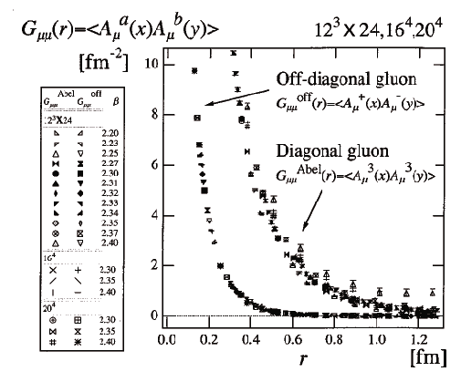
DSC picture in MAG
Off-diagonal gluon propagator in ＳＵ（２） lattice QCD
_{procedure}
Amemiya, Suganuma（１９９９）
Due to ＳＵ（２） property,
it is possible to extract the gluons from the links
Off-diagonal gluon
inactive in low E.
Notes:
Eigenvalue is mass dimension

Slide 9
To ＳＵ(3) from ＳＵ（２）...
Gluons have to be extracted exactly from link-variables.

Slide 10
Off-diagonal gluon propagator in ＳＵ（3） lattice QCD
S.G, Iritani, Suganuma
Notes:
Eigenvalue is mass dimension

Slide 11
Method to Extract Gluons from Link-variables in ＳＵ（３） lattice QCD
Furui, Nakajima（2004）
LogU Method
Solutions for the cubic equation
３×３ diagonal matrix
Notes:
Other non perturbative phenomena

Slide 12
Method to Extract Gluons from Link-variables in ＳＵ（３） lattice QCD
Furui, Nakajima（2004）
LogU Method
Solutions for the cubic equation
Gluons can be derived analytically from the link-variables
３×３ diagonal matrix
Notes:
Other non perturbative phenomena

Slide 13
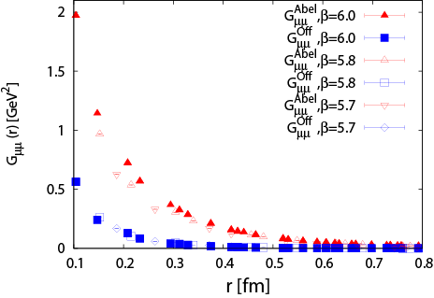
Dual-Superconductor picture in MA gauge
Off-diagonal gluon propagator in ＳＵ（3） lattice QCD
Notes:
Other non perturbative phenomena

Slide 14
Dual-Superconductor picture in MA gauge
Off-diagonal gluon propagator in ＳＵ（3） lattice QCD
・Diagonal components
⇒ active in low energy
・Off-diagonal components
⇒ inactive in low energy
Infrared Abelian Dominance!
Notes:
Other non perturbative phenomena

Slide 15
How range does the infrared abelian dominance hold in MA gauge ?
Estimation of the off-diagonal gluon mass
Proca formalism （free massive vector boson）
：modified Bessel function
Notes:
Other non perturbative phenomena

Slide 16
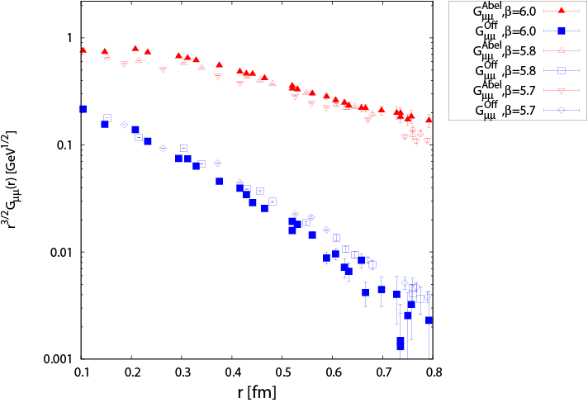
How range does the infrared abelian dominance hold in MA gauge ?
Estimation of the off-diagonal gluon mass
Notes:
Other non perturbative phenomena

Slide 17
How range does the infrared abelian dominance hold in MA gauge ?
Estimation of the off-diagonal gluon mass
The infrared abelian dominance holds within
Notes:
Other non perturbative phenomena

Slide 18
How range does the infrared abelian dominance hold in MA gauge ?
Estimation of the off-diagonal gluon mass
The infrared abelian dominance holds within
But,
This functional form cannot be described in whole region...
Notes:
Other non perturbative phenomena

Slide 19
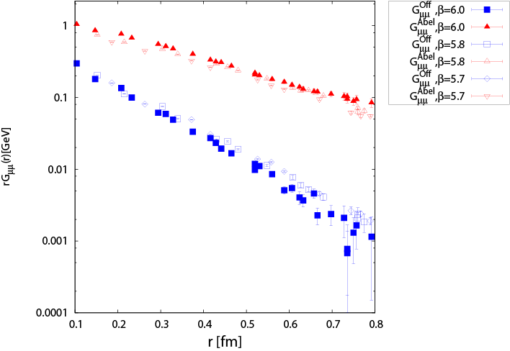
What is the functional form in MA gauge ?
Functional form of the off-diagonal gluon propagator
4D Yukawa function in Euclidean
c.f. Iritani, Suganuma, Iida（2009）
Notes:
Other non perturbative phenomena

Slide 20
What is the functional form in MA gauge ?
Functional form of the off-diagonal gluon propagator
4D Yukawa function in Euclidean
c.f. Iritani, Suganuma, Iida（2009）
Almost linear
This functional form can be described with 4D Yukawa in whole region of r = 0.1-0.8fm.
Notes:
Other non perturbative phenomena

Slide 21
What is the functional form in MA gauge ?
The spectral function of the off-diagonal gluons
4D Yukawa function in Euclidean
Spectral function is obtained
by Inverse Laplace transf.
Notes:
Other non perturbative phenomena

Slide 22
What is the functional form in MA gauge ?
The spectral function of the off-diagonal gluons
4D Yukawa function in Euclidean
Spectral function is obtained
by Inverse Laplace transf.
：modified Bessel function
Inverse Laplace transf.
Notes:
Other non perturbative phenomena

Slide 23
What is the functional form in MA gauge ?
The spectral function of the off-diagonal gluons
4D Yukawa function in Euclidean
Spectral function is obtained
by Inverse Laplace transf.
：modified Bessel function
Inverse Laplace transf.
Differentiating by ω
Notes:
Other non perturbative phenomena

Slide 24
What is the functional form in MA gauge ?
The spectral function of the off-diagonal gluons
the spectral function has a negative region.
Notes:
Other non perturbative phenomena

Slide 25
Summary and Future work
Summary
We show that, in ＳＵ(3) MA gauge, the off-diagonal gluons behave
as a massive vector boson with M_{off} ≒ 1 GeV
(the infrared abelian dominance holds within r ≫ M_{off}⁻¹ )
We show that, in ＳＵ(3) MA gauge, the off-diagonal gluon propagator
is well described by 4D Euclidean Yukawa function.
(the spectral function of the off diagonal gluons has a negative region.)
Future work
Study of the diagonal gluon propagator more precisely.
Application of the method to extract gluons from the links
（improved gauge fixing, a various gluon propagator, etc）

