Slide 1
Quark-quark interaction in baryons from Nambu-Bethe-Salpeter amplitudes on lattice
Hideaki Iida (Kyoto Univ.) in collaboration with Yoichi Ikeda (Tokyo Inst. of Tech.)
“The 30th International Symposium on Lattice Field Theory”
24-29 Jun. 2012 @ Cairns, Australia

Slide 2
Contents
Brief review: qq^{bar} potential from NBS amplitude
Interquark interaction for baryons Effective 2q interaction
Summary and conclusion

Slide 3
qq^{bar} potential from NBS amplitudes
We extract qq^{bar} potential with finite quark mass from Nambu-Bethe-Salpeter (NBS) amplitudes
cf) NN potential from lattice QCD (HAL-QCD Collaboration)
qq^{bar} potential from lattice QCD
−
q
N
q
−
N
q
q
t
0
t
0
velocity exp.
New method to extract qq^{bar} potential … qq^{bar} potential for finite quark mass

Slide 4
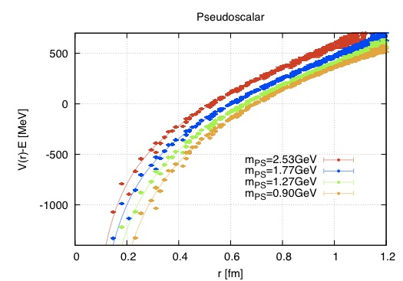
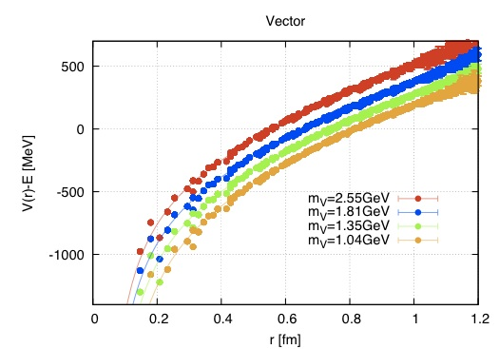
qq^{bar} potential from NBS amplitudes
Obtained potentials
The potentials show Coulomb + linear behavior
String tension for heavy quark mass is about 900MeV/fm … consistent with that obtained from Wilson loop
Good agreement with a phenomenological potential

Slide 5
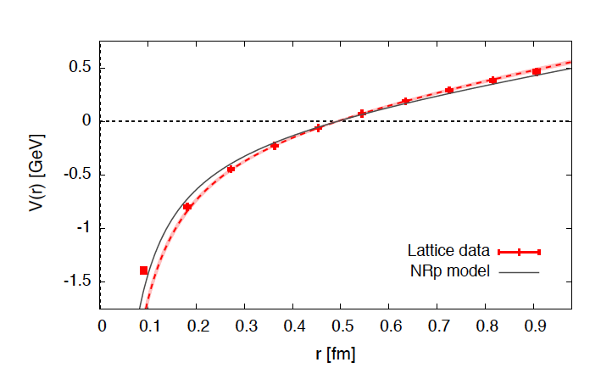
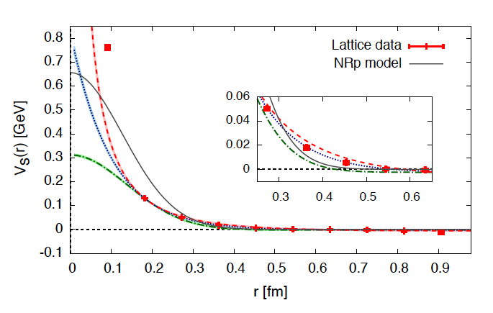
qq^{bar} potential from NBS amplitudes
c^{bar}-c potential in 2+1 flavor FULL QCD simulation at almost PHYSICAL POINT generated by PACS-CS Collaboration (m_{π}=156(7), m_{K}=553(2) MeV) Iwasaki gauge action + RHQ action
T.Kawanai, S.Sasaki, PRD85, 091503 (2012)
Spin-independent force
Spin-dependent force
・Spin-independent force shows Coulomb + linear form
・Lattice QCD potential is consistent with NRp model
(Barnes, Godfrey, Swanson,PRD72 (2005))
・Spin-dependent force shows short range
but not point-like repulsion
Construction of “quark model” from 1st principle of QCD

Slide 6
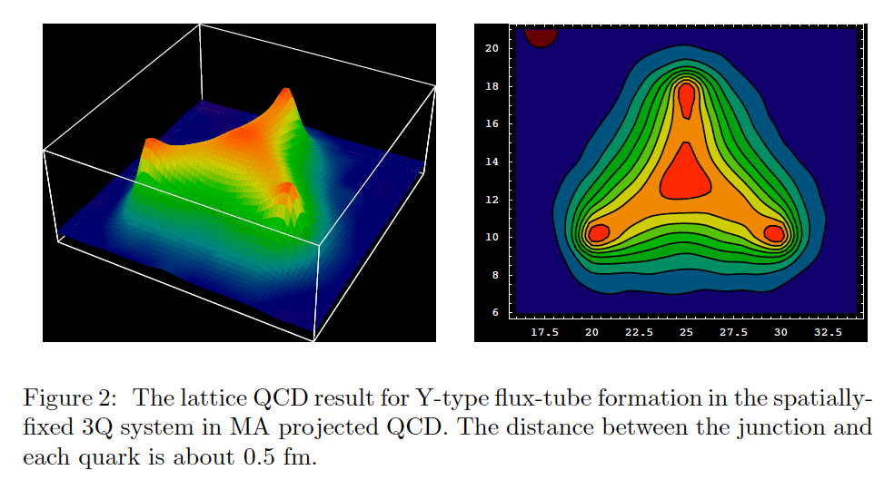
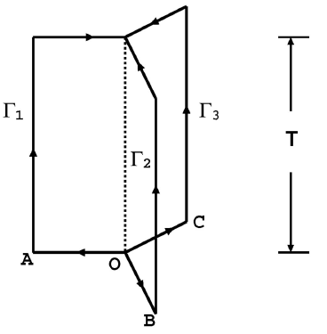
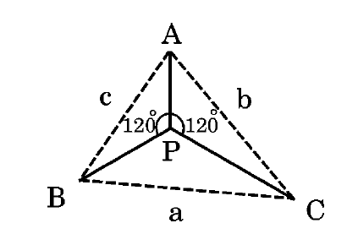
Interquark interaction for baryons
− Three-body force … essential for multi-quark system
Flux tube formation of 3Q system in lattice QCD (from H.Suganuma et al., Afr.J.Math.Phys.3, 11(2006).)
Static 3Q potential (T.T.Takahashi et al.):
●
: AP+BP+CP
(minimum length connecting 3Q)
●
●
is dependent on the configuration of 3Q

Slide 7
Interquark interaction for baryons
We study effective 2q interaction in baryons
・Three-body Schrödinger-type equation :
・Effective two-quark interaction : integrate out spectator particle
Doi et al, (HAL QCD Coll.), (2011).
integrated out

Slide 8
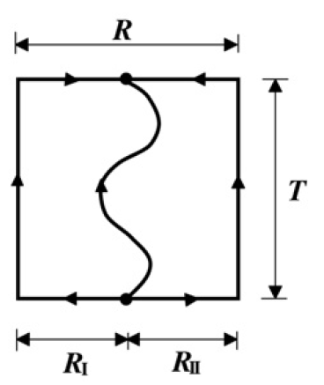
Interquark interaction for baryons
Effective 2q interaction v.s. q^{bar}-q potential (spin independent parts)
Expectation:
・String tension would be comparable
・Coulomb part is different by factor two with one-gluon exchange
cf)
Three-quark potential Valence light quark effect for 2Q T.T.Takahashi et al., PRD70, 074506 (2004) A.Yamamoto et al., PLB664, 129 (2008)
(for charm quark mass region)

Slide 9
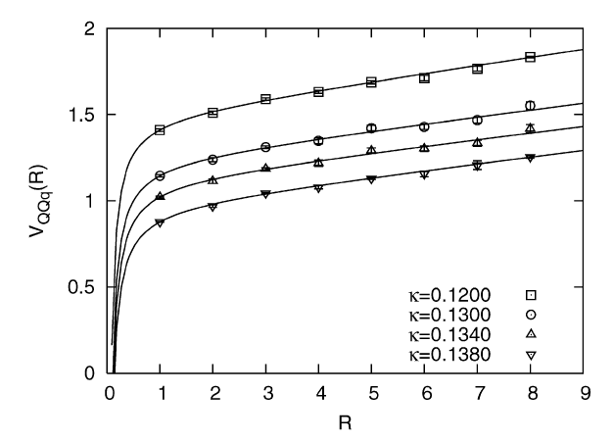
Interquark interaction for baryons
Effective 2q interaction v.s. q^{bar}-q potential (spin independent parts)
Expectation:
・ behave like Coulomb + Linear form ・String tension: comparable for the charm quark mass region For more lighter quark mass, the string tension would be reduced.
・Coulomb part: different by factor two with one-gluon exchange
cf)
Valence light quark effect for 2Q interaction A.Yamamoto et al., PLB664, 129 (2008)
・ Linear behavior of potential is seen at least up to R<0.8fm
・ for charm quark mass region. ・ For more lighter quark mass case, the string tension is
reduced by the valence-quark effect

Slide 10
Lattice setup
Quenched calculation
Action: plaquette gauge action & standard Wilson quark action
β=6.0
Lattice size: 32³×48 (V=(3.2fm)³)
Quark mass:
β=6.0, standard…m_{π}=2.53, 1.77, 1.27, 0.94GeV m_{ρ}=2.55, 1.81, 1.35, 1.04GeV
(zero momentum) Wall source
Gauge fixing: Coulomb gauge

Slide 11
Interquark interaction for baryons
Lattice QCD result of effective 2q interaction:
Effective 2q interaction seems to show Coulomb + linear form
(quark mass for spectator particle)
χ²/Ndf = 0.6 [ 0.2 < r < 0.8 fm ]
σ = 870 (209) [MeV / fm]
A = 101 (24) [MeV fm]
(t=20: ground state saturation achieved)
・Coulomb coefficient A is reduced … about a half of that for qq^{bar} potential
(c.f., σqbar-q =822 [MeV / fm], Aqbar-q =200 [MeV fm])
・String tension … difficult to say something under the current statistics

Slide 12
Quark-mass dependence
Interquark interaction for baryons
・Interactions look Linear + Coulomb form for all quark masses
・String tension σ becomes weaker and Coulomb coefficient A becomes stronger for smaller m_{q}

Slide 13
Quark-mass dependence
Interquark interaction for baryons
・Interactions look Linear + Coulomb form for all quark masses
・String tension σ becomes weaker and Coulomb coefficient A becomes stronger for smaller m_{q}

Slide 14
Quark-mass dependence
Interquark interaction for baryons
・Interactions look Linear + Coulomb form for all quark masses
・String tension σ becomes weaker and Coulomb coefficient A becomes stronger for smaller m_{q}

Slide 15
Quark-mass dependence
Interquark interaction for baryons
・Interactions look Linear + Coulomb form for all quark masses
・String tension σ becomes weaker and Coulomb coefficient A becomes stronger for smaller m_{q}

Slide 16
Quark-mass dependence
Interquark interaction for baryons
smaller m_{q}
・Interactions look Linear + Coulomb form for all quark masses
・String tension σ becomes weaker and Coulomb coefficient A becomes stronger for smaller m_{q}

Slide 17
Quark-mass dependence
Interquark interaction for baryons
smaller m_{q}
smaller m_{q}
Fit results: t=2-8, all spatial points used
: σ=873(209)MeV, A=101(24)MeV・fm
: σ=727(186)MeV, A=113(22)MeV・fm
: σ=578(176)MeV, A=126(23)MeV・fm
: σ=381(191)MeV, A=146(28)MeV・fm
Errorbars are very large
Difficult to say something
but…
・String tension … reduced for smaller m_{q}?
・Coulomb coefficient … larger for smaller m_{q}?
Need more statistics

Slide 18
Interquark interaction for baryons
Effective 2q interaction v.s. q^{bar}-q potential (spin independent parts)
Expectation:
・ behave like Coulomb + Linear form ・String tension: comparable for the charm quark mass region For more lighter quark mass, the string tension would be reduced.
・Coulomb part: different by factor two with one-gluon exchange
cf)
Valence light quark effect for 2Q interaction A.Yamamoto et al., PLB664, 129 (2008)
・ Linear behavior of potential is seen at least up to R<0.8fm
・ for charm quark mass region. ・ For more lighter quark mass case, the string tension is
reduced by the valence-quark effect

Slide 19
Summary and perspectives:
Summary
We apply the method obtaining qq^{bar} pot. from NBS w.f. to interquark interaction in baryons
We calculate effective 2q interaction in 3q system
The interaction behaves like Coulomb + Linear form
Coulomb part is reduced, which is consistent with one-gluon exchange
String tension … difficult to say under the current statistics
Perspectives
More statistics, Full-QCD simulations, three-quark potential…
・String tension … reduced for smaller m_{q}?
・Coulomb coefficient … larger for smaller m_{q}?

Slide 20
Backup slides

Slide 21
Formalism: qq^{bar} case
−
q
q
−
q
q
• Measure equal-time BS amplitude:
t
0
• S-wave projection:
• satisfies the stationary effective Schroedinger equation:
• → expanded by velocity & taking leading term:
− Assumption of − with large

Slide 22
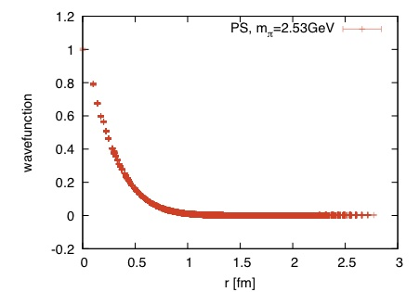
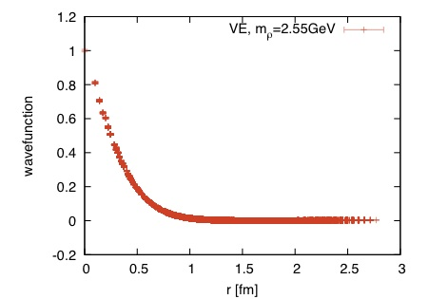
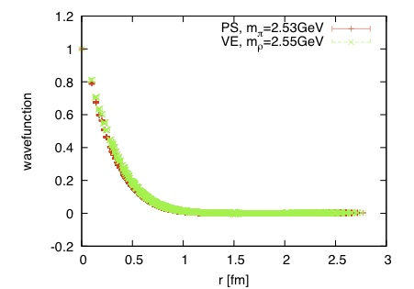
Results
Wavefunction
(t=20)
PS
V
・Wavefunction vanishes already at 1.5fm
… box size is enough.
・There is little channel dependence.
channel dependence

Slide 23
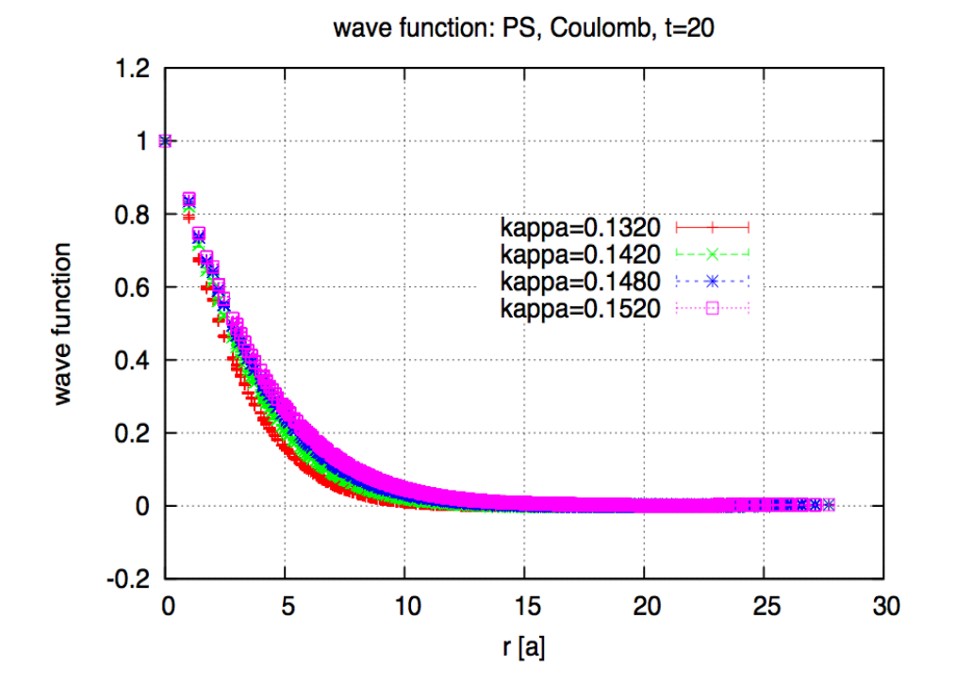
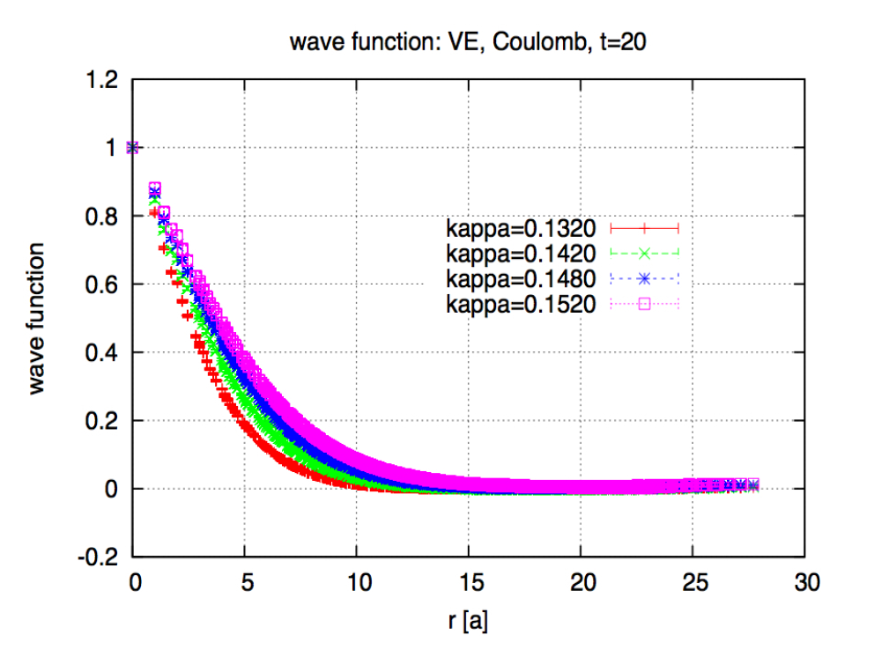
Results
Wavefunction: quark mass dependence
Compare m_{V}=2.55, 1.81, 1.35, 1.04GeV case
m_{q}
m_{q}
・Size of wavefunction becomes small as increasing m_{q}
・All the wavefunctions vanish even in small m_{q}.

Slide 24
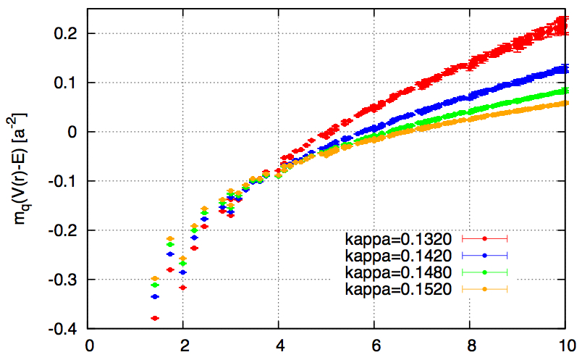
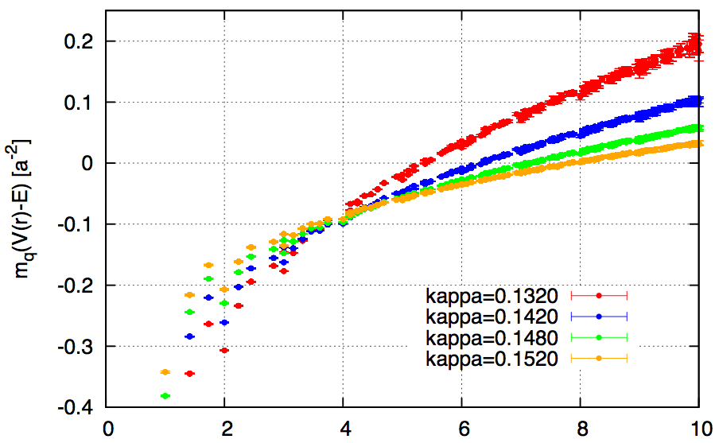
Results
• Bare data:
m_{PS} = 2.53, 1.77, 1.27, 0.94 (GeV)
m_{VE} = 2.55, 1.81, 1.35, 1.04 (GeV)
Pseudoscalar channel
Vector channel
m_{q}
m_{q}
r [a]
r [a]
These potentials show Coulomb + linear behavior !

Slide 25
Results
Potential:
m_{q}
m_{q}

Slide 26
Results
Fit results only on-axis data fit range: 3a – 10a
m_{q}
・Fitting of Coulomb + Linear type function is good!
・Roughly reproduce known value of string tension from Wilson loop
・String tension: larger for larger m_{q}
・Coulomb coefficient: smaller for larger m_{q}

Slide 27
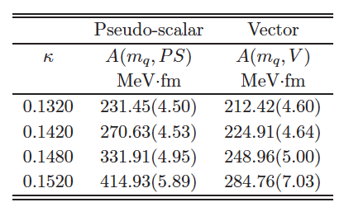
Results
Fit results only on-axis data universal σ for different m_{q} and channels
is minimized
m_{q}
σ=723(30)MeV/fm, χ²/N_{df}=1.52

Slide 28
- Function 2: Cornell + log + 1/r² (log term… prediction from effective string theory)
σ=750(120) MeV/fm
・Coulomb coefficient becomes small.
・Errorbar is very large…
Notes:
Second, we perform another fitting, with universal string tension for all the quark masses and channels.
We perform the least chi2 analysis, where the chi2 is determined by the sum of the chi2 for different quark masses and channels.
If the string tension is not universal, the minimum of total chi2 is equivalent to the some of minimum of individual \chi2.
However, here, the string tension is universal for all mq and channels, this is not the case.
If we fit by function 1, then we obtain these results.
The string tension σ=…
In this fit, the Coulomb coefficients is large compared to that obtained from Wilson loop.
If we fit the data to function 2, which include log term and 1/r^2,
then the Coulomb coefficient becomes small.
The important point is that the chi^2 of all the fit shown above is about 2 or less.
Therefore, Cornell-type fit function is good.
Function 1 is the Coenell type potential but the string tension is universal for all the quark masses and channels.
We find that the

Slide 29
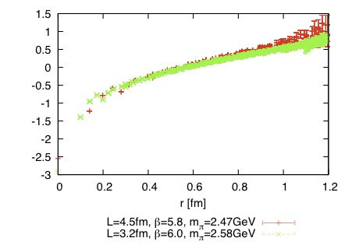
Results
Check: volume dependence of potential
・L=4.5fm (β=5.8, m_{π}=2.47GeV, clover): red
・L=3.2fm (β=6.0, m_{π}=2.58GeV, standard): green
・Small difference between them … volume is enough

Slide 30
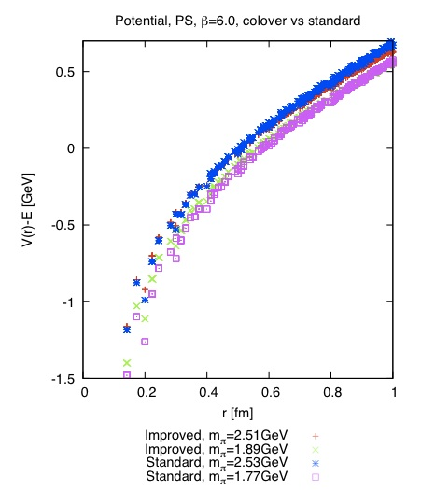
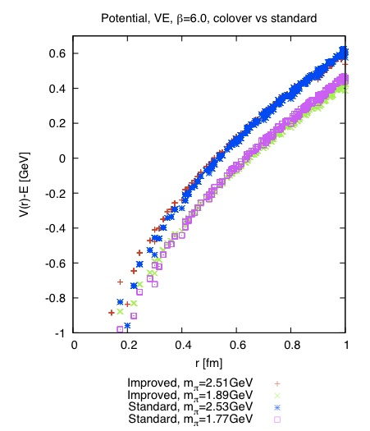
Results
Check: O(a) improvement (cutoff dependence)
Comparison:・Standard Wilson quark action, β=6.0
・O(a) improved action (clover action), β=6.0
The setup (β=6.0, a=0.1fm, standard Wilson, (3.2fm)³) seems sufficient
for the calculation of qq^{bar} potential (in the m_{q} region calculated here).
Small difference between them

Slide 31
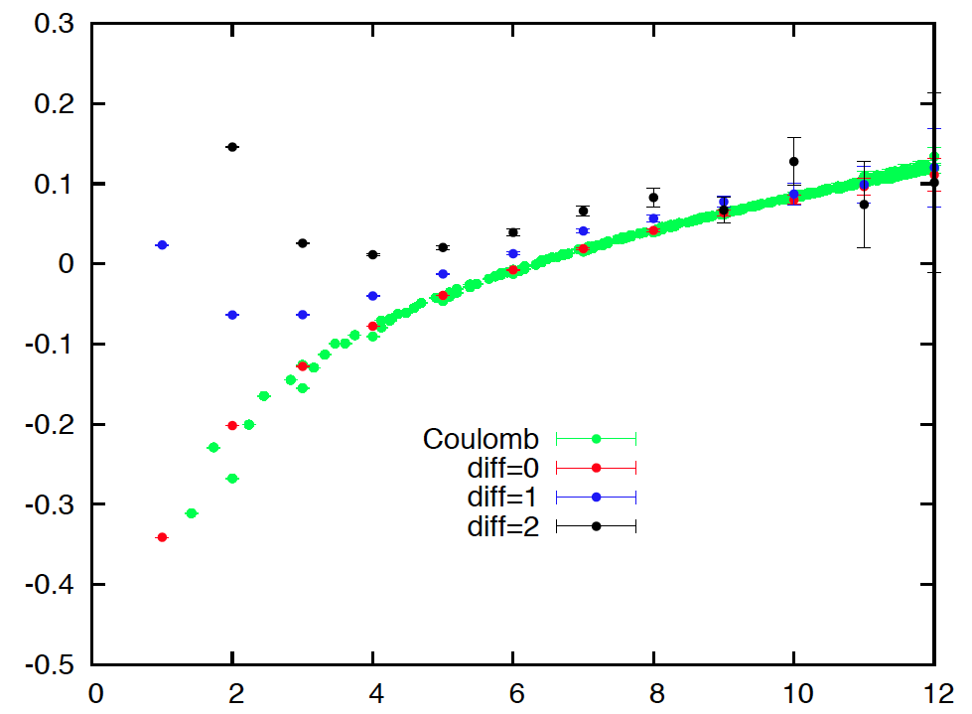
Gauge invariant calculation
connecting q and q^{bar} by link variable → gauge invariant
Δφ/φ
diff
κ=0.1480
quark prop.
r
link variable
t
t=0
link variable
≒ gauge field
r
Similar results as in Coulomb gauge
(at least for large r)

Slide 32
Operator in Coulomb gauge link-connected sink
M.Laine et al.: gauge-invariant real-time correlator
… qq^{bar} is connected with Wilson line
T=0, κ=0.1480
very similar!
Potential in Coulomb gauge 〜 That in link-connected sink
Notes:
The potential obtained here is gauge dependent.
However, potential in Coulomb gauge has an special feature.
In the paper written by M.Laine et al.,
the potential is defined gauge-independently,
connecting two quarks with Wilson line.
At T=0, we calculate a potential by gauge-invariant sink,
which means the NBS amplitude is calculated by the sink operator
in which the two quarks are connected by link variables.
The comparison between the potential in Coulomb gauge,
as shown before, and the potential in gauge-invariant sink.
The potential in gauge-invariant sink is calculated only on-axis.

