Slide 1
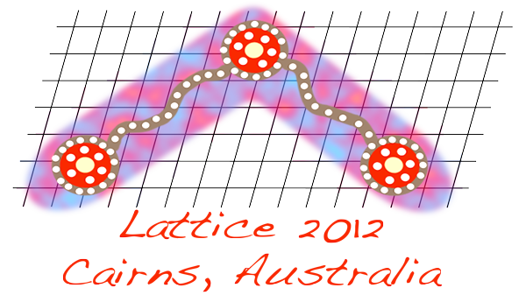
Presentation Not Loaded

