Slide 1
Program Corrections
Additional Poster:
Poster #33: Jian-Bo Zhang (Zhejiang University) Topological susceptibility near Tc in SU(3) gauge theory Poster #34: Michael Glatzmaier (University of Kentucky)
Renormalization of quark and gluon angular momentum operators with novel gauge actions
Talk Cancellation:
Tuesday, June 26, 2:50pm, Meeting Room 4 [Standard Model Parameters and Renormalisation]
Kwangwoo Kim (Seoul National University) Preliminary calculations for matching factor in BK using automatized lattice perturbation
Title changes:
Tuesday June 26, 3:30pm, Hall A [Applications Beyond QCD]
Kenji Ogawa (National Chiao-Tung University)
Infrared Fixed Point of SU(3) gauge theory with 12 flavor staggered fermions
Friday June 29, 3:10pm, Room 6 [Chiral Symmetry] Tung-Han Hsieh (Research Center for Applied Sciences, Academia Sinica)
Observables from the low-lying eigenmodes of the lattice Dirac operator

Slide 2
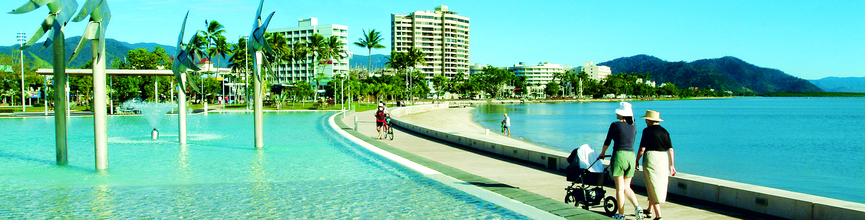
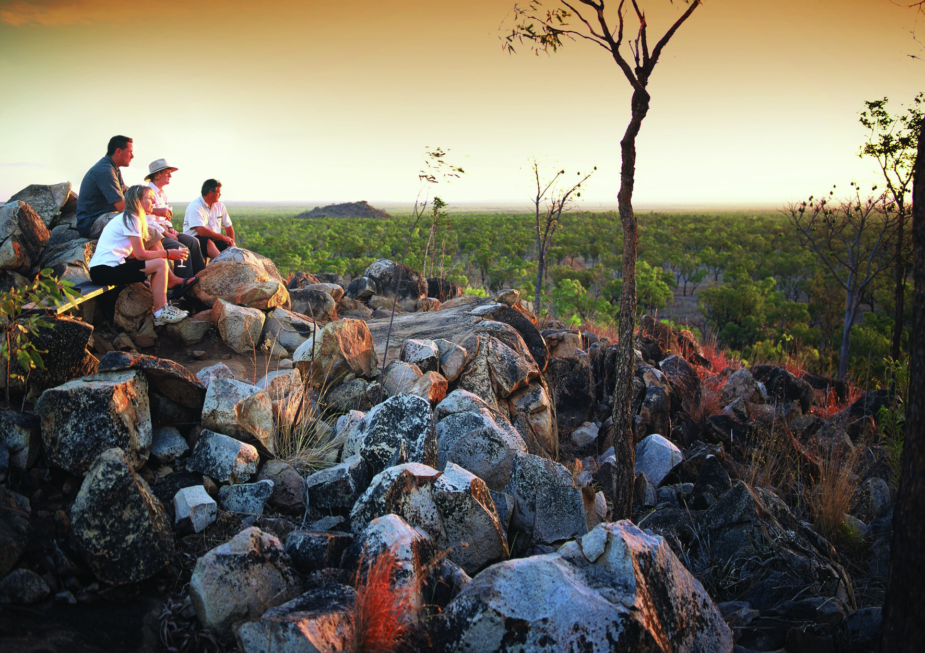
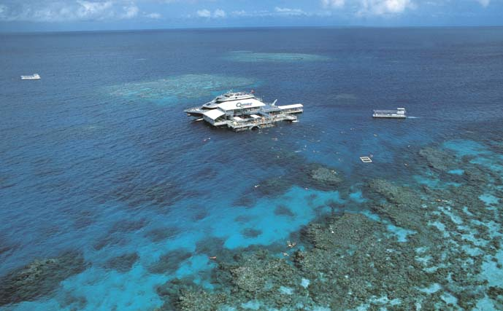
CAIRNS CONVENTION CENTRE - AUSTRALIA
Tour Desk
Staff from Destination Cairns Marketing will be in attendance near the Lattice 2012 Registration area.
Tuesday lunch from 12.30 pm till 2.30 pm
Wednesday from 10.00 am till 1.00 pm
Serious Business in Australia’s Most Stunning Location

Slide 3
Plenary/Parallel Speaker’s Prep Room
Speakers are encouraged to use the Prep Room to upload talks as early as possible and ideally no later than the morning of your talk.
Opening Hours of Prep Room:
Monday through to Friday 8.00 am – 4.40 pm
Except Wednesday: 8.00 am – 12 noon.
If you do not wish to have your talk appear on the Conference website, please delete it at the end of the session.

Slide 4
Poster Session
Poster Boards will be available Tuesday at 8:30 am.
Posters are to be displayed by the location number allocated in the program.
Please have your poster in place by the end of Tuesday’s lunch interval at 2:30 pm.
Poster session runs 4.30 pm to 6.30 pm.
For 1st hour, odd numbered poster presenters will be available at their posters.
For the 2nd hour even numbered poster presenters will be available at their posters.
Posters must be taken down by 12.30 pm on Wednesday.

