Slide 1
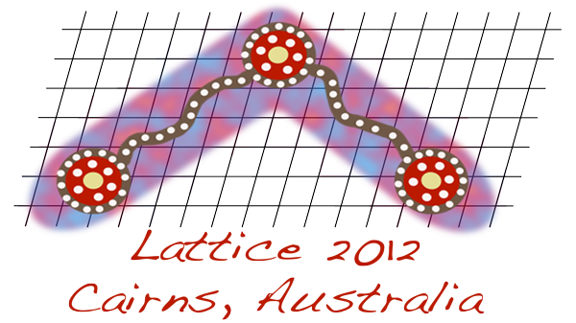
Program Corrections
Additional Poster:
Poster #33
Jian-Bo Zhang (Zhejiang University) Topological susceptibility near Tc in SU(3) gauge theory
Talk Cancellation:
Tuesday, June 26, 2:50pm, Meeting Room 4 [Standard Model Parameters and Renormalisation]
Kwangwoo Kim (Seoul National University) Preliminary calculations for matching factor in BK using automatized lattice perturbation
Title changes:
Tuesday June 26, 3:30pm, Hall A [Applications Beyond QCD]
Kenji Ogawa (National Chiao-Tung University)
Infrared Fixed Point of SU(3) gauge theory with 12 flavor staggered fermions
Friday June 29, 3:10pm, Room 6 [Chiral Symmetry] Tung-Han Hsieh (Research Center for Applied Sciences, Academia Sinica)
Observables from the low-lying eigenmodes of the lattice Dirac operator

Slide 2
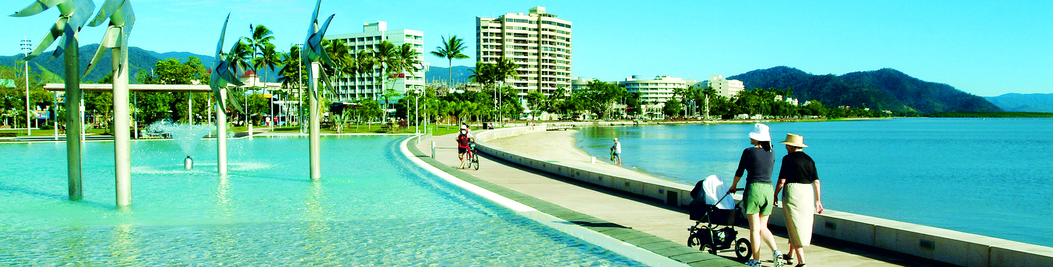
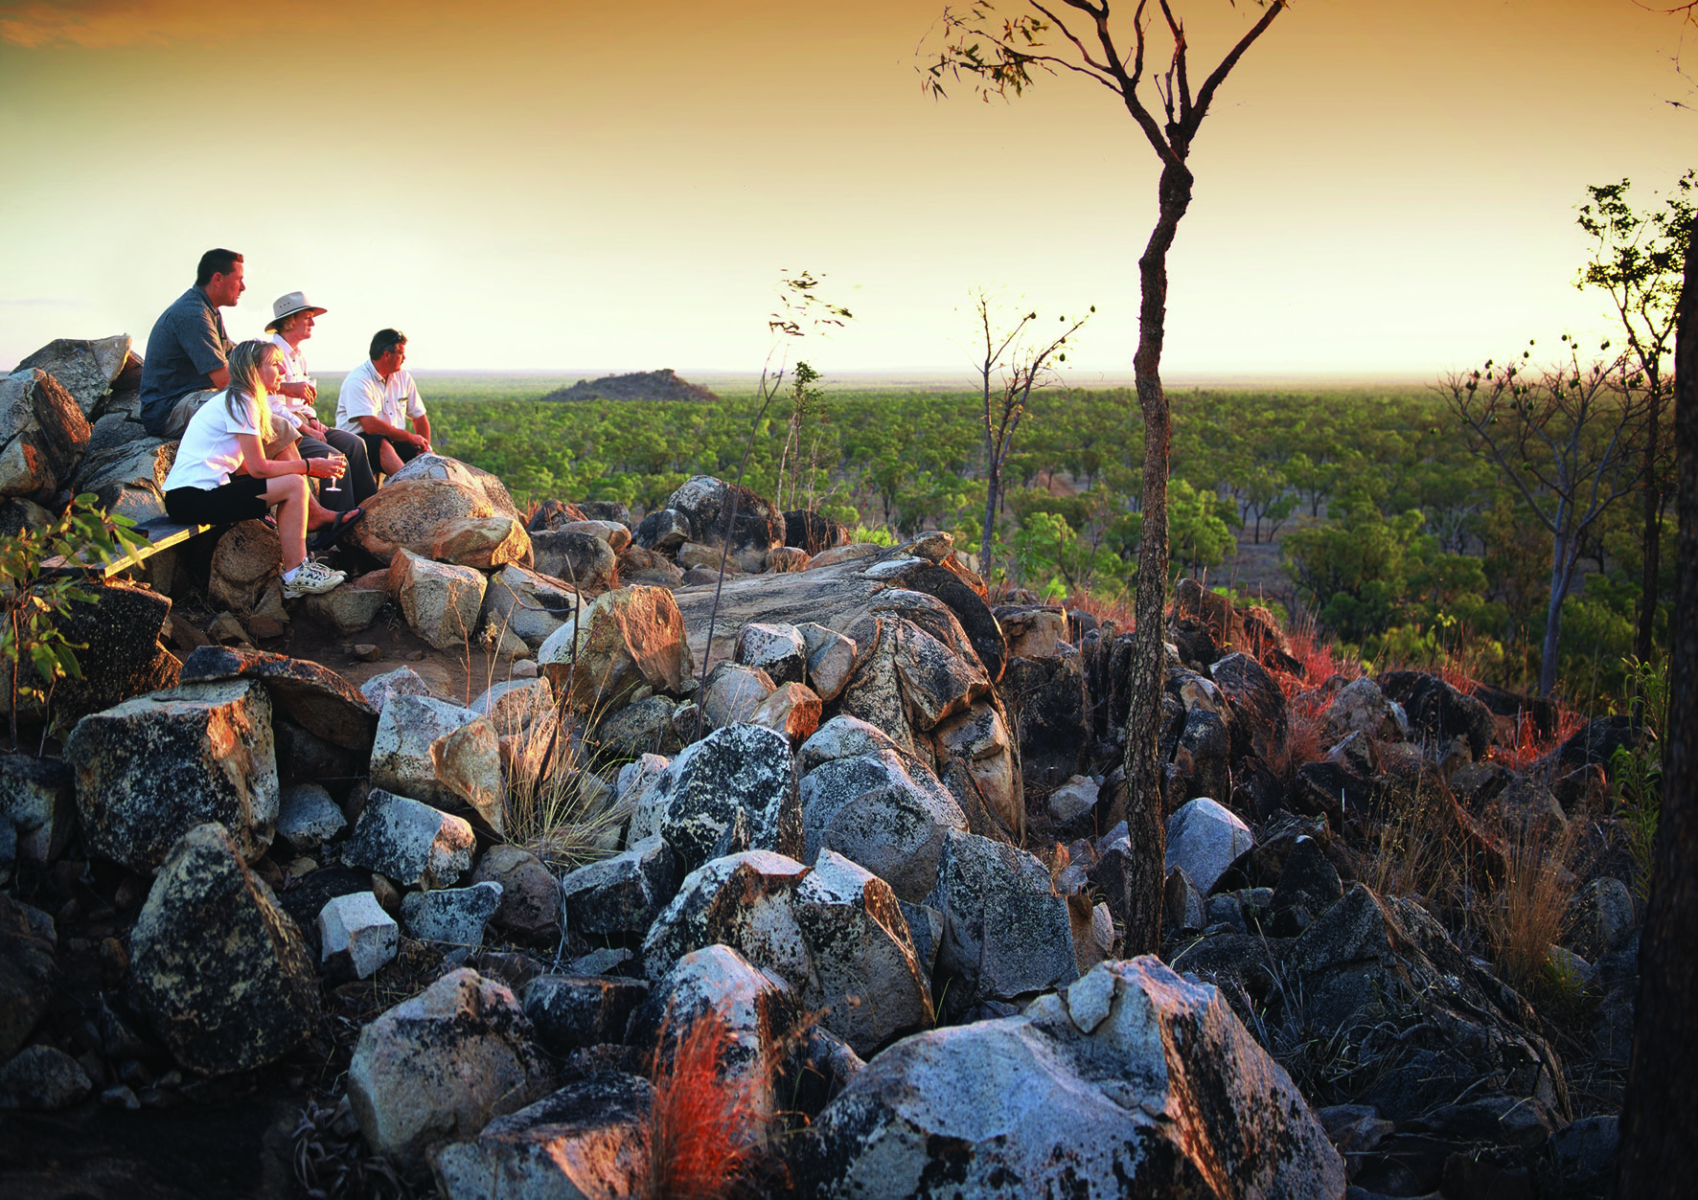
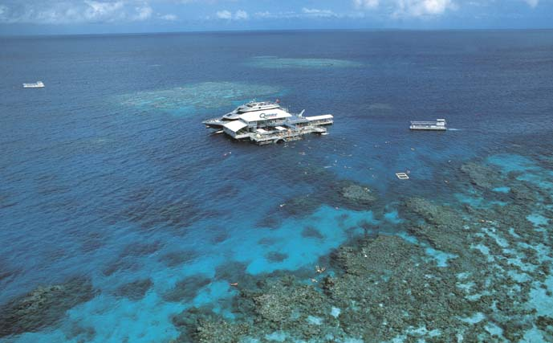
CAIRNS CONVENTION CENTRE - AUSTRALIA
Tour Desk
Staff from Destination Cairns Marketing will be in attendance near the Lattice 2012 Registration area.
Monday lunch from 12.30 pm till 2.30 pm
Wednesday from 10.00 am till 1.00 pm
Serious Business in Australia’s Most Stunning Location

Slide 3
Grab & Go Lunch
Available Wednesday at 12:00 noon
Baguette and drink
Order form in your Conference compendium
Return form with AUD$15 to the Registration Desk today during the admin office hours at the lunch break; i.e. by 2:30 pm.

