Slide 1
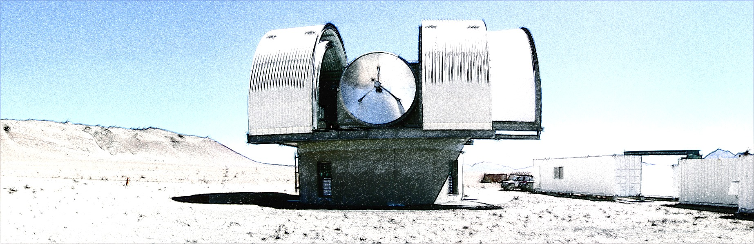


1
NANTEN2 observations
- NASCO project and Gamma-ray SNRs -
Satoshi Yoshiike (Ph.D student, Nagoya Univ.)
Y. Fukui, H. Sano, T. Fukuda, K. Torii, T. Kuwahara, T. Hayakawa,
H. Yamamoto, K. Tachihara, N. M. McClure-Griffiths, G. Rowell,
T. Inoue, R. Yamazaki, S-I. Inutsuka, T. Tanaka, A. Kawamura,
N. Mizuno, T. Onishi, A. Mizuno
and NANTEN2 consortium
NANTEN2 Workshop @ Adelaide 03.Feb.2014

Slide 2
CONTENTS
2
NASCO project
  Brief introduction and results of pilot observation
Results of recent SNR study in Nagoya group
  … from the aspect of ISM role in high-energy phenomena
  1. TeV Shell-Type SNRs
    RX J1731.1-3947, Vela Jr., HESS J 1731.7-3946
  2. Middle-aged SNRs
    W44, IC443
Summary
NANTEN2 Workshop @Adelaide 03.Feb.2014

Slide 3
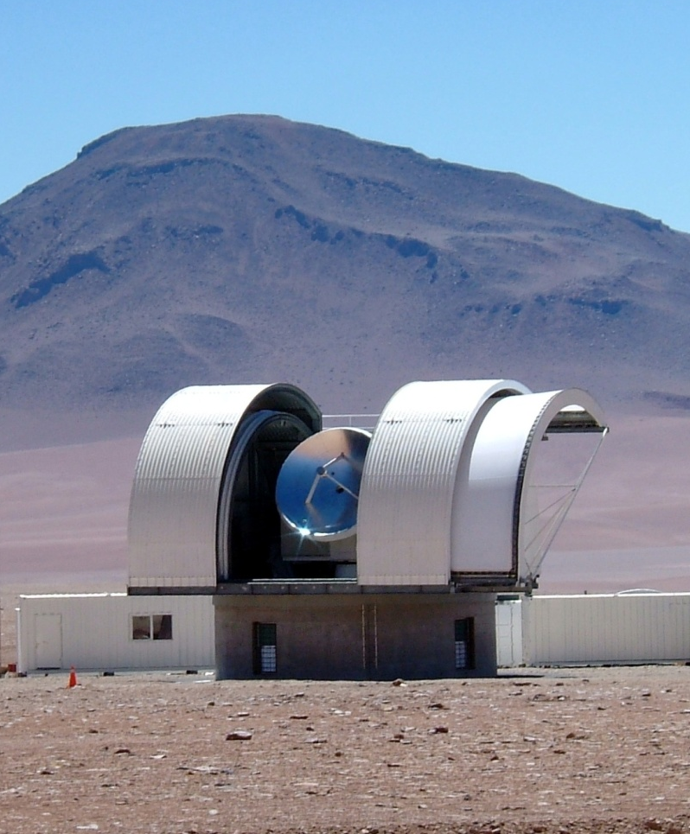
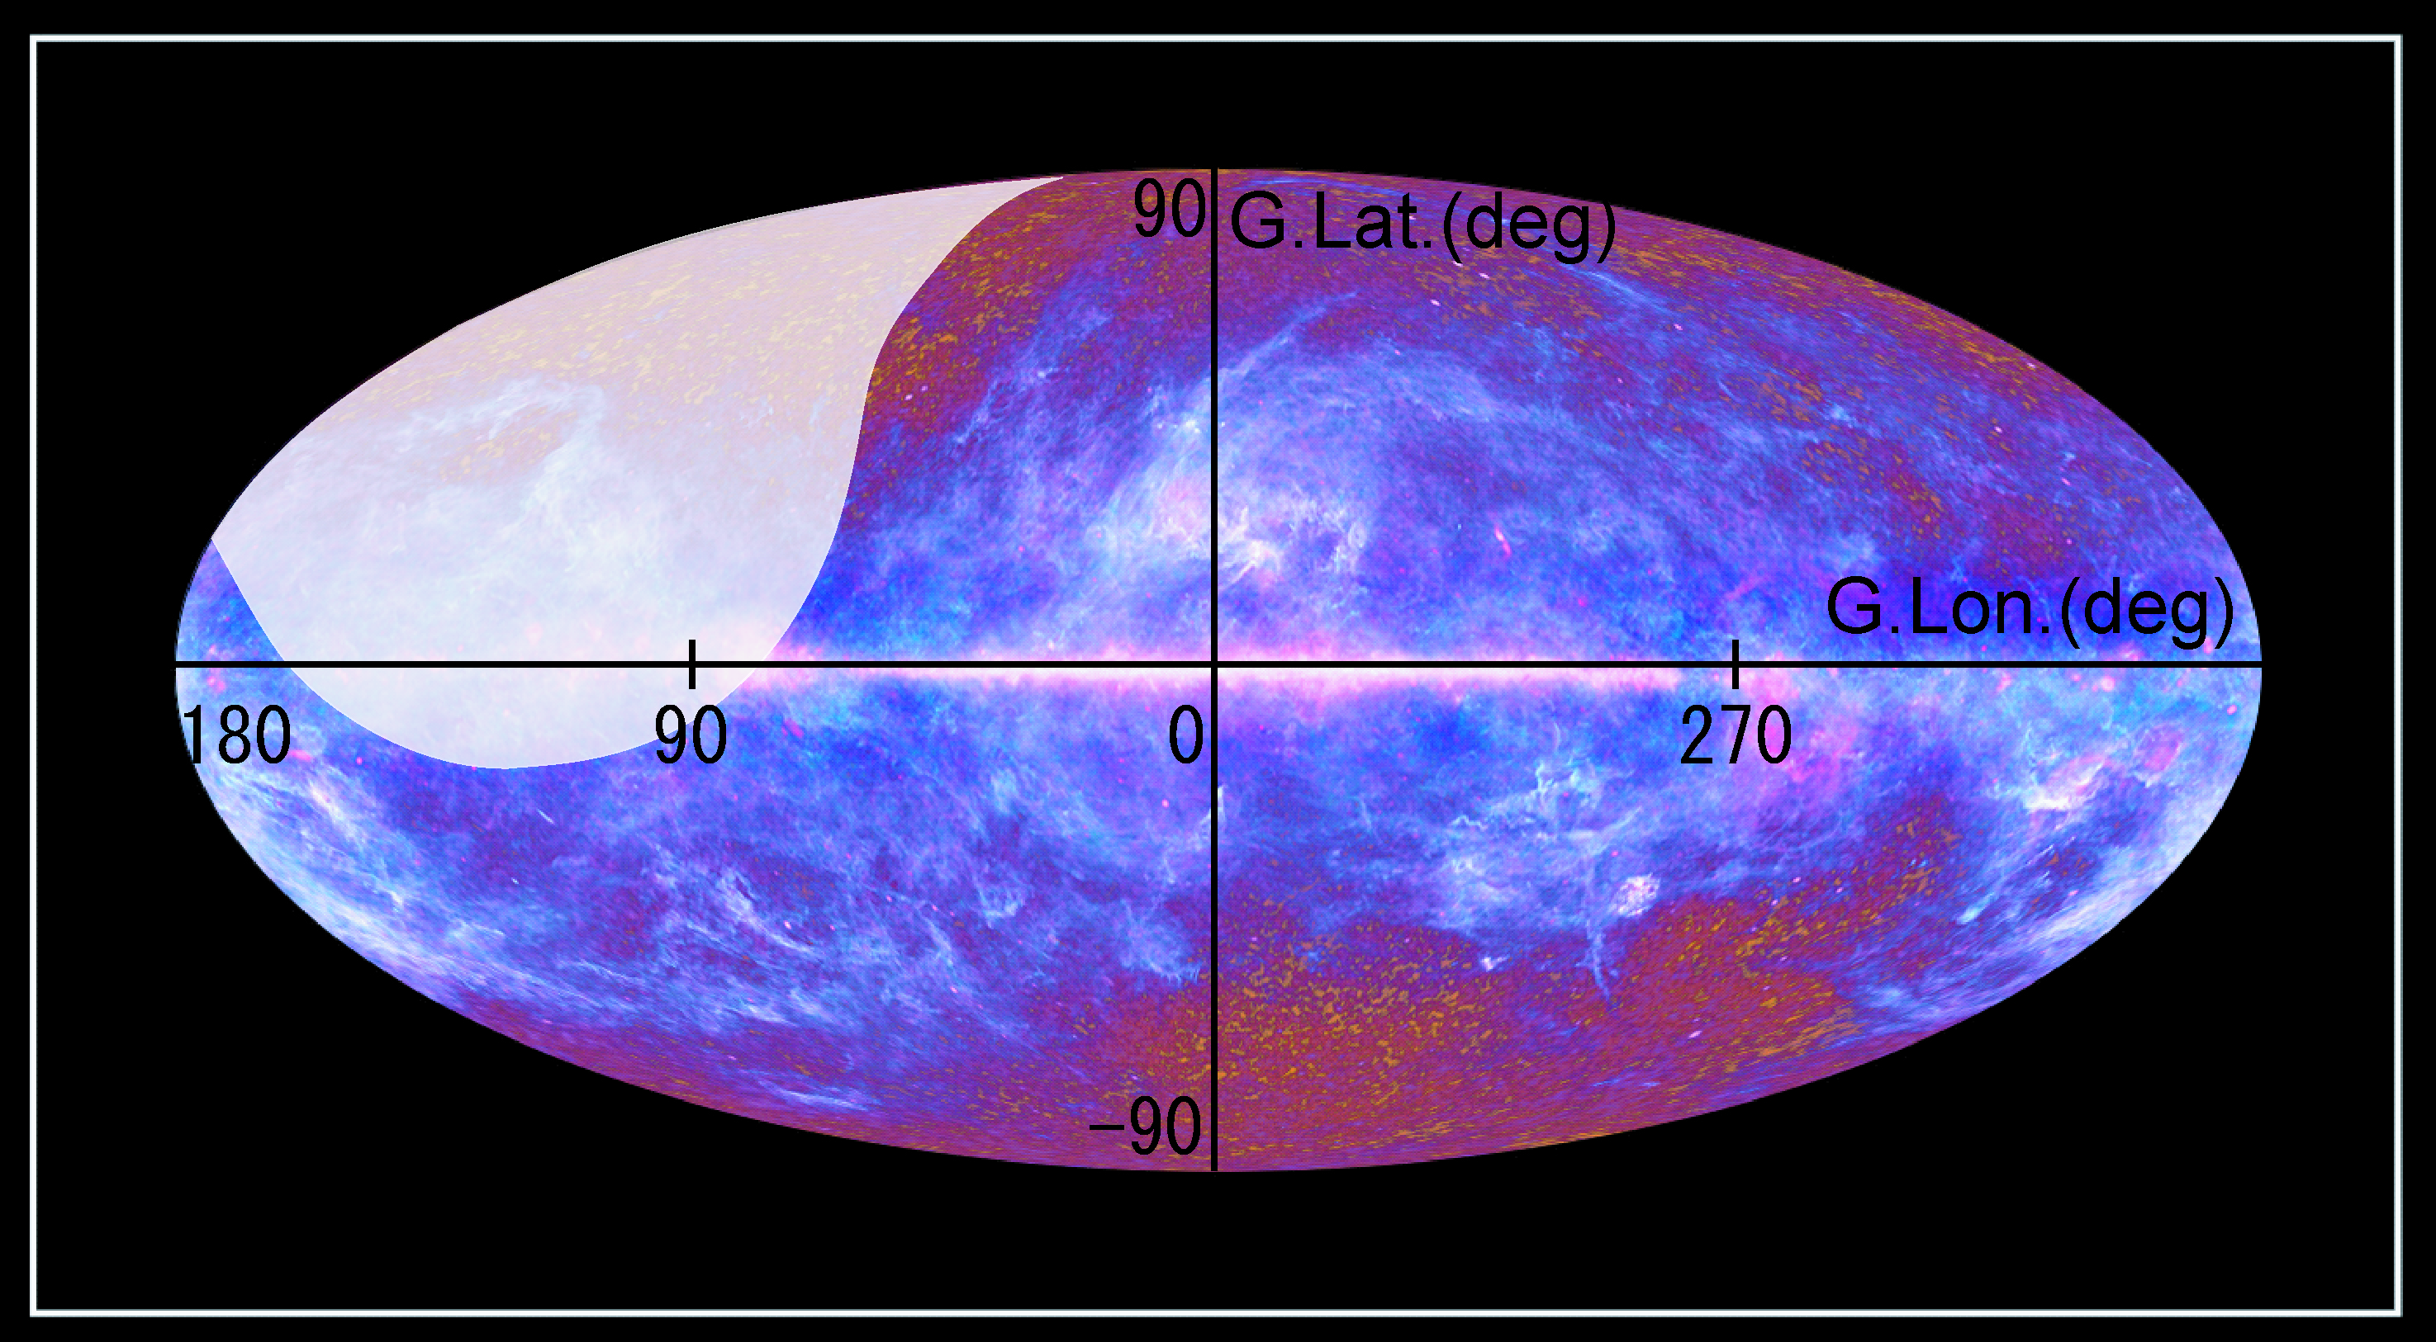
NA nten S uper CO survey as Legacy
3
New Survey of molecular clouds by NANTEN2 ¹²CO and ¹³CO(J=1-0) simultaneously.
Start in 2015
Covering 70% area of whole sky
Collaborative study with Planck team
Obs. area
Unobservable
from NANTEN2
Image: Planck 1 year result , Black shade: MCs by NGPS
Image: Planck 1 year result
Survey Name | Coverage (deg) | HPBW (‘) | Grid (‘) | Vel. cov. (km/s) | Vel. reso. (km/s) | Total points (million)
NGPS | -160<L<60, B<|10| | 2.6 | 4-8 | ±300 | 1.0 | 1.1
NASCO | 70% of sky | 2.6 | 1 | ±1300 | 0.16 | 20
NANTEN2 Workshop @ Adelaide 03.Feb.2014

Slide 4

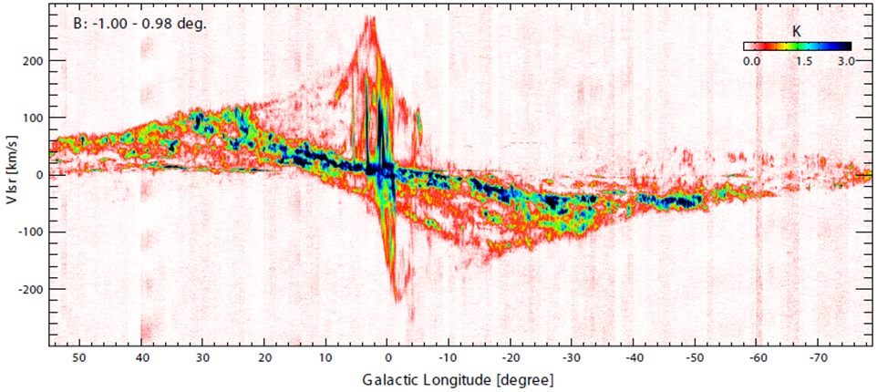
NASCO pilot observation
4
Preliminary
Credit: R. Enokiya
Apr.2011 – Jan.2013
Simultaneous observation of ¹²CO,¹³CO(1-0) by single pixel receiver
Total observation time: ~ 1000 h , Data points: ~ 100,000 x 16,000 !
NANTEN2 Workshop @Adelaide 03.Feb.2014

Slide 5
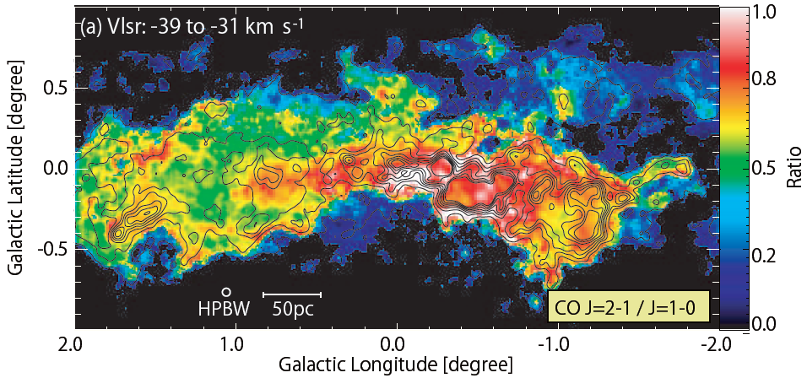
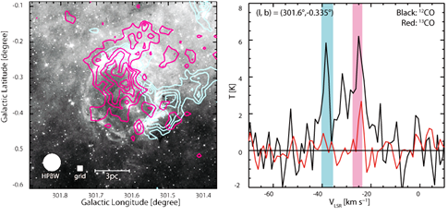
NASCO pilot observation
5
Studies from Pilot Observation
  Galactic Center
  High-mass Star Formation via Cloud-Cloud Collision
    Spitzer Bubbles (# of samples ~ 50)
    Super Stellar Cluster (SSC)
  Gamma-ray SNRs
W51C
W44
RX J1713-3946
W41
W28
HESS J1731-347
↑SSC,NGC3603 (Fukui+’14)
↓Galactic Center (Enokiya +’14)
↓Typical example of Spitzer bubble, S167
NANTEN2 Workshop @ Adelaide 03.Feb.2014

Slide 6
SNR Studies in Nagoya Radio Group
6
Main Members
  Hidetoshi SANO
    RX J1713, Vela Jr., etc
  Satoshi YOSHIIKE
    Middle–aged SNR (W44, IC443..)
  Tatsuya FUKUDA
    HESS J1731-347
γ
π⁰
ISM proton
γ
CR proton
π⁺
π⁻
Topics of SNR Study
  Are SNRs origin of cosmic-rays (CRs), especially CR protons ?
    ISM can be the target to produce γ-ray via the hadronic process.
    Good spatial correlation between γ-ray and ISM
  Do SNRs produce the energy density of the Galactic CRs?
    1-10% of E_{SN}~10⁵¹ erg is needed.
  How dose the shock interaction with ISM affect its environment?
NANTEN2 Workshop @ Adelaide 03.Feb.2014

Slide 7
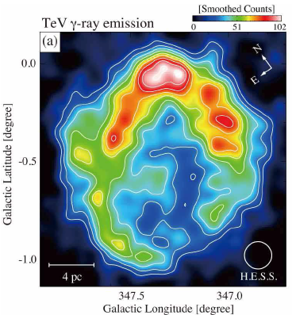
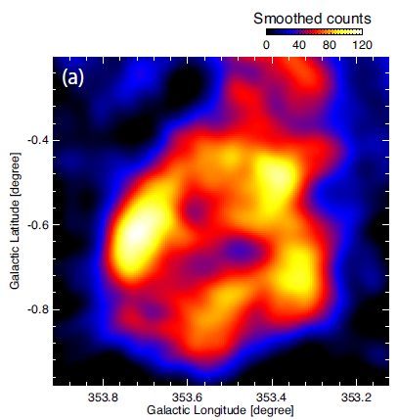
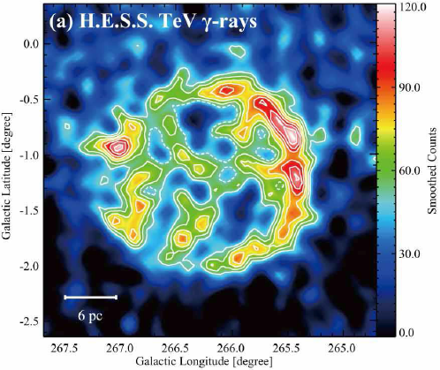
1. TeV Shell-Type SNR
RX J1713-3946
Vela Jr.
HESS J1731-347
Age ~ a few 10³ yr (young)
Shell-like γ-ray distribution
Bright in TeV γ-ray
  Detectable by Atmospheric Cherenkov Telescopes
NANTEN2 Workshop @ Adelaide 03.Feb.2014

Slide 8
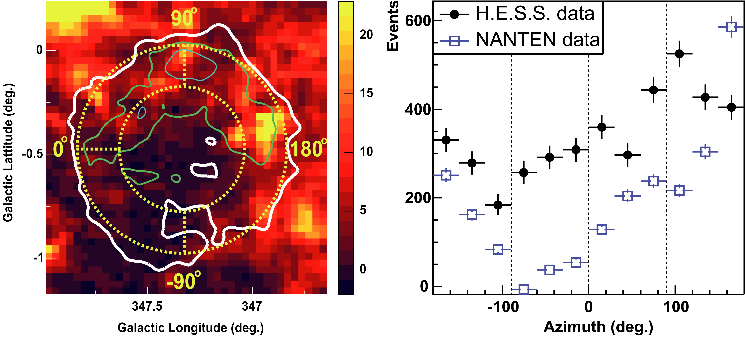
RXJ1713 CO distribution (Aharonian+06)
Azimuthal plot (H.E.S.S. VHE γ-rays and NANTEN CO)
− The global trend between the CO and γ-rays is similar to each other
− However, the correlation is not complete in the SE-rim (-100–0 deg)
NANTEN2 Workshop @ Adelaide 03.Feb.2014
Credit: H. Sano

Slide 9
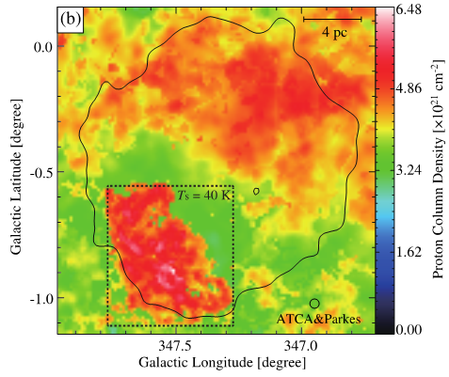
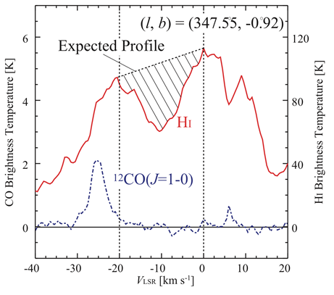
RXJ1713 Dark HI SE Cloud (Optically thick HI)
Fukui+’12
Optically thick HI (N_{H}~100 cm⁻³, T_{s} ~40 K) ⇒ tau > 0.5
Image: (a) Tau map, (b) absorption-corrected HI column density
Contours: VHE gamma-ray boundary
NANTEN2 Workshop @ Adelaide 03.Feb.2014
Credit: H. Sano

Slide 10
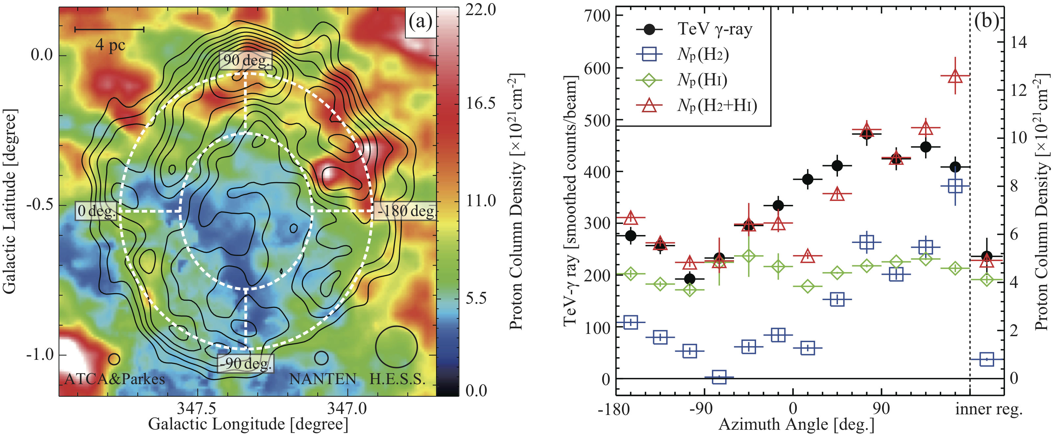
RXJ1713 Total Interstellar Gas (Fukui+12)
10
Azimuthal plot (H.E.S.S. VHE γ-rays and Total ISM Gas)
− H2 mass ~ HI mass （H2: 0.9×10⁴ M◉, HI: 1.1×10⁴ M◉）
− Total CR proton energy: ~10⁴⁸ erg (~0.1 %)
Evidence for the CR proton acceleration
NANTEN2 Workshop @ Adelaide 03.Feb.2014
Credit: H. Sano

Slide 11
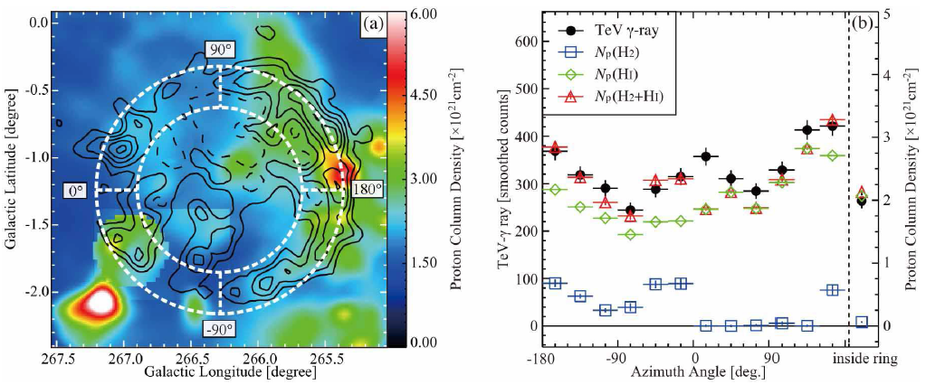
Vela.Jr Total Interstellar Gas (Fukui13)
Azimuthal plot (H.E.S.S. VHE γ-rays and Total ISM Gas)
− H2 mass < HI mass （H2: 0.1×10⁴ M◉, HI: 1.0×10⁴ M◉）
− Total CR proton energy: ~10⁴⁸ erg (~0.1 %)
NANTEN2 Workshop @ Adelaide 03.Feb.2014
Credit: H. Sano

Slide 12
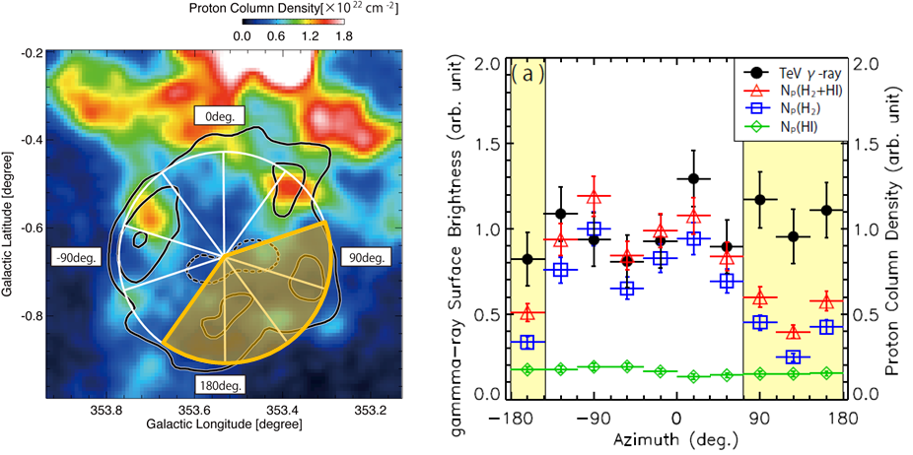
HESS J1731-347 Total Interstellar Gas (Fukuda+ submitted to ApJ)
Azimuthal plot (H.E.S.S. VHE γ-rays and Total ISM Gas)
− H2 mass > HI mass （H2: 5.1×10⁴ M◉, HI: 0.13×10⁴ M◉）
− Total CR proton energy: ~10⁴⁹ erg (~1 %)
The origin of γ-rays may be mixture of hadronic and leptonic origin.
NANTEN2 Workshop @ Adelaide 03.Feb.2014
Credit: H. Sano

Slide 13
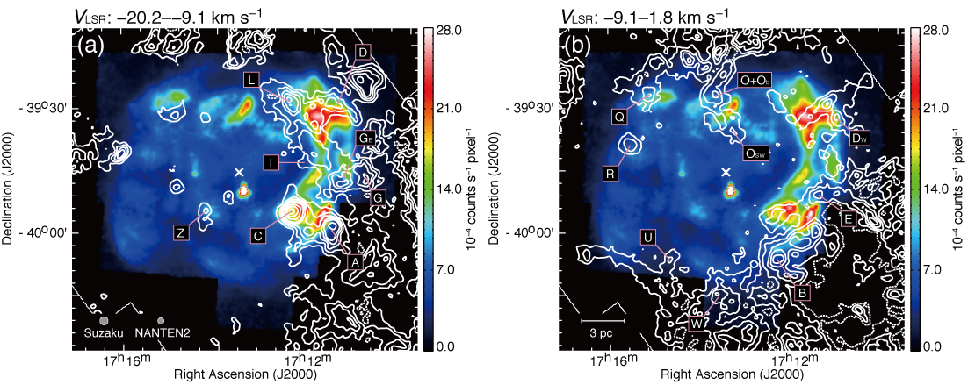
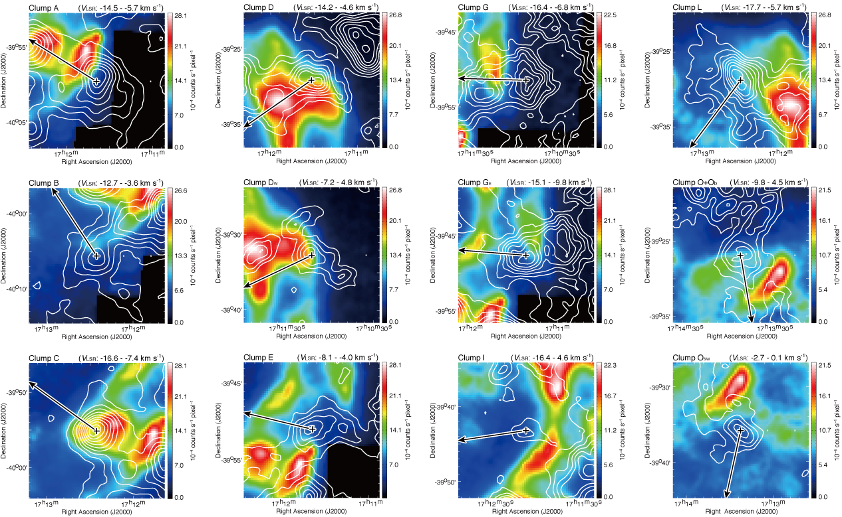
RXJ1713 Synchrotron X-rays & CO
Clumpy ISM (created by progenitor of SNR) ＋ SNR blast waves
⇒ Good spatial correlation (pc scale) and anti-correlation (sub pc scale)
Sano+10, Sano+13
Image: Suzaku 5–10 keV, Contours: ¹²CO(J=2–1) intensity (two velocity ranges)
NANTEN2 Workshop @ Adelaide 03.Feb.2014
Credit: H. Sano

Slide 14
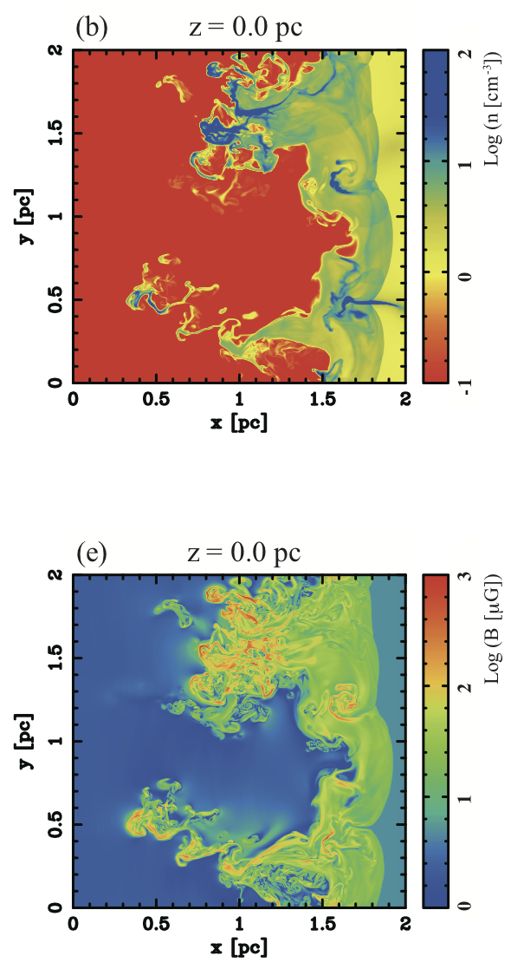
MHD Simulation
Magnetic field amplification in the down stream（Inoue+12）
⇒ The shock waves propagate into the clumpy ISM formed by thermal instability
MHD results explain the spatial distribution between the CO and X-rays
ISM number density
Magnetic field strength
t = 750 yr
Inoue+12
NANTEN2 Workshop @ Adelaide 03.Feb.2014
Credit: H. Sano

Slide 15
MHD Simulation
Magnetic field amplification in the down stream（Inoue+12）
⇒ The shock waves propagate into the clumpy ISM formed by thermal instability
MHD results explain the spatial distribution between the CO and X-rays
ISM number density
Magnetic field strength
t = 750 yr
Inoue+12
NANTEN2 Workshop @ Adelaide 03.Feb.2014
Credit: H. Sano

Slide 16
MHD Simulation
Magnetic field amplification in the down stream（Inoue+12）
⇒ The shock waves propagate into the clumpy ISM formed by thermal instability
MHD results explain the spatial distribution between the CO and X-rays
ISM number density
Magnetic field strength
t = 750 yr
Inoue+12
NANTEN2 Workshop @ Adelaide 03.Feb.2014
Credit: H. Sano

Slide 17
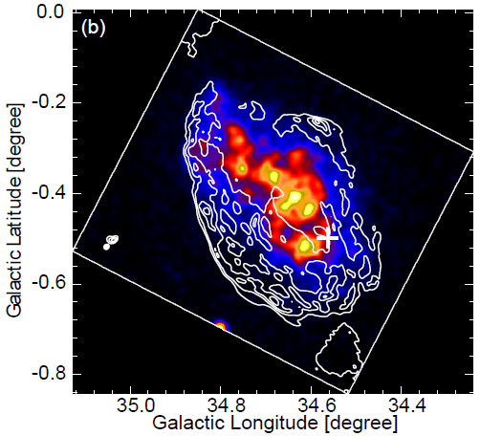
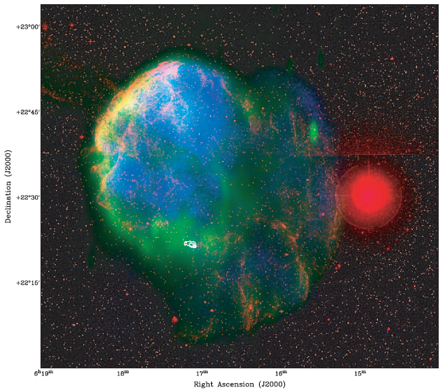
2. Middle-aged SNR
W44
IC443
Yoshiike et al.(2013)
Gaensler et al.(2006)
- Contours : Radio continuum (1.4GHz by VLA)
- Image : X-ray (0.4-2.4 keV by ROSAT)
Red:Optical / Green:1.4 GHz / Blue:X-ray
Age ~ 10,000 yr
Interaction with ISM
Brighter in GeV γ-ray rather than TeV
  Identified as a extended source by Fermi-LAT
NANTEN2 Workshop @ Adelaide 03.Feb.2014

Slide 18
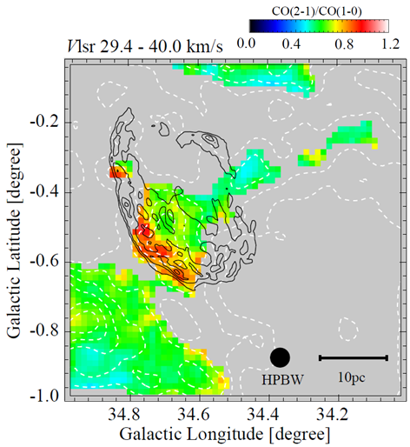
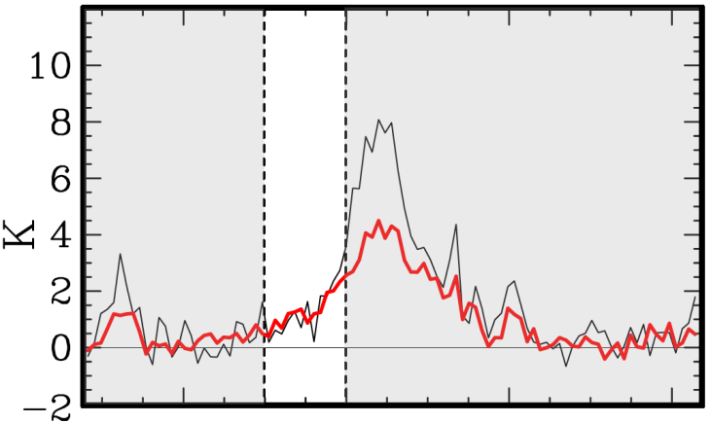
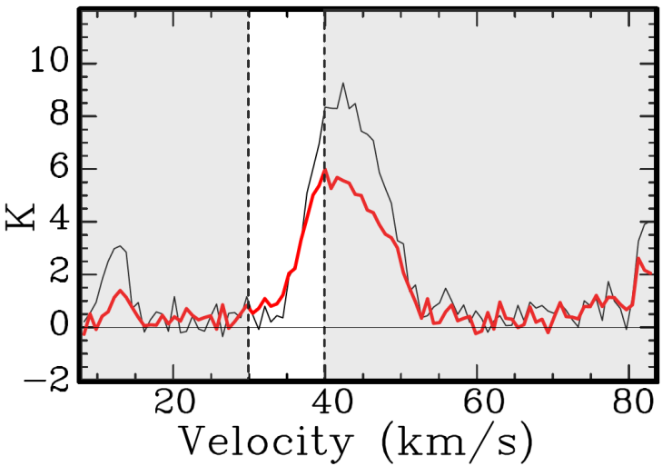
¹²CO(2-1)/¹²CO(1-0) in W44
CO(2-1)
CO(1-0)
Yoshiike+’13
The ratios are enhanced around ~ 1.0 along the eastern rim.
→ indicates the molecular cloud is
compresses and/or heated .
Image … ¹²CO(J=2-1)/ ¹²CO(J=1-0)
Contours … Solid：1.4GHz Radio Conti. (VLA)
Dashed：¹²CO(J=2-1)
Integrated Intensity
NANTEN2 Workshop @ Adelaide 03.Feb.2014

Slide 19
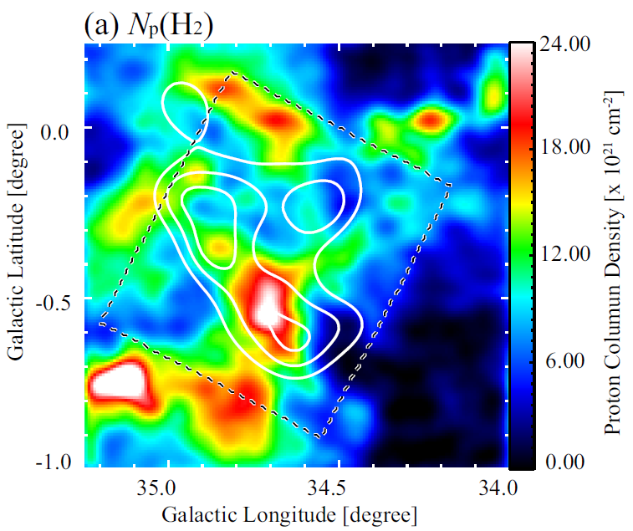
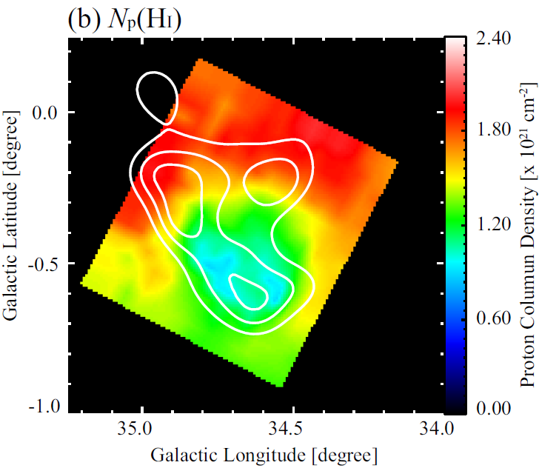
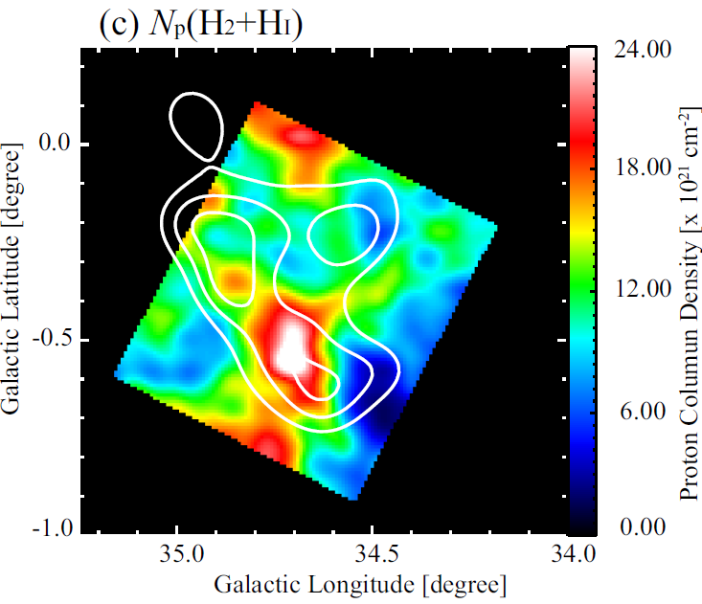
Comparison between γ–ray and ISM
35-45km/s
35-45km/s
Yoshiike+’13
- Xco = 1.56 x 10 ²⁰ cm ⁻²/(K km/s)
(Hunter +’97)
- CO(2-1)/CO(1-0) = 0.6
Absorptions are interpolated.
35-45km/s

Slide 20
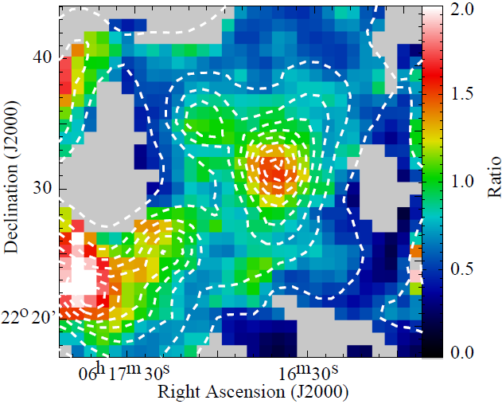

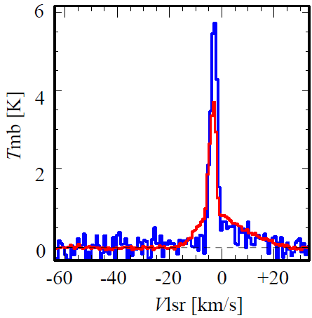
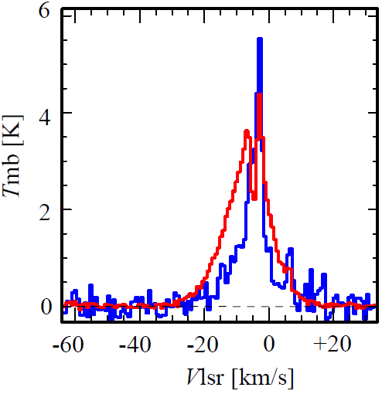
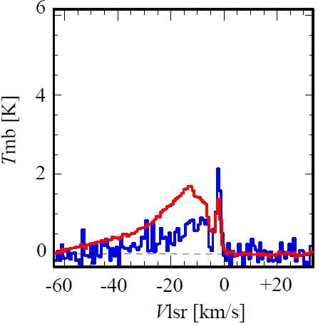
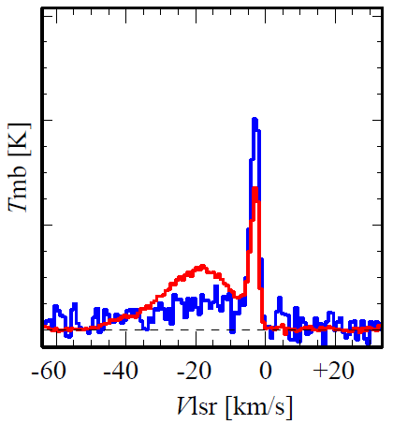
¹²CO(2-1)/¹²CO(1-0) in IC443
Contours … ¹²CO(2-1)
-60 － + 30 km/s
… OH maser
Cloud F
Cloud G
CO(2-1)
CO(1-0)
CO(2-1)
CO(1-0)
Cloud C
Cloud B
Central region of Shell
The ratios are enhanced in each MCs (2-1/1-0 ~ 1 - 3)
Large velocity width < 60 km/s
CO(2-1)
CO(1-0)
CO(2-1)
CO(1-0)

Slide 21
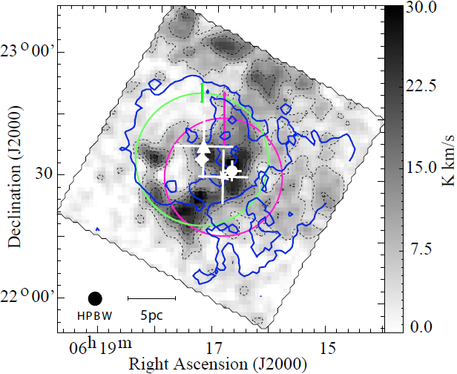
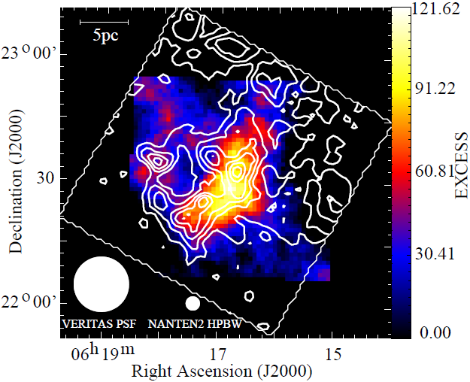
Comparison between γ–ray and ISM
EGRET
MAGIC
VERITAS
Fermi
Image : NANTEN2 CO(1-0)
Blue Contour : DSS Optical
○ : Extension of the VERITAS sources
○ : Extension of the Fermi sources
Image : VERITAS 0.3 -2 TeV
(Acciari et al.2009)
White Contour: NANTEN2 CO(1-0)
NANTEN2 Workshop @ Adelaide 03.Feb.2014

Slide 22
Comparison between Middle-aged SNRs
SNR | age [x 10⁴ yr] | distance [kpc] | Lγ [10³⁵Jy/s] | Proton density [cm⁻³] | Total CR Proton Energy [erg]
IC 443 | 0.4 – 2 | 1.5 | 1.3 | 120 | > 5 x 10⁴⁸
W44 | 2 | 3 | 5.9 | 200 ^{A} | > 1 x 10^{49 A}
W28 | 4.5 | ~ 2 | 1 | 1,000 ^{B} | 3 x 10^{49 C}
W51C | 5.8 | 6 | 13 | --- | 5 x 10⁴⁹(n/100)⁻¹
A:Yoshiike +’13, B: Aharonian+’08, C : Giuliani+’10
W_{p} ~ 10⁴⁹ erg
  1% of the kinematic energy released per SNR, 10⁵¹ erg
This is reasonable lower limit with taking into account CR escape. W28(Aharonian+’08), W44(Uchiyama+’12)
> ~ 10⁴⁸ erg (young SNR, RXJ 1713, Vela Jr)
This may suggest the CR energy to be increased over 10³ to 10⁴ yrs.

Slide 23
Summary
23
Are SNRs origin of cosmic-rays (CRs), especially CRs protons ?
  TeV Shell-Type SNR (RXJ 1713, Vela Jr)
    Good spatial correlation between γ-ray and “total” ISM proton (H₂+HI).
  Middle-aged SNR (W44, IC443)
    The position of shocked gas corresponds with γ-ray.
  These γ-ray should be produced via “hadronic” origin.
Do SNRs produce the energy density of the Galactic CRs?
  Total CR proton Energy : W_{P}
    Middle-age SNR ~ 10⁴⁹erg
    W_{P} ~ 10⁴⁹ ~ 0.01*E_{SN} would be a lower limit because of CRs escaping (e.g., W44, W28).
  How dose the shock interaction with ISM affect its environment?
    Anti-correlatiton between X-ray and ISM in sub-pc scale (RXJ1713)
    Interaction with clumps excites turbulence.
      → Amplification of B field
      → Enhancement of the synchrotron X-ray
NANTEN2 Workshop @ Adelaide 03.Feb.2014

