Slide 1
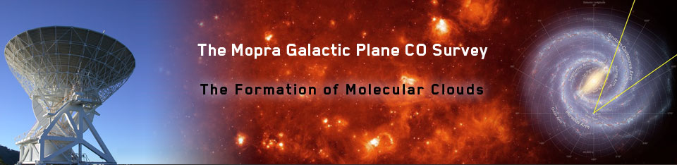

the Mopra Galactic Plane CO Survey www.phys.unsw.edu.au/mopraco
Catherine Braiding
University of New South Wales
Michael Burton, Gavin Rowell, Jarryd Hawkes,
Nick Tothill, Andrew Walsh (Australia)
David Hollenbach, Craig Kulesa, Mark Wolfire, Paul Goldsmith, Chris Martin, Jorge Pineda, Tony Stark, Chris Walker (USA)
Jürgen Stutzki, Robert Simon, Christian Glück, James Urquhart (Germany) and a whole lot more…

Slide 2
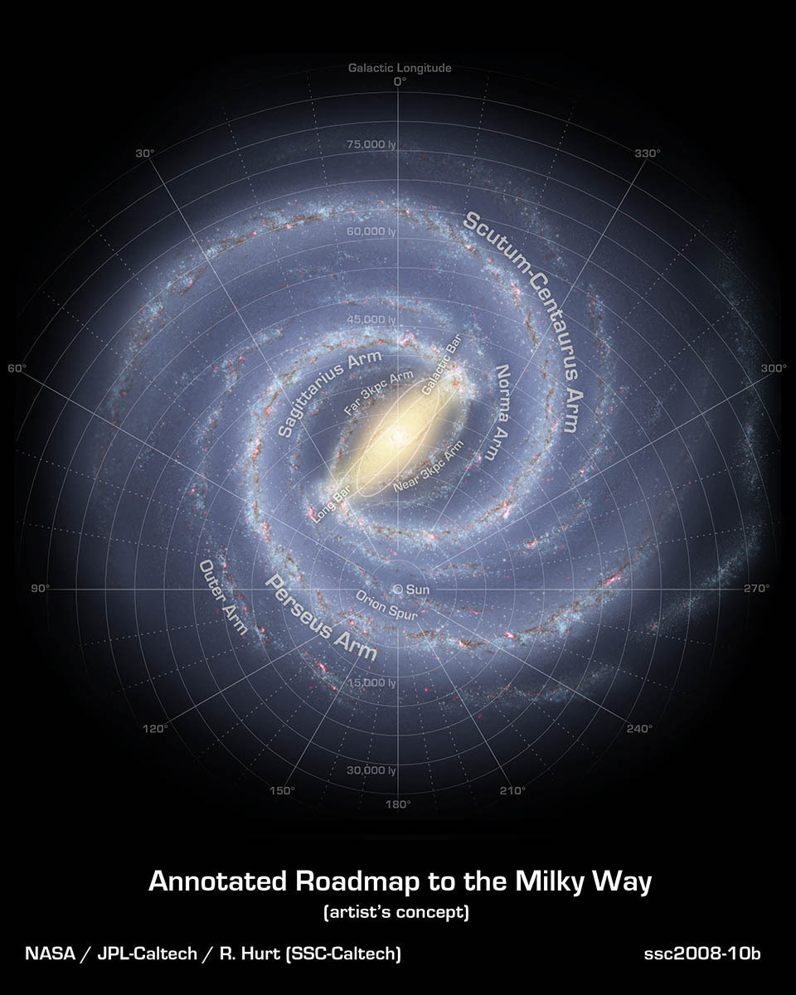
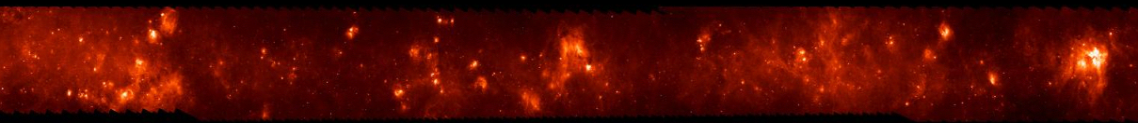
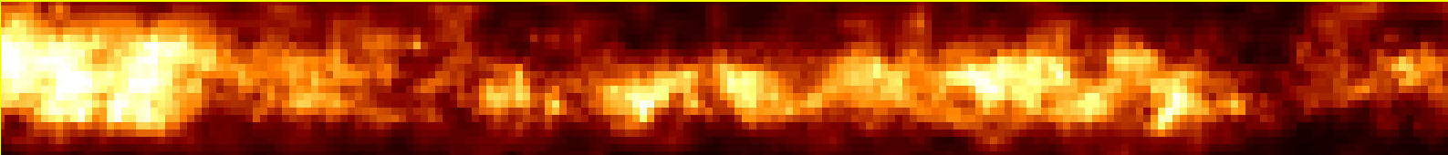
The Mopra CO Survey
l=300º – 345º, and |b|<0.5° spanning the Molecular Ring through the Scutum-Centaurus spiral arm and two inter-arm regions.
Spitzer/MIPS 24 micron
l=340º
l=310º
Parkes 21 cm HI
Columbia/CfA CO J=1-0

Slide 3
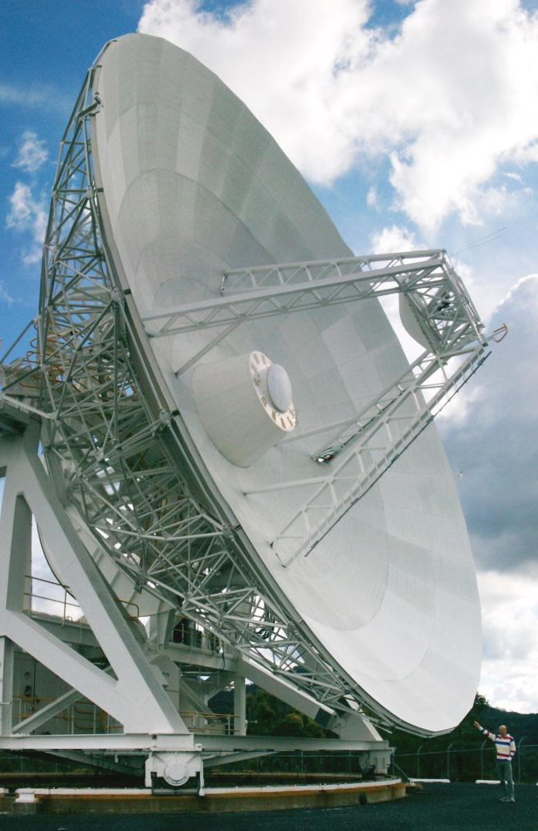
Mopra Telescope MM Capabilities
22-m Telescope for long-wave mm astronomy
  3mm + 7mm + 12mm
77–116 GHz MMIC receiver (2.5-4 mm)
  T_{sys} ~ 150K (@85GHz) – 300K (@115GHz)
  35” beam
  η_{mb} (86 GHz) = 0.49, η_{mb} (115 GHz) = 0.42
  η_{xb} (86 GHz) = 0.65, η_{xb} (115 GHz) = 0.55
30-50 GHz receiver (5-10mm)
  T_{sys} ~ 65K, 75” beam
16-25 GHz receiver (12-18mm)
  T_{sys} ~ 45K, η_{mb} ~ 0.7, 150” beam
Bandwidth 8 GHz: UNSW-MOPS correlator
  Broadband 32,000 channels, 0.8 km/s resn.
  16 Zooms modes over 137 MHz
    4 per band, 4096 channels/zoom, 0.1 km/s@3mm
2 Polarizations (i.e. 64,000 channels)
“Fast-On-the-Fly” (FOTF) Mapping

Slide 4
Fast Mapping with Mopra
Binning mode in 2.048s cycles
  8 x 256ms samples
i.e. 8 x faster for 1/3rd the sensitivity
  Only suitable for CO lines
Scan at 35”/s = 9” cell size
15” row spacing
30 hours/sq. deg. c.f. 350 hours
8 zoom modes, not 16
  ¹²CO, ¹³CO, C¹⁸O, C¹⁷O
60’
uniform
coverage
15’
5’
6’
Thanks also to Warwick Wilson, Dick Ferris, Balt Indermuehle

Slide 5
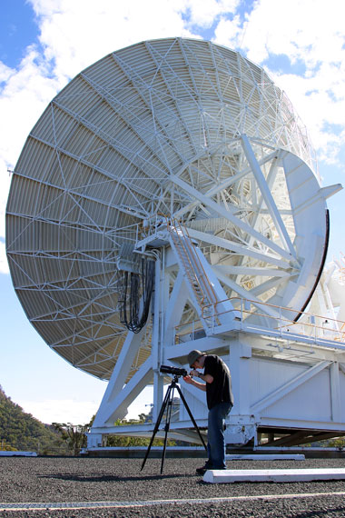
Line Parameters for CO Survey
IF | Frequency (GHz) | Isotopologue | V_{low} (km/s) | V_{high} (km/s)
1+2 | 110.1 | ¹³CO 1-0 | -475 | +270
3+4 | 109.7 | C¹⁸O 1-0 | -495 | +255
5 | 112.3 | C¹⁷O 1-0 | -235 | +130
6+7+8 | 115.2 | ¹²CO 1-0 | -550 | +525
0.6’ Beam @ 0.1 km/s resolution
~4 transits per 1°x1° block (|b|<0.5°)

Slide 6
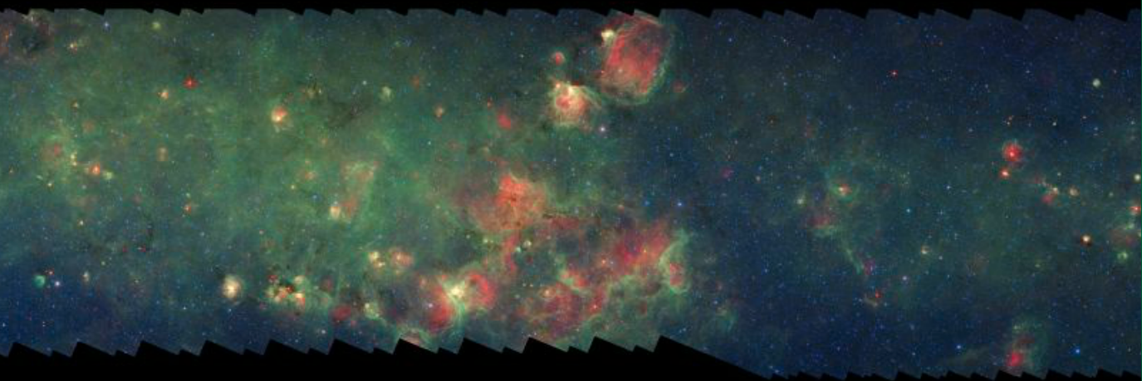
Spitzer: 24µm (warm dust) + 8µm (FUV-fluoresced PAHs)
G323
330°
323°

Slide 7
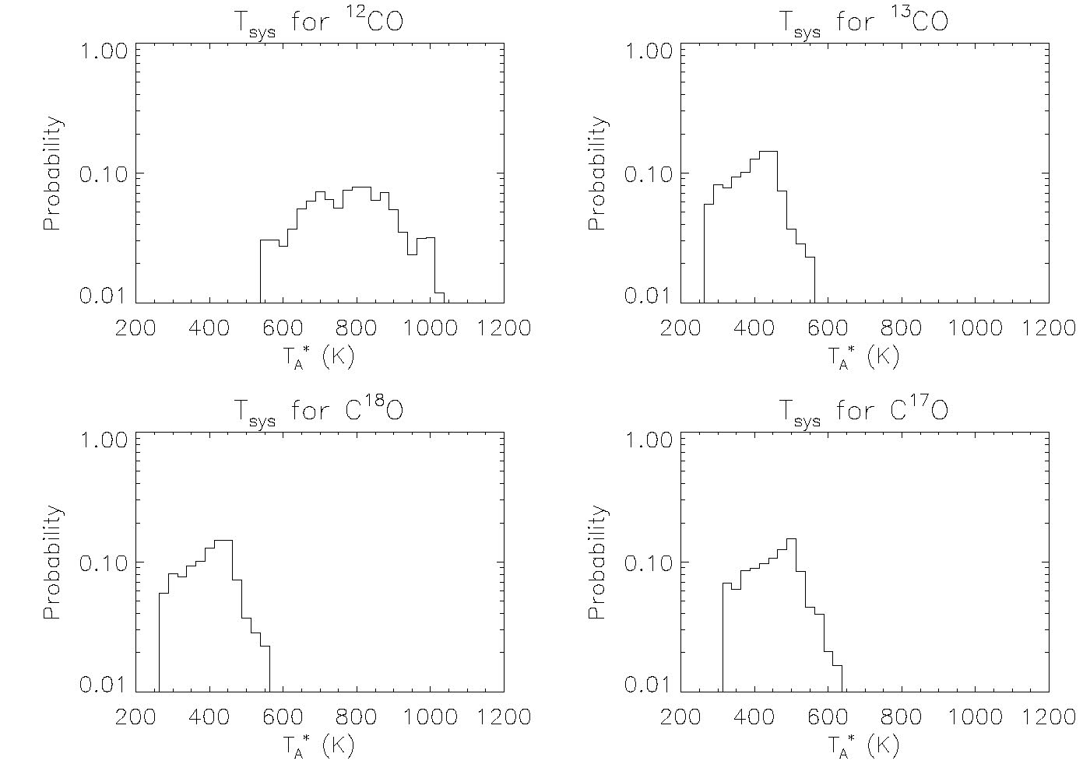
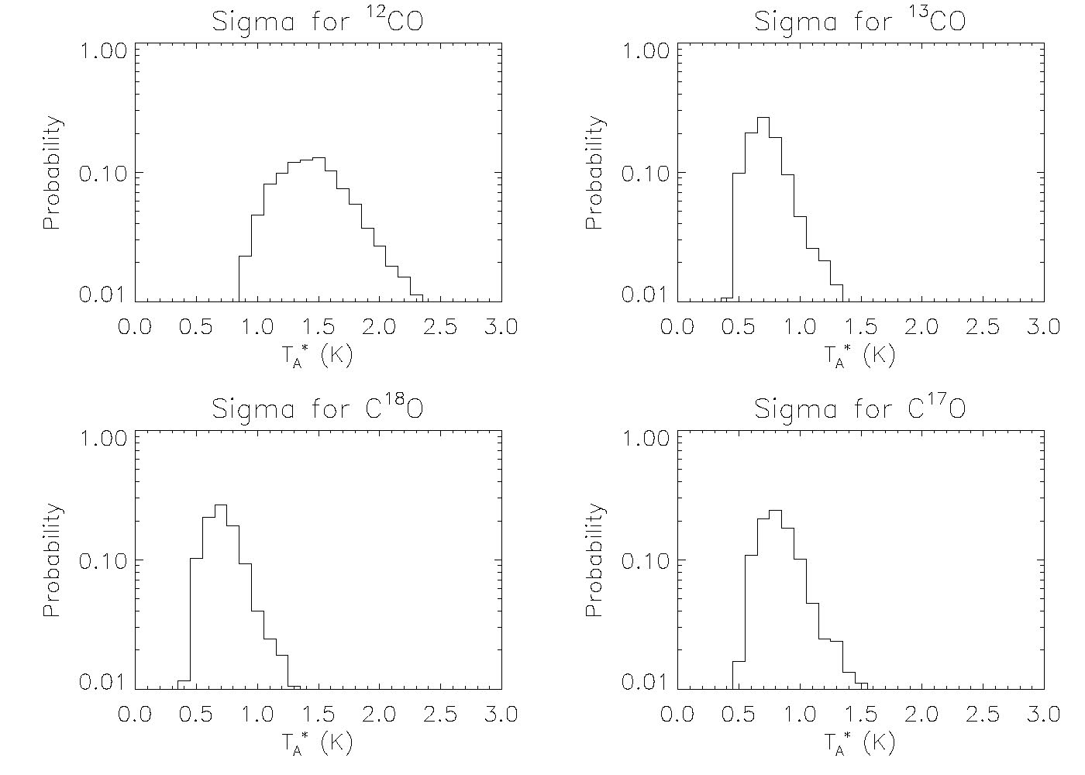
Noise Distributions
T_{sys} σ_{rms}
800K
400K
1.5K
0.7K

Slide 8
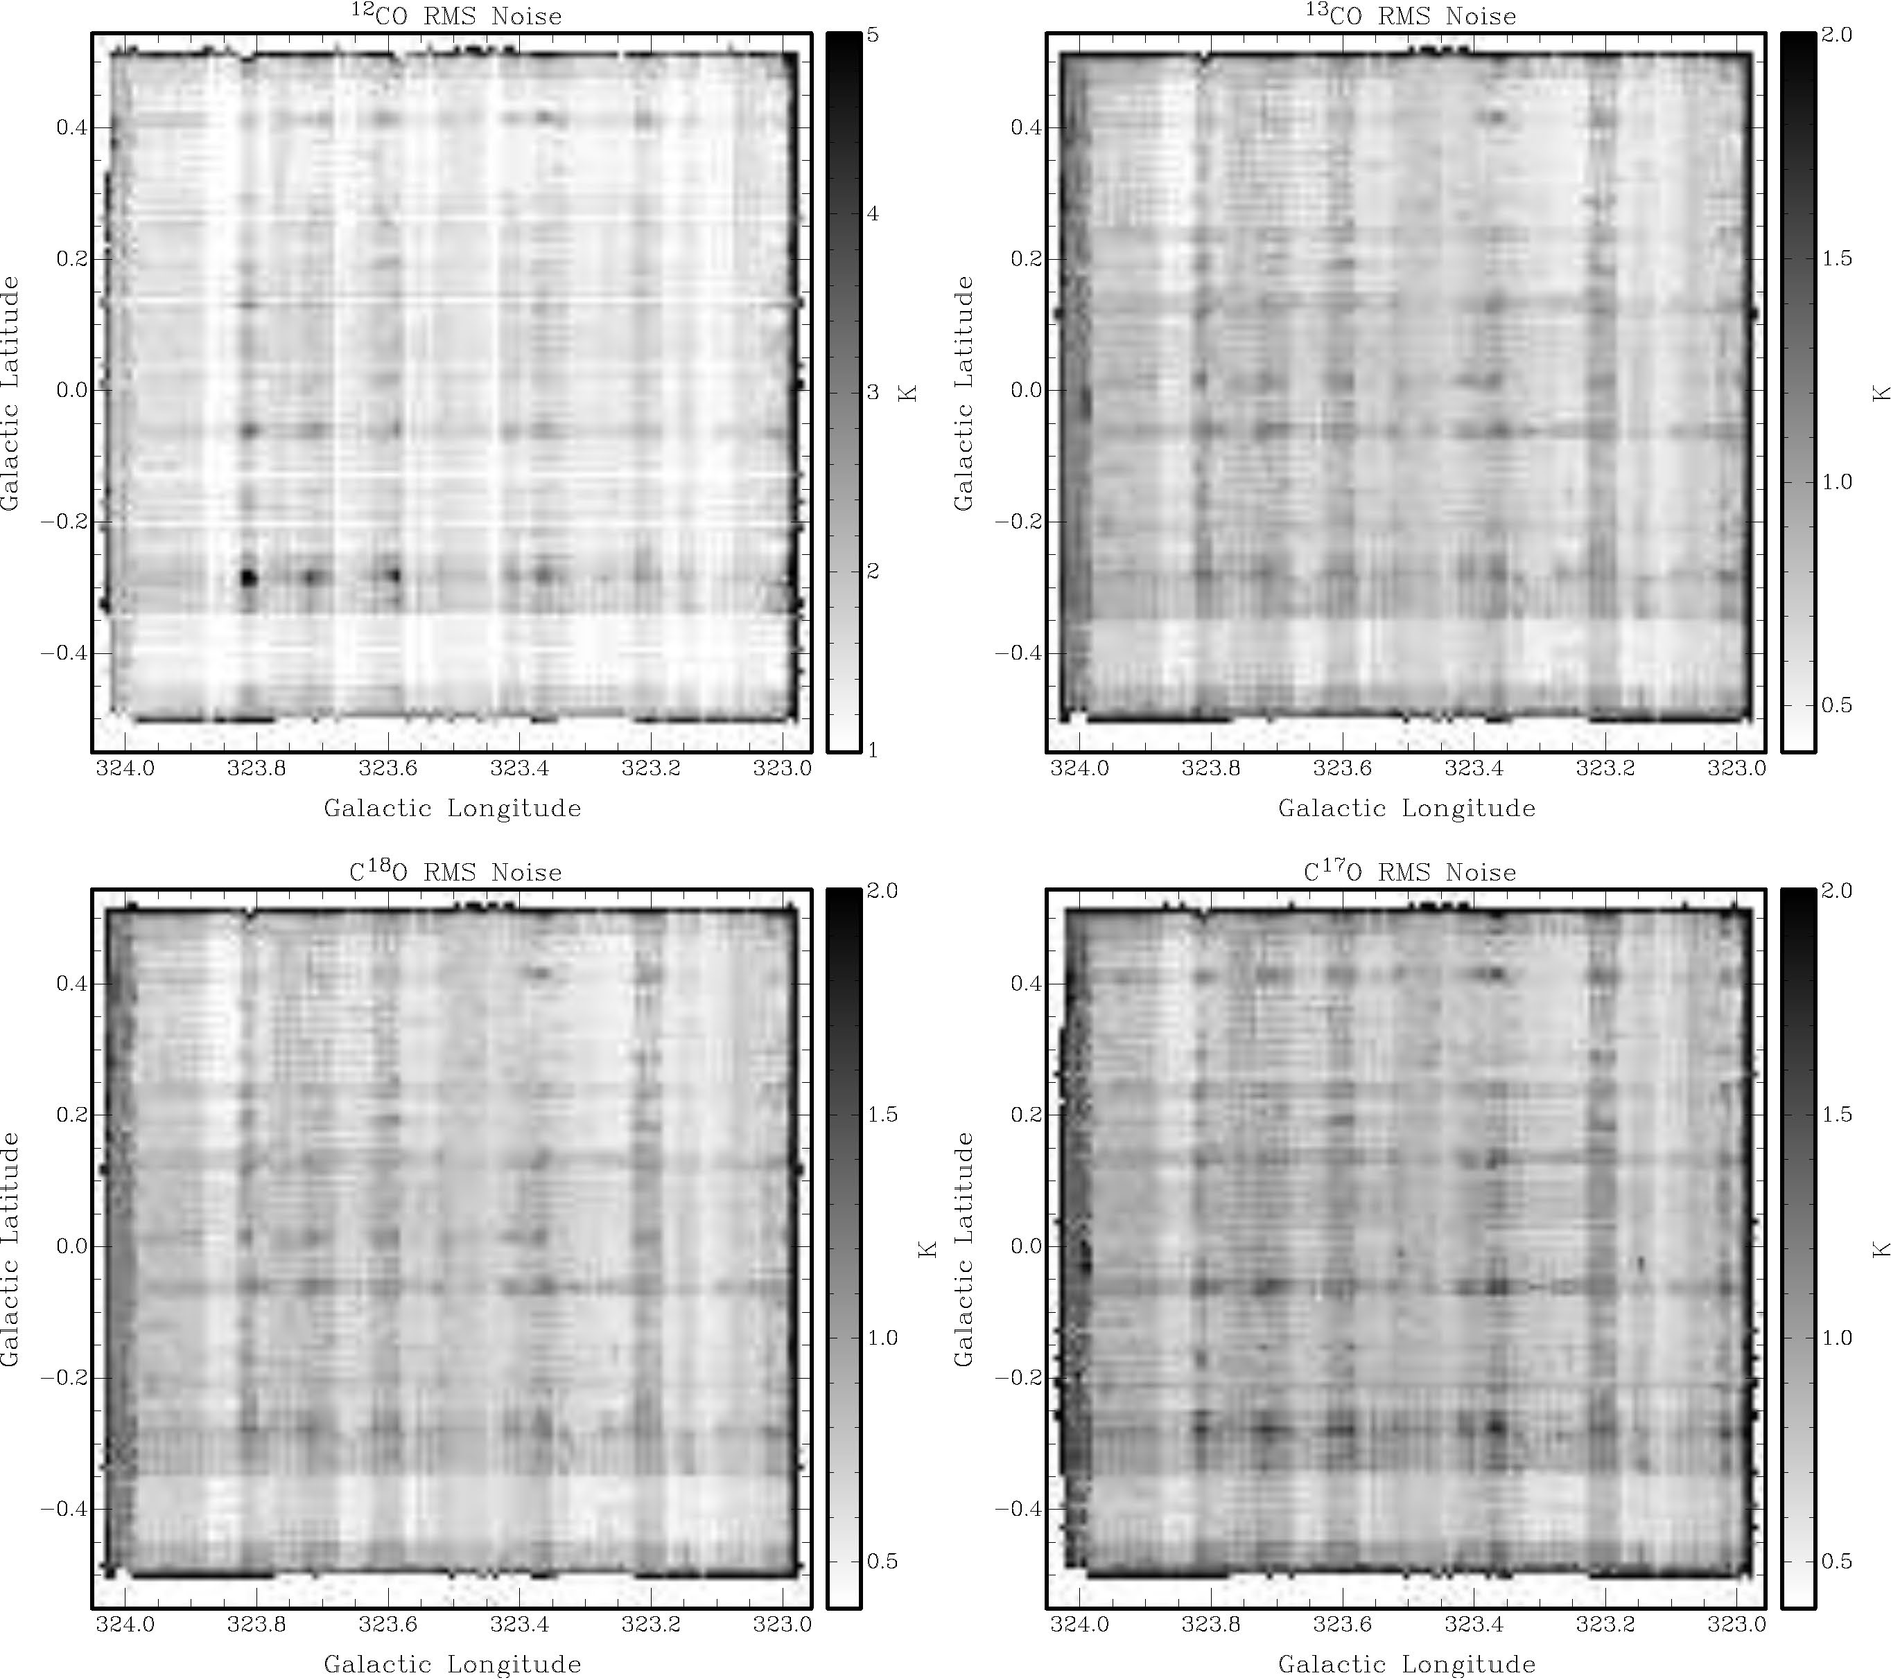
RMS Noise per Voxel

Slide 9
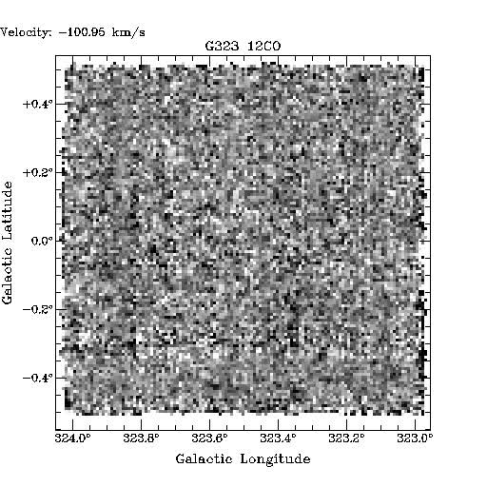
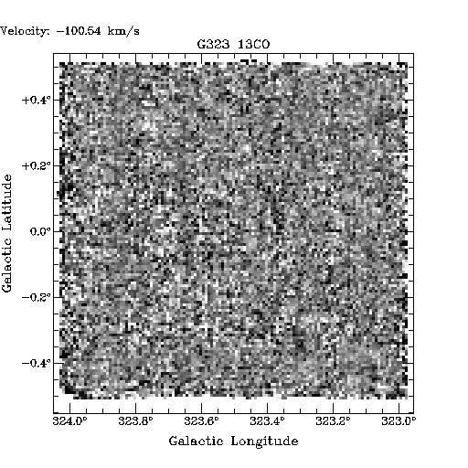
G323 1°x1° ¹²CO + ¹³CO J=1-0
-100 km/s
to
0 km/s
Email Catherine for movies. ☺

Slide 10
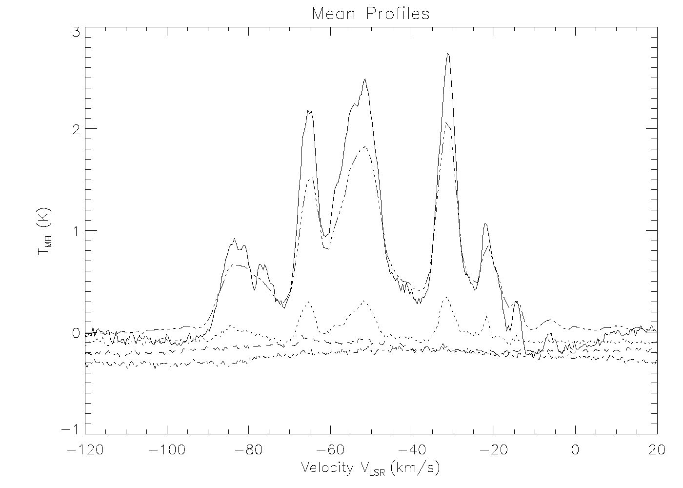
G323: Mean CO Profiles: 1°x1°
¹²CO
Dame survey
¹³CO
C¹⁸O
C¹⁷O

Slide 11
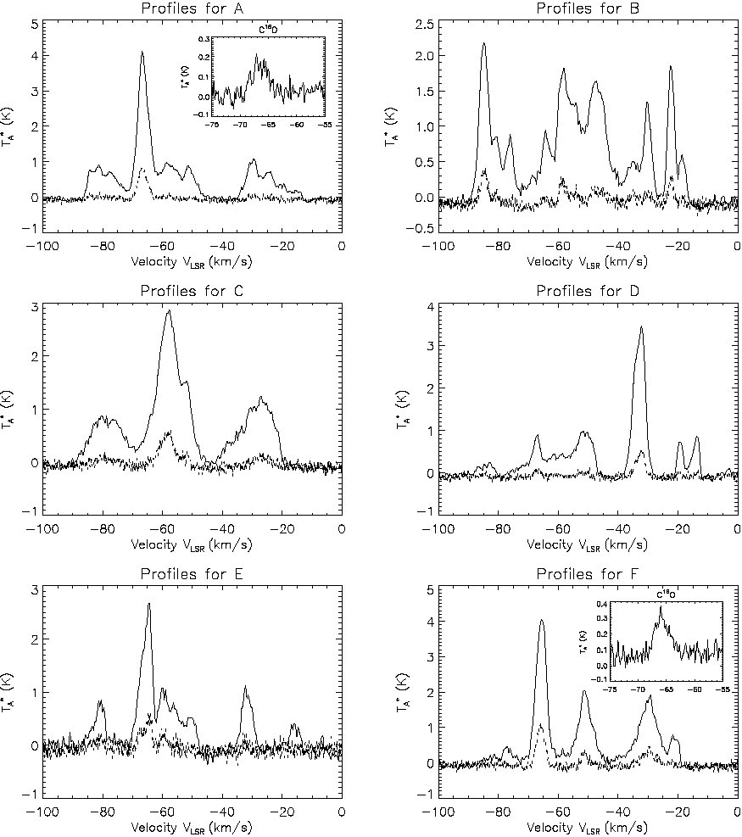
CO Lines Profiles
¹²CO
¹³CO
C¹⁸O

Slide 12
G323: ¹²CO vs. ¹³CO vs. Dame et al

Slide 13
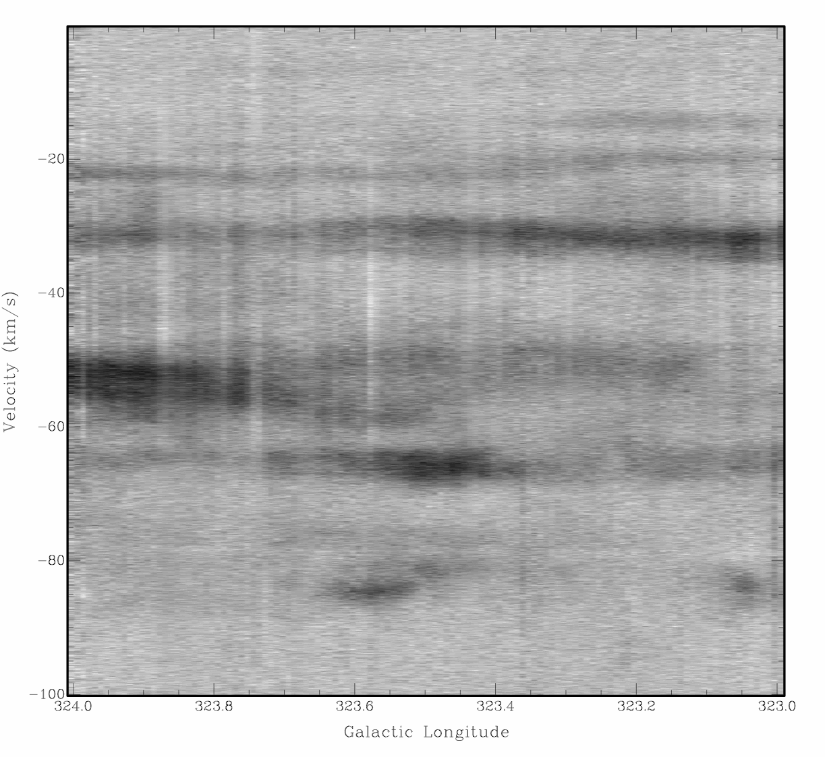
G323: Position - Velocity
[Scutum - Crux]
Sag -
Carina
Scutum
- Crux
Norma -
Cygnus

Slide 14
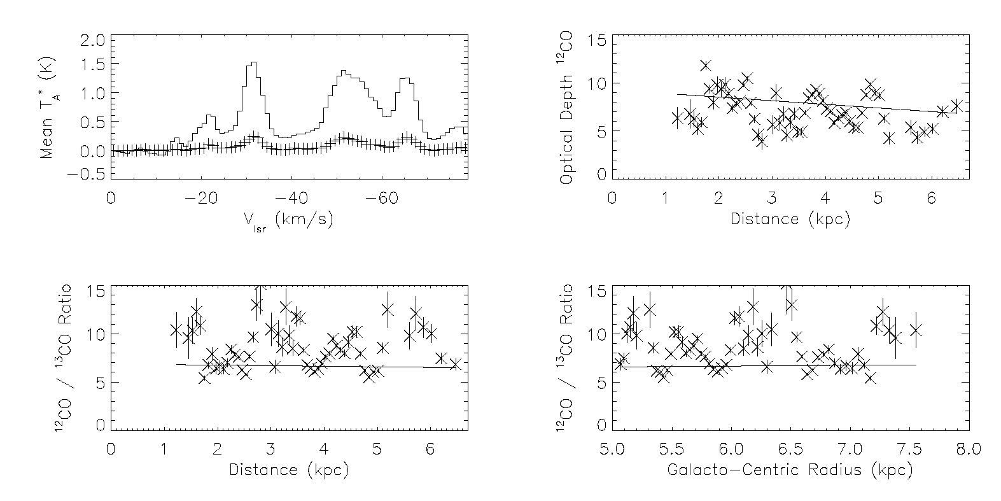
¹²CO / ¹³CO
Line Ratios and Optical Depth
τ_{CO} ∼10
R_{12/13} ~7

Slide 15
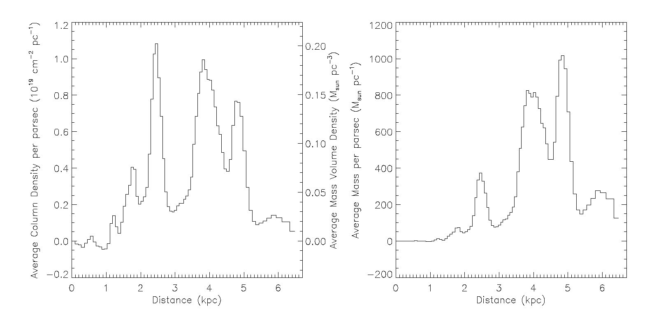
Molecular Mass Distribution at l=323°
M_{total} ~2 x 10⁶ M
ρ_{arm} ~0.1 M/pc³
M_{arm} ~5 x 10⁵ M

Slide 16
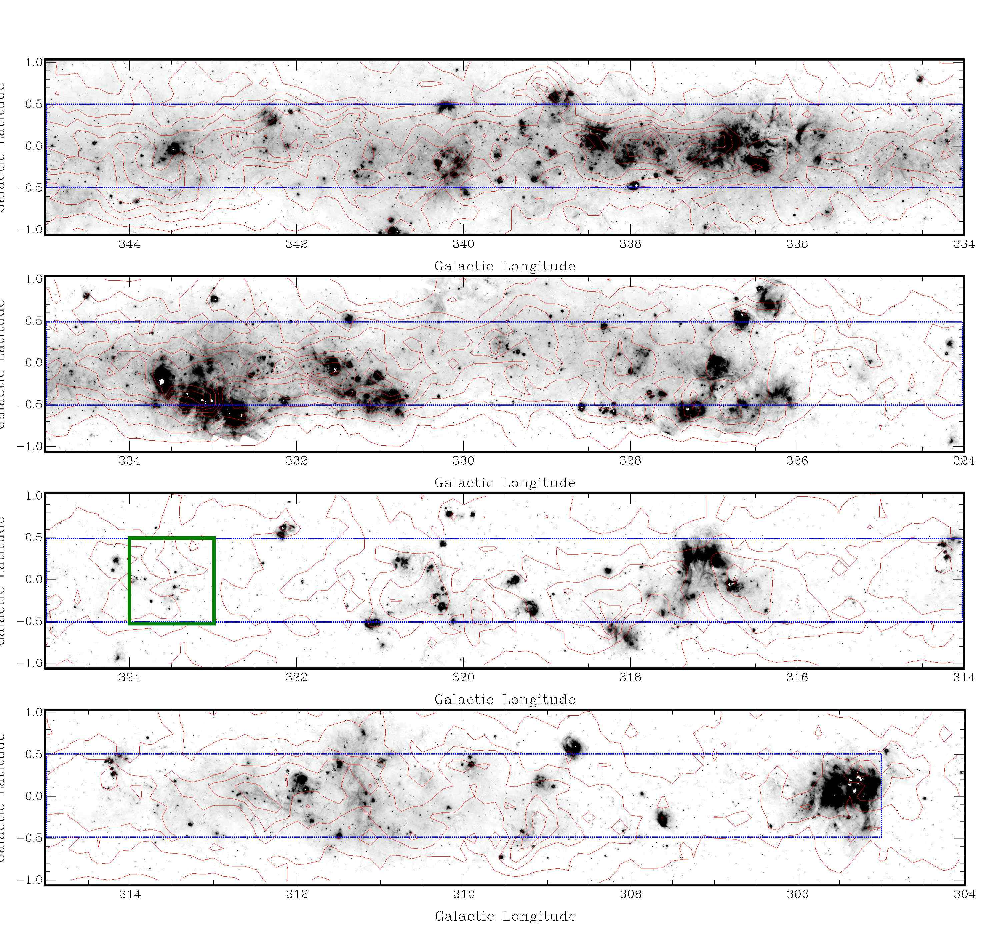
Survey
status
(Nanten2
meeting
2013)

Slide 17
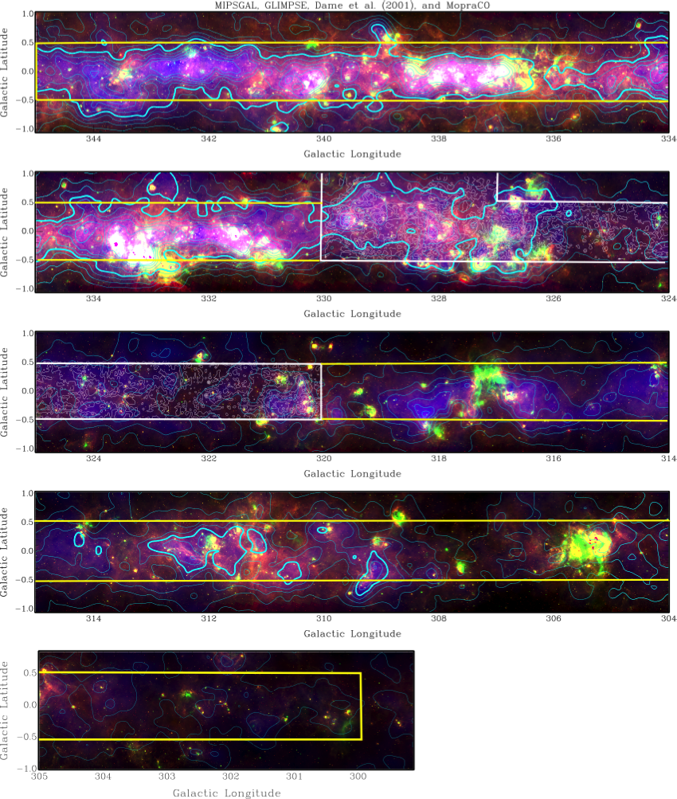
And then…
Survey status
(nanten2
meeting
2014)
Spitzer 8 μm, 24 μm,
Dame et al ¹²CO
(+contours),
MopraCO contours

Slide 18
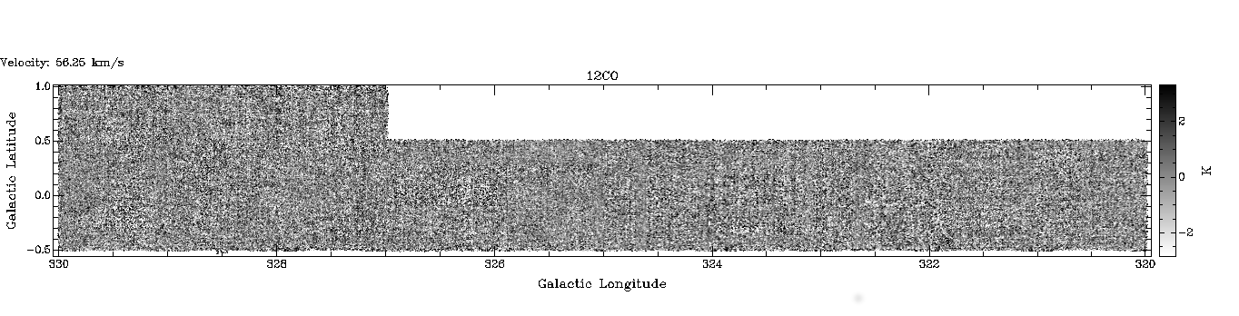
G320 - 330
Email Catherine for movies. ☺

Slide 19
G320 - 330
12CO, 13CO, HI
Spiral arms clearly evident
[Scutum - Crux]
Sag -
Carina
Scutum -
Crux
Norma -
Cygnus

Slide 20
Tsys comparison
G322
G323
Get winter observing time, if you can!

Slide 21
σ_{rms comparison}
G322
G323

Slide 22
And then…
Survey
(starting again in
March)
Spitzer 8 μm, 24 μm,
Dame et al ¹²CO
(+contours),
MopraCO contours

Slide 23
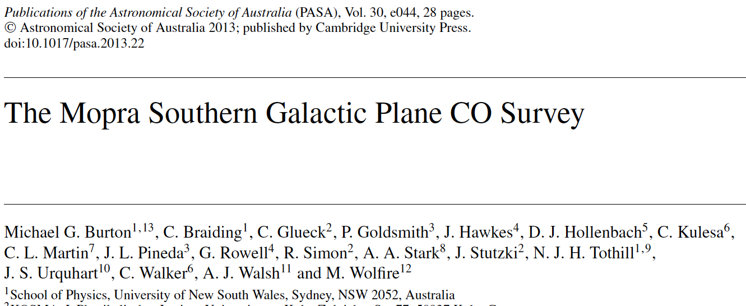
PASA (Publications of the Astronomical Society of Australia), 2013, 30, e044
G323 data available on the ATNF online archive: atoa.atnf.csiro.au
G320-330 coming soon.
(email c.braiding@unsw.edu.au for >330 and <320)

Slide 24
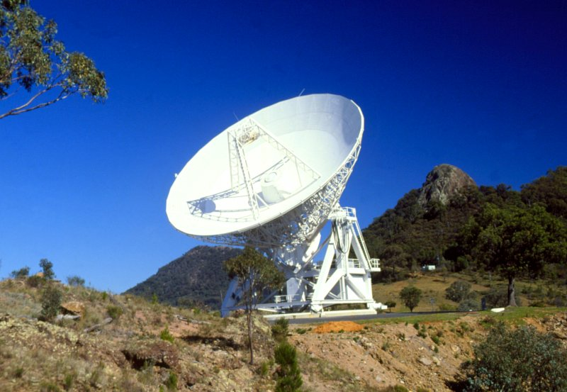
Thank-you!

