Slide 1
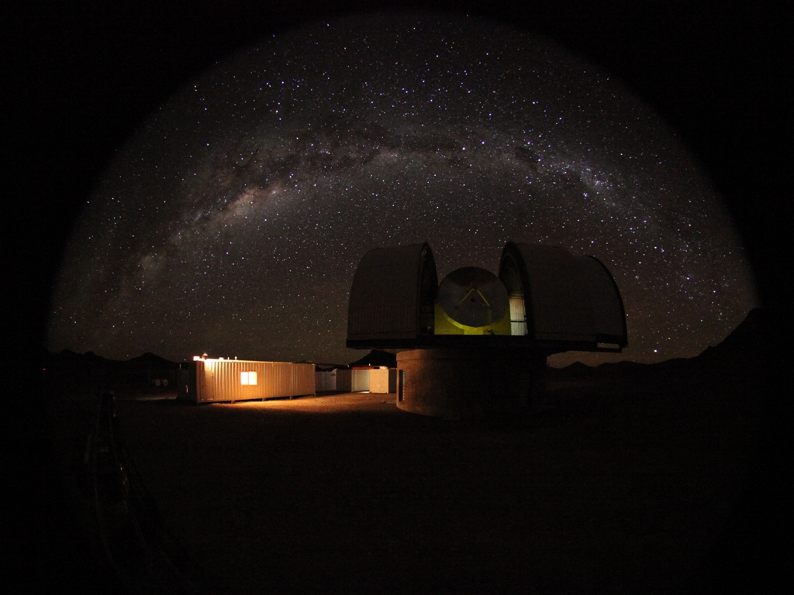
Recent status of the NANTEN2 and Nagoya project
Hiroaki Yamamoto
NANTEN2 project, Nagoya University
Image:
Pampa la Bola @ 4865m
NANTEN2 with Milky Way
NANTEN2 workshop @ Adelaide 2014.2.3-4

Slide 2
Members contributed from Japan
Nagoya University
- Staff: Y. Fukui, K. Tachihara, H. Yamamoto
A. Mizuno, T. Nakajima
- Posdoc: T. Hayakawa, K. Torii, T. Kuwahara
- PhD students: 6, Master course: 5
Osaka Prefecture University
- Staff: Hideo Ogawa, Toshikazu Onishi
- PhD student: 1

Slide 3
Contents
NANTEN2 project
- Timeline, Facility, Site, Instruments,
History in 2013, Weather
Results with Nagoya Receiver
NASCO receiver
Progress on NASCO system

Slide 4
Project Timeline
2004.8: Move to Pampa la Bola from Las
Campanas Observatory
2005.9: First light in mm
2006.4: First light in Sub mm
2007.10: Start remote observations
2009.4: Install of SMART
2014.late: Install of NASCO

Slide 5
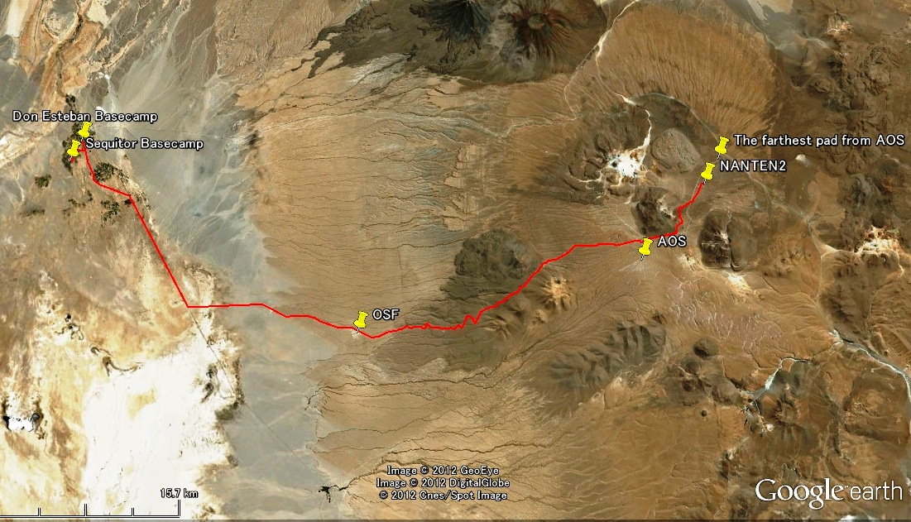
View of area
Alt. 2400m
Alt. 4800m
Alt. 5100m
ALMA Gate
Alt. 2900m

Slide 6
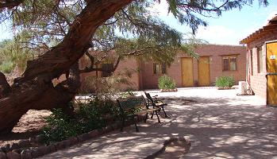
Facilities
・Sequitor Basecamp
・ For only Japanese
・ Inside is Japanese style
・ 3 rooms, max 6 people
・ Satellite connection
・ Cook by ourselves
・Don Esteban Basecamp
・ For German, Australian etc
・ Use other groups as well
・ Satellite connection
・ dining room etc
©2005 Astro-Norte.

Slide 7
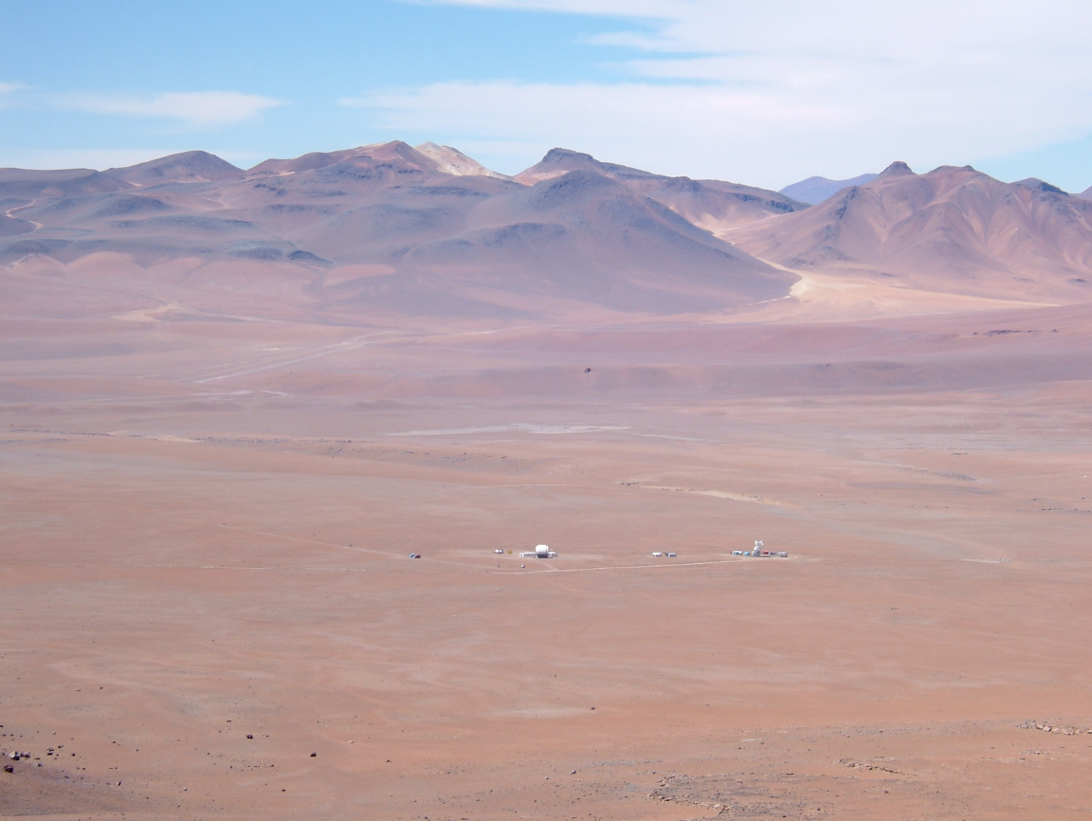
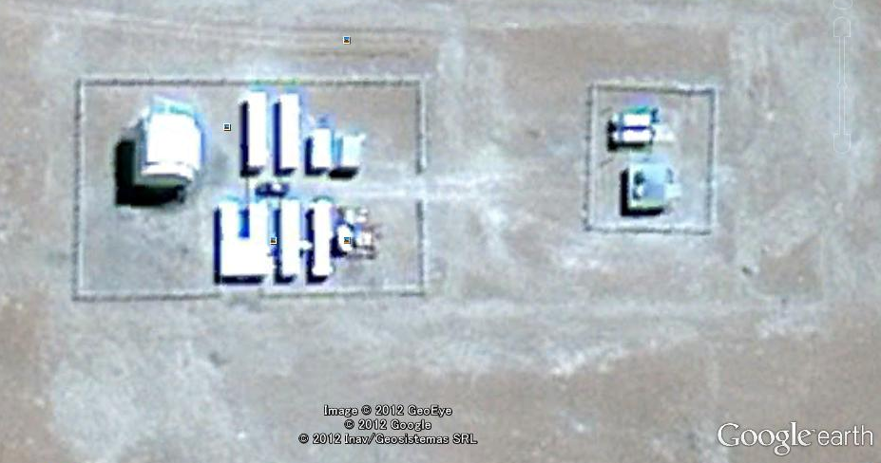
Weather monitor, Old AOS system etc
Dome
Rest, observation
Fuel tanks
(15,000L x 2)
Principal branch
of the power
Satellite
antenna
Old 4m dish
Generator house
Atmospheric
Observation
warehouse
Experimental room, tools

Slide 8
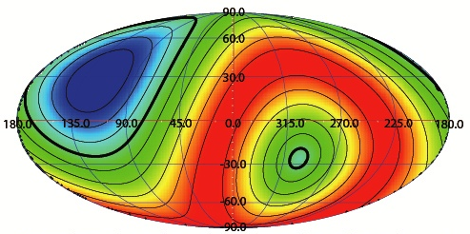
Observable Sky from the NATNEN2
Galactic Longitude
Galactic Latitude

Slide 9
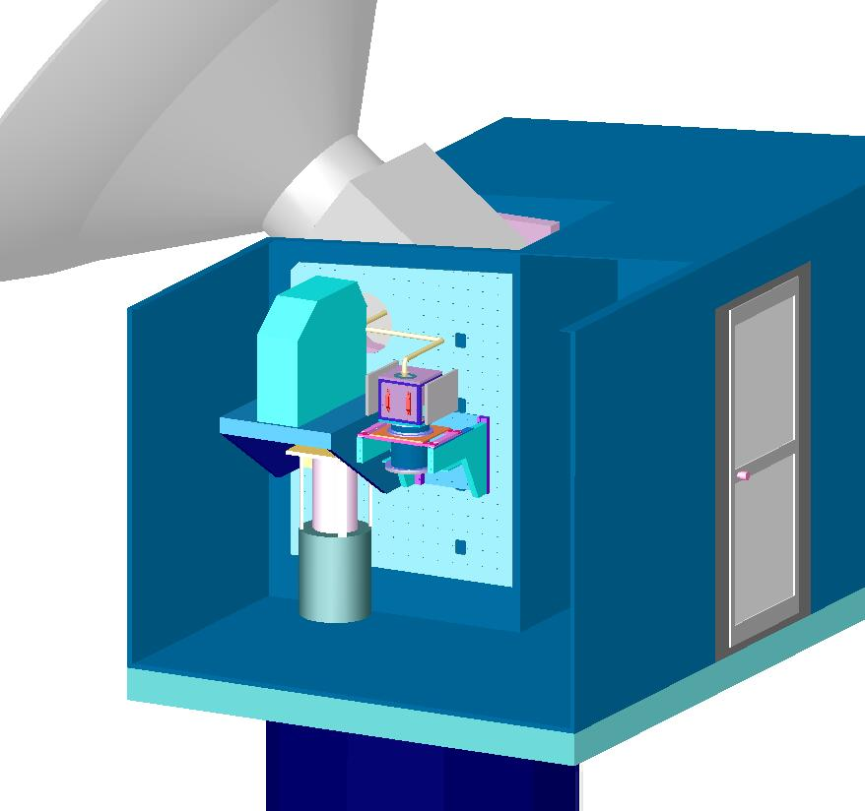
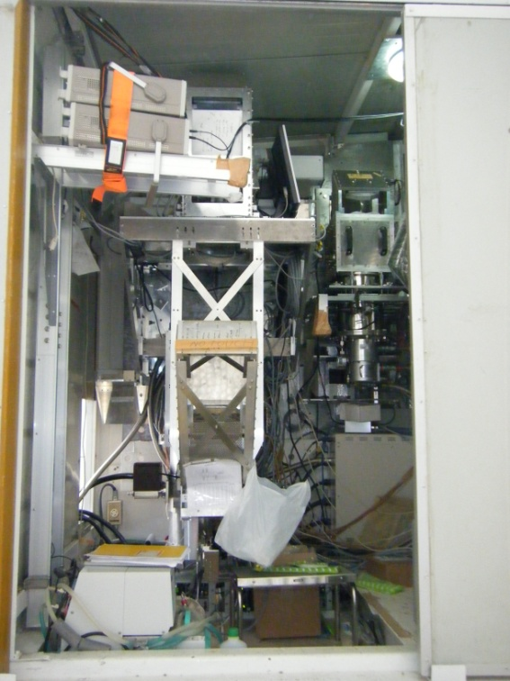
NANTEN2 Optics
Sub-ref
Nagoya RX
Main dish
Tertiary mirror
SMART
Fourth mirror
Fifth mirror with wire grid
Nagoya
Sixth mirror
Cold load
Cabin
SMART
115GHz receiver
SMART

Slide 10
NANTEN2 Instrumentation
230GHz receiver
1 pixel, DSB receiver
4-8GHz IF
2 DFS, 1GHz width and 61kHz resolution for each
Observations of ¹²CO(J=2-1) and ¹³CO(J=2-1),
or ¹³CO(J=2-1) and C¹⁸O(J=2-1), simultaneously
500/800GHz receiver (SMART)
8 pixels for each frequency
Observation in 500/800 GHz simultaneously.
AOS, 1 GHz width and 500kHz resolution for All pixel
DFS, 1.5GHz width for each

Slide 11
2013 timeline
2013
End of January: Generators arrive at ATF.
End of February: Generators arrive at PLB.
Late March-Early April: replacing the generators
Middle of April: Start to an operation
Middle of May: Snowing, impossible to access the site for 10 days
Middle of June: Snowing, impossible to access the site for 5 days
Middle of July: Snowing, impossible to access the site for 1 week
Early August-End of December: Scientific Observations
2014
January: Maintenance of Dome, Telescope and 230GHz system

Slide 12
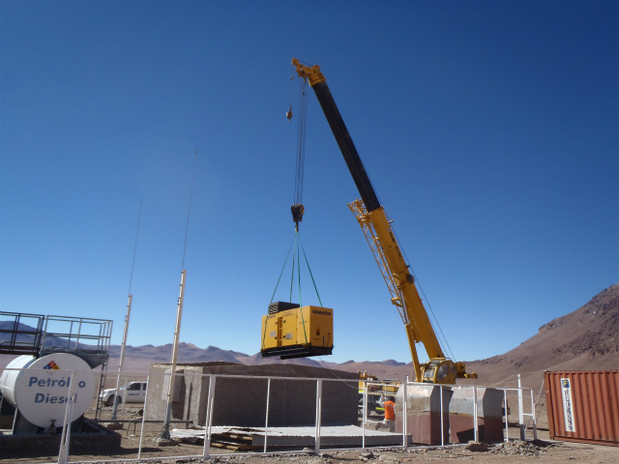
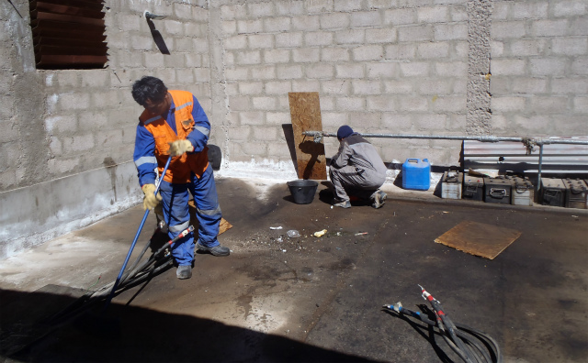
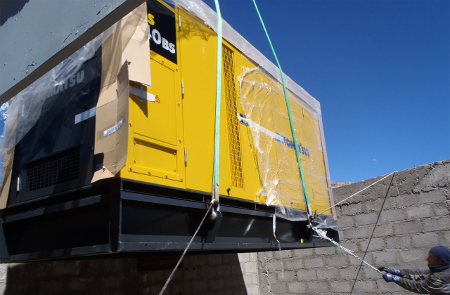
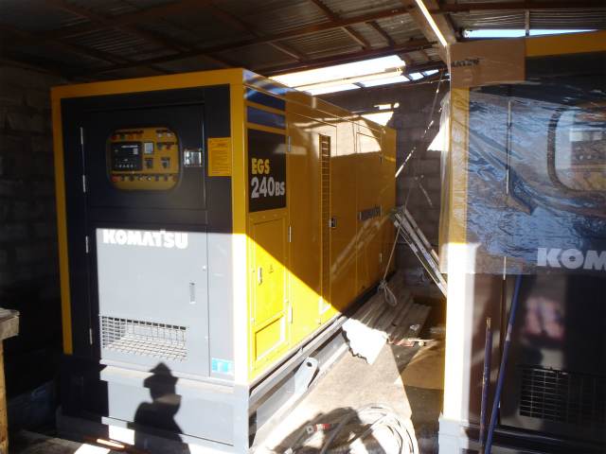
Replacing generators

Slide 13
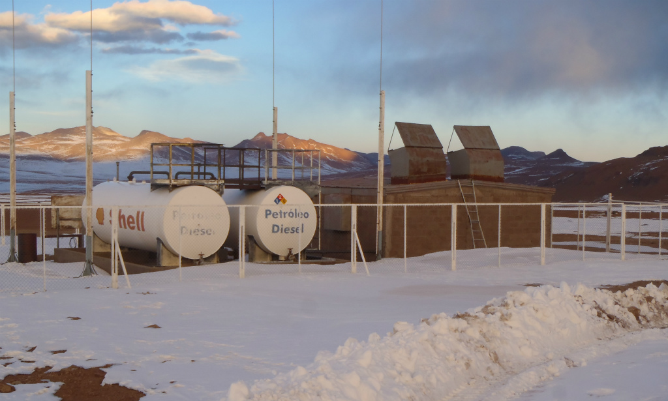
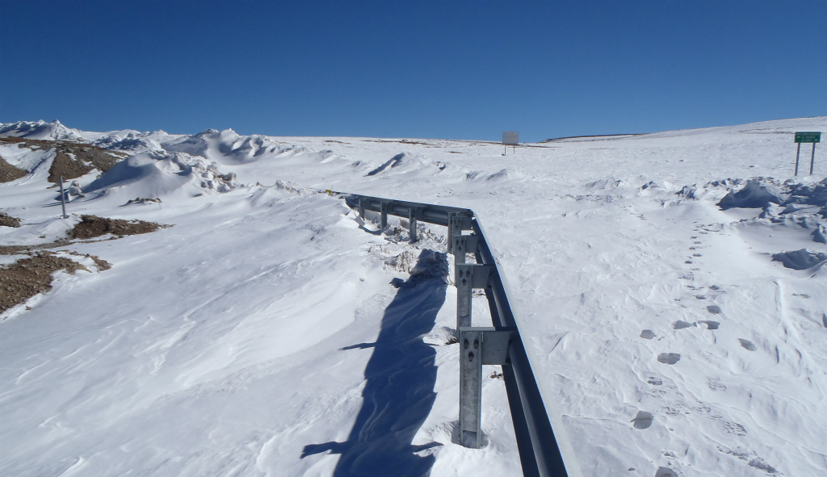
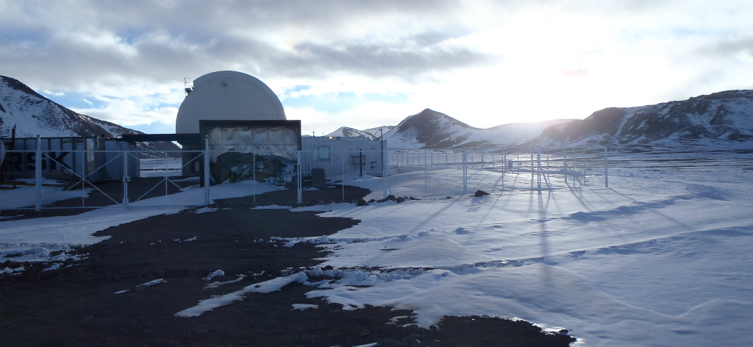
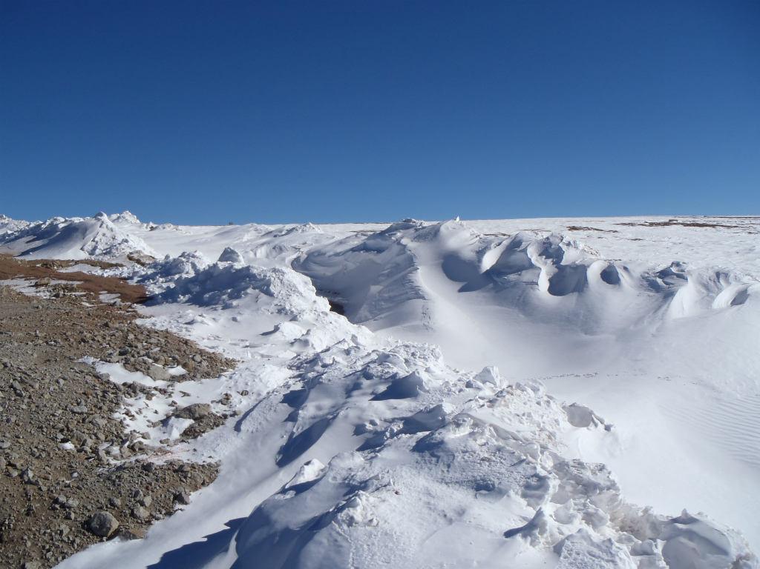
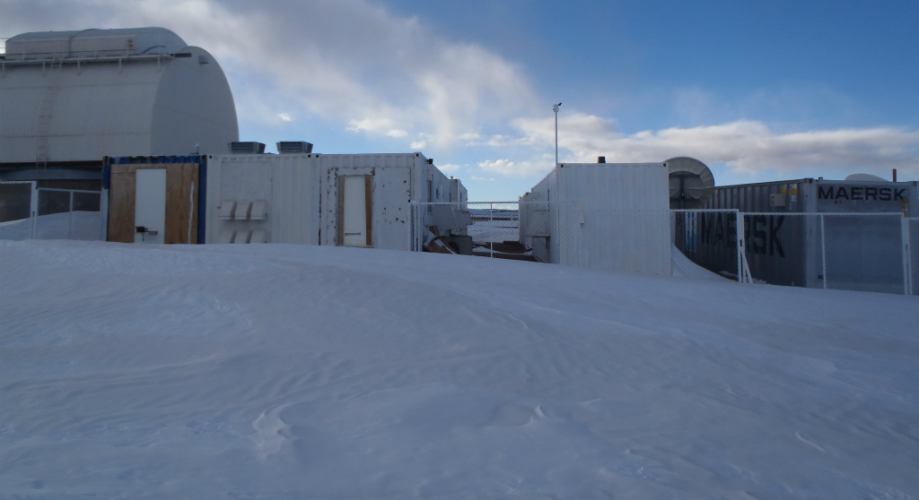
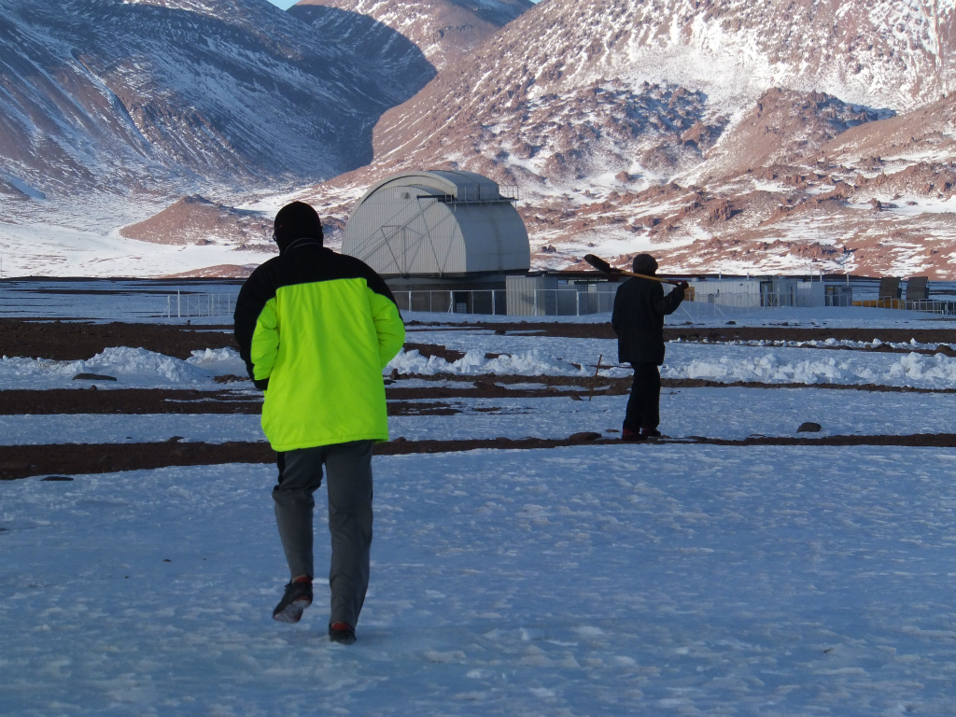
2013.5.27
2013.6.17

Slide 14
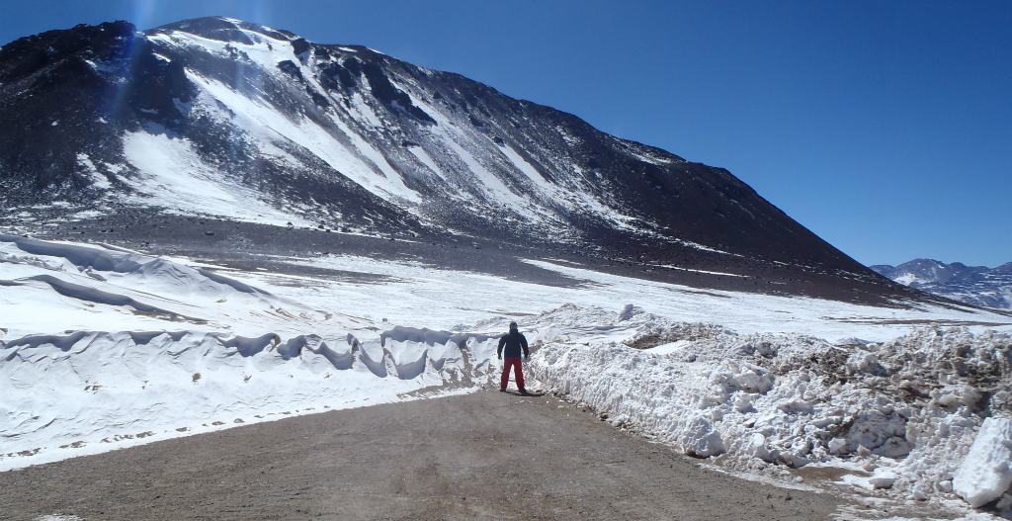
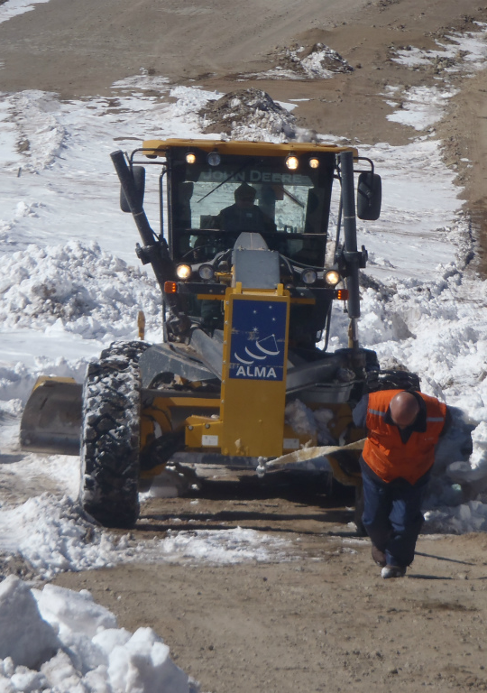
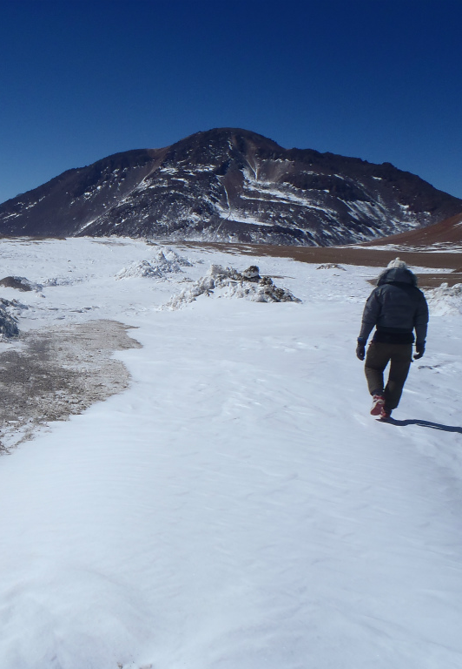
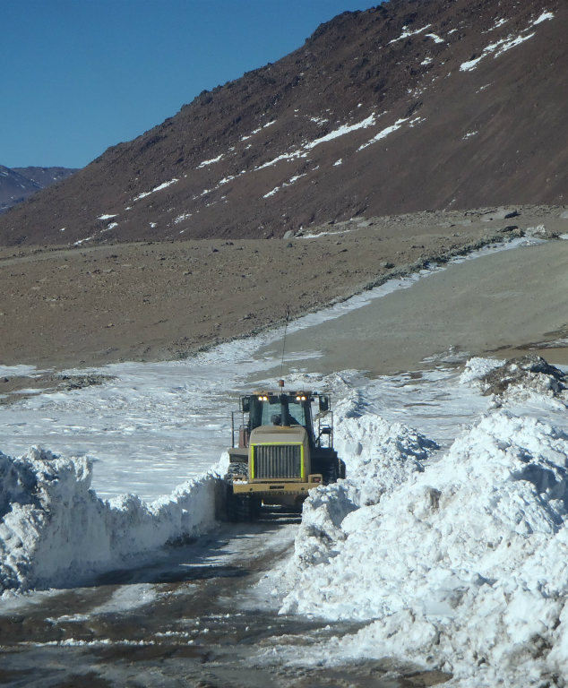
2013.7.23-29

Slide 15
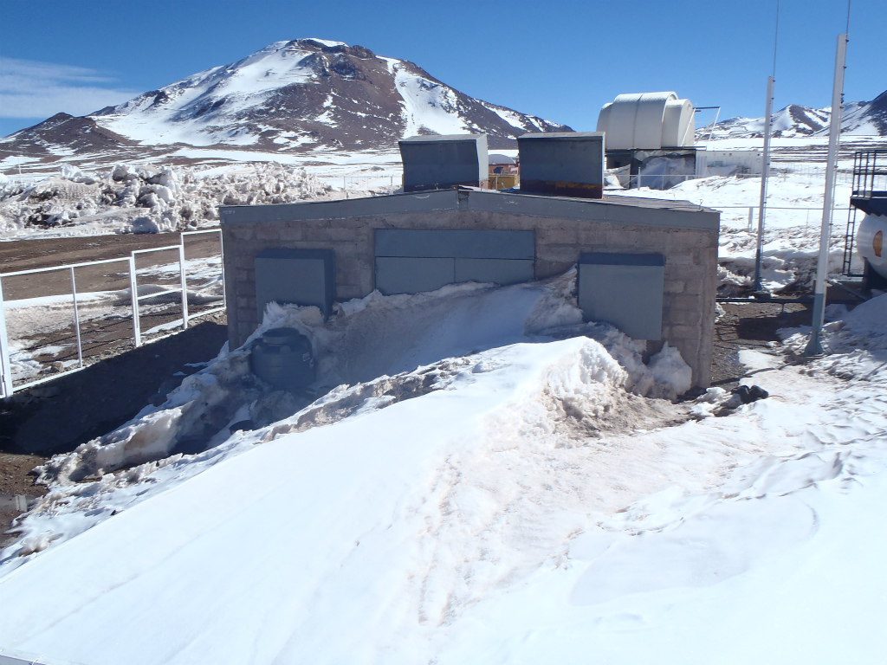
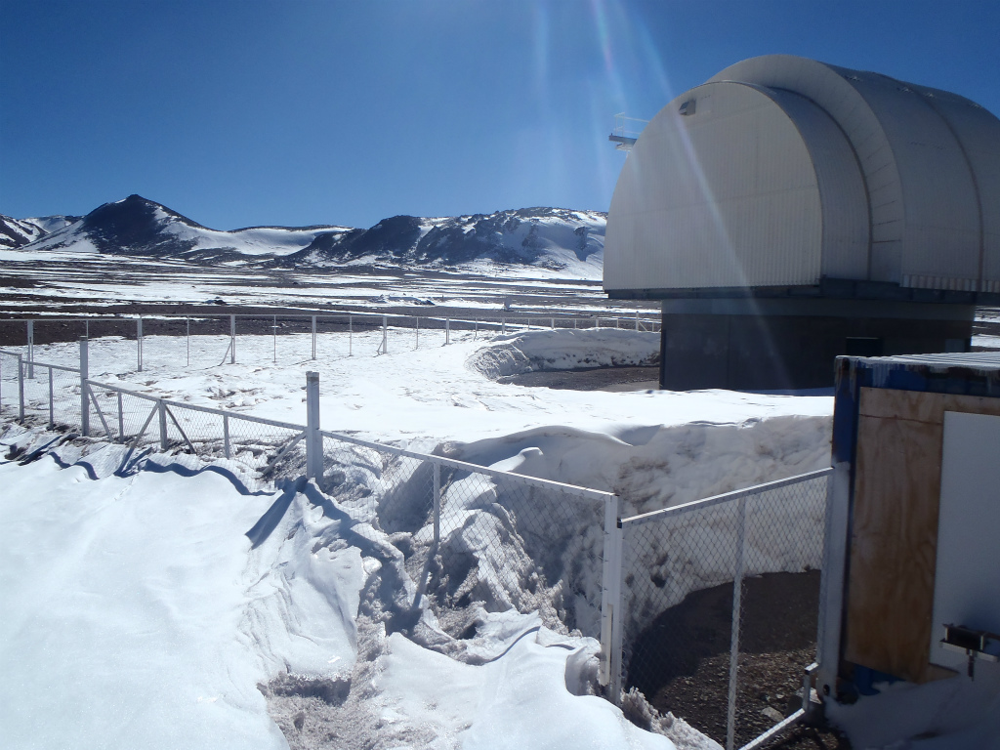
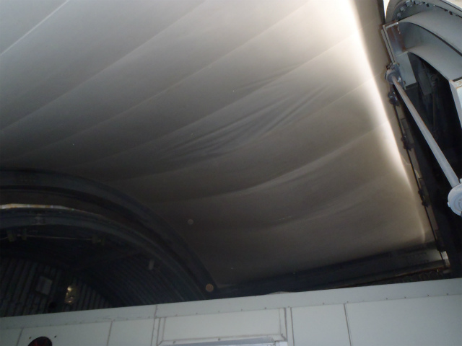
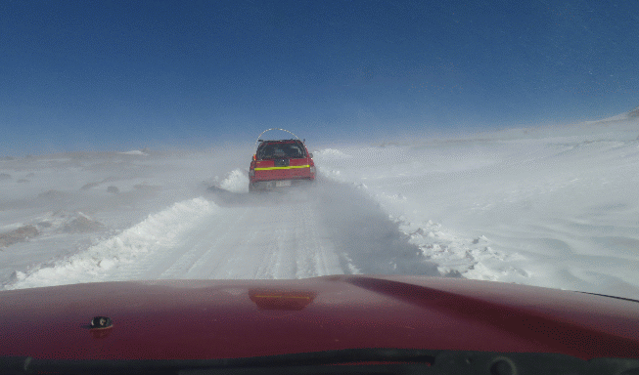
2013.7.29-30

Slide 16
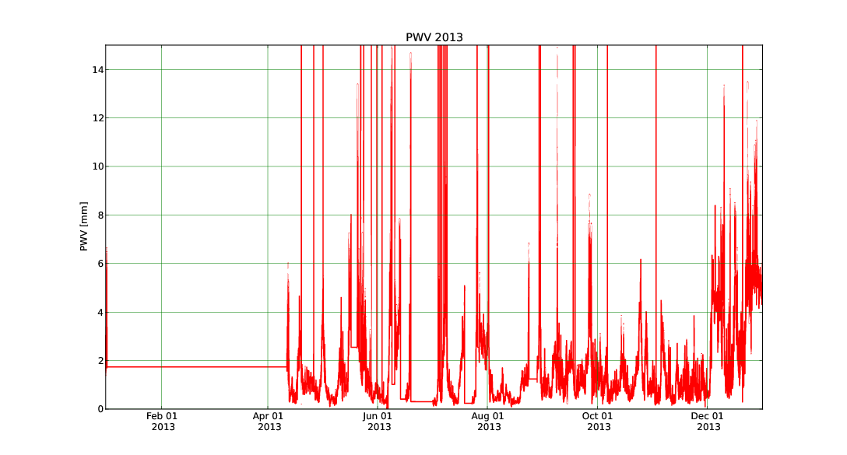
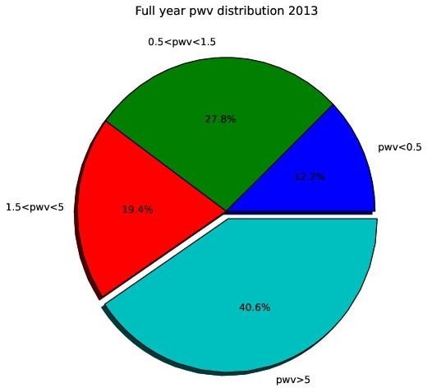
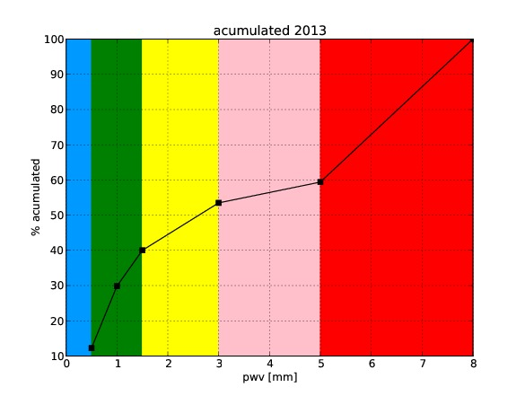
Weather Status in 2013
Generators, snow, weather condition
PWV=1.0mm
Full year PWV distribution 2013
Acumulated 2013
27.8%
12.2%
19.4%
40.6%
From APEX web site
PWV < 1mm 30%, PWV < 1.5mm 40%, PWV < 5mm 60%

Slide 17
Targets in 2013
Objects in the Galactic Center
SNR: IC443
Massive Star Forming Region: RCW38, RCW120
Los Mass Star Forming Region:
High Latitude: Pegasus Loop, B=-70

Slide 18
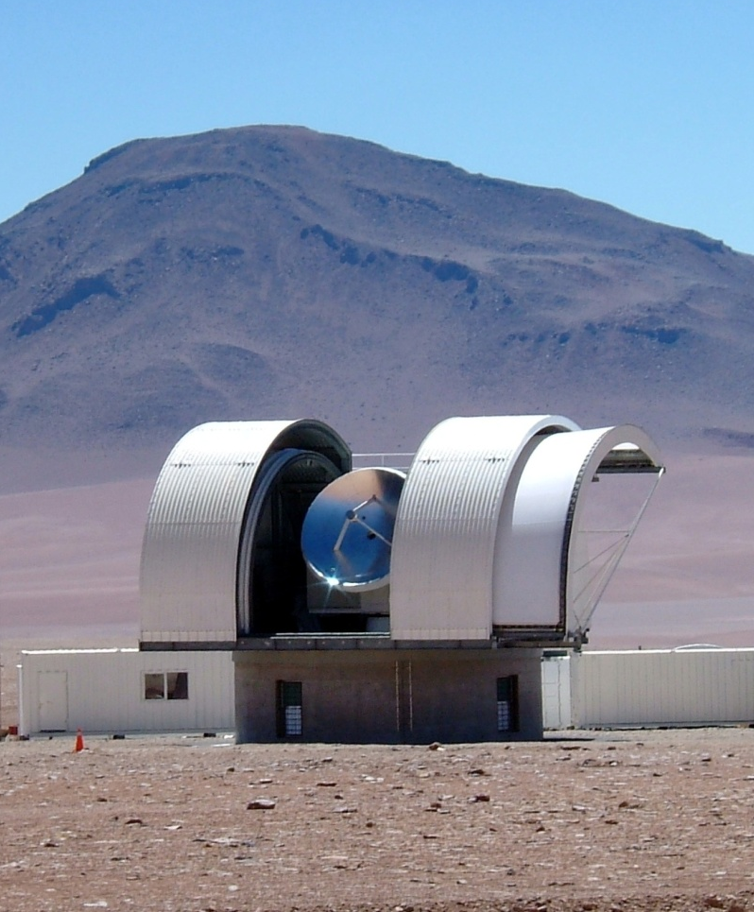
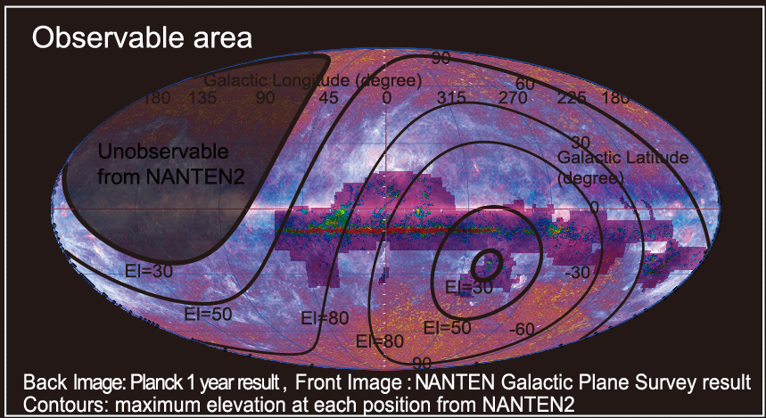
NAnten Super CO survey (NASCO)
New Survey by NANTEN2 in ¹²CO and
¹³CO(J=1-0) simultaneously.
Survey beyond NGPS
Covering 70% area of whole sky
Unobservable
from NANTEN2
Survey Name | Coverage (deg) | HPBW (‘) | Grid (‘) | Vel cov. (km/s) | Vel reso. (km/s) | RMS[K]@ 1km/s reso. | Total points (million)
NGPS | 200<L<60,B<|10| | 2.6 | 4-8 | ±300 | 1.0 | ~0.35 | 1.1
NASCO | 70% of sky | 2.6 | 1 | ±1300 | 0.16 | ~0.2 | 20

Slide 19
System of NASCO
4 beams receiver: DSB mixer with OMT
3 beams for 115GHz and 1 beam for 230GHz
4-12GHz IF for 115GHz and 4-8GHz IF for 230GHz
Back-ends will be shared with SMART
4 beams x 2 polarizations x 2 lines (¹²CO and ¹³CO)
→ 16 IFs in total

Slide 20
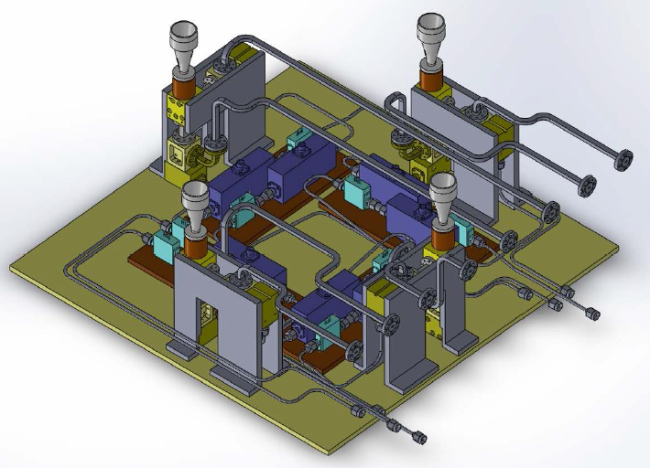
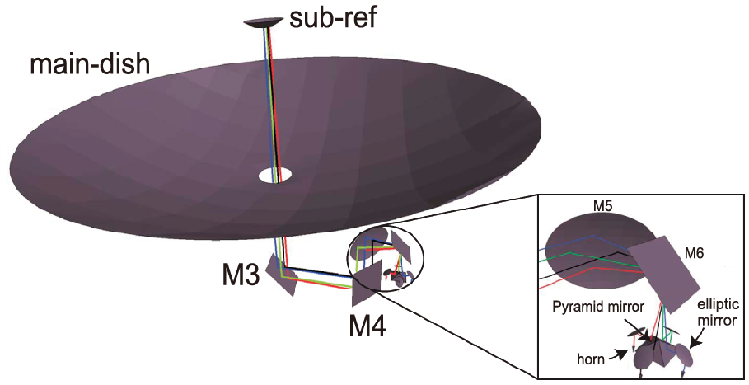
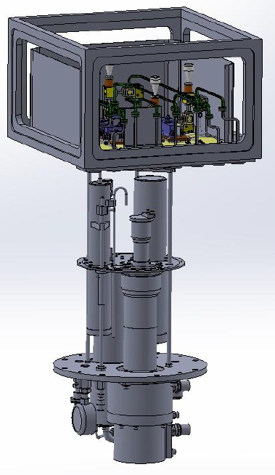
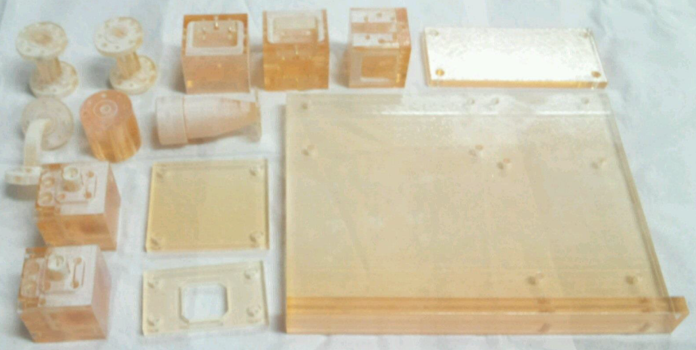
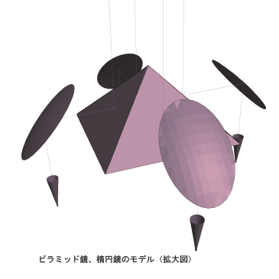
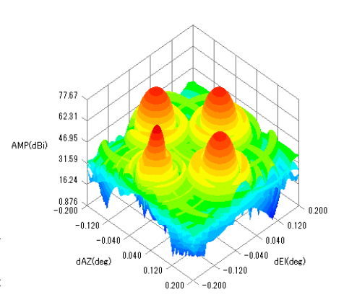
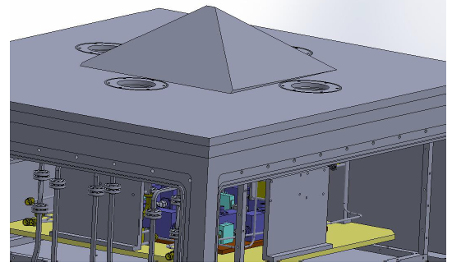
New Optics
Making by 3D printer in University’s machining center
NASCO receiver
Expected Antenna pattern

Slide 21
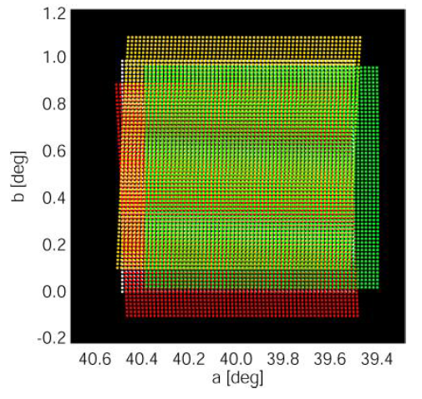
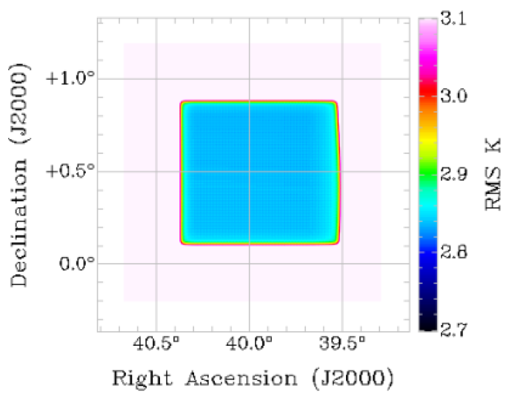
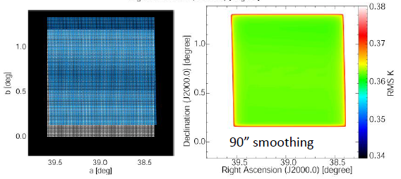
Simulation of Observations
3 beam of
115 GHz
1 beam of
230 GHz

Slide 22
The 2014 Season
Start an operation in April
230GHz receiver is continue to use
Late 2014, we will install NASCO receiver.

