Slide 1
MALT90
The Millimetre Astronomy Legacy Team 90 GHz Survey
James Jackson
University of Newcastle
CTA Workshop; UWS Penrith Observatory; 11 April 2017

Slide 2
Collaborators (partial list)
Jill Rathborne CSIRO
Yanett Contreras Leiden
Scott Whitaker Boston University
Ian Stephens Harvard/Smithsonian CfA
Patricio Sanhueza Natl. Ast. Obs. Japan
Steve Longmore Liverpool John Moores U.
Taylor Hogge Boston University
Friedrich Wyrowski Max Planck Institut
Andres Guzman U. Chile

Slide 3
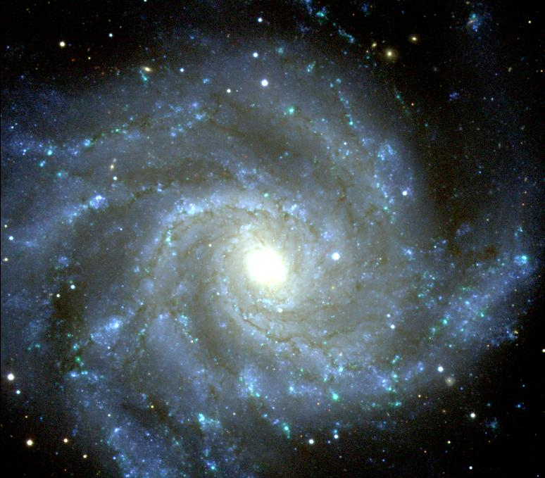
High-Mass Stars in Galaxies
Dominate the luminosity
Dominate the input of energy into the interstellar medium
Produce and disperse the heavy elements
Dominate the chemistry
And yet their formation remains an open problem
M74
HST Image: NASA, ESA, and the Hubble Heritage (STScI/AURA)-ESA/Hubble Collaboration
Notes:
3

Slide 4
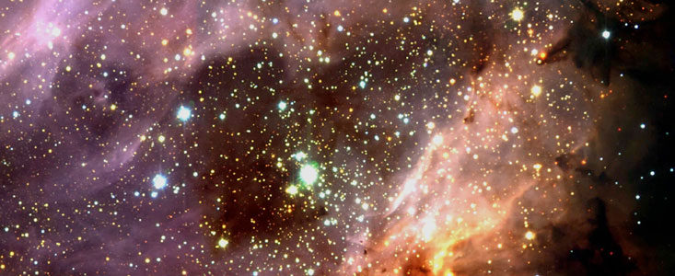
High-Mass Star Formation is poorly understood
• Time scales are short
• High-mass stars are rare
• High-mass stars are disruptive
• Deeply embedded in molecular clouds
M17, near-IR (ESO)
Notes:
The earliest stages in cluster formation are very difficult to observe, primarily because massive stars are extremely disruptive. They have intense UV radiation which photo-dissociates and photo-evaporates the surrounding material. They have strong stellar winds and give rise to supernova explosions after only a few million years.
Cluster formation is also difficult to observe because it occurs deeply within molecular clouds. The large visual extinction toward these regions makes them only observable at radio, sub-mm, mm and IR wavelengths.

Slide 5
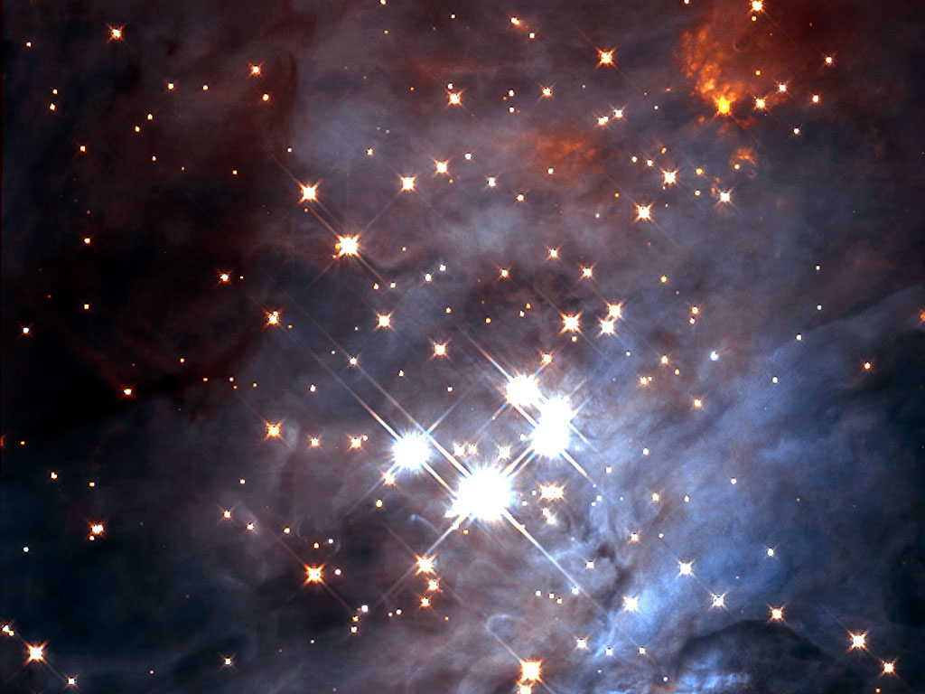
All (high-mass) stars form in clusters or groups from a single molecular “clump”
Orion Trapezium cluster
4 high mass stars;
~3500 total stars
2 pc molecular clump
4500 M gas mass
n ~ 10⁴ cm⁻³
The clump is the
fundamental unit of
cluster formation.
Hubble Space Telescope; near-IR
Lada et al. 1997, Lada & Lada 2003
Notes:
Massive stars typically form within clusters, with many lower-mass stars.
Cluster formation is seen in many molecular clumps, in particular, in the rho ophiucus molecular cloud, we see 100 low to intermediate mass stars have formed from a 2 pc, 600 Msun molecular clump.
In contrast, the Orion star forming region we see many more stars (including several high mass stars) form from a 2 parsec, 4500 solar mass molecular clump.
In general, these values are typical of molecular clumps forming
Clusters: sizes of about 2 pc, and masses of about 1000 Msun.

Slide 6
The evolutionary phases of high-mass star forming clumps
0.2 degrees
1.2 degrees
The “Nessie” Nebula
Jackson et al. 2010 ApJ Letters
Blue - 3.6μm, Green - 8μm, Red - 24μm
Image credit: NASA/JPL-Caltech/Univ. of Wisconsin
Notes:
One remarkable aspect of these clouds is that they tend to be very filamentary. An extreme example of this is shown here. This IRDC has an extremely large aspect ratio, extending more than a degree along the Galactic plane.
What is particularly interesting about this IRDC, is that, when we mapped it in molecular line emission, we discovered that the velocity of the molecular line emission is uniform across the whole filament, which implies that it is a single molecular cloud.
What is also interesting are the number of cores that are located along this filament.

Slide 7
Pre-stellar
Early stage
Cold pre-stellar clump
Blue - 3.6μm, Green - 8μm, Red - 24μm
Image credit: NASA/JPL-Caltech/Univ. of Wisconsin
Notes:
One remarkable aspect of these clouds is that they tend to be very filamentary. An extreme example of this is shown here. This IRDC has an extremely large aspect ratio, extending more than a degree along the Galactic plane.
What is particularly interesting about this IRDC, is that, when we mapped it in molecular line emission, we discovered that the velocity of the molecular line emission is uniform across the whole filament, which implies that it is a single molecular cloud.
What is also interesting are the number of cores that are located along this filament.

Slide 8
Protostellar
Intermediate stage
Protostellar clump
Blue - 3.6μm, Green - 8μm, Red - 24μm
Image credit: NASA/JPL-Caltech/Univ. of Wisconsin
Notes:
One remarkable aspect of these clouds is that they tend to be very filamentary. An extreme example of this is shown here. This IRDC has an extremely large aspect ratio, extending more than a degree along the Galactic plane.
What is particularly interesting about this IRDC, is that, when we mapped it in molecular line emission, we discovered that the velocity of the molecular line emission is uniform across the whole filament, which implies that it is a single molecular cloud.
What is also interesting are the number of cores that are located along this filament.

Slide 9
H II region
Later stage
Stellar “H II region” clump
Blue - 3.6μm, Green - 8μm, Red - 24μm
Image credit: NASA/JPL-Caltech/Univ. of Wisconsin
Notes:
One remarkable aspect of these clouds is that they tend to be very filamentary. An extreme example of this is shown here. This IRDC has an extremely large aspect ratio, extending more than a degree along the Galactic plane.
What is particularly interesting about this IRDC, is that, when we mapped it in molecular line emission, we discovered that the velocity of the molecular line emission is uniform across the whole filament, which implies that it is a single molecular cloud.
What is also interesting are the number of cores that are located along this filament.

Slide 10
Photodissociation Region (PDR)
Latest stage
Photodissociation region (PDR)
Blue - 3.6μm, Green - 8μm, Red - 24μm
Image credit: NASA/JPL-Caltech/Univ. of Wisconsin
Notes:
One remarkable aspect of these clouds is that they tend to be very filamentary. An extreme example of this is shown here. This IRDC has an extremely large aspect ratio, extending more than a degree along the Galactic plane.
What is particularly interesting about this IRDC, is that, when we mapped it in molecular line emission, we discovered that the velocity of the molecular line emission is uniform across the whole filament, which implies that it is a single molecular cloud.
What is also interesting are the number of cores that are located along this filament.

Slide 11
The Millimeter Astronomy Legacy Team 90 GHz (MALT 90) Survey
Science goal: How do high-mass star-forming molecular clumps evolve?
MALT 90 probes the dense
Star-forming gas.
ATNF Mopra 22 m
Notes:
The MDCS will be valuable not only in its own right, but also as an important finding chart to identify key ALMA targets. With its unprecedented large sample of dense cores, the MDCS will identify the rare, extremely interesting objects that demand ALMA’s capabilities. Because the MDCS will provide physical conditions, chemical conditions, and kinematic distances, it will be an essential resource for ALMA scientists who study star-formation. For instance, the MDCS will identify huge numbers of the heretofore elusive high-mass, cold pre-stellar cores. These objects will be key laboratories to test the ideas of monolithic collapse and competitive accretion at high angular resolution.

Slide 12
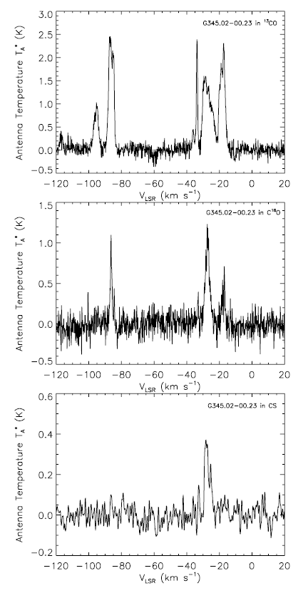
Why 90 GHz ?
¹³CO
Molecular lines at ~90 GHz usually have high dipole moments, and thus require high densities (n > 10⁵ cm⁻³) for their excitation
These lines are therefore sensitive ONLY to dense star-forming clumps.
C¹⁸O
Dense clump
CS
Notes:
We have selected to conduct this survey at 90 GHz because here the spectrum is rich in diagnostic lines. Because these lines have high dipole moments, they require high densities for their excitation. These lines have the advantage of pinpointing only the dense gas that is associated with star-forming cores and not from the surrounding, diffuse molecular cloud.
Moreover, because the lines near 90 GHz span a large range of excitation energies and critical densities, they indicate distinct physical conditions and chemical evolution.
Also, with the measured VLSR, we can derive a kinematic distance to the cores which will allow us to more reliably determine their masses and the luminosities of any protostars. We can then also answer the question about whether or not adjacent cores are physically related.

Slide 13
MALT 90 Survey Observing Parameters
16 lines
3’ x 3’ maps
Two orthogonally scanned “on-the-fly” maps for each source
38” angular resolution
0.05 K sensitivity
0.1 km s⁻¹ spectral resolution
Targets: ATLASGAL 870 μm clumps
ATNF Mopra 22 m
Jackson et al. 2013
Notes:
To test the fesability of this project, we conducted a set of pilot observations last July. In total, 199 cores were mapped - these cores were chosen to be representative of the three groups we are considering.
Not surprisingly, we found signifiant differences between the morphologies of the various lines, their profiles and also between the different types of cores.

Slide 14
Selected lines
IF | Line | Frequency (MHz) | Tracer
1 | N₂H⁺ | 93,173.772 | Density, chemically robust
2 | ¹³CS | 92,494.303 | Optical depth, Column density, V_{LSR}
3 | H41α | 92,034.475 | Ionized gas
4 | CH₃CN | 91,985.316 | Hot core
5 | HC₃N | 91,199.796 | Hot core
6 | ¹³C³⁴S | 90,926.036 | Optical depth, Column density, V_{LSR}
7 | HNC | 90,663.572 | Density; cold chemistry
8 | HC¹³CCN | 90,593.059 | Hot core
9 | HCO+ | 89,188.526 | Density
10 | HCN | 88,631.847 | Density
11 | HNCO 4₁₃ | 88,239.027 | Hot core
12 | HNCO 4₀₄ | 87,925.238 | Hot core
13 | C₂H | 87,316.925 | Photodissociation region
14 | SiO | 86,847.010 | Shock/outflow
15 | H¹³CO⁺ | 86,754.330 | Optical depth, Column density, V_{LSR}
16 | HN¹³C | 86,340.167 | Optical depth, Column density, V_{LSR}
Notes:
Because we can image 16 lines simultaneously, we can obtain a great deal of information about the chemistry and physical conditions within the cores. We have selected these lines as they offer the best combination of optically thin/thick tracers, early time and late time molecules, shocks and outflows, and density probes.
The ground state lines of N2H+, HNC, HCO+ and HCN will be the brightest molecular lines in the band. These lines are used to reveal the dense gas.
In addition to these high-density tracers, we have also selected a number of rarer, optically thin isotopomers. Thses lines will be used to estimate the optical depths and column densities of the cores. Moreover, they will be invaluable to help understand any complex line profiles as they reveal the true systemic velocity of the core.
The third group of lines we have selected require very high densities and temperatures for their excitation. These lines are only found toward very warm, dense ‘hot cores’ which are associated with the protostellar and HII region phases. These will be used as an independent check on the evolutionary state.
The final group of lines require specific conditions for their excitation. The H41 alpha recombination line only arises in HII regions. SiO is only formed in shock, hence, it is a tracer of outflow activity. The C2H line is a distinct tracer of ionized and molecular gas, which will reveal any PDRs.
The combination of these lines will trace both the optically thin and thick gas, the cold and warm gas.

Slide 15
Deep MOPS integration G305

Slide 16
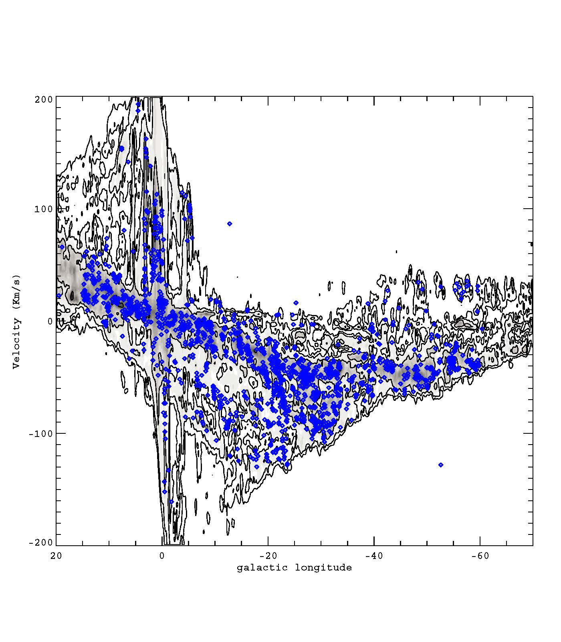
Kinematic Distances: Longitude and velocity of MALT 90 clumps
MALT 90
CO
Source: CfA-Columbia CO survey Dame et al. 2001
Whitaker et al. 2014

Slide 17
Galactic Distribution: MALT 90
Velocities yield kinematic distances.
The clumps are associated with spiral arms, possibly including the “far” portions of Norma and Scutum-Centaurus.
Whitaker et al. 2017

Slide 18
Collapse motions
Collapsing clouds that are heated internally often show an asymmetric line profile in optically thick lines.
The “blue” side (motion toward the observer) is brighter than the “red” side (motion away from the observer).
Line profiles with the “blue-red asymmetry” are often interpreted as a sign of collapse.

Slide 19
A collapsing cloud with a cold exterior and a warm interior

Slide 20
For an optically thick line, at any given velocity we see only the τ = 1 surface
Red-shifted side: moving away:
τ =1 surface is cold

Slide 21
For an optically thick line, at any given velocity we see only the τ = 1 surface
Blue-shifted side: moving toward:
τ =1 surface is hot

Slide 22
The blue-red asymmetry in a collapsing cloud with a warm interior
Hot, blue
Cold, red
Intensity
velocity

Slide 23
Define Asymmetry Index
$$α=\frac{I_{blue}−I_{red}}{I_{blue}+I_{red}}$$
Systemic velocity from N₂H⁺
Blue asymmetry α > 0
Red asymmetry α < 0

Slide 24
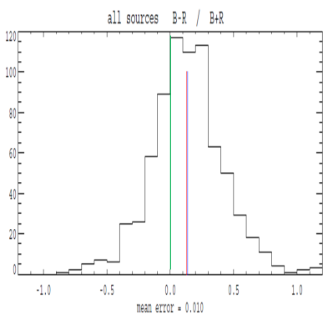
The ensemble of all MALT90 clumps exhibit the blue-red asymmetry.
Expand
Collapse
The clumps are collapsing!
As predicted by “competitive accretion” models
All
# of Sources
Asymmetry Index
(I_{blue}-I_{red})/I_{tot}
Jackson et al. 2014

Slide 25
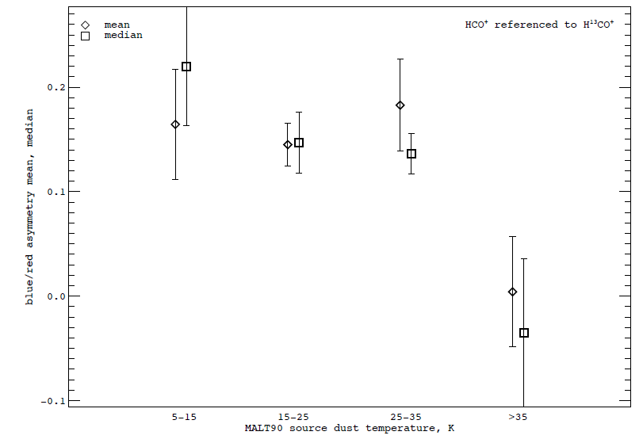
The Blue-Red Asymmetry Evolves

Slide 26
Can we identify the early, cold progenitors to Young Massive Clusters?
With MALT90 kinematic distances and Herschel dust data, we can determine dust temperatures, column densities, and masses.
Search for cold (T~10 K), high N, but high-mass (M~20,000 Msun) clumps.
After an exhaustive search, we found….
Contreras et al. 2017

Slide 27
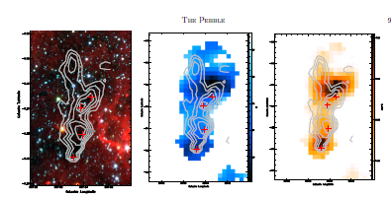
The Pebble: Cold T_{dust}, large N(H₂), large M
Jackson et al. 2017

Slide 28
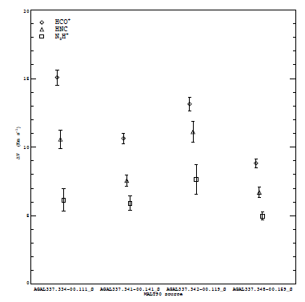
The Pebble: But Large Linewidths
Jackson et al. 2017

Slide 29
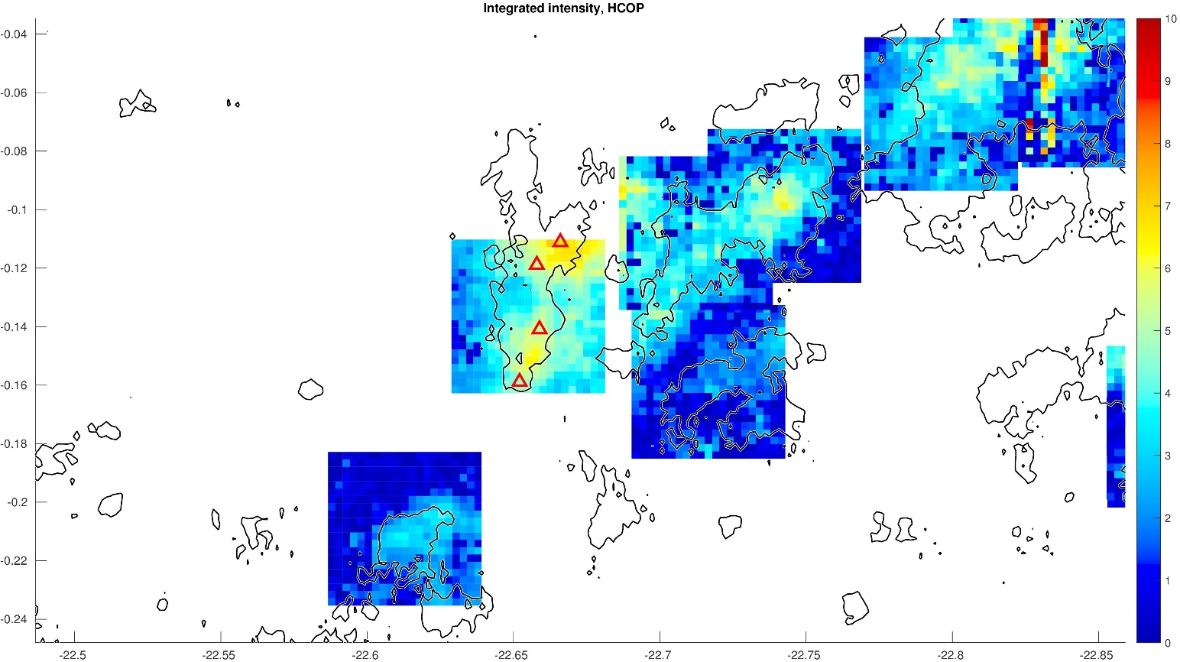
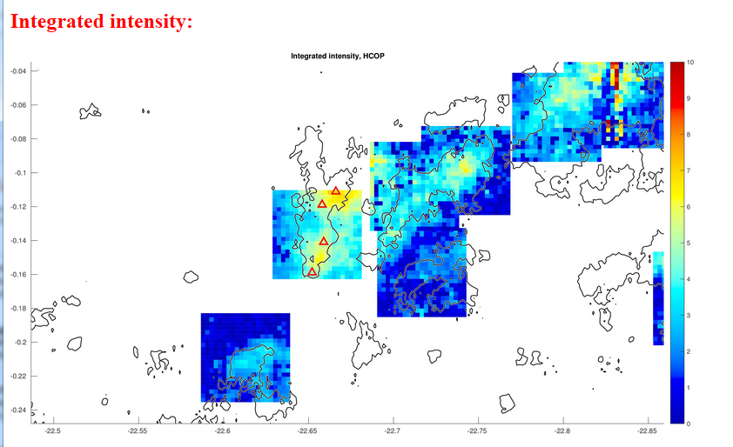
The Pebble is part of a larger structure with large linewidths throughout

Slide 30
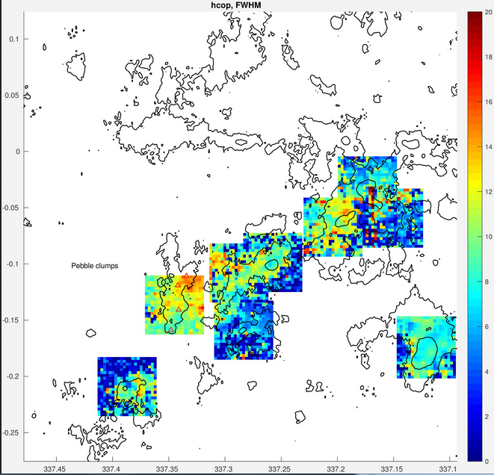
ΔV

Slide 31
MALT90+
To move forward, we want to examine the larger scale structures.
Are filaments collapsing toward clumps or all along the filament (toward the axis)?
What is the connection between young massive clumps?
What is the large-scale distribution of dense gas?
Mopra observations targeting entire filaments can address these questions.

Slide 32
Summary
MALT90 has detected dense gas toward ~3,000 clumps
MALT90 has established velocities and kinematic distances for this sample.
The “blue-red” asymmetry indicates that clumps are collapsing.
MALT90 has identified one potential progenitor to a Young Massive Clusters.
MALT90+ aims to fill in the MALT90 gaps explore large-scale filamentary structure.

