Slide 1
Australia and the CTAO
Cherenkov Telescope Array Australia : Consortium Workshop 5
ADFA, Canberra
27 November 2017

Slide 2
CTA Australia Consortium Workshop 3
NCRIS 2017+ AAL HE/MM-Astro WG - CTA engagement + Mopra 2017/18 'missing ARC LIEF' - CTAO fees (40kEuro/yr now) min 2% share (membership) $80k/yr - CTAO running costs ~15kEuro/scientist/year ? - CTA-Australia project office/institute from now? Rep–AAL? - Computation needs – HP Comp WG AAL
CTAO Membership → AAL rep? On CTAO Council (by 2017?) “full member” CHECK – Any funding obligations attached to Founding Agreement?
Explore MoUs with radio facilities (ASKAP, MWA, UTMOST, SKA, Optical!) via AAL/CTA-Oz-office?

Slide 3
Vision and Mission
Vision
Current: Australian-based astronomers will have access to the best astronomical research infrastructure.
?: Australian astronomy is world leading, sustainable and publicly valued.
Mission
Current: AAL will achieve its vision by engaging with astronomers in support of the national research infrastructure priorities of the Australian astronomy decadal plan, and advising the Australian Government on the investments necessary to realise those priorities.
?: Astronomy Australia Limited will:
ensure Australian-based astronomers have access to the best astronomical research infrastructure,
identify and unlock the economic value of Australia’s astronomy research, and
support Australian-based astronomers to inspire and inform the next generation of Australians.

Slide 4
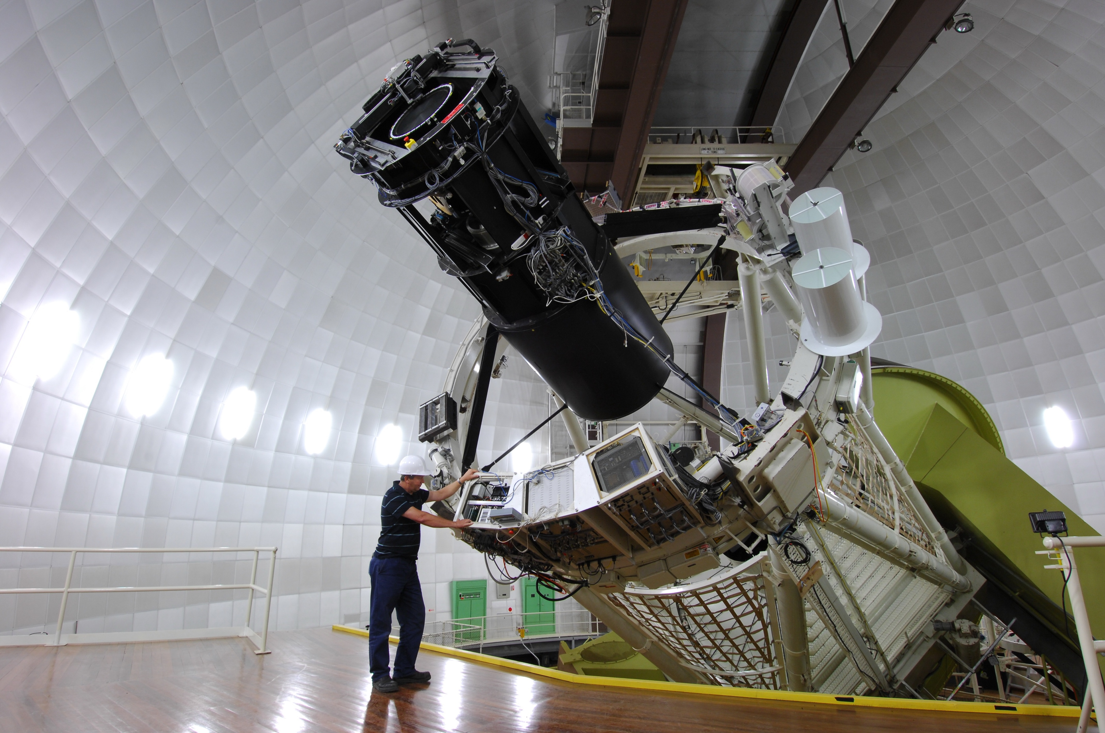
AAO
Negotiated > $3M from universities for AAT Operations
$5M NCRIS Funding for Sydney Optical Instrumentation Hub

Slide 5
NCRIS Eligibility
In decadal plan?
Priority?
Tier 2
Assess against criteria
YES
NCRIS Funding sought
NO
High
AAL will not consider funding
AAL will proactively seek funds
Possible funding

Slide 6
What will be considered
The number of institutions supported by the infrastructure.
The number of (named) active users.
The unique benefit(s) from AAL involvement.
The risks associated with the facility.
Access arrangements for the wider community.
The Australian outputs – publications, industry collaborations and contracts and other impacts of the facility, expected due to AAL support.
The strategic importance to Australian astronomy.
Identification of a pathway (for new projects), or progress along a pathway (for existing projects), to a strategic international partnership involving wide representation across the Australian astronomy community.
Identification of a pathway (for new projects) or progress along a pathway (for existing projects) to future sustainable funding that moves beyond small “seed funding” awards from AAL.
The level of university-level cash matching is to be included in the plan for projects at a scale where university-level funding is appropriate.
Demonstration that the level of funding requested, and the identified role for AAL, aligns with AAL’s vision and mission.

Slide 7
Why Join CTAO gGmbH?
Construction and operation of CTAO will be managed by a successor entity – most likely a European Research Infrastructure Consortium
We need to ensure that the funding model for the ERIC allows Australia to participate on reasonable terms

Slide 8
Current Position
Australia’s membership has been accepted by Council of CTAO gGmbH
AAL is obtaining a German legal opinion to conduct final due diligence on share purchase
Membership fee for 2018 is €58k
Share purchase involves vendor and purchaser meeting face to face in Munich in the presence of a notary public.

