Slide 1
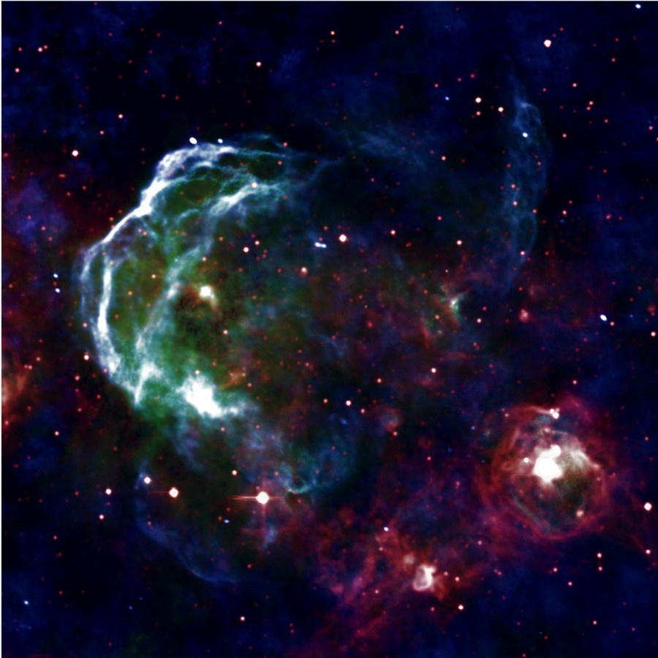

Gamma-Rays and the ISM
(Mopra, ATCA, ASKAP... and others)
Gavin Rowell
High Energy Astrophysics Group,
School of Physical Sciences
University of Adelaide
CTA/MWL Meeting (Adelaide) Sept. 2016
Image Credit: NRAO

Slide 2
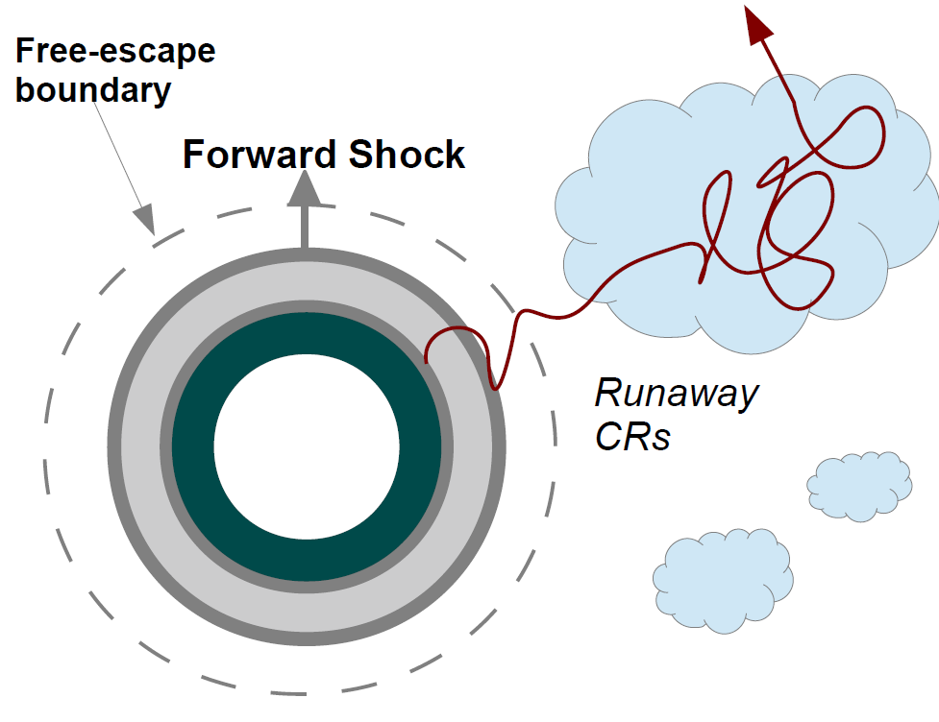
Image from Giovanni Morlino

Slide 3
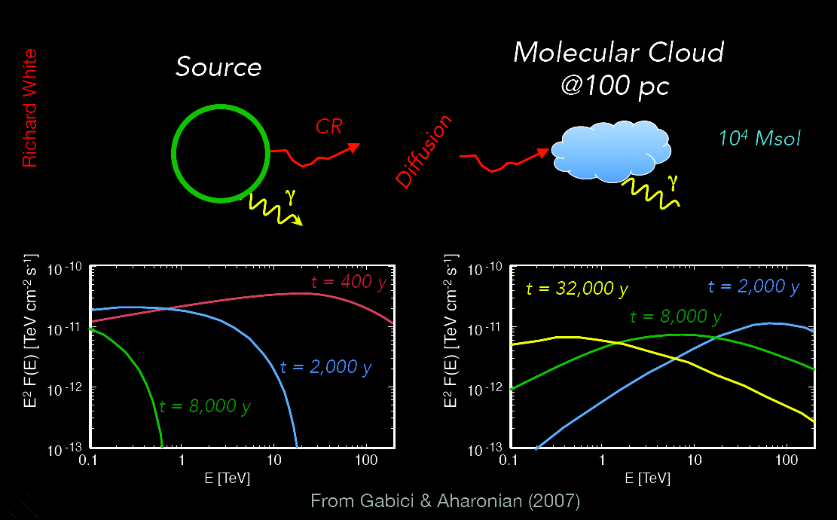
Gamma-ray spectra from local and escaped CRs
e.g. Aharonian & Atoyan 1996
Slide from Richard White

Slide 4
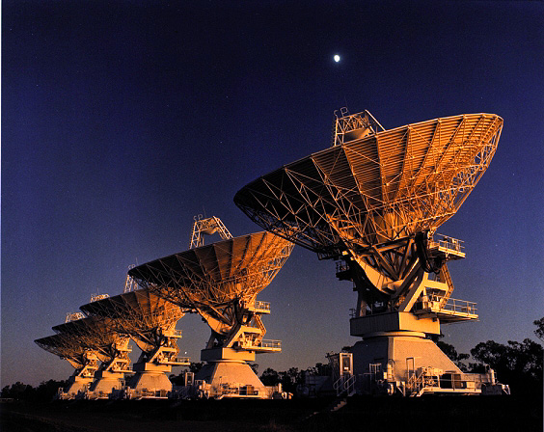
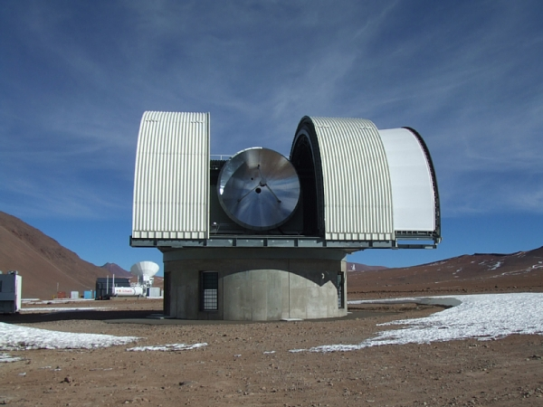


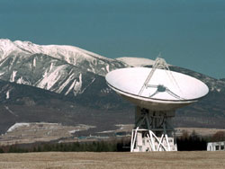

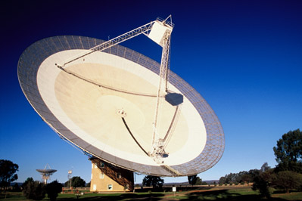

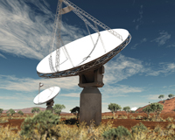
Interstellar gas tracers & telescopes..
www.atnf.csiro.au/research/HI/sgps
HI (atomic H), OH, CS CO CO, NH₃, CS, SiO...
Gas density
~10^{1 to 4} cm⁻³ ~10³ cm⁻³ >10 ^{3 to 4} cm⁻³
ATCA
Parkes
HEAT – THz (Antarctica)
[CI] + [CII]
ASKAP

Slide 5
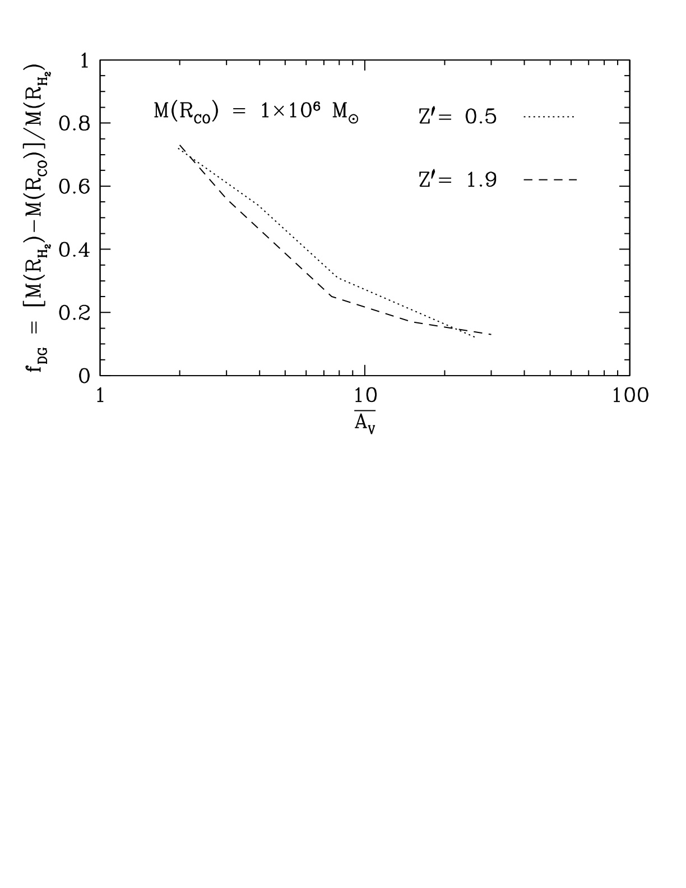
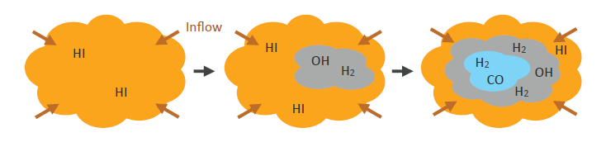
Missing Gas :“Dark” HI & H₂
Inferred by MeV/GeV gamma-ray observations
e.g. Greiner etal 2005, Ackermann etal 2011
Perhaps one-third of the
molecular gas is “dark”?!
Dark molecular gas has little/no
CO, but carbon and OH present
→ optically thick HI (Yasuo Fukui)
→ OH 1.6/1.7 GHz lines
(Parkes, ASKAP)
→ CI, C+ ~THz lines
(Nanten2, HEAT, STO2, SOFIA, STO2, DATE5, )
Wolfire, Hollenbach & McKee, 2010
Graphic adapted from J. Dawson
c⁺
c⁺
c
c

Slide 6
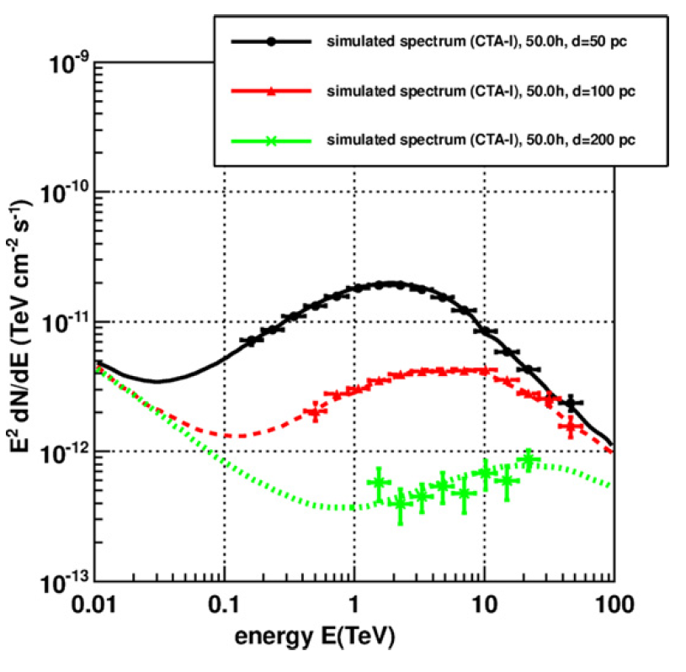
CTA 50h Observation - CRs escaping accelerators Acero etal 2013
SNR age 2000 yr
Cloud mass10⁵ M_{sun}
d = 1 kpc
D=10²⁸(E/10GeV)^{0.5} cm²/s
PeV CRs escape first and arrive at the cloud first!
Probe for CR PeVatrons
But confusion guaranteed in Gal. Plane!
Need wide ISM surveys
→ Mopra, Nanten2, Nobeyma, ASKAP (S&N)

Slide 7


CR Diffusion Into Molecular Clouds e.g. Gabici etal 2007,
Inoue etal 2012
R = distance CR travels into
molecular cloud core
R ~ sqrt[6 D(E_{p}, B) t]
χ=diffusion suppression factor
→ Low energy CRs can't reach cloud core.
→ Harder TeV spectra from cores.
→ Depends on B-turbulence
(e.g. Morlino & Gabici 2015)
→ Don't expect electrons to penetrate!!
(due to sync. losses)
→ Need to map dense cloud cores ~1 arcmin or better
10 TeV proton 1 TeV proton
Crutcher 2010
mol. cloud core

Slide 8
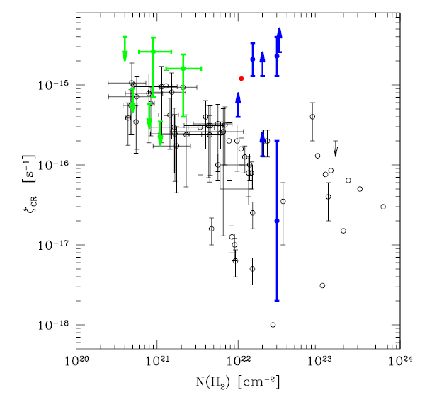
Sub-GeV CR penetration into MCs – Ionisation rates
Review by Gabici & Montmerle 2015
Isolated MCs
Padovani & Galli 2013
SNR/MC assoc
IC443, W51C, W28
Vaupre etal 2014,
Indriolo etal 2010,
Ceccarelli etal 2011
→ low E CRs less penetrating in denser clouds
→ synergies with ionisation rate tracers: HCO+/DCO+ ; H₃⁺ ; OH etc..

Slide 9
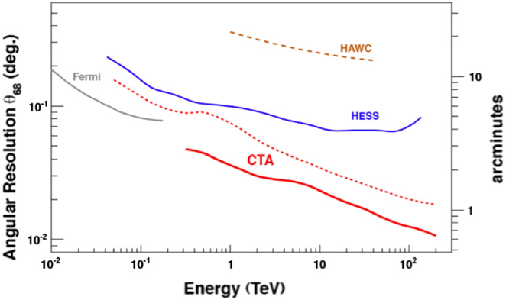
Angular Resolution (HESS, CTA..) Acharyara etal 2013
HESS hi-res cuts
e.g. DeNaurois etal 2009
>=10 tels
ISM cloud core at few kpc
Typical radius
CTA – 2 tels
X e.g. Cameron et al 2012
CTA MST-SCTs with small pixels and/or hi-res cuts → resolve cloud cores!

Slide 10
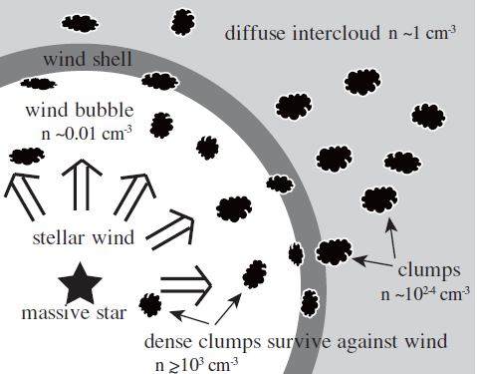
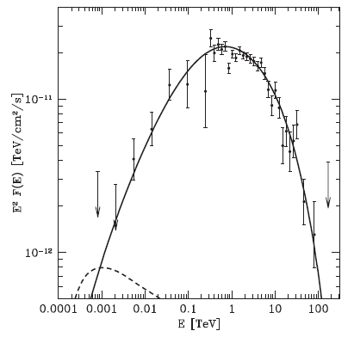

Hadronic Gamma-Rays from Clumpy ISM
SNR RXJ1713
Inoue et al. 2012
Gabici & Aharonian 2014
Gamma-rays from
Dense
Clumps
Shell diffuse gas
CR penetration depth
→ Dense clouds/clumps could play critical role in hadronic component

Slide 11
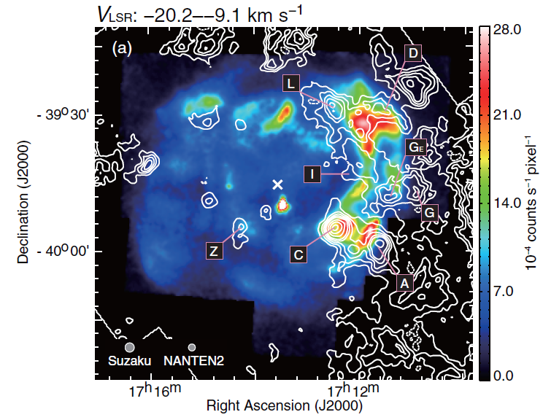
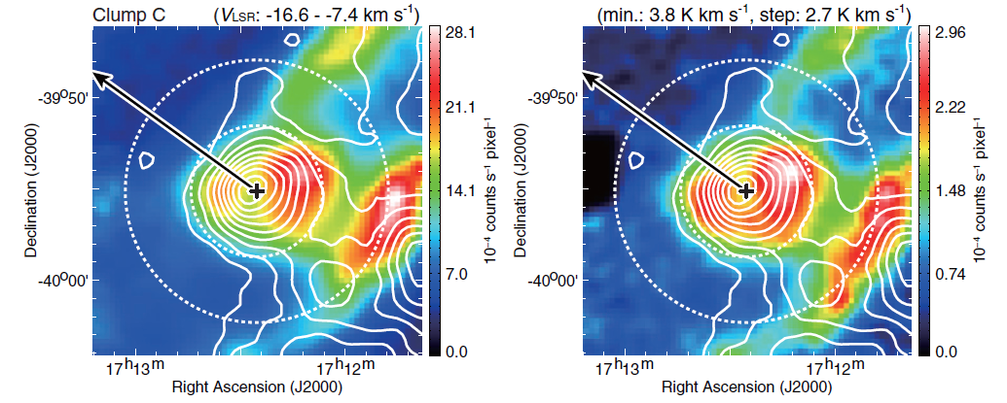
Dense Cores filter out external electrons! e.g. RXJ1713.7-3946:
Sano etal 2013
- CO(2-1) Nanten2 contours +X-ray images
- Synch cooling length < pc for
30 TeV electrons, 6 keV X-rays,
n=10⁵/cc, B~400μG
See also Uchiyama et al 2007

Slide 12
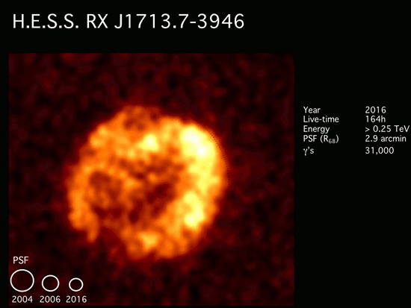
HESS Collab. in prep 2016
https://www.mpi-hd.mpg.de/hfm/HESS/pages/home/som/2016/09/

Slide 13
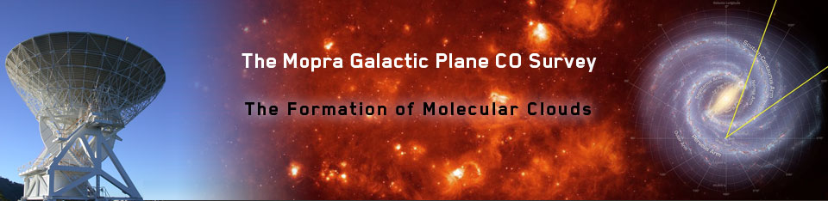
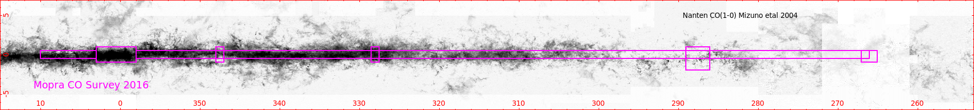
http://www.phys.unsw.edu.au/mopraco/
~35” beam @ ~0.1 km/s resolution (also 70” CO survey Barnes etal 2015)
CO(1-0), ¹³CO(1-0), C¹⁷O(1-0), C¹⁸O(1-0)
l = 265 to 358; b = ±0.5deg mostly complete
extension to ±1.0deg l=2 to 10deg (compare to Dame etal 2000 ~8arcmin beam)
Data cubes publicly available once processed
l = 320 – 330 deg available now
Complementary to Nanten2 CO surveys over wider area
& Nobeyama CO survey (20” beam) in the north (Nishimura etal 2015)

Slide 14
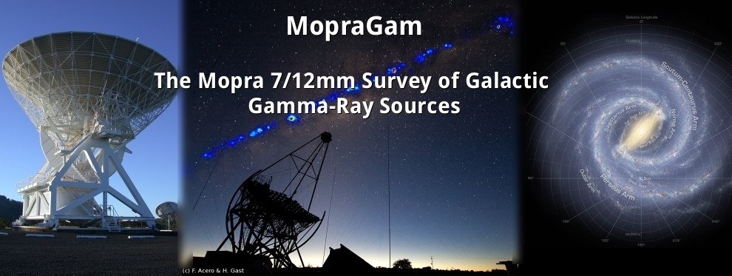
http://www.physics.adelaide.edu.au/astrophysics/MopraGam/
Main ISM Tracers
CS(1-0), SiO(1-0), CH₃OH
Targets
Since 2012 observed over ~40 bright UnID TeV gamma and high energy sources (>1500 hrs)
→ Determine distance to cloud components (often difficult with CO)
→ Understand particle propagation
→ Disentangle hadronic/leptonic components
→ Some examples shown here (and see posters Maxted etal, Voisin etal)
Coverage is limited to discrete sources → Systematic survey MALT45+

Slide 15
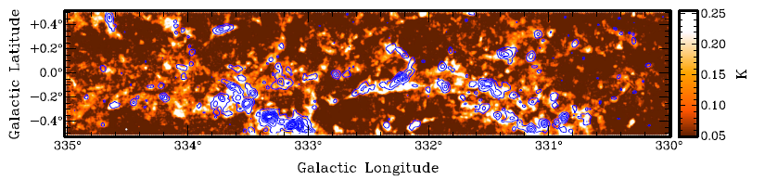
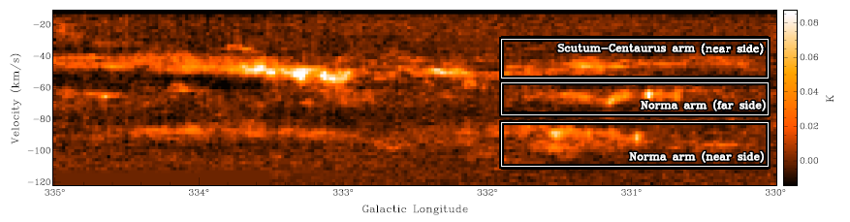
(Jordan etal 2013, 2015)
MALT45 7mm Survey with ATCA
> 5x more sensitive than Mopra
CS(1-0) peak pixel image with HOPS NH3(1,1) contours
CS(1-0) position/velocity → can see far side of galaxy in dense gas!
Proposal to extend to “Full Strength MALT 45” l = 300 to 360
→ dense gas ISM survey legacy for CTA

Slide 16
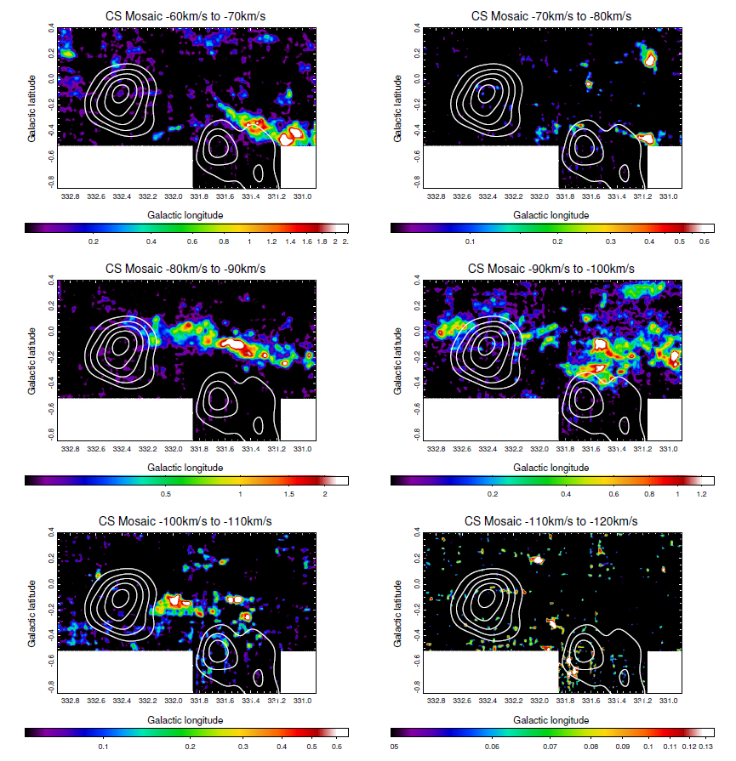
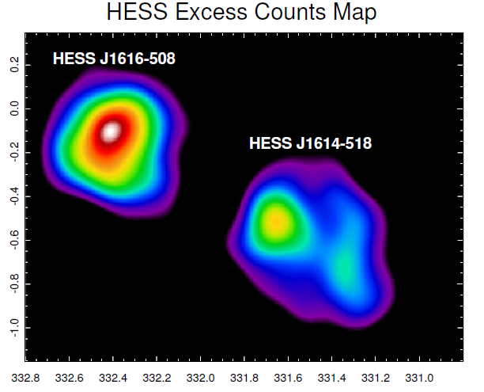
MALT 45 CS(1-0) towards two TeV
sources.
S. Pointon
(MPhil thesis 2015)
MALT45 data (Jordan etal 2015)
+ Mopra CS(1-0) extension to south

Slide 17
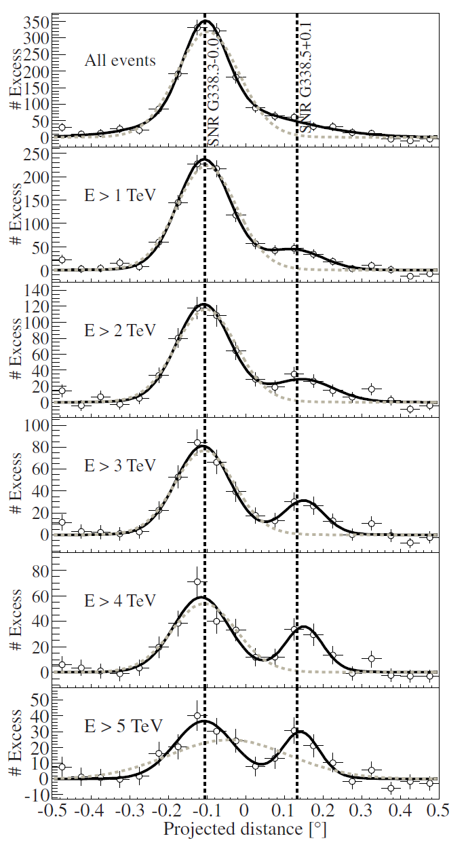
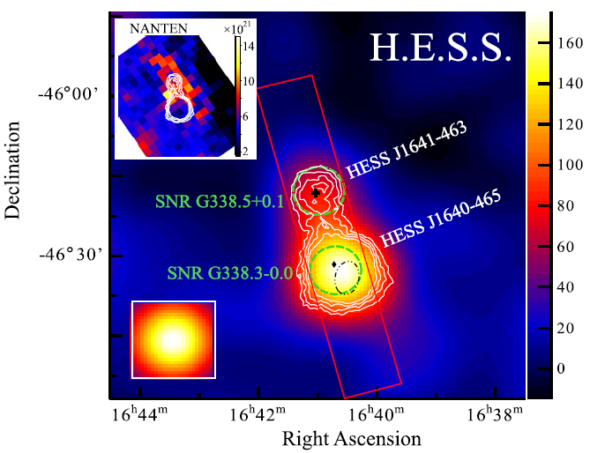
HESSJ1641-463
A Galactic PeVatron?
Does HESSJ1641 result from cosmic-rays escaping SNR G338.3?
Hard-spectrum source HESSJ1641
(HESS Coll. 2015)

Slide 18
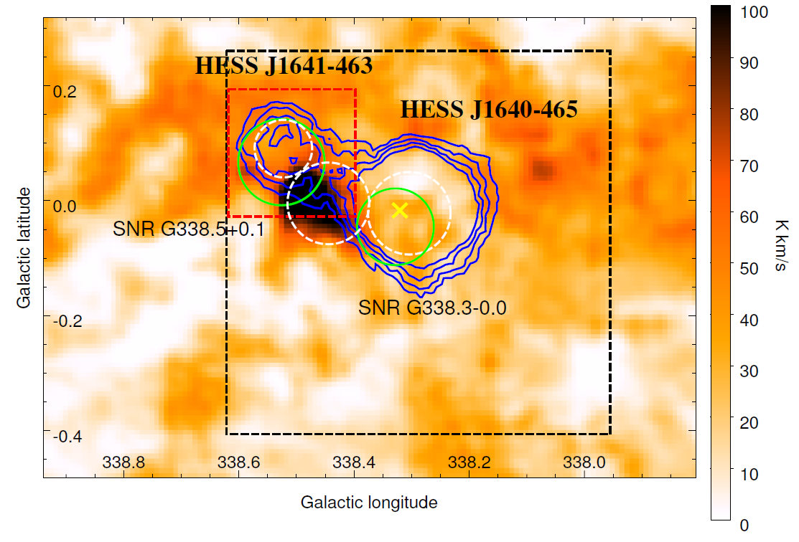
Mopra CO(1-0)
-53 to -23 km/s dist ~ 11 kpc
ISM studies by Lau etal 2016 (HESSJ1640 ISM – Supan et al 2016)
→ ISM density >200/cc towards TeV sources and 'bridge'
→ Hadronic: CR density ~100 for HESSJ1641; >350 for HESSJ1640

Slide 19
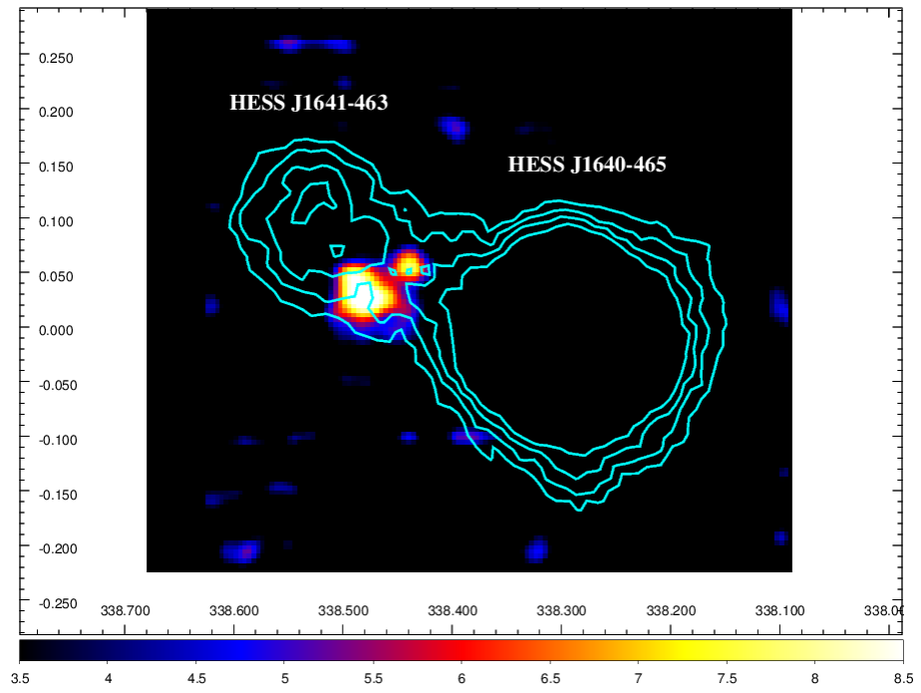
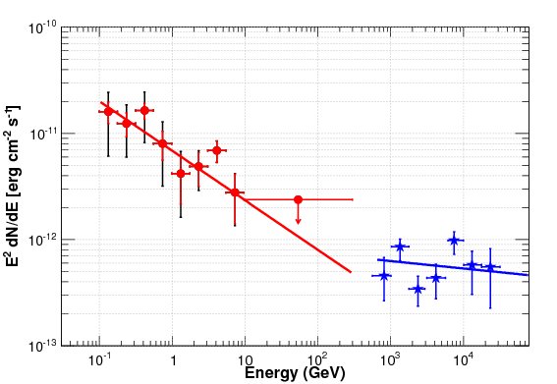
Mopra CS(1-0)
Gamma-Ray Energy Fluxes
HESSJ1640-465
HESSJ1641-463
- Dense gas (>10⁴/cc) bridge
between TeV sources
→ Can filter low-E CRs from
SNR G338.3

Slide 20
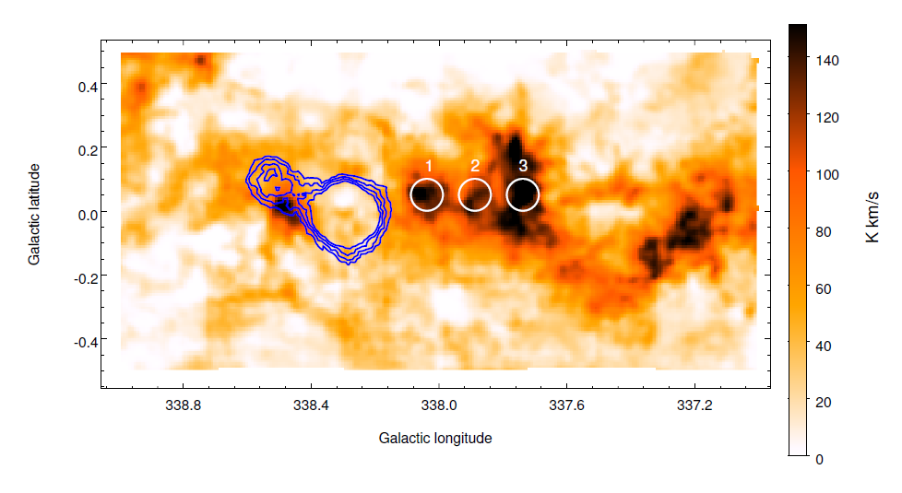
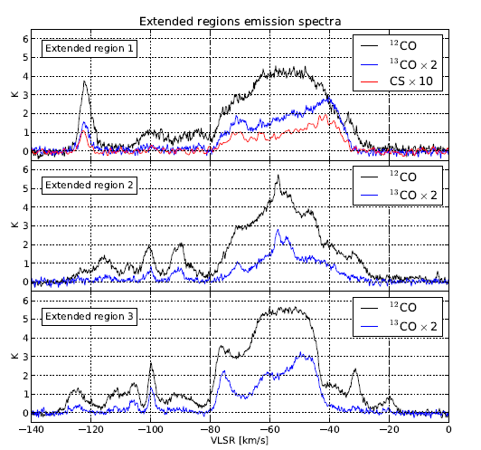
What about this huge ISM cloud to Galactic west?
Why no TeV source at region '1' ?
→ Cloud slightly in fore/background?
Only need ±50 pc distance to reduce CR density (e.g. Aharonian & Atoyan 1996)

Slide 21
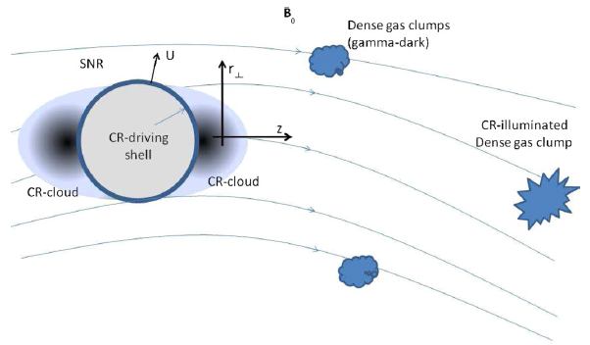
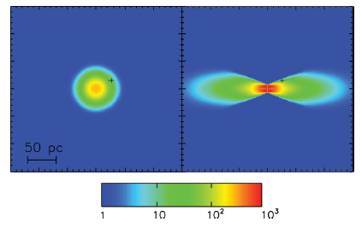
CR diffusion – not necessarily
Isotropic!
Malkov etal 2013
Nava & Gabici 2013
→ Nearby clouds will see different CR densities
→ Need detailed maps of ISM gas +
B-field direction
CR propagation along B flux tube
Isotropic Anisotrpic
CR overdensity

Slide 22
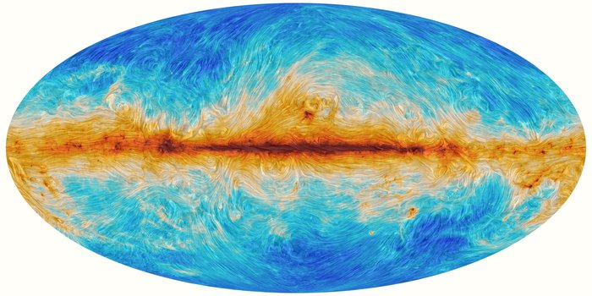
Planck map of B-field direction (dust polarisation)
http://www.esa.int/spaceinimages/Images/2015/02/Polarised_emission_from_Milky_Way_dust
Note: In Gal. plane this is dominantly the foreground B-field direction.
Next Step: ASKAP POSSUM (Faraday rotation measures in great detail)

Slide 23
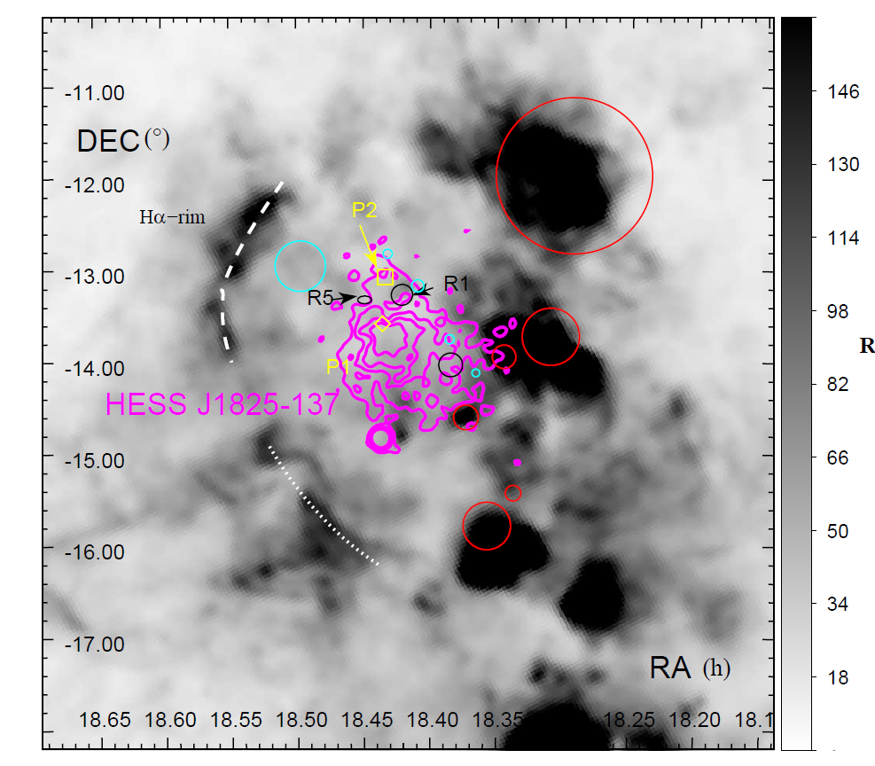
H-alpha: Looking for shocked gas around old SNRs
ISM study towards
HESSJ1825 &
HESSJ1826
Voisin etal 2016
TeV-bright
pulsar powered nebula (J1825)
Northern TeV emission (J1826) overlap with dense ISM
→ cosmic-rays escaping SNR?
Halpha image Stupar etal 2008

Slide 24
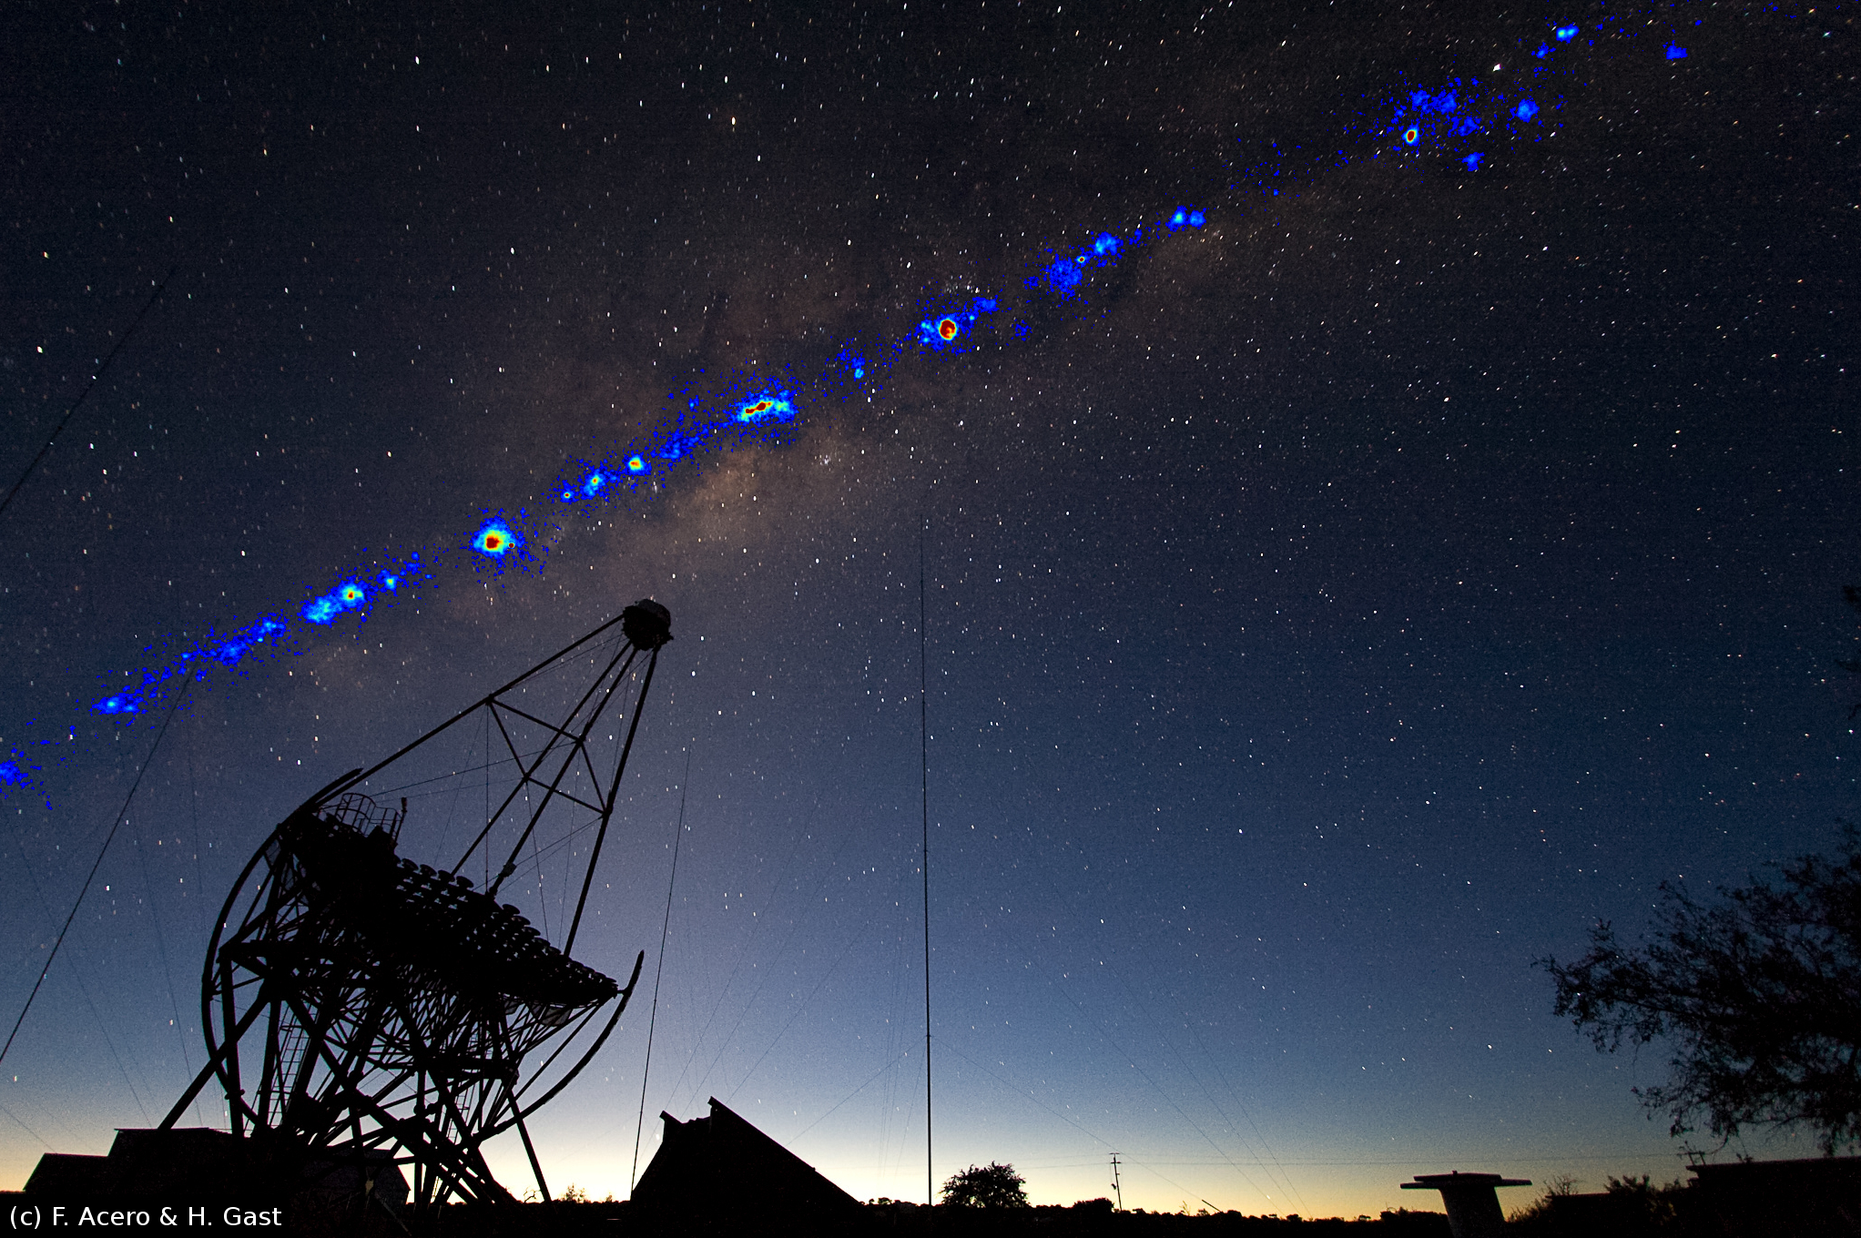
Gamma Rays & ISM
- ISM gas is an essential ingredient in understanding
gamma-ray sources
→ What accelerates the particles?
→ What types of particles are accelerated?
- Critical requirements of ISM surveys
→ (sub)arcmin CO surveys (Mopra, Nobeyama..)
→ wide CO coverage (Nanten2)
→ dense gas (Mopra, ATCA, ASKAP)
→ atomic gas (ASKAP)
→ dark gas (ASKAP, HEAT, DATE5....)
→ angular resolution perfectly matched with CTA
(& hi-res deep HESS obs)
→ CTA needs these new ISM surveys..

Slide 25
Backup ….

Slide 26
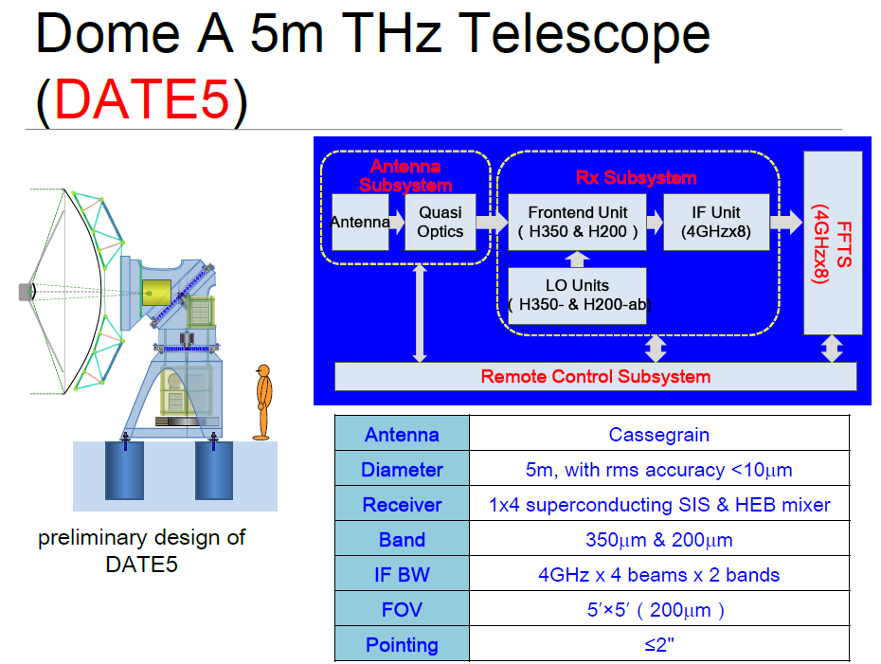
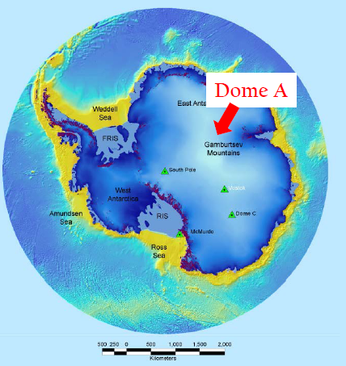
Led by CAS, China

Slide 27
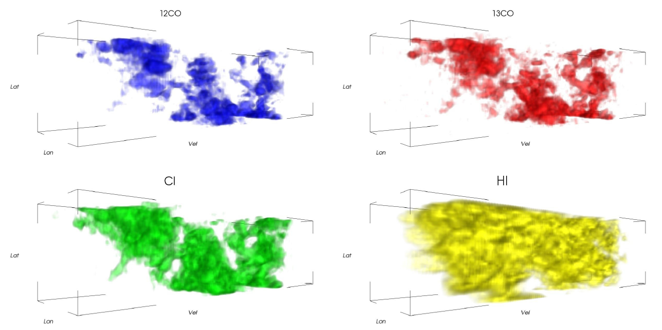
CI, CO, HI towards G328 region (1x1 deg)
CI (2-1) – HEAT 2' beam
CO(1-0) – Mopra 30” beam
HI – Parkes/ACTA 2' beam
(Burton et al 2013, 2015)
3D pixel (voxel) analyis → 50% increase in CI / ¹³CO ratio at cloud edges.

Slide 28
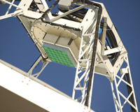
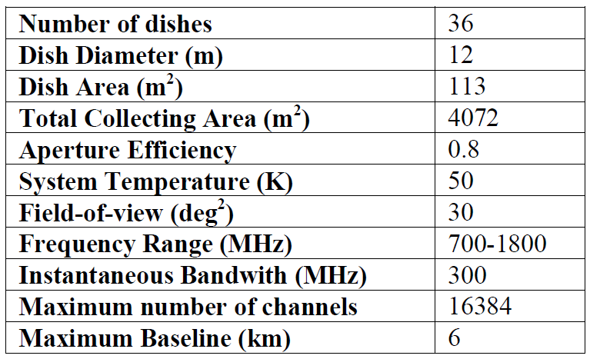

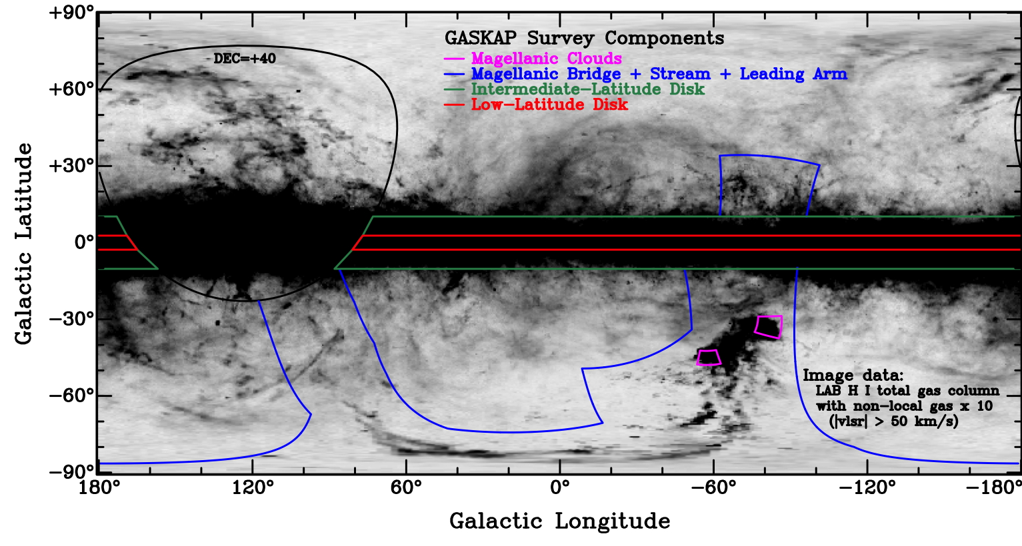
ASKAP - Australian Square Kilometre Array Pathfinder
http://www.atnf.csiro.au/projects/askap
Phased array feeds (PAFs) 30-beams
> 5 deg FoV.
- All dishes built; All PAFs by 2016
- Continuum survey, HI & OH lines, B-field strength & turbulenc, transients
→ Many key science projects
www.atnf.csiro.au/research/GASKAP/
Key HI/OH survey
- 30 arc-sec resolution

Slide 29
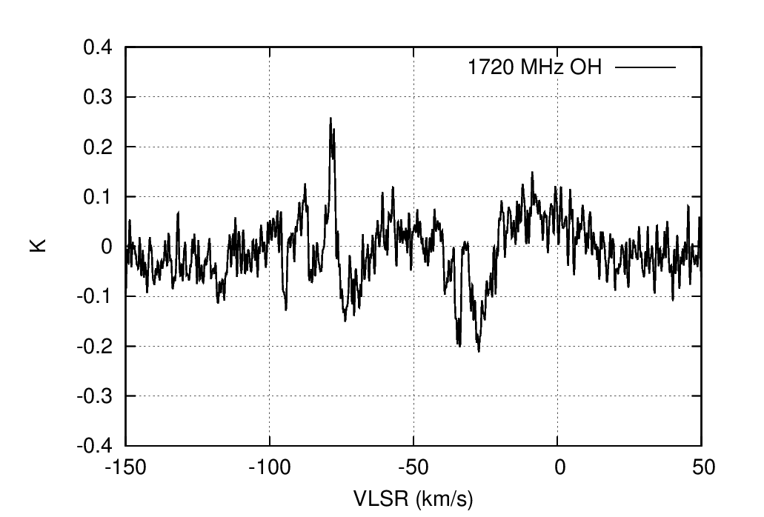

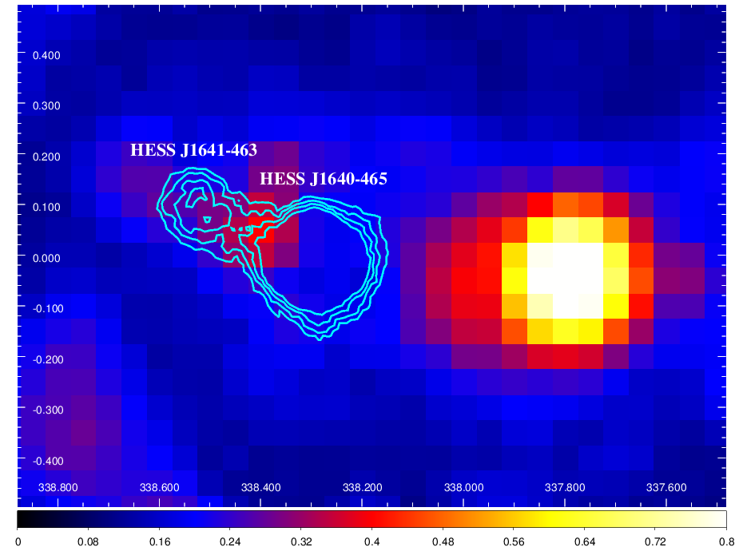
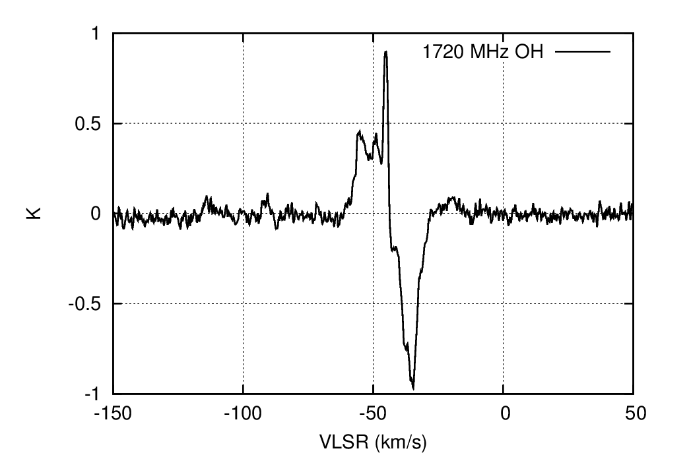
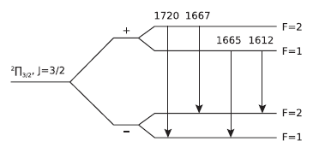
Parkes SPLASH 1720 MHz OH
(Dawson et al 2013, 2014)
Aims: Search for SNR pumped 1720 MHz
lines (ie those without other OH transitions 1667, 1665, 1612 MHz)
Search for OH without CO
– Parkes beam (12') too big
→ ASKAP 30” beam

Slide 30
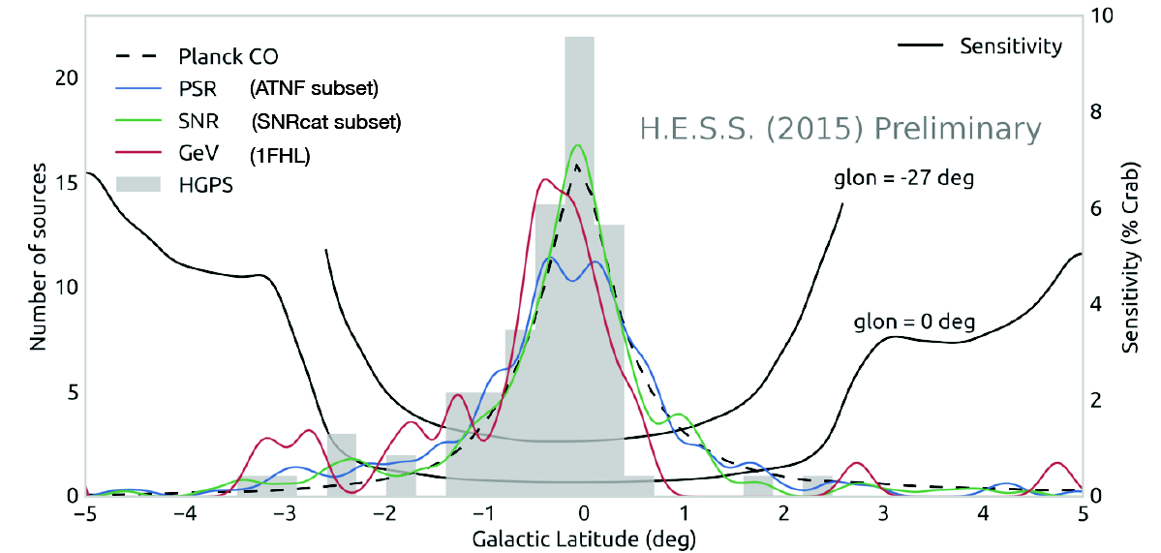
Deil et al 2015
Latitude Distribution - HGPS Sources et al.

Slide 31
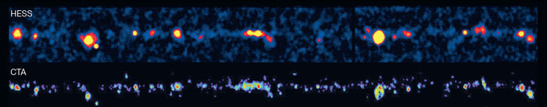
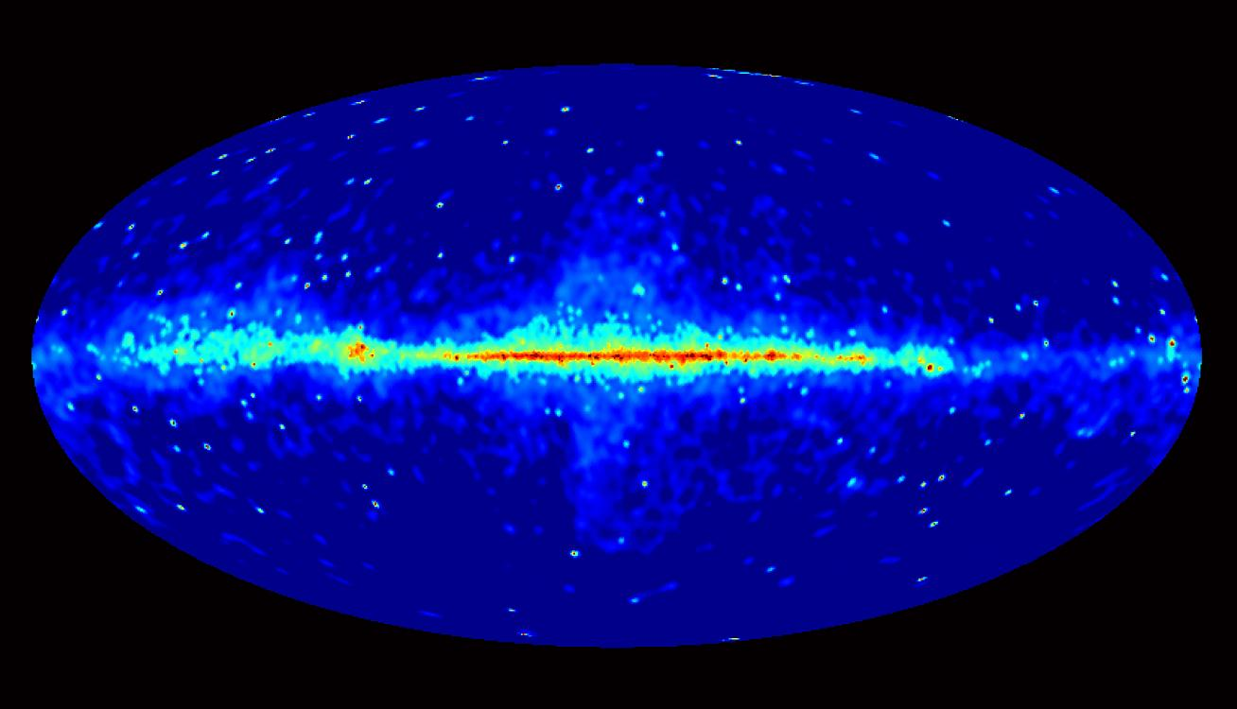
Galactic Plane TeV Surveys : HESS → CTA
Funk et al 2012
- CTA will provide Galactic Plane TeV Gamma-ray maps
on ~1-3 arc-min scales
(~0.5 arc-min possible – high quality cuts)
- >3 sources per deg² |b|<0.2º |l|<30º (Dubus etal 2013)
- Diffuse TeV components visible?
from CR 'sea' – maybe
local CR accelerator enhancements – yes
Confusion guaranteed (same as for Fermi-LAT at GeV energies!)
- Mapping the ISM on arc-min scales over the plane will be essential Mopra (CO, CS ), Nanten2 (CO), ASKAP (HI, OH), THz (CI, C+)

Slide 32

B-fields from Zeeman splitting
Crutcher et al 2010
HI – filled circles
Dark clouds - open circles/squares
Mol. Clouds – filled squares
→ B-field amplification only in dense (>300/cc) clouds

Slide 33


PWN HESS J1825-137 + HESS J1826-130
Energy-resolved morphology (+ HESSJ1303-631)
Molecular cloud to north
> 2.5 TeV
1 – 2.5 TeV
< 1 TeV
TeV electron origin:
Synchrotron & IC cooling vs.
distance from pulsar.
Aharonian etal 2006
Voisin etal 2016
Maybe also search for hadronic pulsar winds !
(Hoshino etal 1992, Gallant etal 1994, Amato etal 2003, Horns etal 2007, DiPalma etal 2016)

Slide 34


HESS Galactic Plane Survey (HGPS) – Skymaps
→ 77 sources (13 new sources)
Deil et al 2015
12 – pulsar wind nebulae
6 – SNRs
6 – composite SNRs
3 – binary (NS/BH + star)
50 – unidentified (confused associations)
Several potential PeVatrons (hard spectra >10 TeV)

Slide 35

Strong, extended CS(1-0) emission
→ Dense molecular cloud to north
→ Don't expect electrons to penetrate

Slide 36


Mopra HOPS &
HESS TeV Surveys DeWilt etal 2016
HOPS
Survey of NH₃, H₂0 masers, plus other 12mm lines
Walsh etal 2011,
Purcell etal 2012
e.g. HESSJ1745-303
Broad NH3 emission detected towards northern parts.
Related to SNR G359.-0.5?
(many 1720MHz OH masers but at different velocity.)
See CO/HI studies (Hayakawa etal 2012)

Slide 37

TeV gamma-ray production:
1. Cooling Time t = E / (dE/Dt)
Cooling times lead to radiative propagation limits for particles
2. Diffusive Transport: distance ~ [6 D(E,B) t] ^{0.5}
(for turbulent B-field)
for diffusion coefficient D(E,B)
ISM density n; B-Field B(n)
→ ISM has critical influence on gamma-ray source size and spectra.
→ Need to measure ISM over degree scales, and at arc-min
resolution

Slide 38


Simulated TeV gamma-ray emission (units GeV/cm²/s/sr) from CRs escaping SNR RXJ1713.7-3946 (Acero etal 2013)
Based on Casanova etal 2010 (with Nanten CO(1-0) data)
D =10²⁸(E/10GeV)^{0.5} cm²/s
E_{escape} ~ 500 (t/100 yr)^{-0.43} TeV
Image from Giovanni Morlino

Slide 39
Angular Resolution (HESS, CTA..) Acharyara etal 2013
HESS hi-res cuts
e.g. DeNaurois etal 2009
Nanten2 CO(1-0)
Mopra/ATCA CS(1-0)
X e.g. Cameron et al 2012
Mopra CO(1-0), CS(2-1)
Beam Sizes 68% containment radius

Slide 40

Gamma Rays from multi-TeV particles
+ CMB
Protons: Gamma-rays and gas targets are generally spatially correlated
(need to map atomic and molecular ISM)
Electrons: Gamma-ray (IC) + X-ray, radio emission (synch.) coupled
(Bremss. usually minor)

Slide 41

Arc-min Angular Resolution

Slide 42

Hadronic Gamma-Rays from Clumpy ISM
SNR RXJ1713
Gabici & Aharonian 2014

Slide 43
HESS Galactic Plane Survey (HGPS) – Skymaps
→ 77 sources (13 new sources)
Deil et al 2015
12 – pulsar wind nebulae
6 – SNRs
6 – composite SNRs
3 – binary (NS/BH + star)
50 – unidentified (confused associations)
Several potential PeVatrons (hard spectra >10 TeV)

