Slide 1
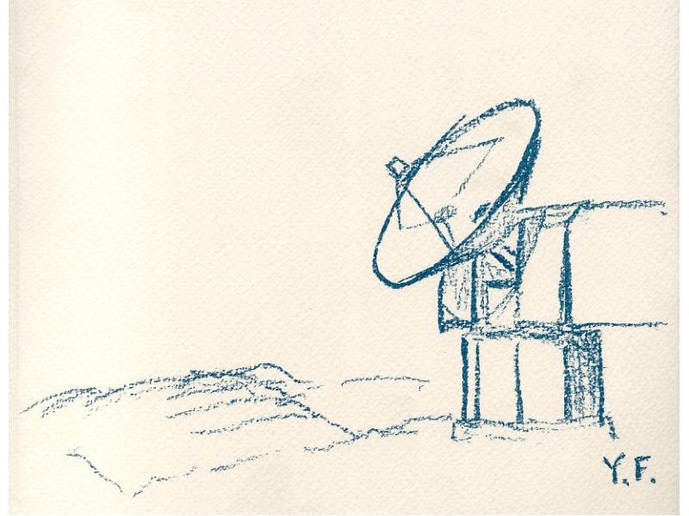
Accurate measurement of interstellar hydrogen
as the target of hadronic gamma rays
Yasuo Fukui
Nagoya University
Southern Observatories
CTA meeting
April 16-17, 2015, Adelaide

Slide 2
ISM
Interstellar medium ISM between stars
ISM consists of gas and dust
Mgas/Mdust is 100, dust grains include most of the
heavy elements; H:He:CNO = 1:10⁻¹:10⁻⁴
Gas consists of neutral and ionized components
Neutral is dominant, related to star formation
Neutral consists of molecular and atomic gas
1951 discovery of 21cm HI
1970 discovery of 2.6mm CO [H2 has no suitable transition]

Slide 3
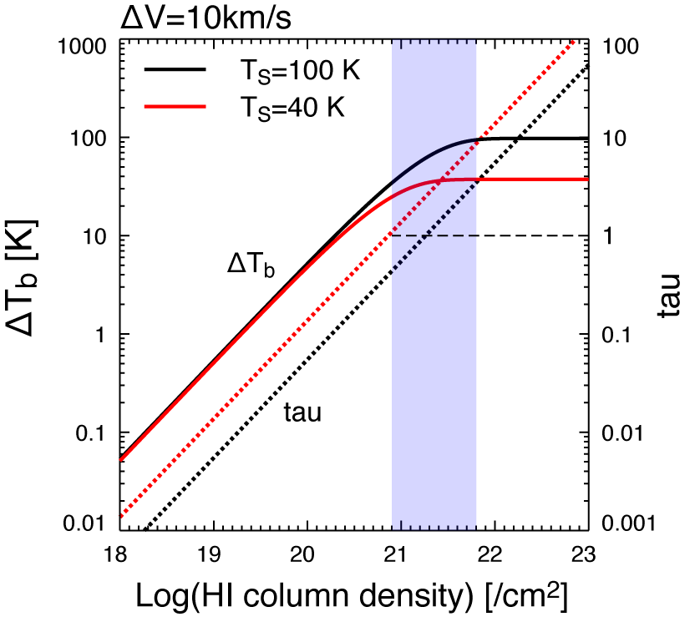
HI is assumed to be optically thin in text books

Slide 4
Molecular vs. atomic
HI gas: average density 1 cm-3, Tk=125K
“assumption, 21cm line optically thin”
--NHI=1.8e18 WHI
Dark gas: gamma rays (pp reaction π⁰ 2γ),
dust extinction “cannot be seen in HI or CO”
--CO-free H2?
H2 gas: density 1000 cm-3, Tk=10K
“CO 2.6mm line via Xco factor”
--NH2=Xco Wco (factor of 2 uncertainty)

Slide 5
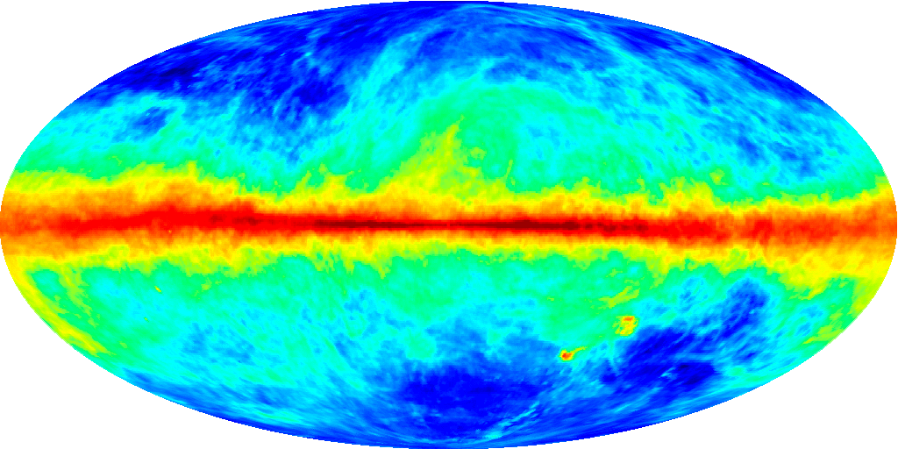
HI LAB
The Leiden/Argentine/Bonn Galactic HI Survey
Kalberla+ 2005
Courtesy of Legacy Archive for Microwave Background Data Analysis

Slide 6
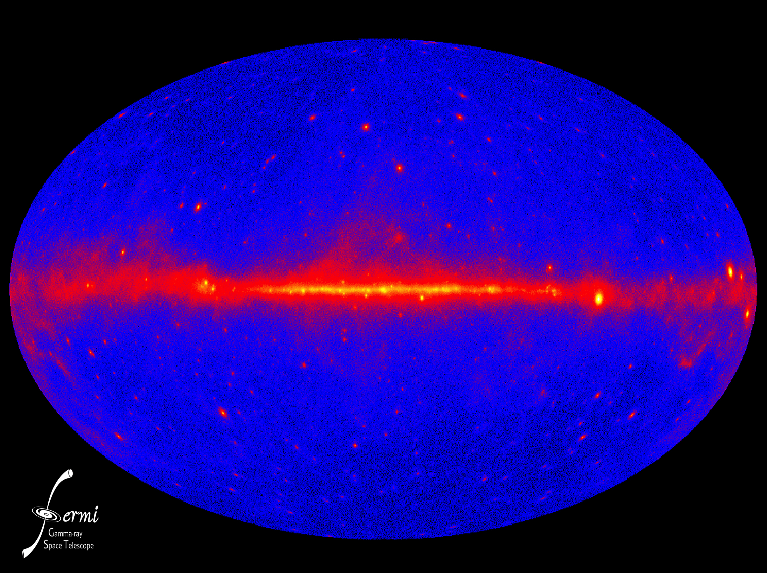
GeV Gamma rays

Slide 7
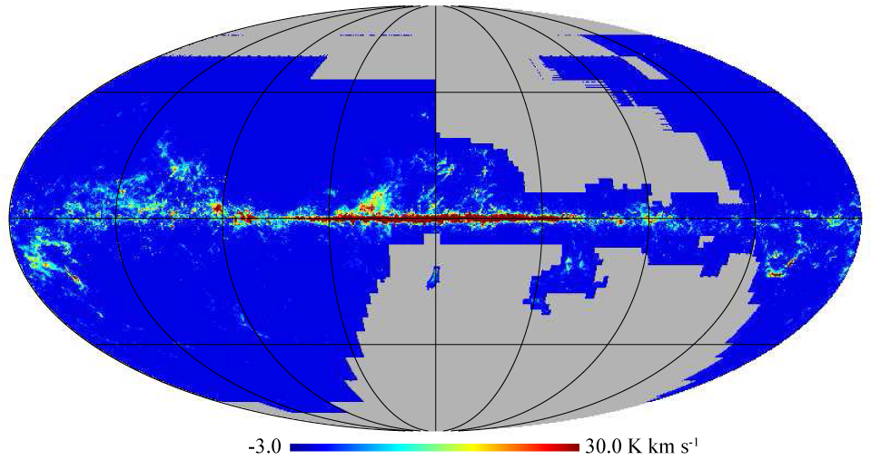
CO surveys : CfA + NANTEN
Planck Collaboration, arXiv:1101.2029

Slide 8
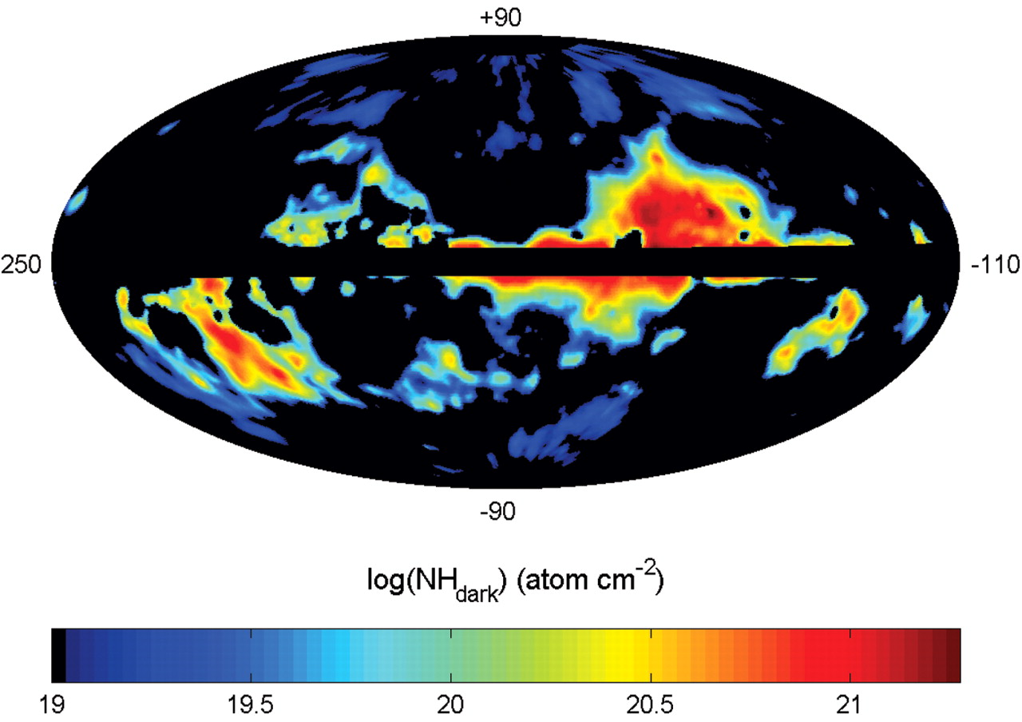
Isabelle Grenier et al. Science 2005
Column density of dark gas ~ 10^{20.5}-10^{21.5} /cm²
Notes:
Map, in Galactic coordinates centered on l = 70°, of the column densities of dark gas found in the dust halos, as measured from their γ-ray intensity with the reddening map. This gas complements that visible in HI and CO. The two dust tracers [E(B-V) and 94-GHz emission] yield consistent values within 30% over most regions.

Slide 9
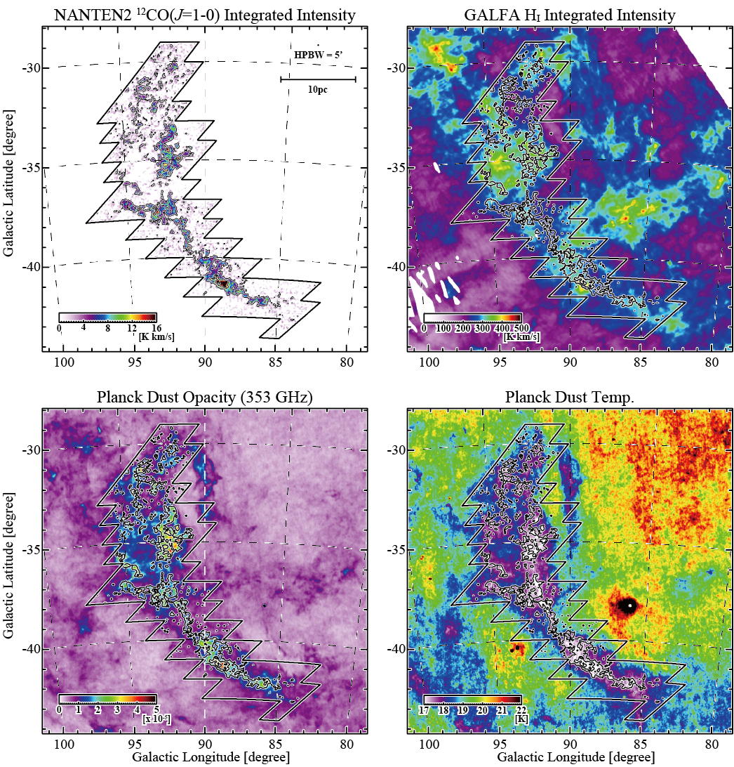
Nearby cloud without background source [Fukui+ 2014]

Slide 10
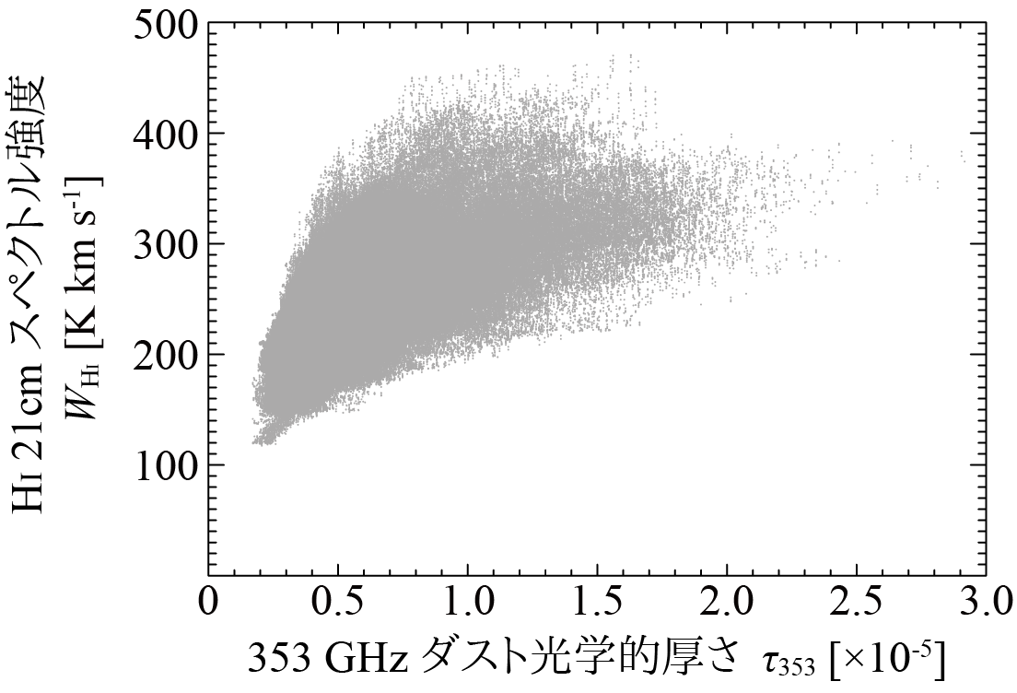
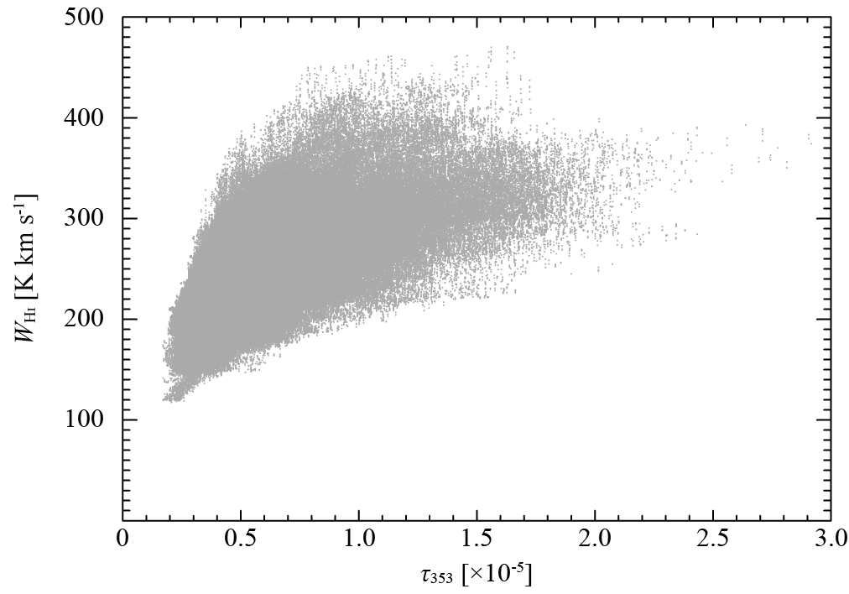
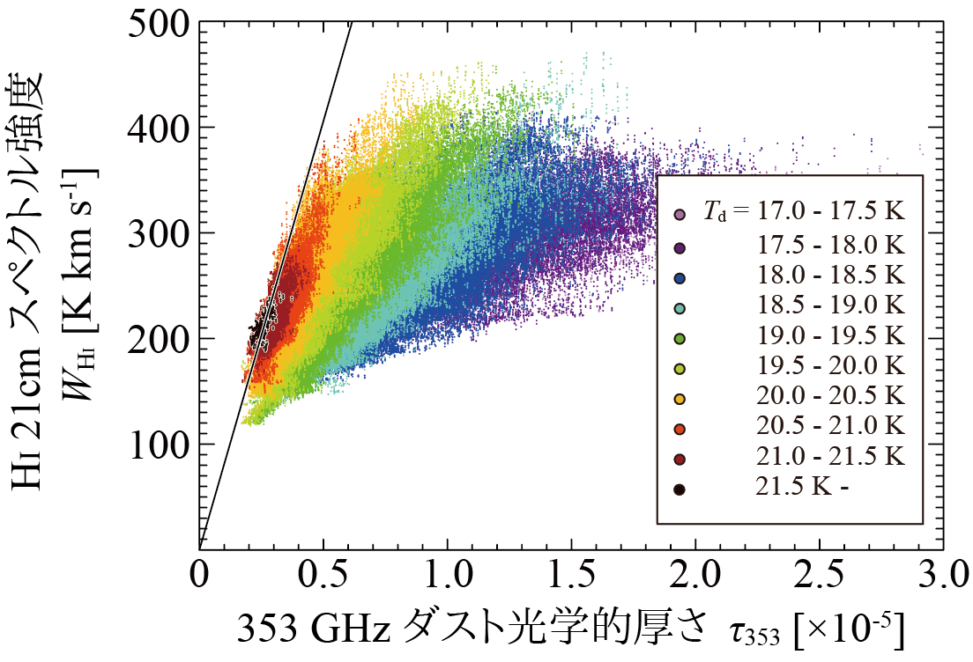
HI dust correlation is bad
Planck sub-mm data
MBM 53, 54, 55
tau353-WHI 相関プロット

Slide 11
HI dust correlation is bad
Planck sub-mm data
Td highest
HI is thin
With Td decrease
HI becomes thick
Fukui+ 2014; 2015
MBM 53, 54, 55
tau353-WHI 相関プロット

Slide 12
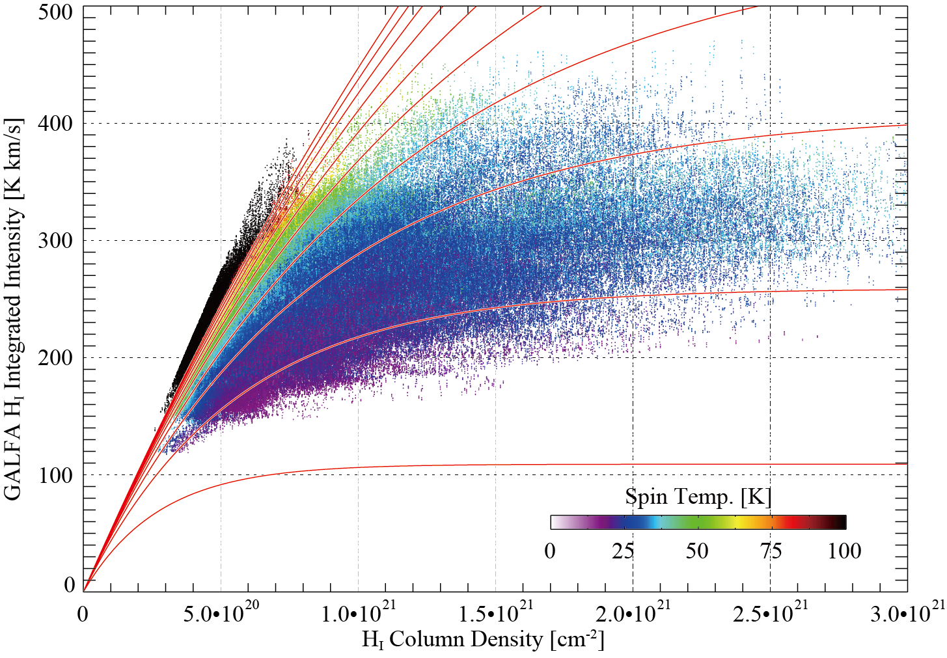
Fig. 3
Ts=10, 20, 30, …, 100 K

Slide 14
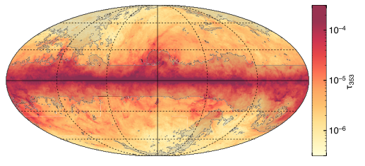
All sky Planck tau353: Fukui+2015
masked in gray [double HI profiles/Hα/CO/Plane]

Slide 15
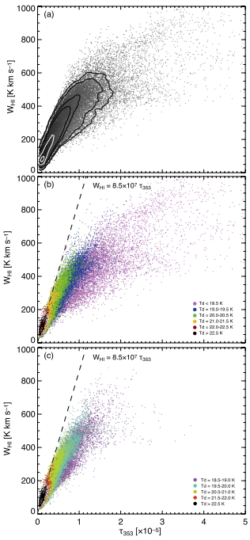
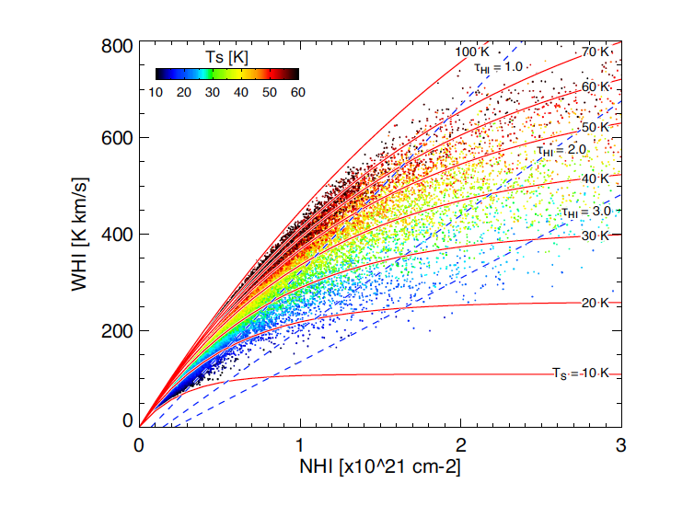

Slide 16
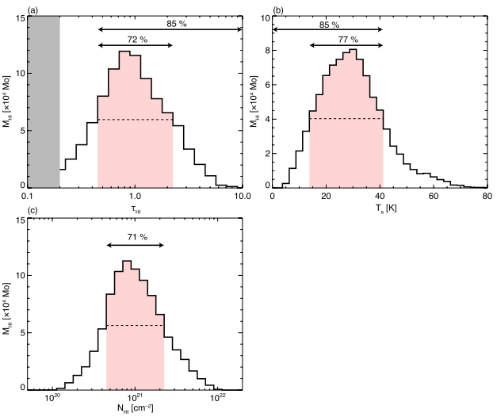

Slide 17
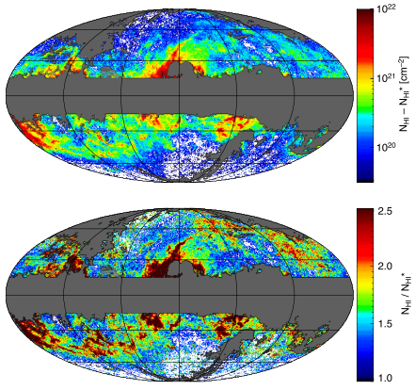
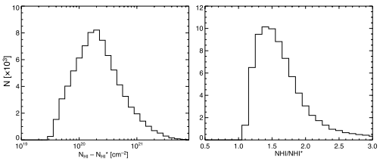
Excess NHI
=“Dark gas”

Slide 18
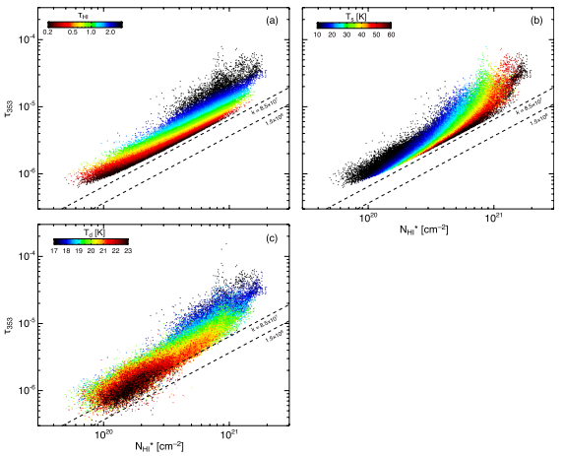
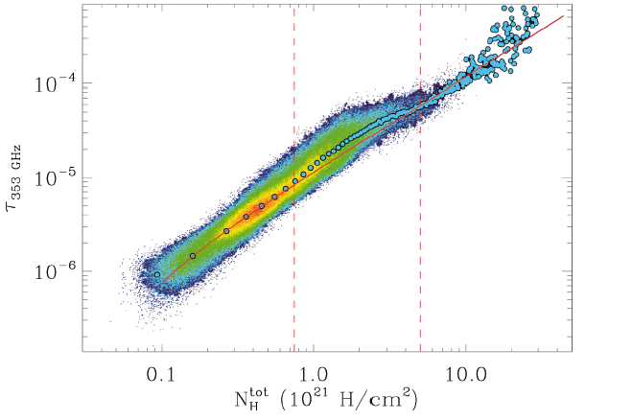
Planck Collaboration, arXiv:1101.2029

Slide 19
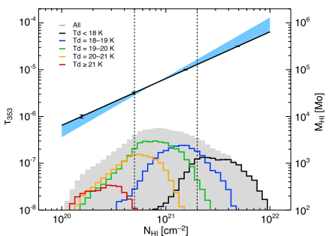
Planck Collaboration, arXiv:1101.2029

Slide 20
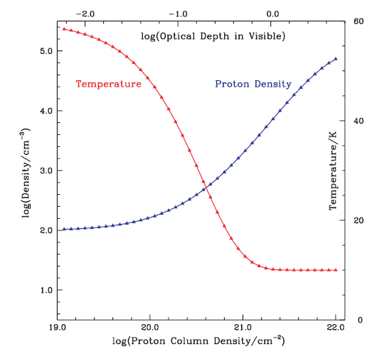
HI becomes dark at higher density
Goldsmith et al. 2007

Slide 21
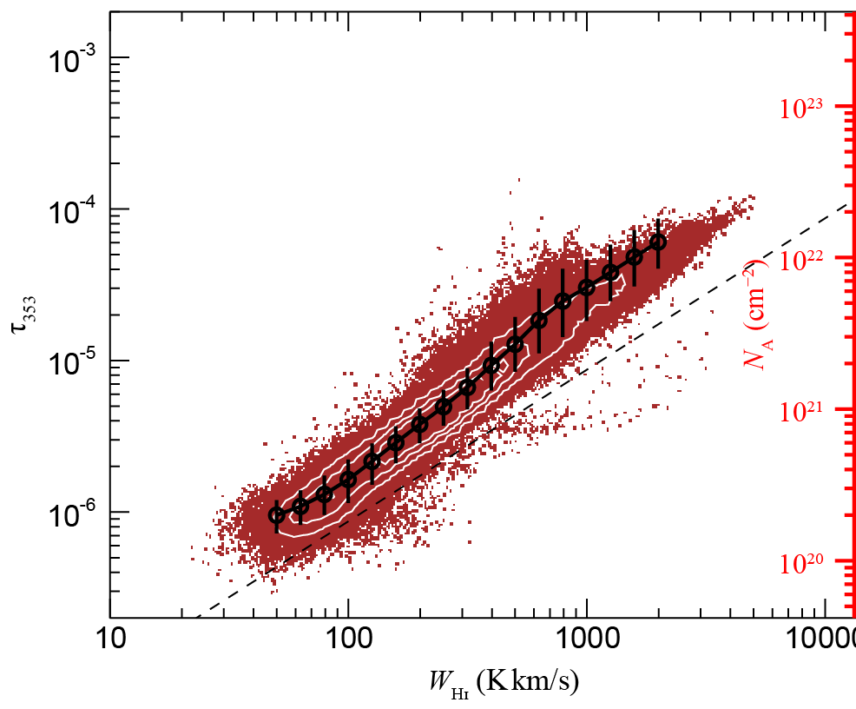
Tau 353 vs. W(HI)
Step 1
We estimate the W(HI) range
Step 2
Estimating a conversion factor form W(HI) to NH using linier fitting
Step 3
We apply the correction
Notes:
Therefore, we tried the correction by using the relationship between the W(HI) and Tau353.
This figure represents a scatter plots among the W(HI), Tau353 and NH presented by Hayakawa-san yesterday.
First, We estimate the W(HI) range and conversion factor from W(HI) to NH by linier fitting.
And then, we applied the correction.

Slide 22
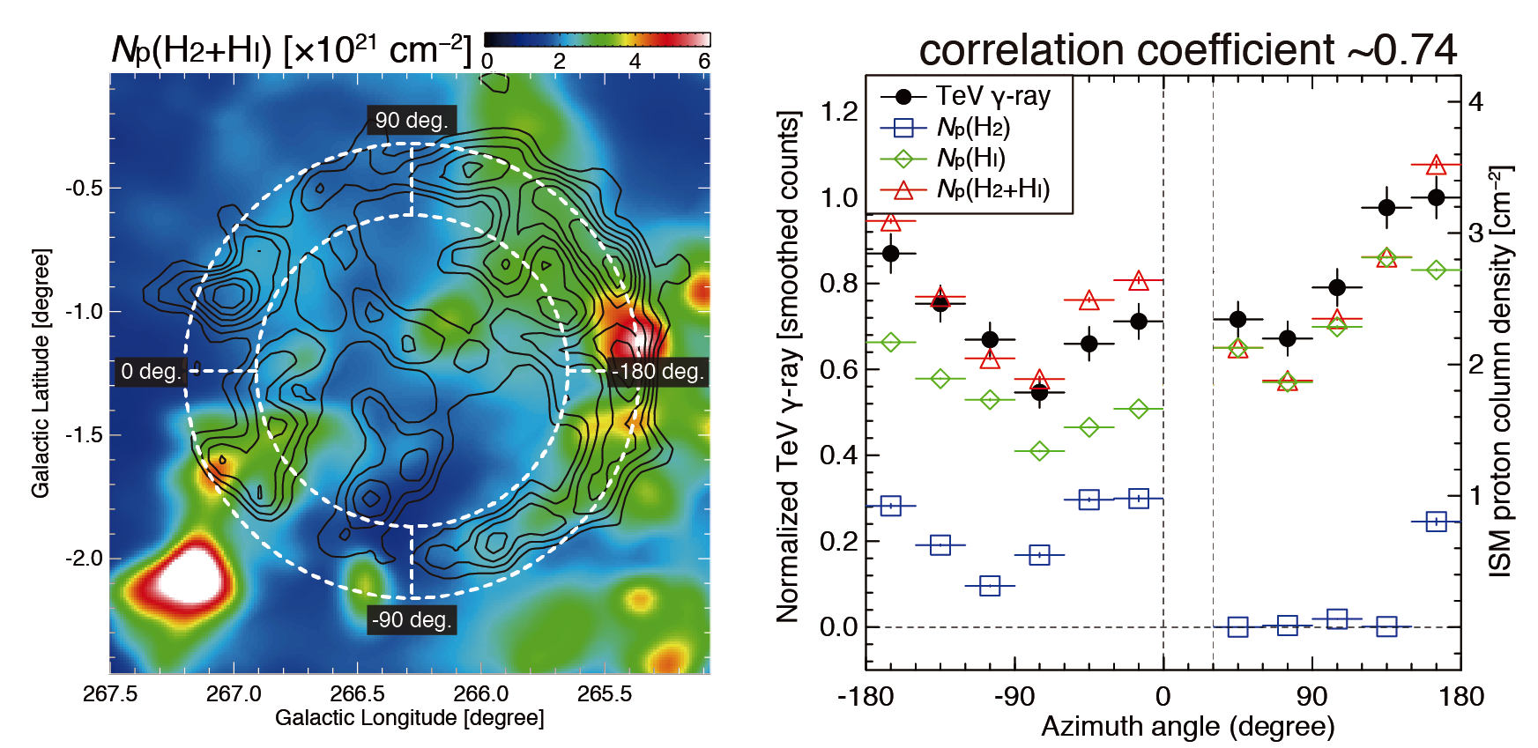
Vela Jr. total ISM protons & TeV γ-rays
(left) Image: Total interstellar proton column density, contours: TeV γ-rays (Aharonian+07)
(Right) Azimuthal plots
Fukui, Sano+15 in prep.
Notes:
Left figure shows the total interstellar protons map overlaid with TeV gamma-ray contours of Vela Jr.
Right panel shows the azimuthal profiles. TeV gamma-rays show a good spatial correspondence with the total interstellar protons. However, a slight difference is exist.
In this case, we should corrected the cold HI components because the HI is dominant.

Slide 23
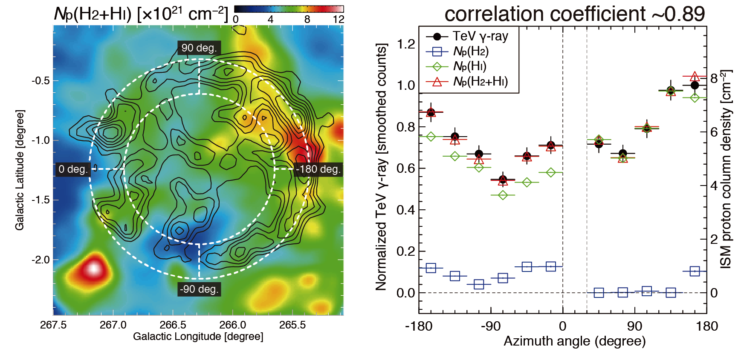
Vela Jr. total ISM protons & TeV γ-rays (optically thick HI corrected)
(left) Image: Total interstellar proton column density, contours: TeV γ-rays (Aharonian+07)
(Right) Azimuthal plots
Fukui, Sano+15 in prep.
Notes:
Left figure shows the total interstellar protons map overlaid with TeV gamma-ray contours of Vela Jr.
Right panel shows the azimuthal profiles. TeV gamma-rays show a good spatial correspondence with the total interstellar protons. However, a slight difference is exist.
In this case, we should corrected the cold HI components because the HI is dominant.

Slide 24
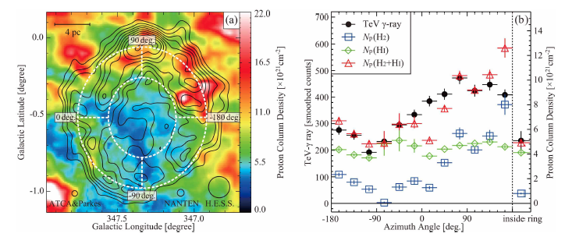
RX J1713.7-3946: Interstellar proton vs. TeV gamma rays
HI + 2H₂
Fukui et al. 2012

Slide 25
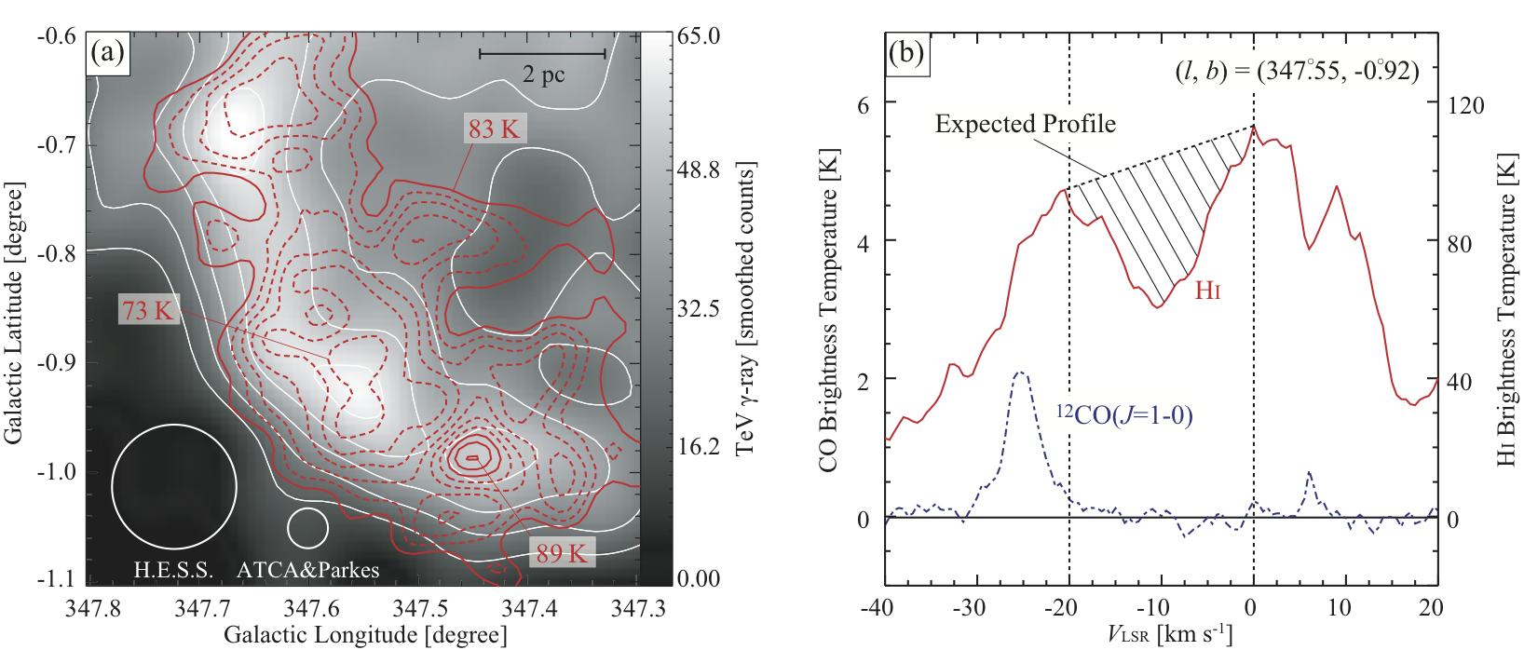
Dark HI SE Cloud (Self-Absorption)

Slide 26
HI self absorption

Slide 27
Very accurate measurement of both atomic/molecular hydrogen has become possible by “truly optically thin HI”
HI gas: average density 1 cm-3, Tk=125K
“assumption, 21cm line optically thin”
--NHI=1.8e18 x WHI but HI is optically thick
Dark gas: gamma rays (pp reaction π⁰ 2γ),
dust extinction. CTA will play a major role
H2 gas: density 1000 cm-3, Tk=10K
“CO 2.6mm line via Xco factor”
--NH2=Xco x Wco (factor of 2 uncertainty)

